Slide 1
SARVAM UCS
Unified Communication Server for Modern Enterprises

Slide 2
Target Customers
Modern Enterprises
Star Hotels
Specialty Hospitals
SIP Trunking Service Providers

Slide 3
UNIFIED NETWORKS
COLLABORATION
BYOD
SARVAM UCS
UNIFIED MESSAGING
MOBILITY

Slide 4
MOBILITY - Application for Android and iOS Smartphones - Application for Windows PC - One Number Reach
UNIFIED NETWORKS - VOIP (SIP)
- GSM/3G (Voice/SMS)
- ISDN T1E1 PRI
- PSTN/CO/FXO
BYOD
- Android Smartphone/Tablet
- iOS Smartphone/Tablet
- Windows PC
- SIP Video Phone
- SIP Phone
- Analog Phone
UNIFIED NETWORKS
SARVAM UCS
UNIFIED MESSAGING
- SMS to Email
- Email to SMS
- Voice Mail to Email
- SMS over GSM SIMs
COLLABORATION - Presence and Chat
- Audio Conferencing
- Video Calling
- Corporate Directory Integration
- Voice Mail System

Slide 5
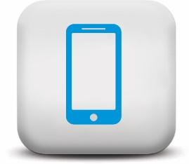
KEY DIFFERENTIATORS
Presence
IM / Chat
Unified Messaging
Conferencing
Video
Calling
Collaboration
Client – VARTA WIN200
Mobile
Client – VARTA ADR/AMP100
Application
Integration

Slide 6
SOLUTION OVERVIEW
TELEPHONY | SIP Trunks | T1E1 ISDN PRI | GSM SIMs | POTS (CO)
ENDPOINTS | UC CLIENTS | IP SUBSCRIBER | Key Phones | Analog Phones
APPLICATIONS | Android/iOS/Windows PC UC Client | Voice Mail | SMS Gateway SMS to Email Email to SMS | Hospitality Module
INTEROP | ITSPs (VOIP Carriers) | PMS/CAS Integration | Third-Party SIP Devices | Call Center Solutions
MANAGEMENT | Web based GUI | Remote Support | SNMP | Class of Services

Slide 7
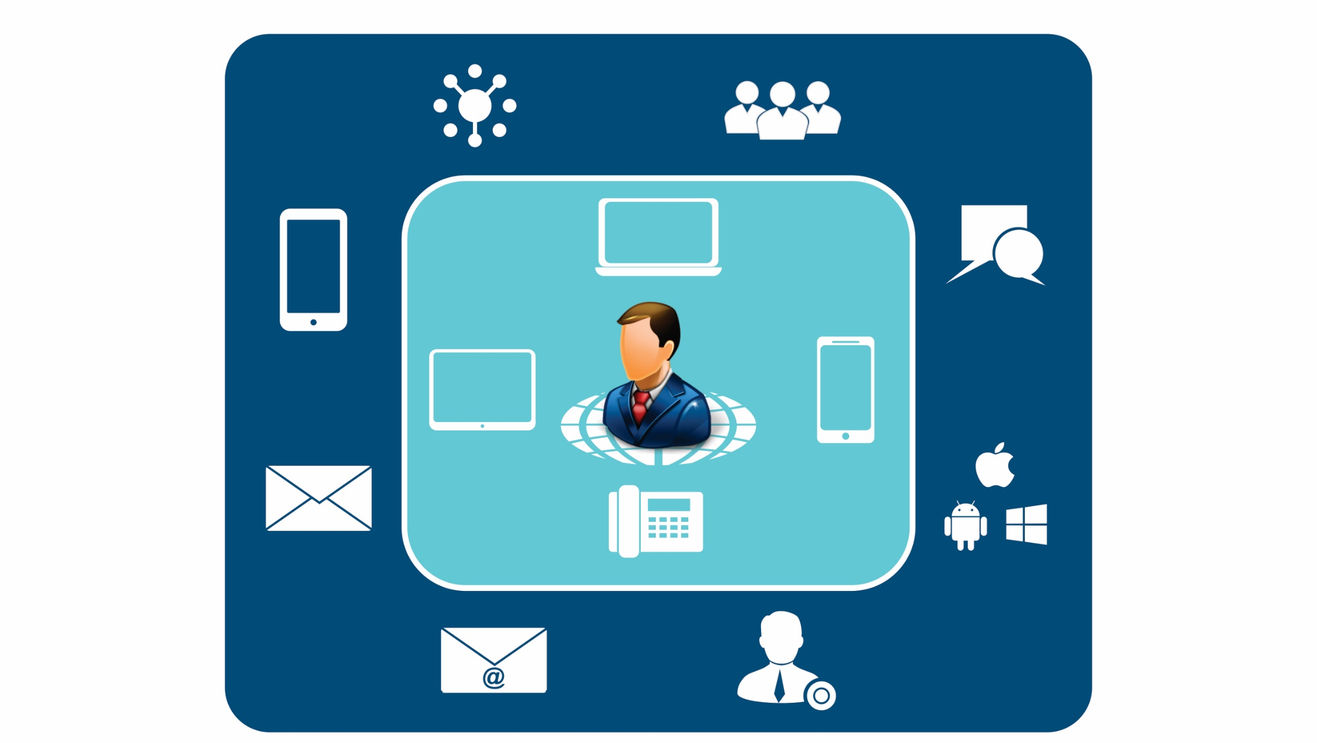
SARVAM UC Solution
Unified
Networks
Conference
PC
Smartphone
Chat
Mobility
Tablet
IP Phone
Unified Messaging
Unified Clients
Email to SMS
Presence

Slide 8
MOBILITY

Slide 9
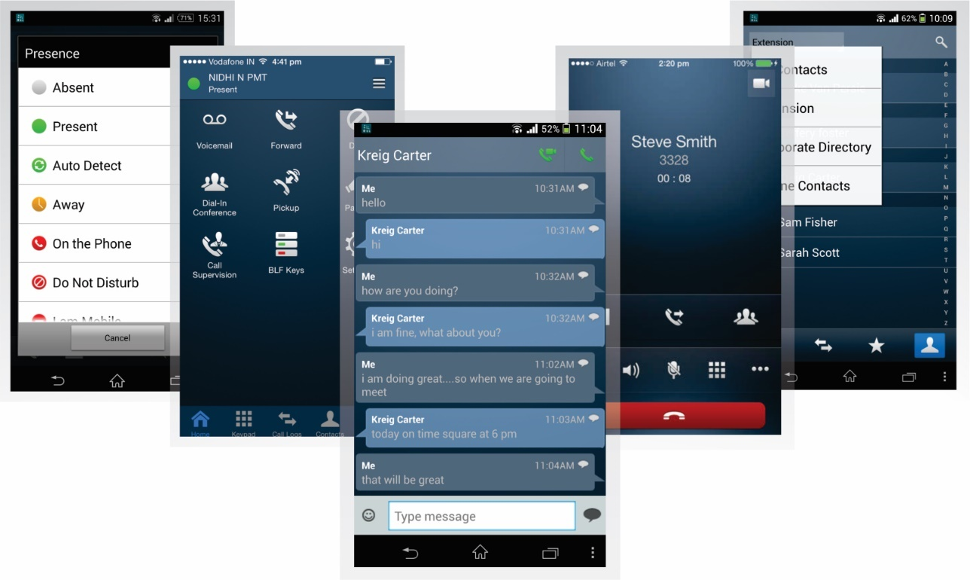
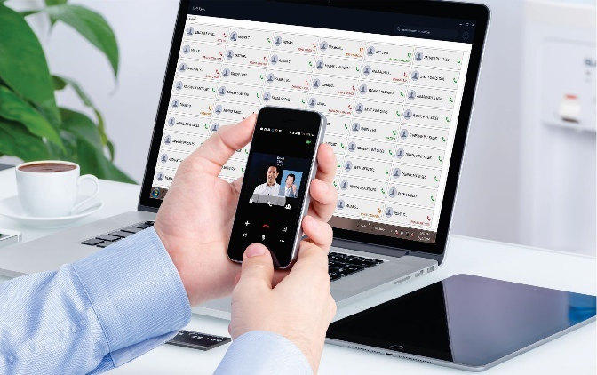
MOBILE CLIENT– VARTA ADR100/AMP100

Slide 10
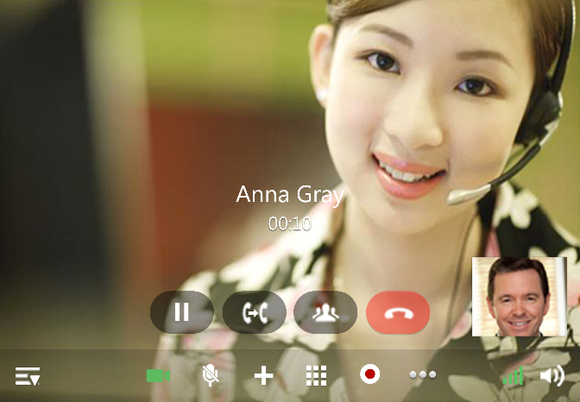
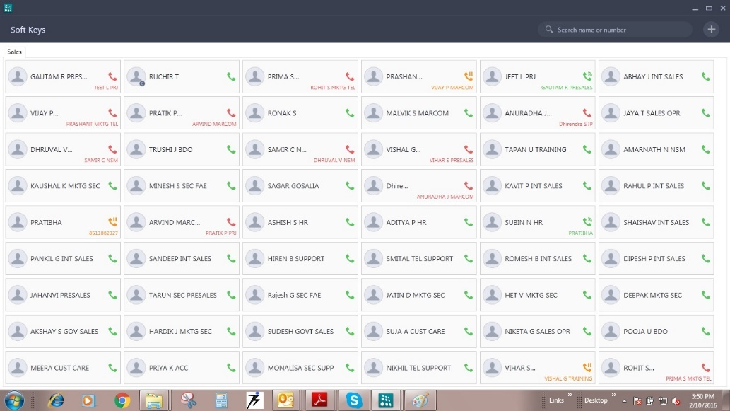
PC CLIENT – VARTA WIN200
Video Calling
Live Call Status with Name
User can Define Keys

Slide 11
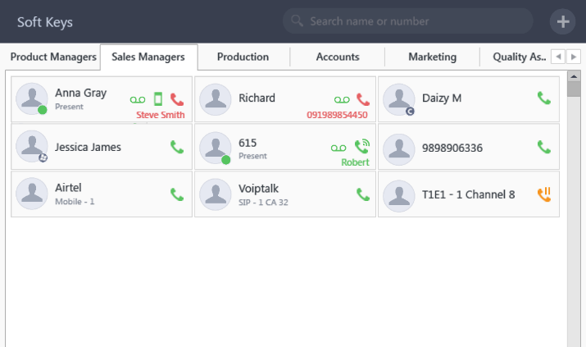
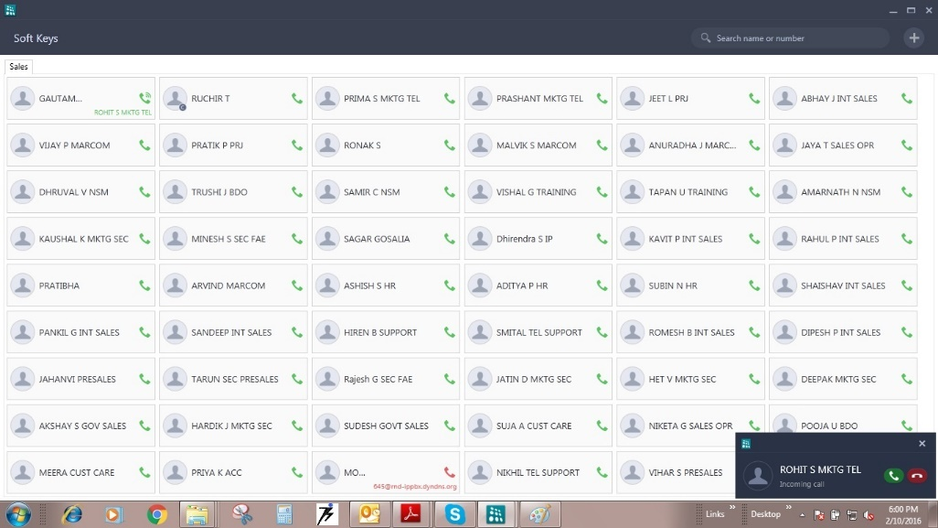
PC CLIENT – VARTA WIN200
Contact Grouping
Pop-up Notification

Slide 12
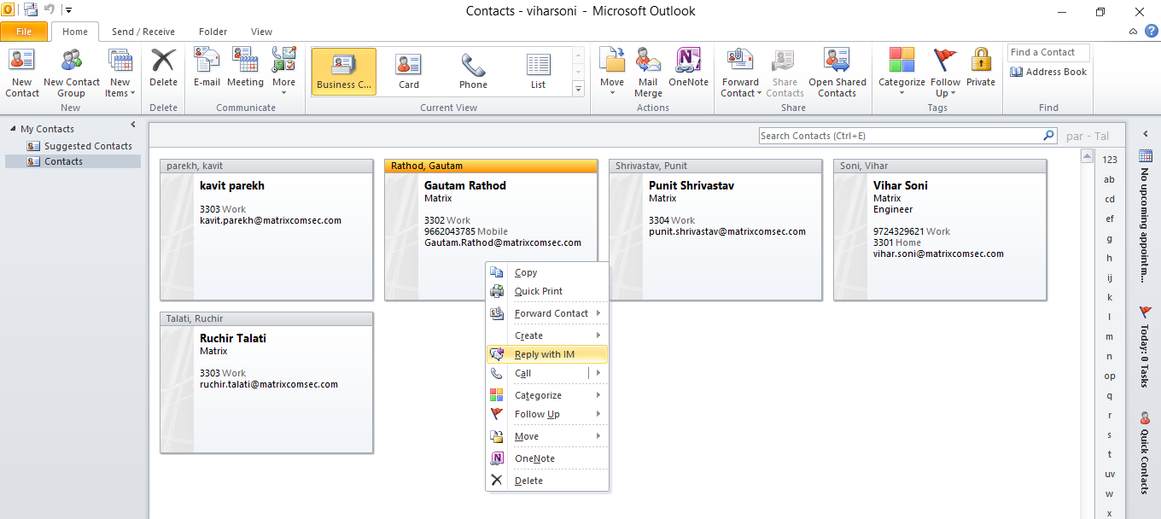
PC CLIENT – VARTA WIN200 – OUTLOOK INTEGRATION
Call from Outlook
Call from Outlook

Slide 13
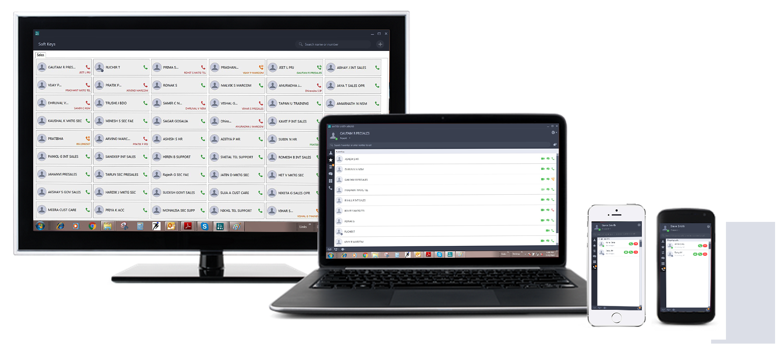
Bring Your Own Device (BYOD)

Slide 14
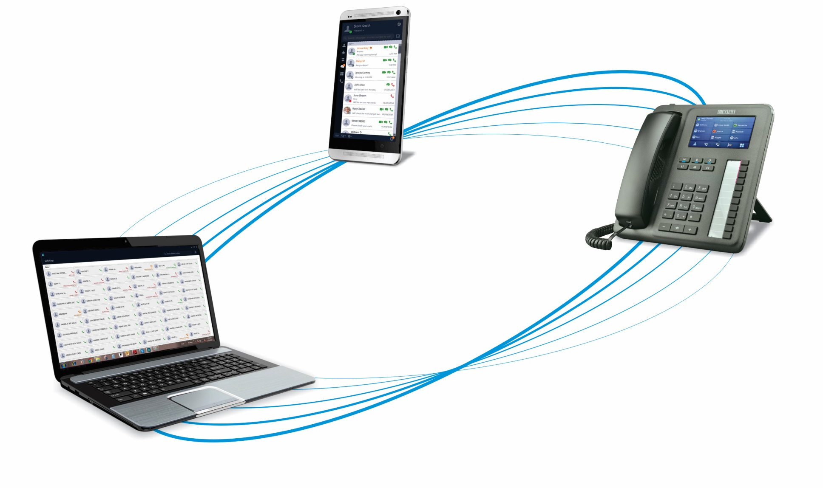
Multiple Devices One Number Reach

Slide 15
UNIFIED NETWORKS

Slide 16
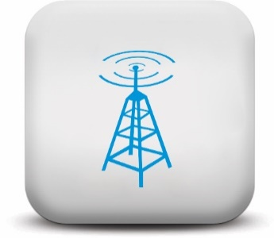
SIP TRUNKING
MOBILE VOICE
GSM
ISDN BRI
ISDN T1/E1 PRI
FIXED TELEPHONY
E&M
RADIO

Slide 17
UNIFIED CLIENTS

Slide 18
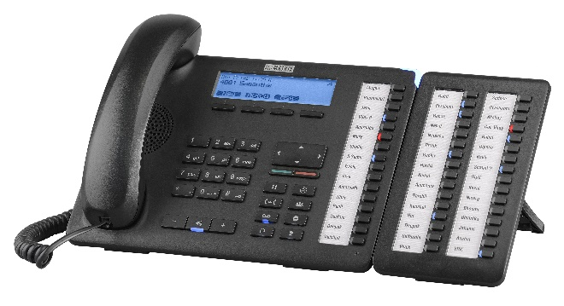
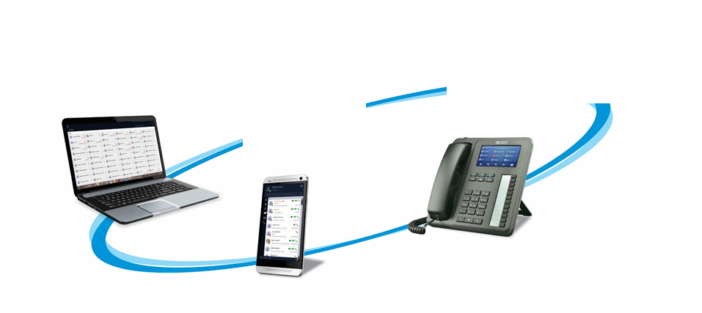
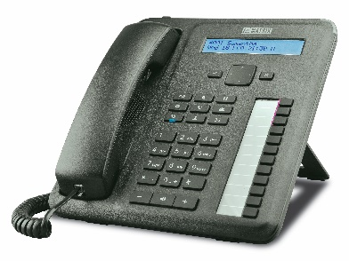
Future Ready Connect to New-age UC Clients

Slide 19
UNIFIED MESSAGING

Slide 20
Unified Messaging
PRESENCE &
CHAT
CONFERENCING
EMAIL TO
SMS
TELEPHONY
FEATURES
VOICEMAIL TO
EMAIL

Slide 21
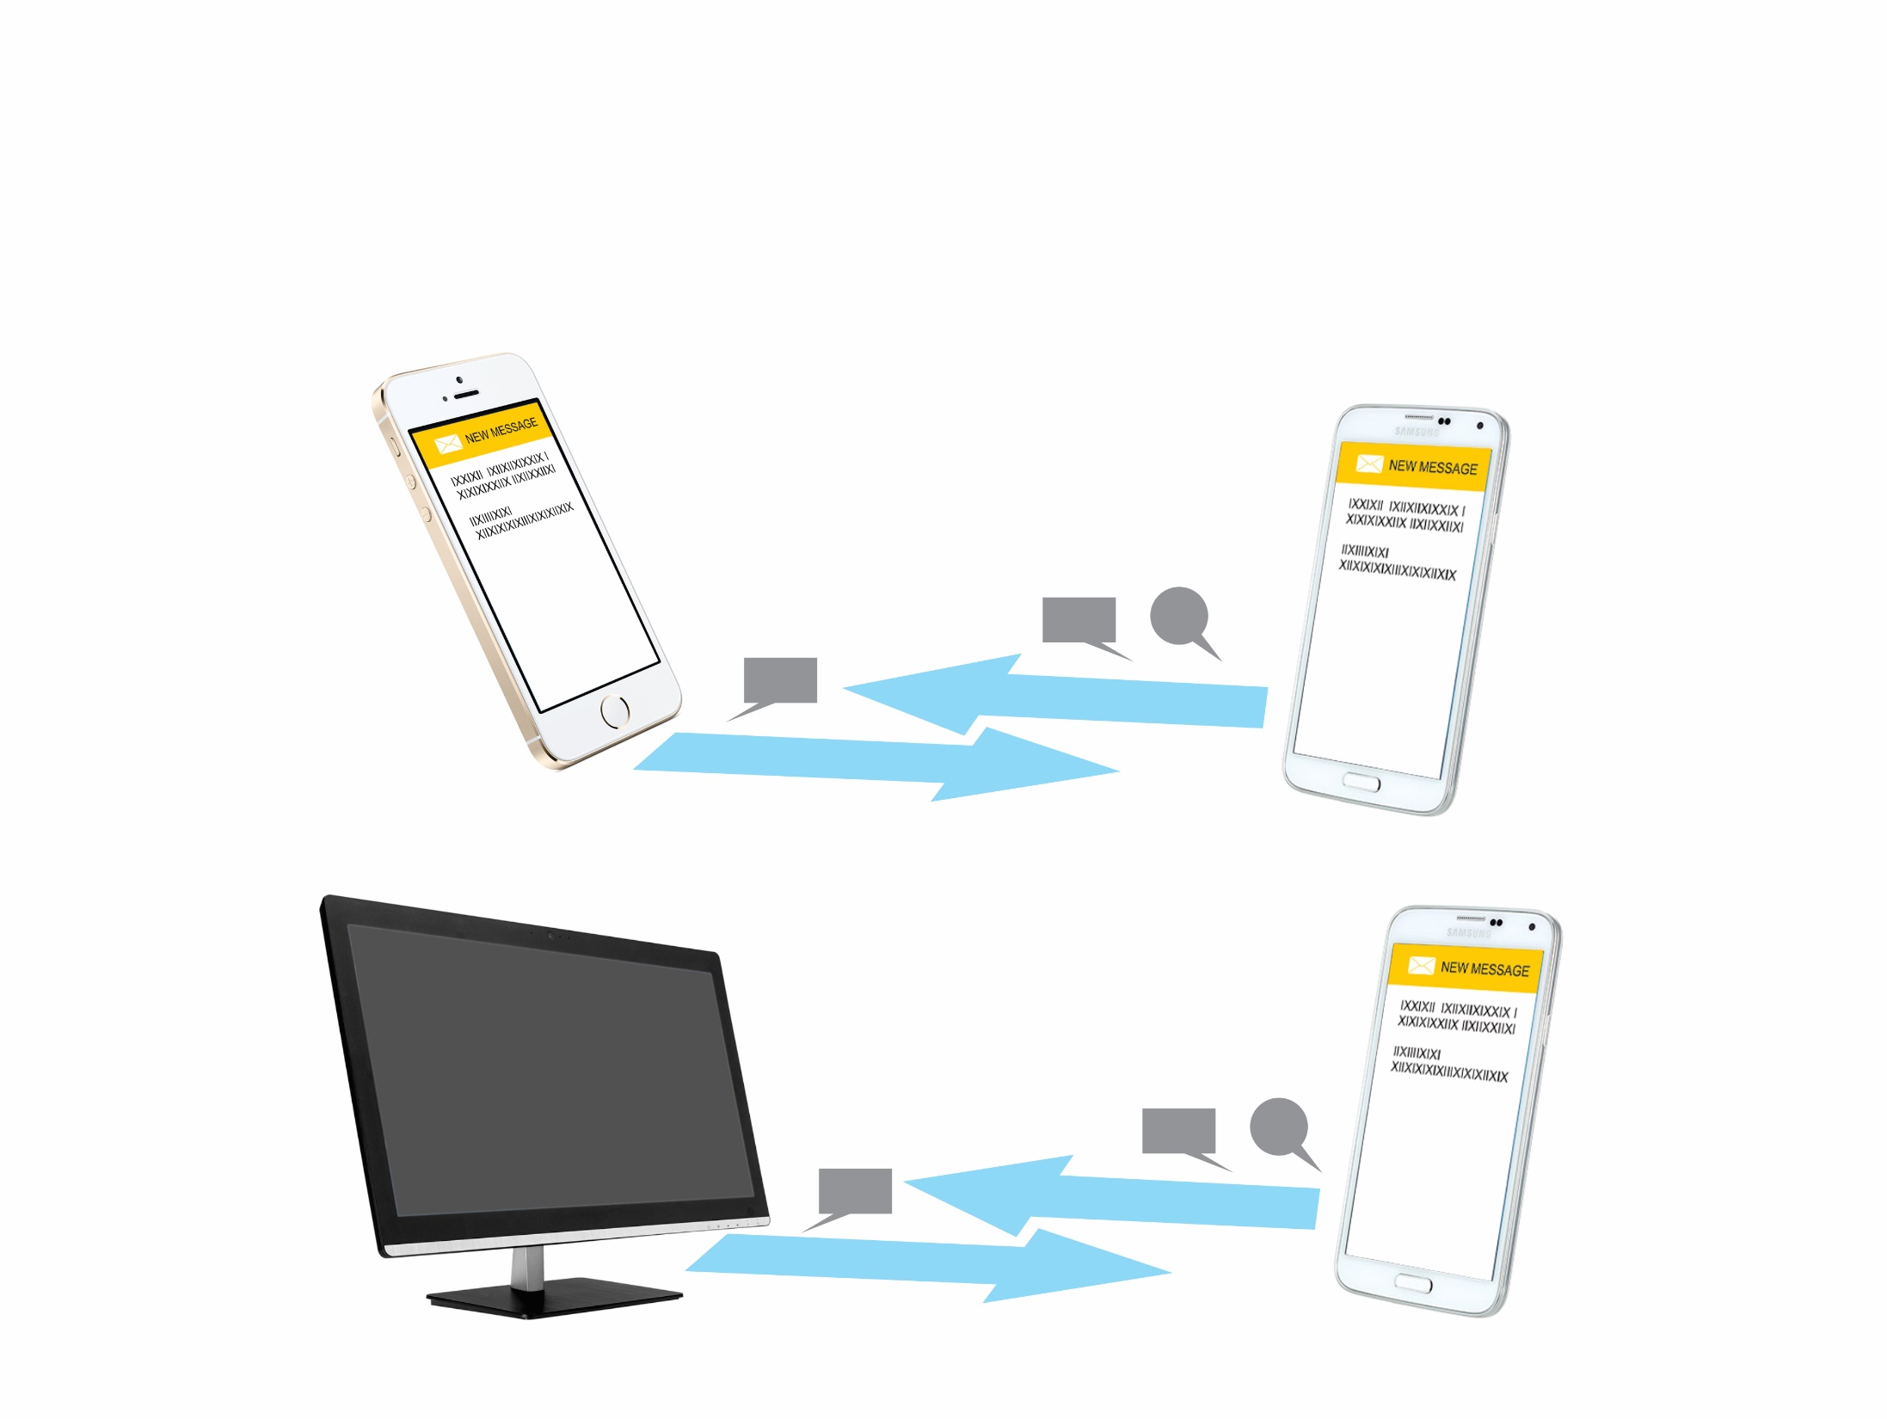
PRESENCE AND CHAT

Slide 22
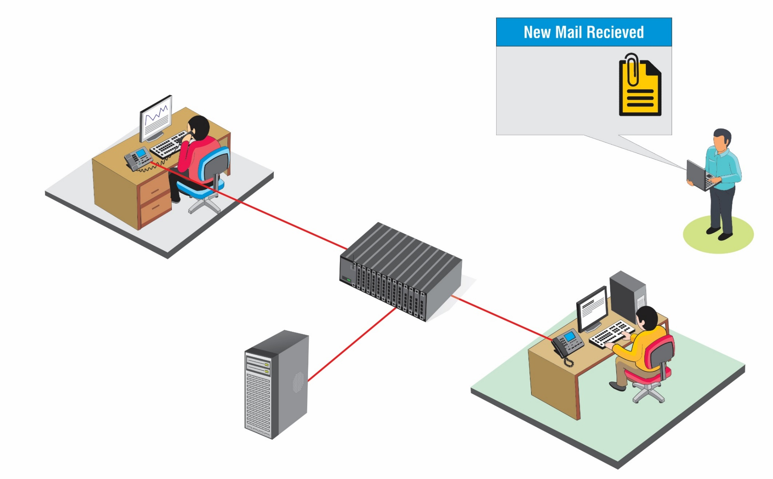
VOICEMAIL TO EMAIL
New message in Mailbox received on 5th May, 16 at 2:00PM
Message: XXX.wav
MATRIX ETERNITY NX
john@abc.com
BRANCH OFFICE
Calling JOHN. Ext 501
SMTP Client
Ext 501
JOHN
MAIL SERVER
HEAD OFFICE

Slide 23
CONFERENCING
62 Participants Audio Conference
Crystal Clear Voice
External and Internal Participant
Multiple Conference Group
3-Party Conference of 20 Groups
21-Participants in Single Conference
Conference Dial-in

Slide 24
TELEPHONY FEATURES
Global Directory Integration
Comprehensive Call Handling
Drag and Drop Conference
One Touch Access

Slide 25
SARVAM UCS ARCHITECTURE
ETERNITY
NX
Platform - Hardware
SARVAM UCS
Server – Software License
SARVAM UC SOLUTION

Slide 26
* SIP Users are add-on to Analog Users

Slide 27
MULTI-LOCATION COLLABORATION

Slide 28
THANK YOU

Slide 29
For further information please contact: Inquiry@MatrixComsec.com

