Slide 1

Building Intercom Solution
For Secure and Feature-rich Communication

Slide 2
Key Aspects
  Technological Advanced Digital PBX
  Specialized Intercom Card; Offer Value for Money Proposition
  Reliable and Secure Communication
  Flexible and Modular
  Group PBX - Connectivity over IP
  Voice Mail System
  Specifically Build for:
  Residential Colonies
  Housing Complexes
  Property Developers
  Commercial Complexes

Slide 3
Solution Overview
Communication
Security
Strengthening Social Network
Improve Safety of Home and Residents
Matrix
Building Intercom Solution
Enhance productivity and User experience
Less Maintenance
Early ROI
Convenience
Reliability

Slide 4
Why Matrix?
Established Brand
Value for Money Proposition
Trusted by many Leading Real Estate Developers
500+ Installations
A Future Proof Investment

Slide 5
Benefits for Residents
Free Internal Communication between Building Residents
Superior Voice Quality
Value added built-in features – Conference, Auto call-back
Call Detail Record
Single/Multiple Security Extension – Building-wise, Group-wise
Maintain Privacy – Barring amongst group of flats

Slide 6
Benefits for Property Developers
Enhance Image and Value of Property
Enrich User Experience and Services
Flexible Numbering Plan -
Phase-wise, Building-wise, Floor-wise, Flat- wise
Value for Money Proposition
Reliable and Feature-rich Building Intercom Systems
Built-up on Cutting-edge Technologies
Less Maintenance

Slide 7
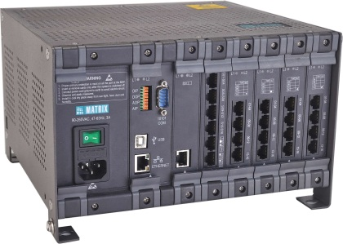



ETERNITY Building Intercom Systems
ETERNITY Building Intercom Systems
To effectively manage call activities
Security
Improve Safety of home and residents
Door Lock
Sensor
PAS Port
Music Port

Slide 8




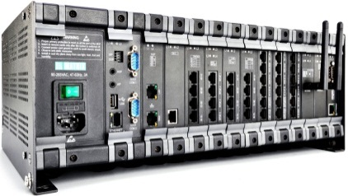
Security Phones support with ETERNITY ME
Resident Phones
Phone Options
Voice Mail
Web-based Configuration
Valued-added Services
for convenience
Easy Administration and Remote Maintenance
Matrix Building Intercom Solution
VoIP
(Peer-to-Peer)
Multiple Buildings Connectivity
Security Devices
Door Lock, Sensor, etc.
Paging
Security

Slide 9

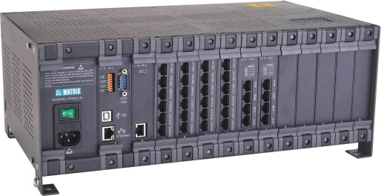
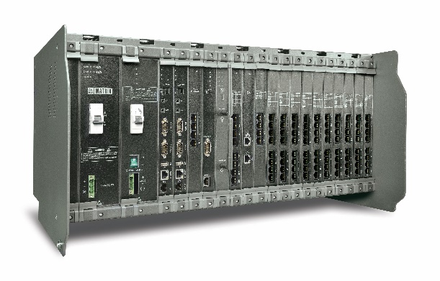
ETERNITY Building Intercom Systems
For Small and Medium Complexes
up to 200 flats/apartments
ETERNITY GE6S
ETERNITY GE12S
For Large Complexes
up to 500 flats/apartments
ETERNITY ME16S

Slide 10
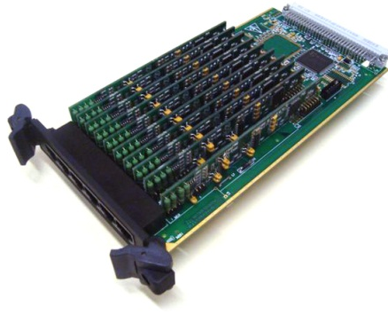
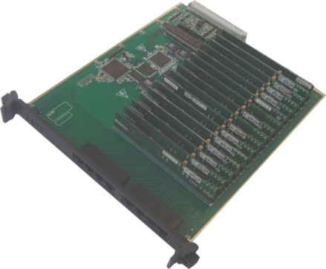
Platform Highlight
System Architecture
Digital 100% Non-blocking
Specialized Hardware
Intercom Line Card (ILC)
Integration
Integrated Public Address, Digital Sensor, Digital Control and External Music Port
Voice Mail System
Built-in Functionality
Multi-channel Conferencing
Flexibility
Modular and field expandable design
Multiple Systems Connectivity
Over IP (Peer-to-Peer)
Ideal for
Small, Medium and Large Complexes up to 500 Rooms
ETERNITY GE CARD ILC20
ETERNITY ME CARD ILC32

Slide 11
Value Added Features and Benefits

Slide 12
Value Added Features | Benefits
Easy to Deploy and Maintain System | Easy Troubleshooting Less Maintenance Reduced Downtime
Flexible Numbering Plan (up to 6 digits) | Changing the old Intercom System do not need to change the extension numbering
Built-in CLI (DTMF and FSK) | Know the caller before answering
Web-based Configuration | Easy Administration and Remote Maintenance
Security Alarm and Reporting Feature | In case of any emergency (DIP sensor activation), the system dials pre-assigned extensions and plays a pre-recorded message. Even a hooter can be activated.
Background Music | Saving the cost incurred for putting up speakers and wiring. The option of using an external music source like CD player, FM radio, etc. is available.

Slide 13
Value Added Features | Benefits
Alarms | Set for each day of the week or for a particular date and time
Compact and Sturdy | Smaller foot-print
Technology 32-bit RISC Processor Digital PBX | 100% Non-blocking Superior Voice Quality
Built-in Paging port | Can be connected to Public Address System for Announcement
Built-in Sensor port | Fire Alarm, Glass Break sensors etc. can be connected
Built-in Relay port | Digital devices can be connected to switch them on/off
Typical application Sensor-Relay port | A fire alarm or smoke sensor connected to the DIP, senses smoke and triggers hooter/siren connected to DOP.

Slide 14
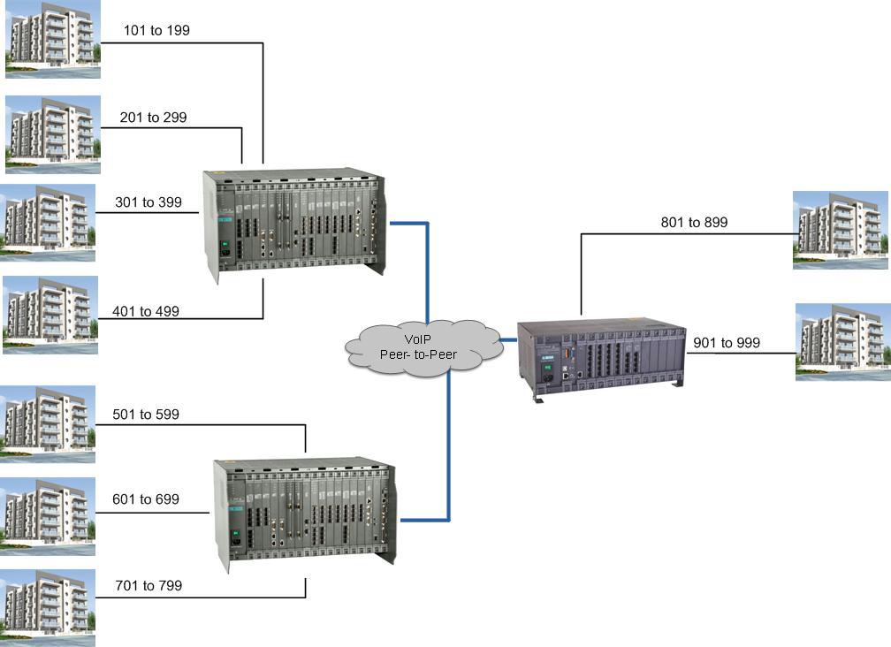
Application

Slide 15
Benefits
Savings on Cabling Cost
Enhanced Reliability
Group Building Intercom Systems virtually functions as One
Connectivity over IP – Distance between Buildings does not matter
Advanced Intercom Features

Slide 16
Type of Presentation: Building Intercom Solution
Number of Slides: 17
Revised on: February 8, 2013
Version-Release Number: V1R1
For Further Information Please Contact:
Email ID: pmt@matrixcomsec.com
Mobile: +91 9662544402
Visit us at www.MatrixComSec.com

Slide 17

Notes:
17

