Slide 1

Matrix Video Surveillance Solution for Retail

Slide 2

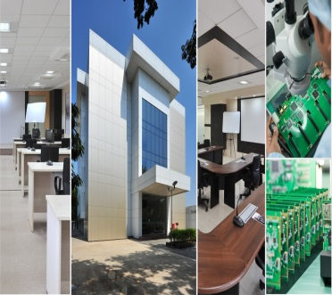
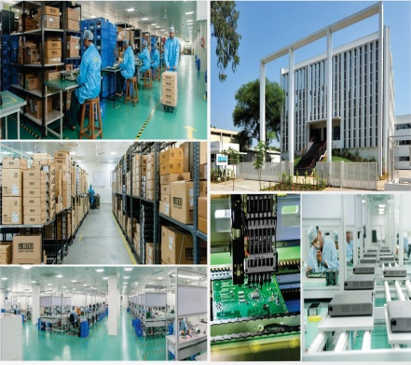
About Matrix
Established in 1991
Products: 60+
Telecom and Security Solutions
Global Presence: 40+ Countries
No. of Partners: 500+
No of Employees: 500+
Awards and Achievements: 25+
for Excellence in Product Engineering,
Design and Innovation
www.MatrixComSec.com
CORPORATE OFFICE
Based at Vadodara, Gujarat, India
Departments: Marketing, Sales, Product Management, Support, Finance,
Customer Care, Purchase
R&D CENTER
77,000 Sq.Ft
More than 40% Manpower in R&D, 700+ Man-years of R&D Experience
World-class Technology Platform and Processes
MANUFACTURING UNIT
73,000 Sq.Ft
100+ Work Stations
International Quality Systems and Processes
Notes:
The capabilities of Matrix Video Surveillance are not just limited to security. It also increases productivity and quality standards across all hotel chains. This helps in providing guests with a peace of mind and a memorable experience and thereby increasing your

Slide 3




Why Matrix?
Higher Business Revenue
Increase Security
Ease of use
Higher Productivity
Matrix Video Surveillance Solution for Retail
Notes:
The capabilities of Matrix Video Surveillance are not just limited to security. It also increases productivity and quality standards across all hotel chains. This helps in providing guests with a peace of mind and a memorable experience and thereby increasing your

Slide 4
Increased Security

Slide 5
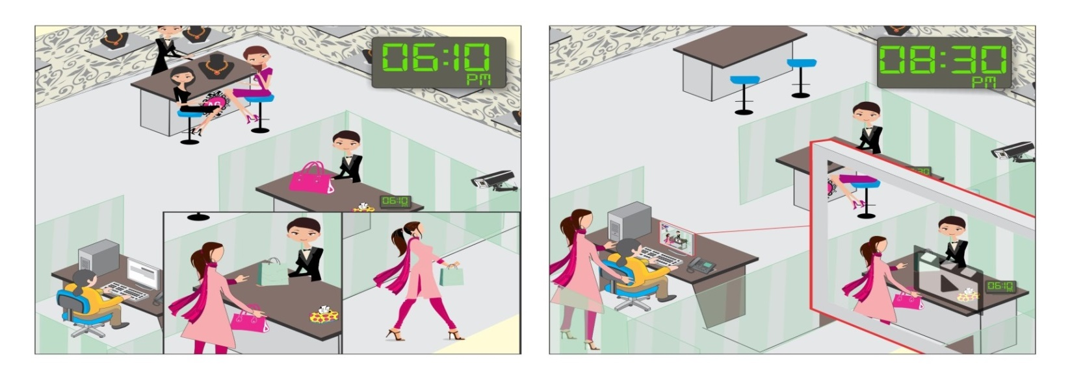
Our Solution
1. Real-time Security
Customers often forget their belongings in your store?
View every movement in high resolution with great details: Megapixel Cameras
Works as deterrent: Camera Tamper
Real-time Security: Intelligent Video Analytics, Real-time Notifications
Trace Customer Belongings: Investigation in playback

Slide 6
Higher Productivity

Slide 7
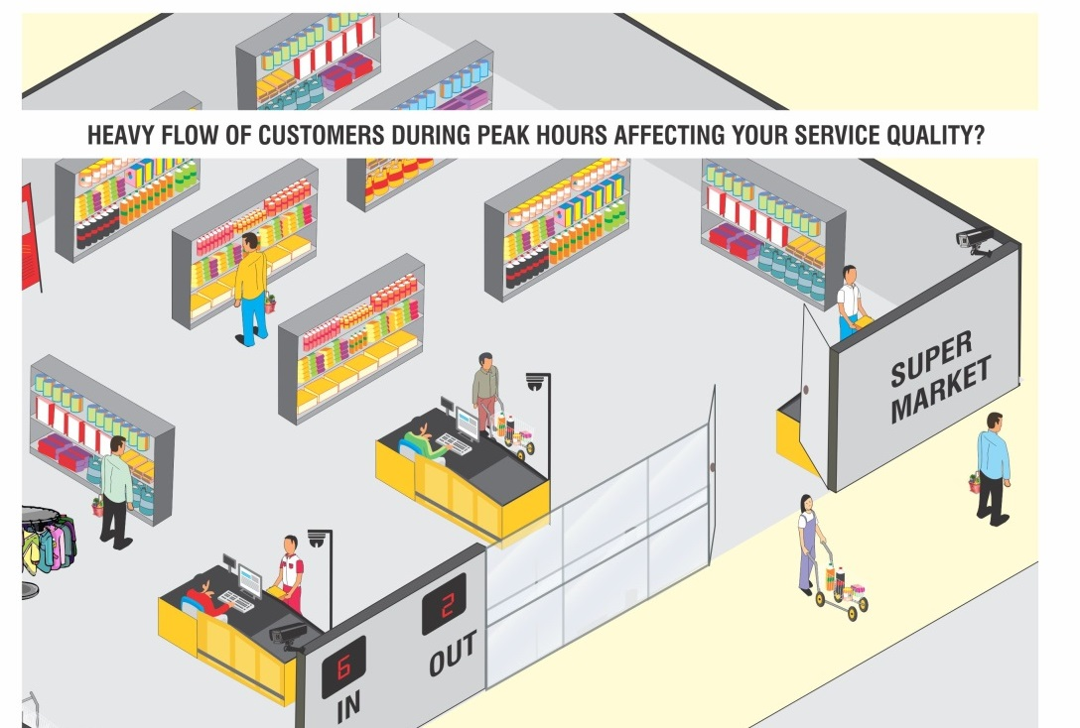
Our Solution
2. Productivity
Heavy flow of customers during peak hours affecting your service quality?
Employee Discipline: Camera Grouping and Sequencing, Mobile App
Stock Verification: Easy Playback, Missing Object Detection
Crowd Management, Save cost by hourly staffing system: People Counting

Slide 8
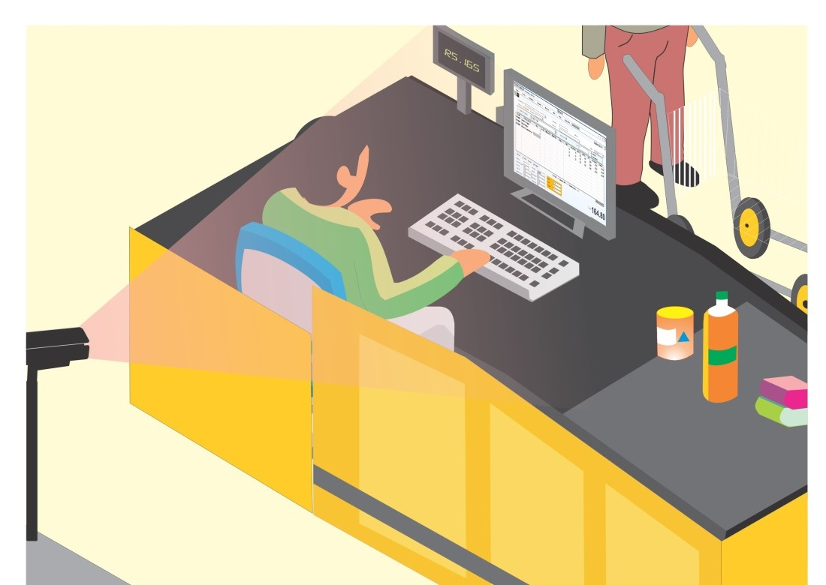
Our Solution
2. Productivity
Prevent Disputes with Customers: POS Integration

Slide 9
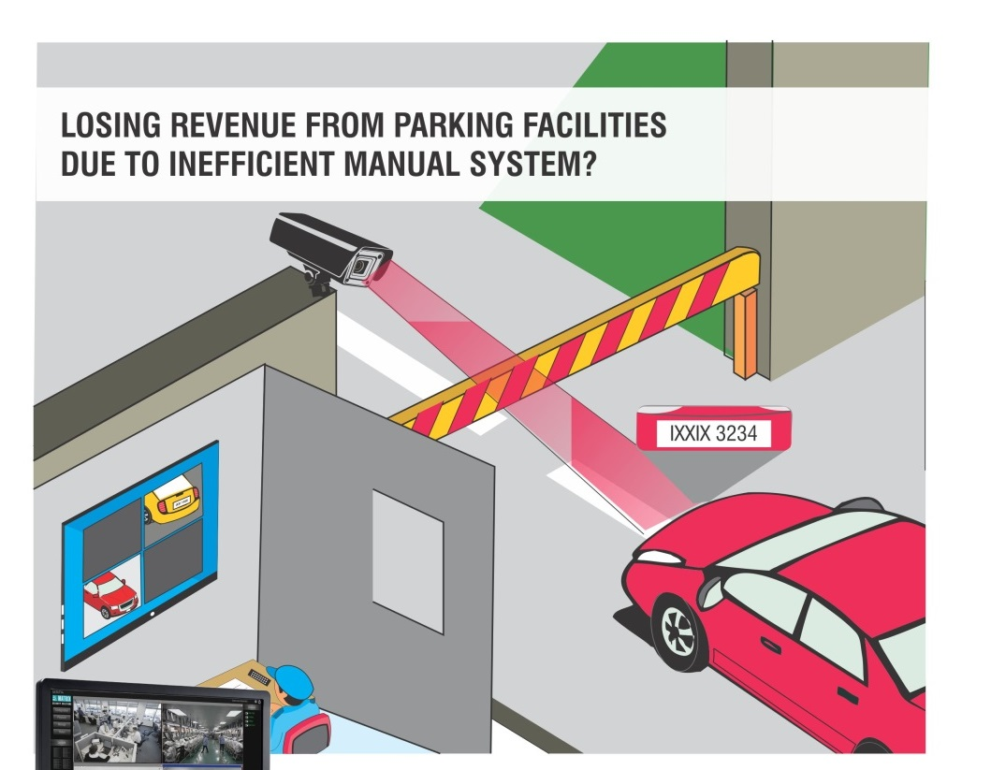
Our Solution
2. Productivity
Losing revenue from parking facilities due to inefficient manual system?
Personalized Service with License Plate Recognition: License Plate Recognition

Slide 10
Ease of Use

Slide 11
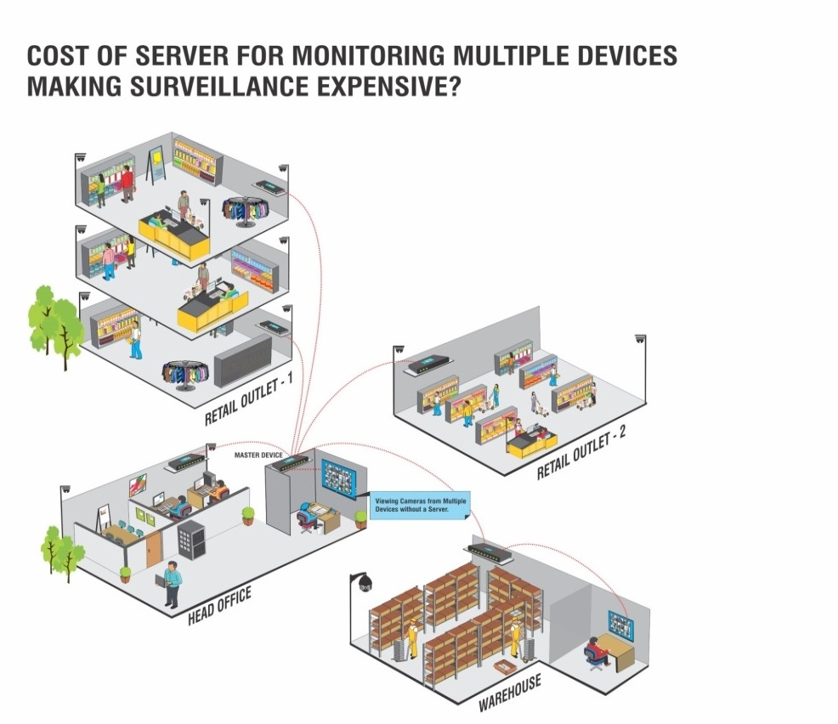
Our Solution
3. Ease of Use
Cost of server for monitoring multiple devices making surveillance expensive?
Real-time working status: Health Status Monitoring
No Server required: Cascading
Easy Playback: Synchronous/Asynchronous Playback, Investigation

Slide 12
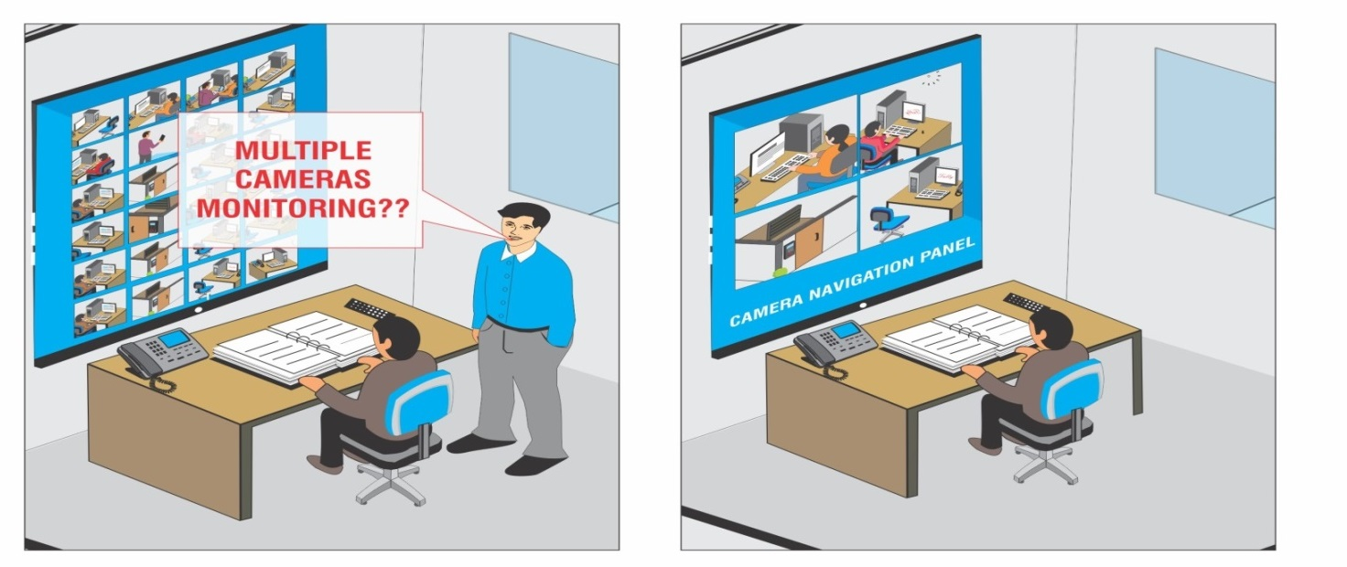
Our Solution
3. Ease of Use
Difficulty in monitoring multiple cameras?
Easy Monitoring: Camera Grouping and Sequencing

Slide 13
Expect More: Value for money Solution
Increase Security
Enhance Productivity
Ease of Use

