Slide 1

Matrix Video Surveillance Solution for Hospitality

Slide 2

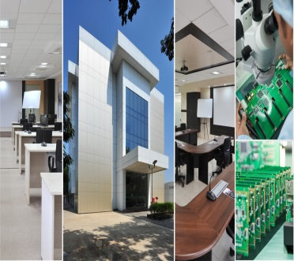
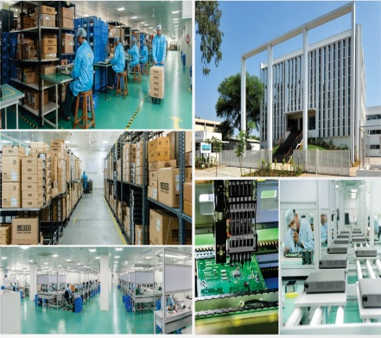
About Matrix
Established in 1991
Products: 60+
Telecom and Security Solutions
Global Presence: 40+ Countries
No. of Partners: 500+
No of Employees: 500+
Awards and Achievements: 25+
for Excellence in Product Engineering,
Design and Innovation
www.MatrixComSec.com
CORPORATE OFFICE
Based at Vadodara, Gujarat, India
Departments: Marketing, Sales, Product Management, Support, Finance,
Customer Care, Purchase
R&D CENTER
77,000 Sq.Ft
More than 40% Manpower in R&D, 700+ Man-years of R&D Experience
World-class Technology Platform and Processes
MANUFACTURING UNIT
73,000 Sq.Ft
100+ Work Stations
International Quality Systems and Processes

Slide 3





Why Matrix?
Higher Business Revenue
Customer Retention
Customer Referral
Increase Security
Enhance Customer Service
Matrix Video Surveillance Solution for Hospitality
Notes:
The capabilities of Matrix Video Surveillance are not just limited to security. It also increases security and customer service standards across all hotel chains. This helps in providing guests with a peace of mind and a memorable experience and thereby increasing your business revenue

Slide 4
Increase Security
      ~ For customer peace of mind

Slide 5
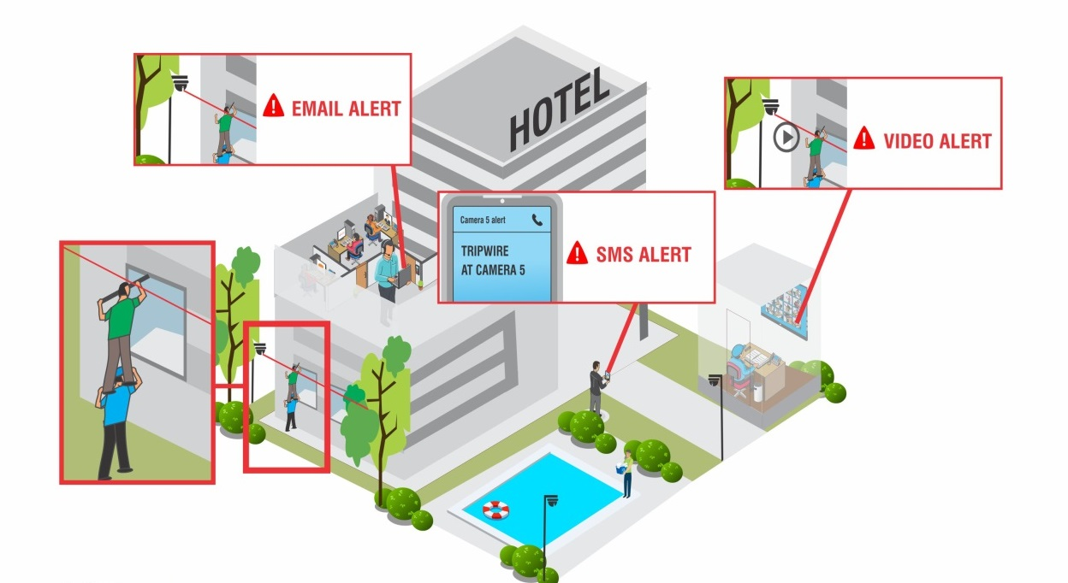
Our Solution
1. Real-time Security
Worried about trespassers intruding your hotel premises?
Prevent thefts and other criminal activities: Easy monitoring with Cascading, Camera Grouping and Sequencing, E-map
Keep a watch on your premise from anywhere, anytime: Mobile App, CMS
Prevent intruders by securing perimeters: Early Detection with IVAs like Trip Wire, Intrusion Detection, Motion Detection, Face Detection & Instant Notifications with alerts like E-mail with Snapshot, SMS, Video pop-up, Alarms and Buzzers
Notes:
Absence of monitoring stations because of high cost of server and qualified manpower
Intruders intending criminal or terrorist activities specially near the coasts. You can monitor such activities in real time through cascading and camera grouping. Without server all cameras can be monitored, it helps monitoring cameras from multiple locations as well.
E-maps can be used to monitor lobbies as all the lobbies in hotels look similar. It becomes difficult to differentiate each lobby floor wise, so here e-map helps to differentiate cameras of each floor as well as blinks in case of motion detection.
Owners can also monitor when not at premise by using Mobile App
PREVENT INTRUDERS FROM ENTERING HOTEL PREMISES IN REAL-TIME WITH SMART MONITORING TOOLS OF MATRIX VIDEO SURVEILLANCE SOLUTION FOR HOSPITALITY

Slide 6
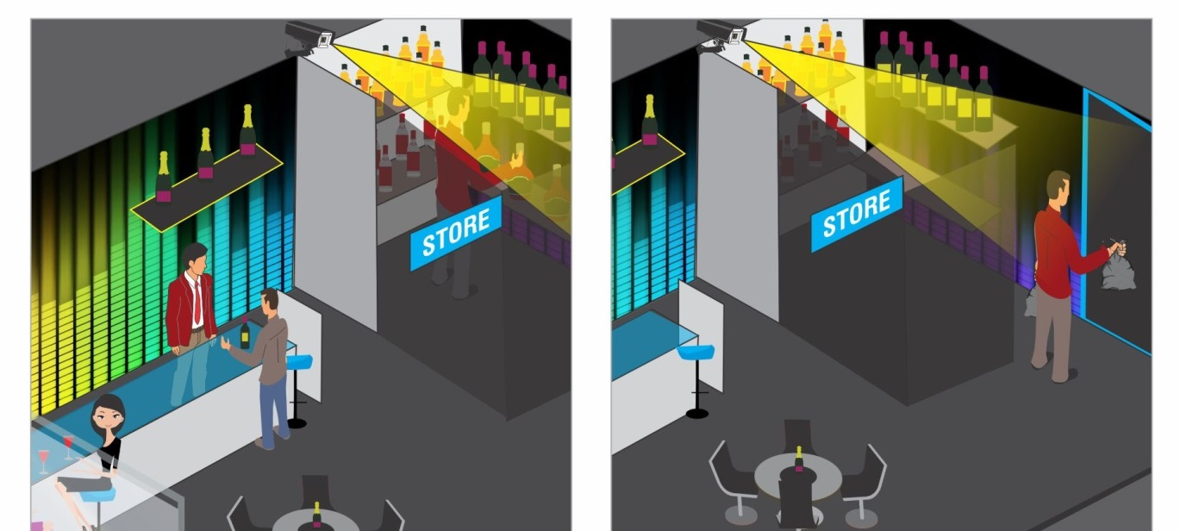
Our Solution
2. Quick Investigation
Incurring losses because of food and alcohol theft from hotel stores?
Easily investigate reasons behind theft and crime: Event & Time Based Playback, Investigator with IVAs
Safeguard Evidence: Evidence Lock, Clip Export and NAS/FTP Support
Store recordings for higher number of days & at half the cost: Adaptive Recording, Camera-wise Recording Retention
Notes:
Some events require post analysis. Investigating becomes simpler and quicker with Matrix’s time and event based playback options. E.g.: If there’s a theft, it can easily be tracked. And the evidence can be safeguarded with Evidence Lock, Clip export.

Slide 7
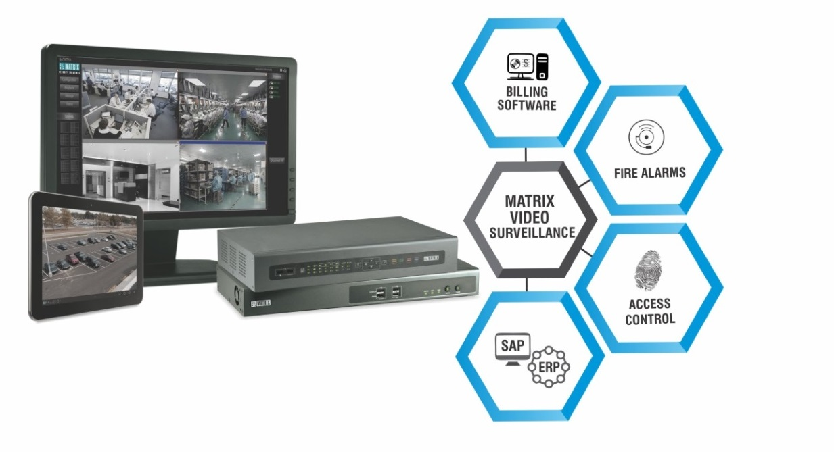
Our Solution
3. Improve Safety
Managing multiple software systems at your hotel difficult?
Occupancy control & mapping success of events: People Counting, Vehicle Counting
Ensure amenity based access: Integration with Access Control
Ensure time based access: Loitering, Intrusion Detection and Alarms
Quick evacuation: Integration with Fire Alarms & Smoke Detectors, People Counting and Two-way Audio
Notes:
Management of crowd during events like new year, or any parties
Count the number of people in and out for occupancy control and mapping success of events like food festivals, exhibitions, etc.
Access control Integration to allow only authorized guests to use amenities like gym, spa, etc.
People going near the sea during high tides, swimming pools, safes, etc. after working timings can be detected with time based intrusion detection and loitering to trigger an alarm immediately.
Integration with fire alarms help detect fire in real time and the recordings can be bookmarked to show them in case of insurance claims. 2 way audio also helps as a PA system to declare evacuation in case of fire or any such events.

Slide 8
Enhance Customer Service
      ~ For a memorable customer experience

Slide 9
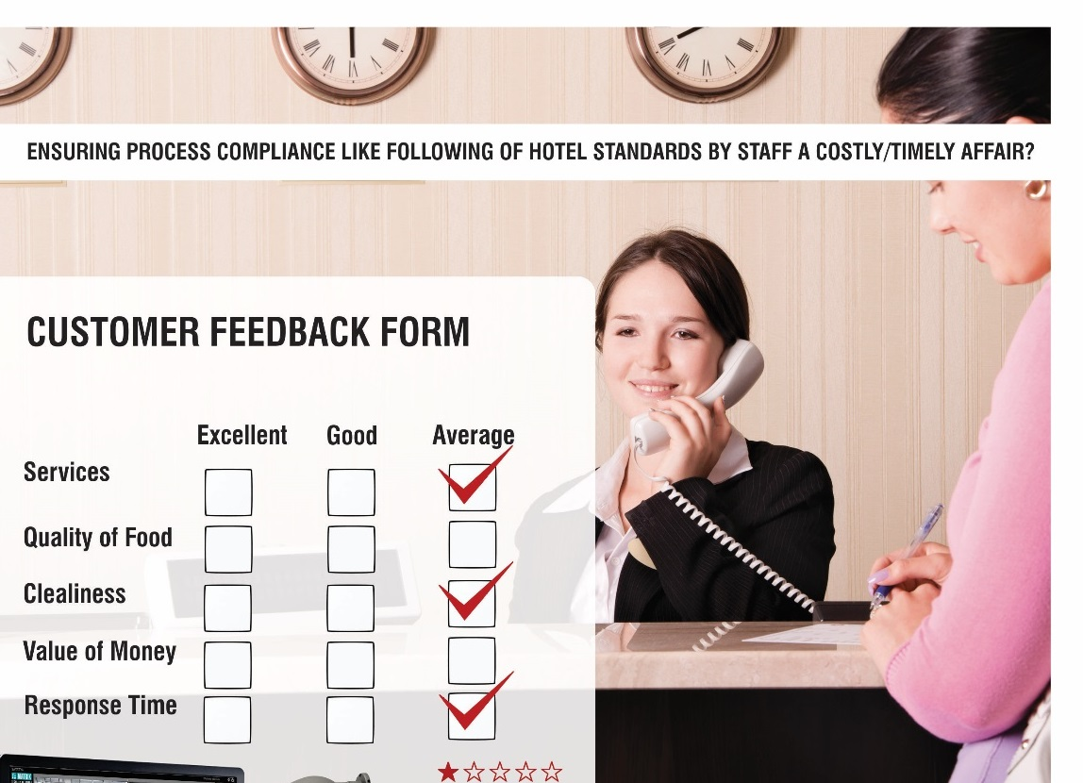
Our Solution
1. Enhance Customer Service
Ensuring process compliance like following of hotel standards by staff a costly/timely affair?
Cost effective random checks like chefs wearing cap while cooking, timeliness in serving food in restaurant: Edge recording
Ensure process compliance like guard greeting guests, serving welcome drink, timeliness in check-in/check-outs, etc.: Daily Highlights
Excellent tool for customer service training: Clip export
Notes:
Compliance of safety and cleanliness standards by staff like Chef wearing cap while cooking in the kitchen, proper washing of utensils and vegetables
Checking of staff meeting customer service protocols like guards wishing guests at the entrance, waiter serving welcome drink at the reception, etc.
Bring streams to central location only when required, instead of sending streams continuously and save huge bandwidth costs
Save

Slide 10
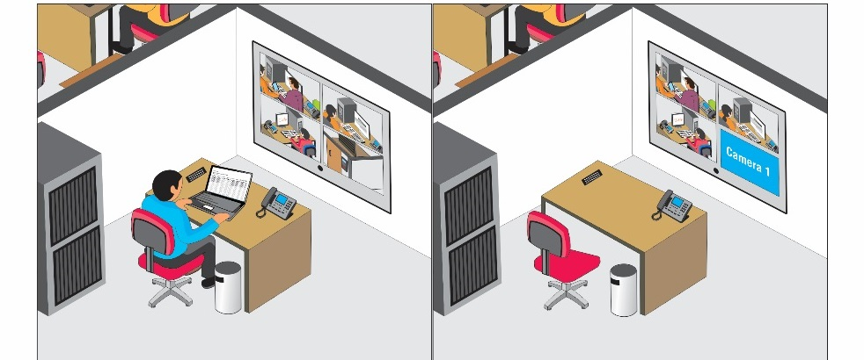
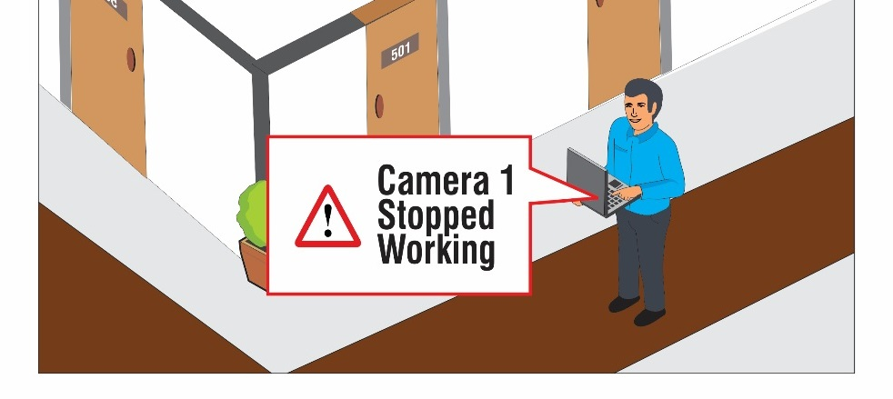
Our Solution
2. 24x7 Reliability
Hotel Cameras turned off frequently without your notice?
Ensure lower breakdowns: TCP Based Notifications, Health Status Monitoring and Reports
Instant Support & Service: Multi-level support through channel partners, technical support, RMA
Notes:
TCP Based Notifications: Ensure no breakdowns of security systems against power failures, tampering, etc. Within 5Kbps bandwidth
Health Status
Instant support and service
Timely updates on any advancements on product front
SMART DASHBOARD ANALYTICS AND PUSH NOTIFICATIONS KEEP YOU UPDATED ABOUT FUNCTIONING STATUS OF THE SECURITY SYSTEMS TO AVOID BREAKDOWNS

Slide 11



Our Customers
The Indian Hotels Company Ltd- Taj Group
Citadel De Daman
Le Grande
Comfort Inn

Slide 12
Expect More: Value for money solution
Increased Business Value
Higher Return on Investment
Increase Security
Enhance Customer Service
Thank You

