Slide 1

Matrix Video Surveillance Solution for Healthcare

Slide 2

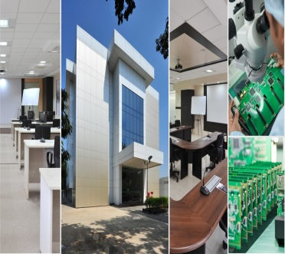
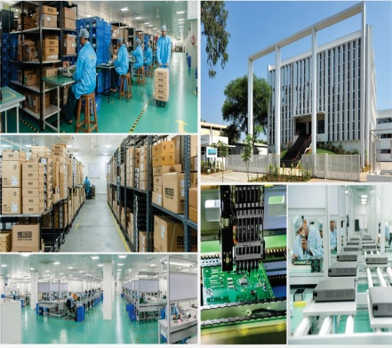
About Matrix
Established in 1991
Products: 60+ Telecom and Security Solutions
Global Presence: 40+ Countries
No. of Partners: 500+
No of Employees: 500+
Awards and Achievements: 25+ for Excellence in Product Engineering,
Design and Innovation
www.MatrixComSec.com
CORPORATE OFFICE
Based at Vadodara, Gujarat, India
Departments: Marketing, Sales, Product Management, Support, Finance,
Customer Care, Purchase
R&D CENTER
77,000 Sq.Ft
More than 40% Manpower in R&D, 700+ Man-years of R&D Experience
World-class Technology Platform and Processes
MANUFACTURING UNIT
73,000 Sq.Ft
100+ Work Stations
International Quality Systems and Processes

Slide 3







Why Matrix?
Enhanced Hospital Reputation
Patient Satisfaction
Personal Referrals
Greater Security
Ensure Process Compliance
Efficient Patient Care
Matrix Video Surveillance Solution for Healthcare

Slide 4
Greater Security
~ For patient’s peace of mind

Slide 5
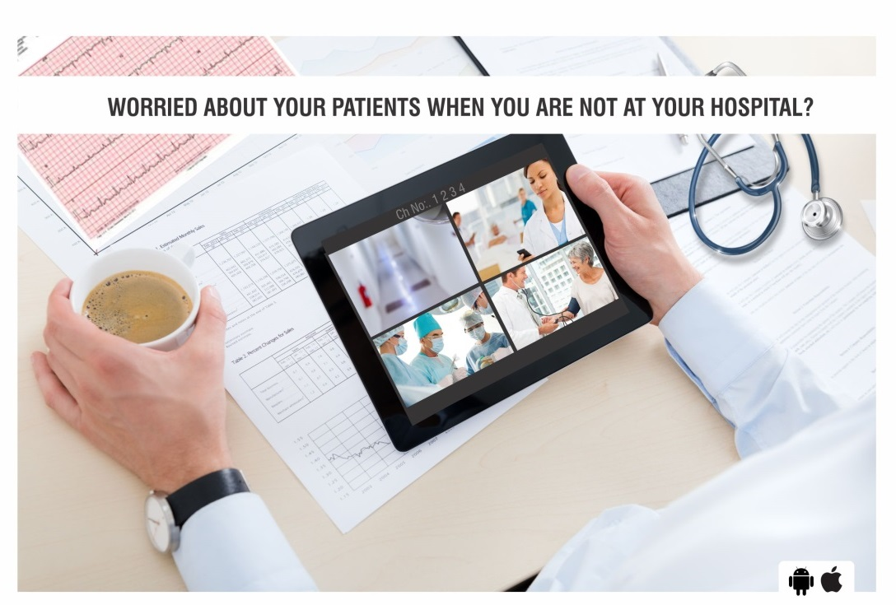
Our Solution
1. Real-time Security
Worried about your patients when you are not at you hospital?
Effective Monitoring
Cost effective patient monitoring setup 24*7: Cascading, Sequencing and Camera Grouping
Monitor patients from anywhere, anytime: Mobile App
Restrict patients with psychiatric/neurological conditions from leaving their wards: E-map
Prevent child abduction from incubation centers: Integration with Access Control, send snapshot to central location and via email to alert security of any suspect
Early Detection and Instant Notification
Prevent theft of expensive surgical equipment: Missing Object Detection and time based IVA’s like Intrusion Detection, Trip Wire, etc. and Instant Notifications like E-mail, SMS, Alarms, etc.
Notes:
Trained staff in a central operations center can observe multiple patients over the facility's existing network, quickly alerting staff when intervention is needed
Hospital personnel can gain earlier awareness of incidents that can compromise patient safety by using video analytics software to send an alert based on loitering, boundary crossing, or queue length.

Slide 6
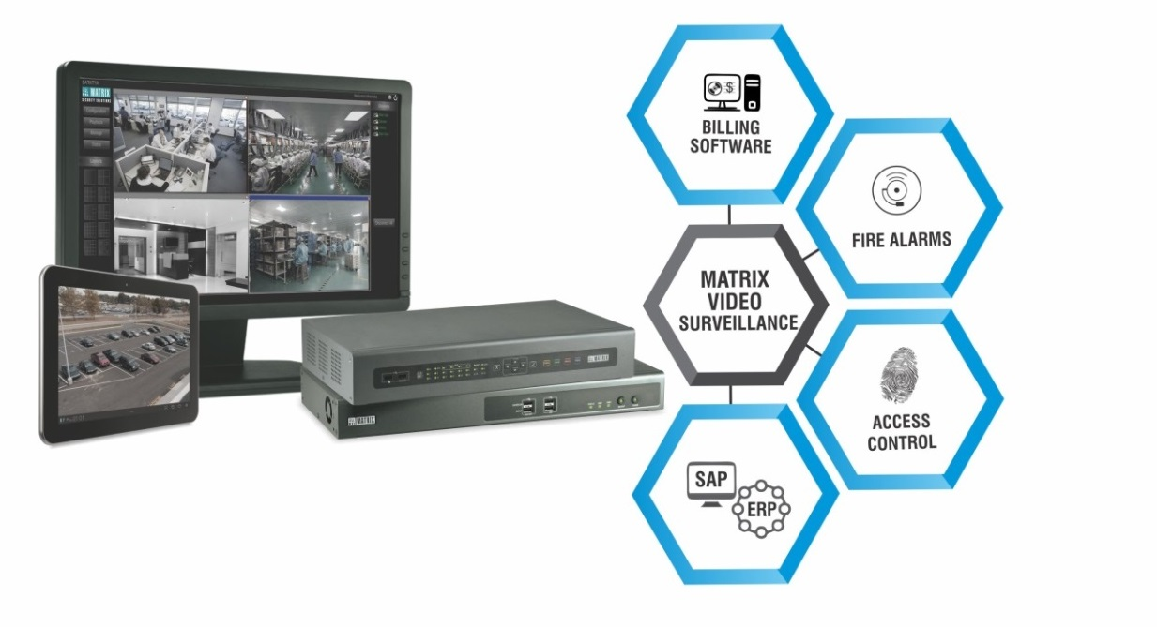
Our Solution
2. Improve Safety
Avoid risks of overcrowding: Crowd Management and Vehicle Management to alert the security when number of people increases more than limit
Ensure quick and easy evacuation in case of emergencies: Integration with Fire Alarms, People Counting and Two-way Audio
Prevent drug diversion: Integration with billing software to capture snapshot on each billing transaction and Loitering
Notes:
rug diversion is a problem not only in the main pharmacy, but also in satellite pharmacies, dispensing areas on the floor, loading docks, and other areas of the hospital. One cost is financial loss. Another is the safety risk resulting from substitution of saline for morphine, for example. Video surveillance can also help hospitals identify healthcare personnel who divert drugs for personal use.
Prominent video surveillance cameras can help deter drug diversion (Figure 3). It is more effective to transmit video over the network for central storage than to store it locally, because centrally stored video remains available even if the perpetrators damage local equipment. Video analytics software that detects loitering can send an alert if an individual remains in a drug-dispensing area or adjacent area longer than a specified time.

Slide 7
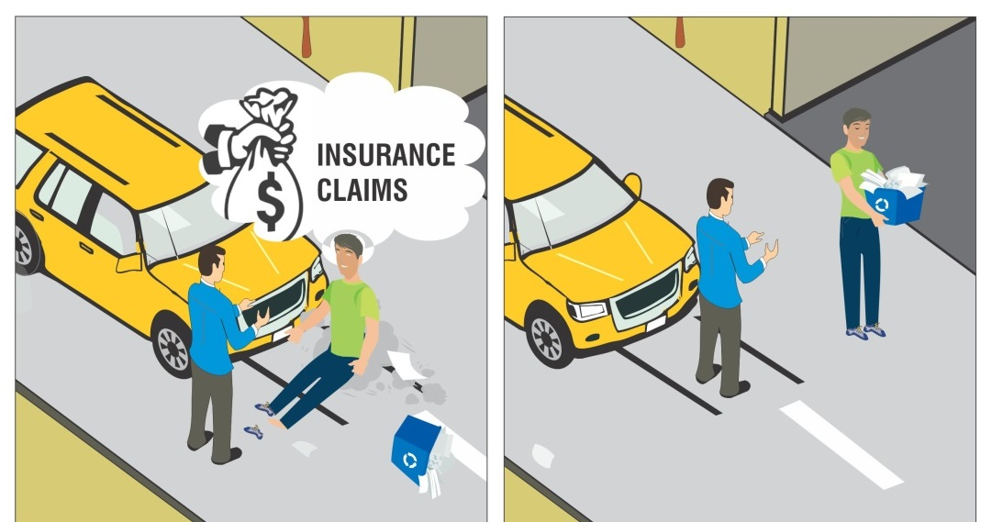
Our Solution
3. Quick Investigation
Paying for patients’ or visitors’ false insurance claims?
Prevent false insurance claims: Time and Event Based Playback
Avoid malpractice or questions in case of failed surgeries: Camera-wise playback
Safeguard visual evidences in events like a police case: Evidence Lock, Clip Export and NAS/FTP Support
Store recordings for higher number of days & at half the cost: Adaptive Recording, Camera-wise Recording Retention

Slide 8
Ensure Process Compliance
~ For greater productivity

Slide 9
Our Solution
1. Ensure Process Compliance
Ensure staff follows cleanliness standards to avoid hospital acquired Infections: Daily Highlights
Ensure timely response: Edge Recording
Ensure trainees/nurses follow proper processes during surgeries: Centralized monitoring through CMS
Use recordings as teaching/training material for interns and staff: Clip export
Ensure visitors or employees do not smoke: Integration with smoke detectors
Notes:
Compliance of safety and cleanliness standards by staff like Chef wearing cap while cooking in the kitchen, proper washing of utensils and vegetables
Checking of staff meeting customer service protocols like guards wishing guests at the entrance, waiter serving welcome drink at the reception, etc.
Bring streams to central location only when required, instead of sending streams continuously and save huge bandwidth costs

Slide 10
Efficient Patient Care
~ To ensure proactive treatment to patients

Slide 11

Our Solution
1. Efficient Patient Care
Difficulty in contacting the right person during emergencies?
Prevent negligence by caretakers: No Motion Detection, Loitering
Allow easy view of their related wards to doctors: Doctor-wise viewing roles and rights
Ensure prompt response to emergency cases: Calling from Mobile App to take senior doctor’s advice
Easy staff communication on critical cases: Two-way Audio
Ensure transparency in billing: Integration with POS system
Notes:
TCP Based Notifications: Ensure no breakdowns of security systems against power failures, tampering, etc. Within 5Kbps bandwidth
Health Status
Instant support and service
Timely updates on any advancements on product front
SMART DASHBOARD ANALYTICS AND PUSH NOTIFICATIONS KEEP YOU UPDATED ABOUT FUNCTIONING STATUS OF THE SECURITY SYSTEMS TO AVOID BREAKDOWNS

Slide 12



Our Customers
Pinnacle Hospital
S.L. Raheja Hospital
Rabindranath Tagore Hospital
Vital Healthcare Pvt. Ltd.
Anandalok Hospital
Notes:
TCP Based Notifications: Ensure no breakdowns of security systems against power failures, tampering, etc. Within 5Kbps bandwidth
Health Status
Instant support and service
Timely updates on any advancements on product front
SMART DASHBOARD ANALYTICS AND PUSH NOTIFICATIONS KEEP YOU UPDATED ABOUT FUNCTIONING STATUS OF THE SECURITY SYSTEMS TO AVOID BREAKDOWNS

Slide 13
Expect More: Value for money Solution
Increase Hospital Brand Awareness & Reputation
Enhance Patient Care
Ensure Process Compliance
Increase Security
Thank you

