Slide 1

Matrix Video Surveillance Solution for Education

Slide 2

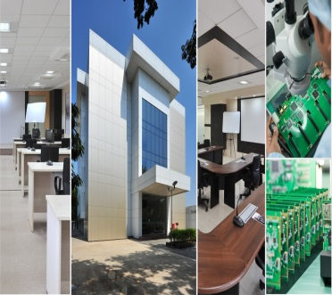
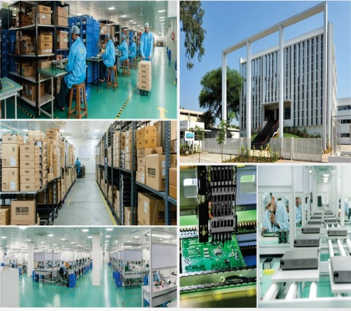
About Matrix
Established in 1991
Products: 60+
Telecom and Security Solutions
Global Presence: 40+ Countries
No. of Partners: 500+
No of Employees: 500+
Awards and Achievements: 25+
for Excellence in Product Engineering,
Design and Innovation
www.MatrixComSec.com
CORPORATE OFFICE
Based at Vadodara, Gujarat, India
Departments: Marketing, Sales, Product Management, Support, Finance,
Customer Care, Purchase
R&D CENTER
77,000 Sq.Ft
More than 40% Manpower in R&D, 700+ Man-years of R&D Experience
World-class Technology Platform and Processes
MANUFACTURING UNIT
73,000 Sq.Ft
100+ Work Stations
International Quality Systems and Processes

Slide 3





Why Matrix?
Higher Business Revenue
Better Reputation
Improved Academic Performance
Enhanced Security
Enhanced Discipline
Matrix Video Surveillance Solution for Education
Notes:
The capabilities of Matrix Video Surveillance are not just limited to security. It also increases productivity and quality standards across all hotel chains. This helps in providing guests with a peace of mind and a memorable experience and thereby increasing your

Slide 4
Increased Security

Slide 5
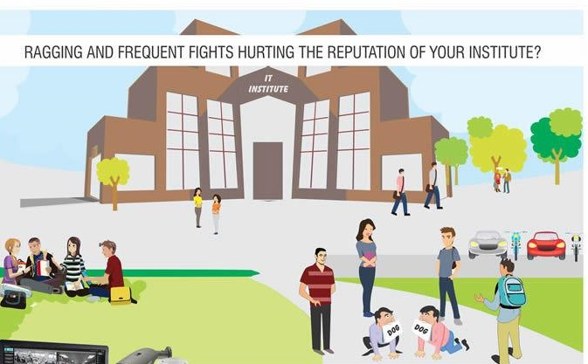
Our Solution
1. Real-time Security
Ragging and Frequent fights hurting the reputation of your institute?
Prevent ragging, fights, drug menace, crime, molestation, kidnapping: Easy monitoring with Cascading, Camera Grouping and Sequencing, Mobile App, E-map
Prevent intruders by securing perimeters: Trip Wire, Intrusion, etc.
Prevent unauthorized access: Integration with Access Control
Keep a watch on your premise from anywhere, anytime: Mobile App, CMS
Works as a deterrent
Notes:
Unauthorized Access: Can be of two types: outsiders entering the campus
Internal restrictions: labs where only research scholars are allowed access
Works as a deterrent: Video Surveillance has a psychological impact on the minds of miscreants which prevents them from indulging in misdeeds

Slide 6

Enhanced Discipline

Slide 7
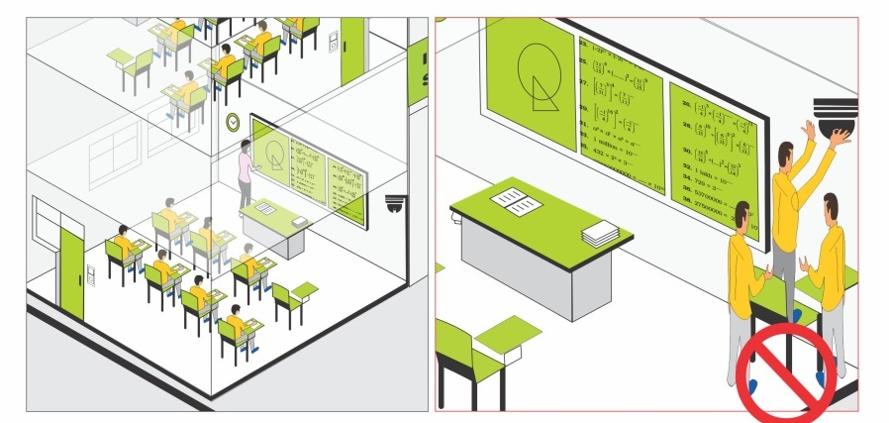
Our Solution
2. Productivity and Discipline
Student tampering with cameras to avoid getting caught?
Provide remote access to absent students/recorded lectures for future reference: Recording with Two-way Audio
Evaluation of Teachers: Continuous Recording, Date and Time based search
Prevent book theft from library: Integration with Library Management Software
Notes:
Two way audio allows you to record reach and every lecture for future reference. This can be used if any student is absent for health reasons/ representing institute at sporting events/ seminars or for revision
Using the same clips, performance of teachers can also be evaluated whether they are adhering to university standards
Integration with library management software allows taking a video clip whenever a book is issued through the software. This fixes accountability in case a book goes missing

Slide 8
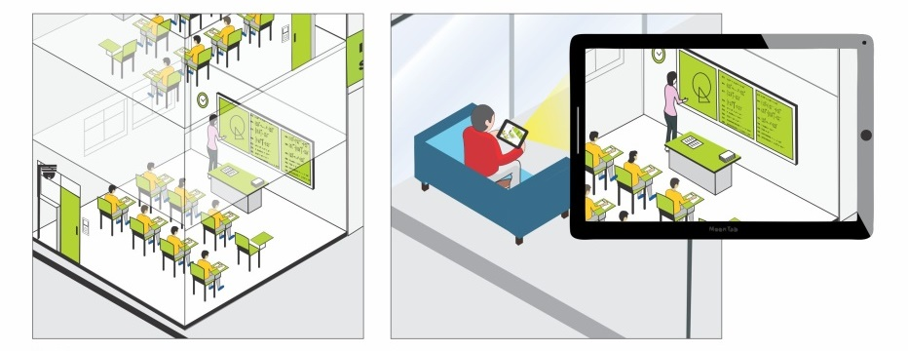
Our Solution
2. Productivity and Discipline
Performance of students affected due to missed classes?
Better manage students inside campus: Can act as Public Announcement System
Prevent Bunking : Intrusion Detection, Works as a deterrent
Prevent copying during exams: Continuous recording, Multiple Monitoring modes
Notes:
Public announcement system allows addressing individual classes/ or group of classes together, so that instructions can be passed on to students and teachers within no time
Intrusion will give a notification in case any student tries to jump over the boundary wall

Slide 9

Enhanced Guardian Satisfaction

Slide 10
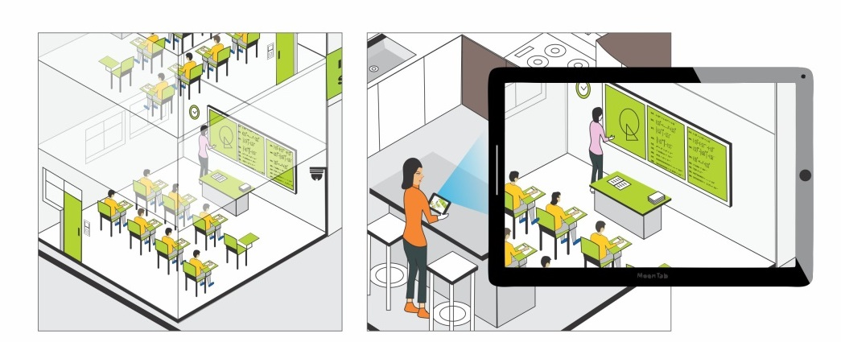
Our Solution
3. Enhance Guardian Satisfaction
Parents skeptical of their wards going to school regularly?
Limited viewing access to parents: User Defined Roles and Rights, SATATYA SIGHT
Centralized Control of Multiple Branches: Multi-display, Smart Client
Notification to parents on wards reaching/leaving school: Integration with Access Control
Notes:
Limited viewing access to parents: Parents can be given access to limited cameras to view how their wards are doing at school. This will increase their trust in school and will also result in peace of mind
Centralized control of multiple branches: All the branches can be monitored from a single location with the help of video surveillance. This saves huge travel time and cost

Slide 11

Ease of Use

Slide 12
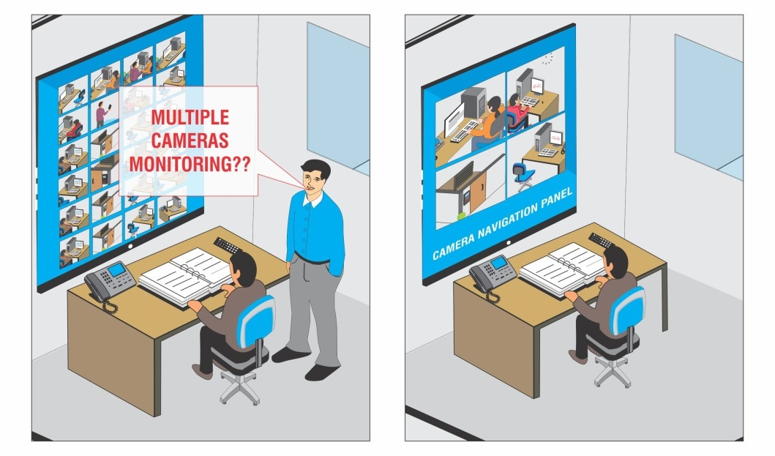
Our Solution
4. Ease of Use
Easy Playback: Synchronous/Asynchronous Playback, Investigation in playback
Ease of Use: Clip export in .avi format
Ease of Monitoring: Cascading
Easy Backup: Backup over FTP/NAS
Storage Optimization: Adaptive Recording, Camera-wise Recording Retention

Slide 13
Expect More: Value for money Solution
Increased Security
Enhanced Productivity and Discipline
Increased Parent Satisfaction
Ease of Use
Thank You

