Slide 1

Matrix Video Surveillance Solution for Banking

Slide 2

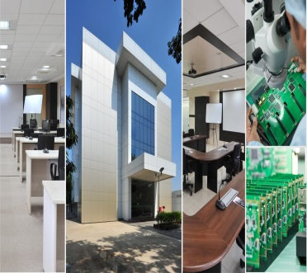
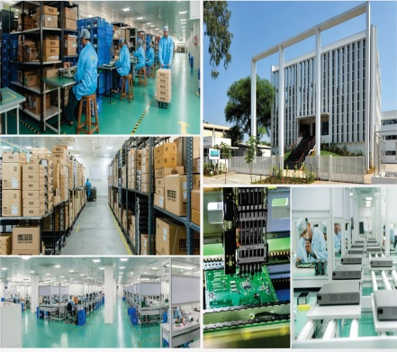
About Matrix
Established in 1991
Products: 60+
Telecom and Security Solutions
Global Presence: 40+ Countries
No. of Partners: 500+
No of Employees: 500+
Awards and Achievements: 25+
for Excellence in Product Engineering,
Design and Innovation
www.MatrixComSec.com
CORPORATE OFFICE
Based at Vadodara, Gujarat, India
Departments: Marketing, Sales, Product Management, Support, Finance,
Customer Care, Purchase
R&D CENTER
77,000 Sq.Ft
More than 40% Manpower in R&D, 700+ Man-years of R&D Experience
World-class Technology Platform and Processes
MANUFACTURING UNIT
73,000 Sq.Ft
100+ Work Stations
International Quality Systems and Processes

Slide 3







Why Matrix?
Higher Revenue & More Customers
Customer Trust
Centralized Control
Greater Security
Process Compliance
Higher Reliability
Matrix Video Surveillance Solution for Banking

Slide 4
Centralized Control

Slide 5
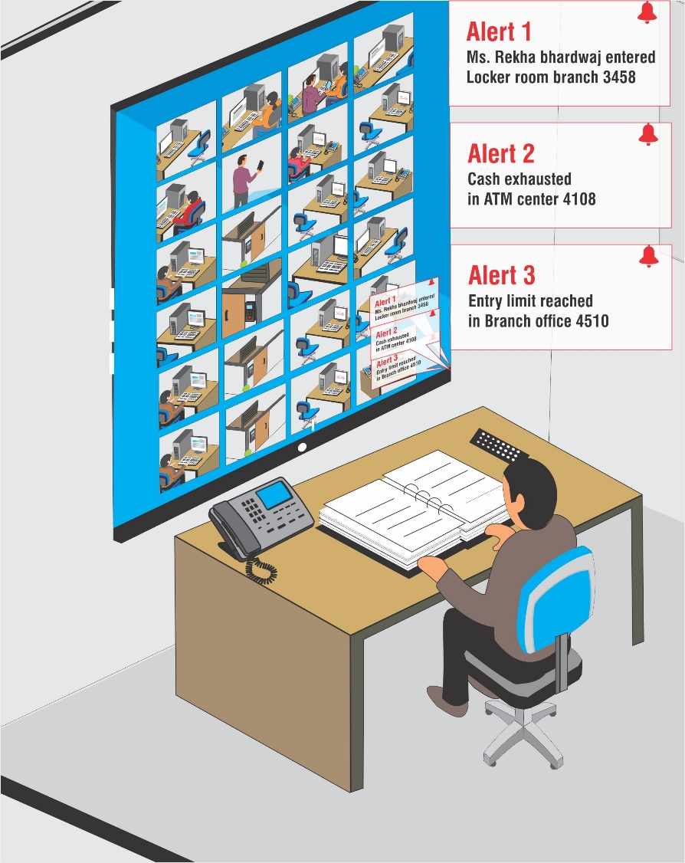
Our Solution
1. Greater Control

Slide 6
Our Solution
1. Greater Control
Create user based login credentials with different roles and rights for IT manger, admin manager, local security in charge & security guards.
Integrate Matrix video surveillance with access control & lightening system to lock the ATM door or locker room at the time of thefts and robberies. You can also integrate Matrix Video Surveillance system with Alarm systems, sensors and buzzer systems.
Store data at local recording server and investigate centrally with distributed architecture of Matrix Video Surveillance..
Get prompt notification through Snapshots emails, SMS, Video Pop up, live streaming, audio alarm, & buzzers during events like thefts, robberies, camera tamper, hard disk failure, camera recording failure. Configuration can be done in such a way that different people can be notified during different events.

Slide 7
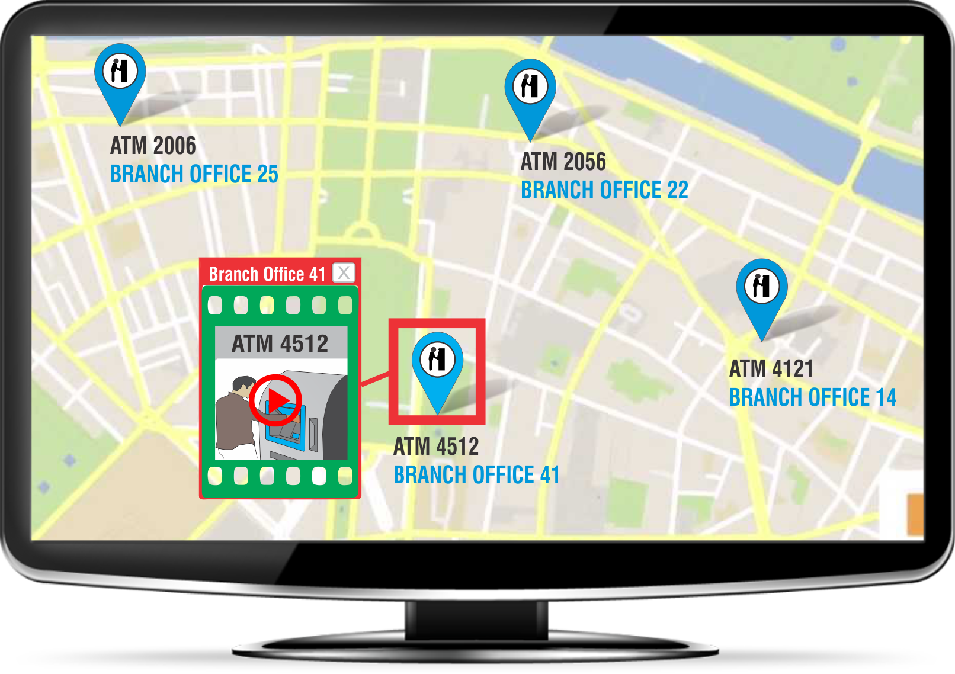
Our Solution
2. High Visibility
In case of Multi-location keep an overview of whats happening in all the branches of your region by having access to all the cameras through our Cascading feature.
No need to turn camera pages or switch screens, easily monitor all the ATM center & branches through Emap.
Access Daily Highlights of all the events that occurred at different branches from a Central location
You can view up to 64 Cameras on the same screen ,that too can be further distributed over Multiple Monitors

Slide 8
Greater Security

Slide 9
Our Solution
1. Real time security
Ensure safety of Locker Rooms and bank perimeter at night time using IVA’s like Trip wire, Motion Detection Face Detection and trigger an alarm instantly.
Safeguard your locker room with People counting IVA and restrict number of people entering it.
Safeguard valuable assets of customers and employees through efficient real time monitoring with the help of logical grouping and sequencing of cameras.
Secure ATMs with IVA’s like, Loitering, Missing Object & Tail gating.

Slide 10
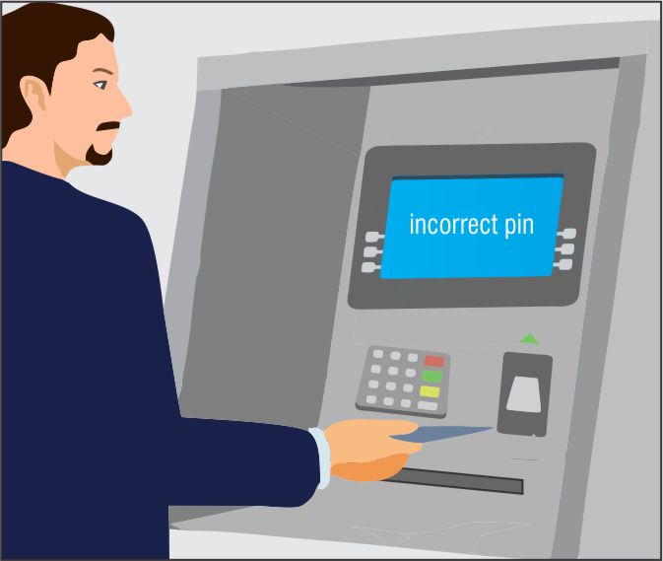

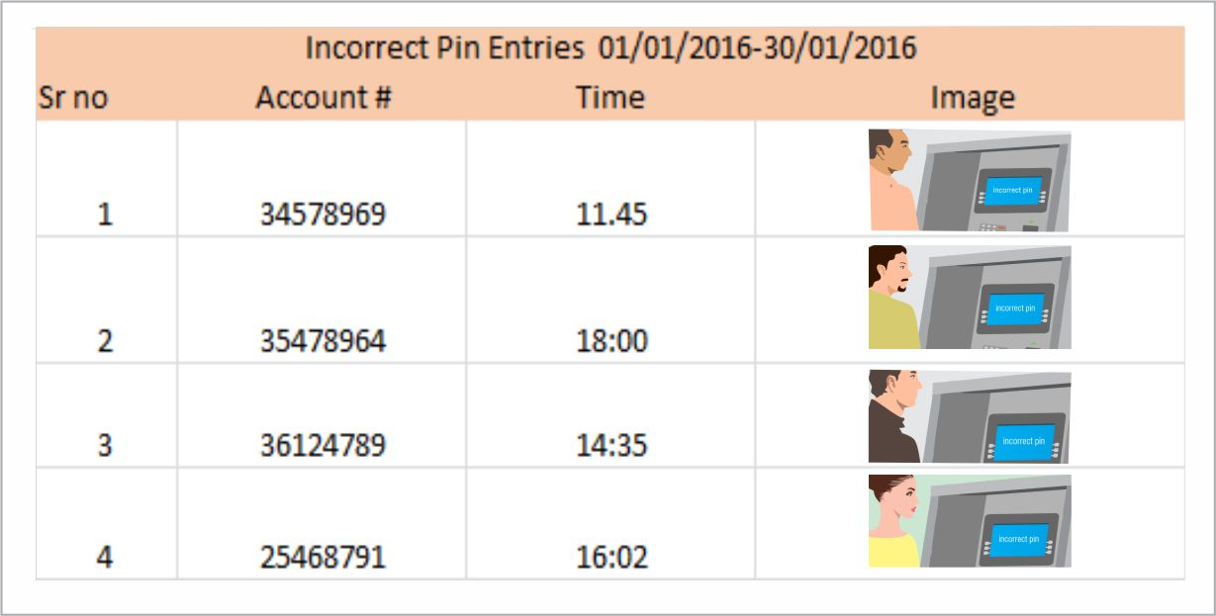
Our Solution
2. Investigation

Slide 11
Our Solution
2. Investigation
Investigate check frauds by capturing the transaction data and image of the person who came to deposit the Cheque.
At the time of suspicious withdrawals get investigating proof, with face detection IVA.
Store recordings for higher number of days & at half the cost with Adaptive Recording and Camera-wise Recording Retention
Investigate a stolen asset in your premises with Missing object IVA.

Slide 12
Process Compliance

Slide 13
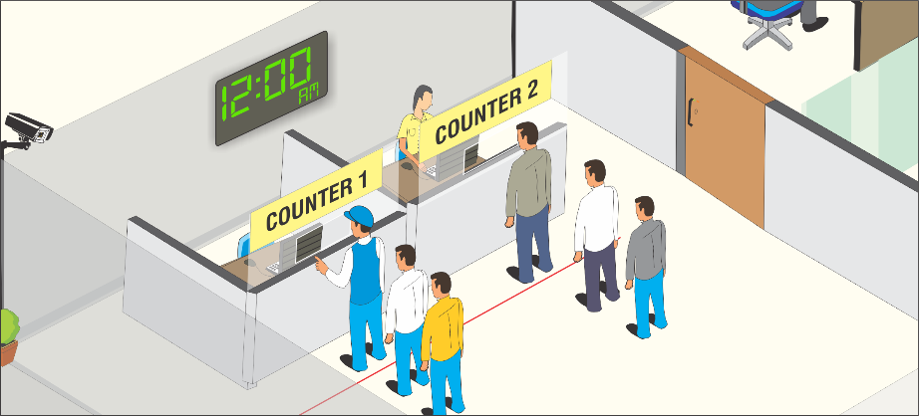
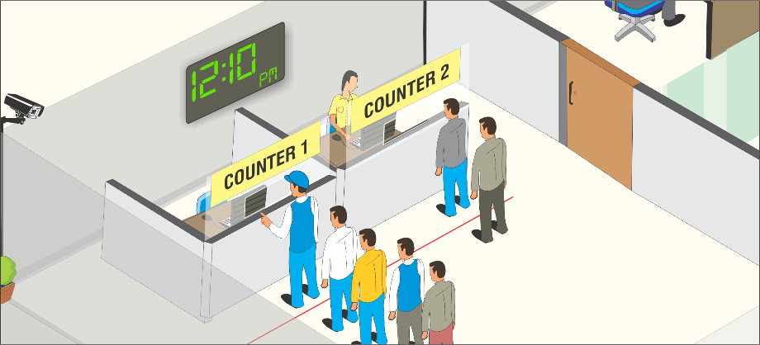
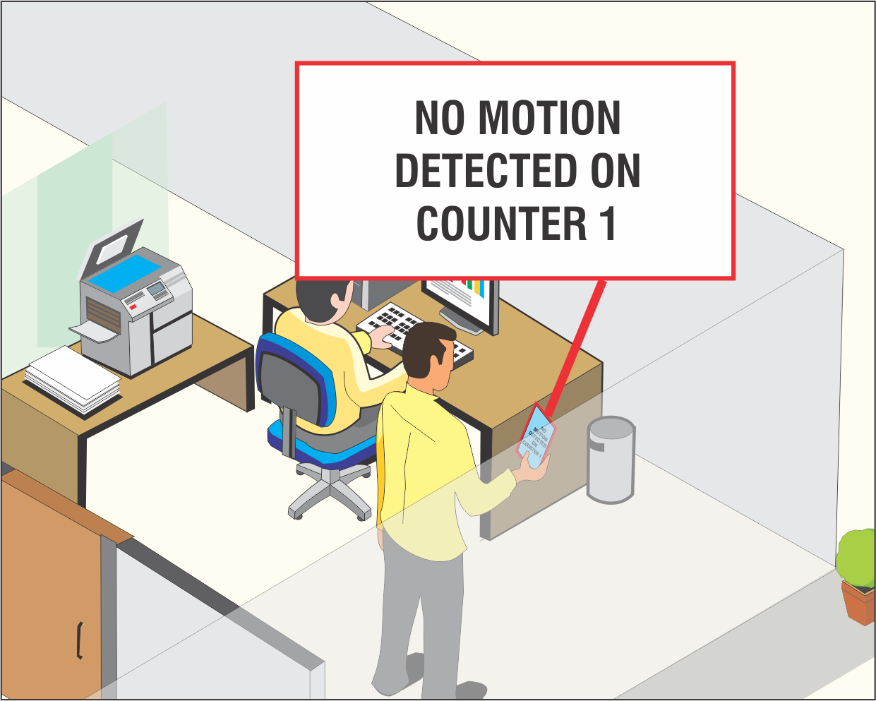
Our Solution
1. Productivity

Slide 14
Our Solution
1. Productivity
Check employee presence on cash counter with No Motion IVA.
Deduce peak hours when you have high number of customers.
Keep a check on your security guards/Watchman’s tour around the perimeter with the help of No Motion IVA.

Slide 15
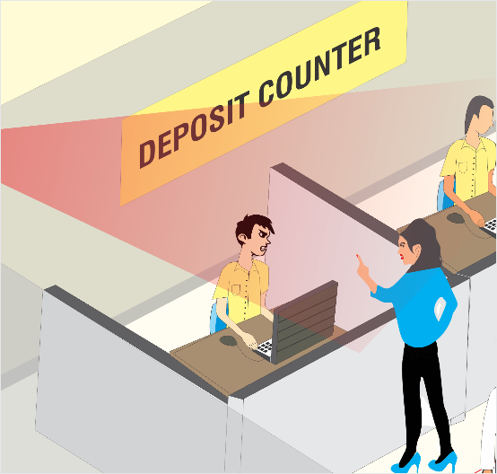
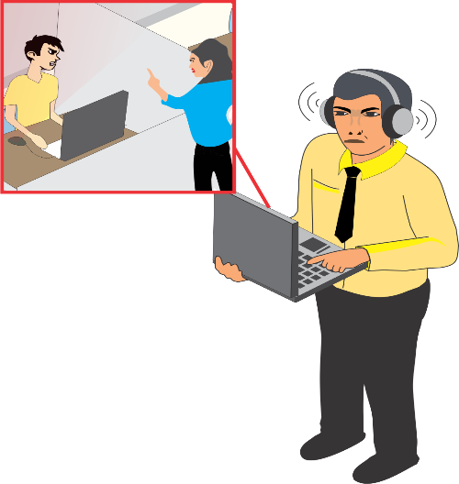
Our Solution
2. Employee Discipline
Listen the conversation remotely and keep a check on your employee’s behavior with the customers.
Know if your employees are idle, wasting time with Loitering IVA
Have snapshots of staff member coming late.

Slide 16
Higher Reliability

Slide 17
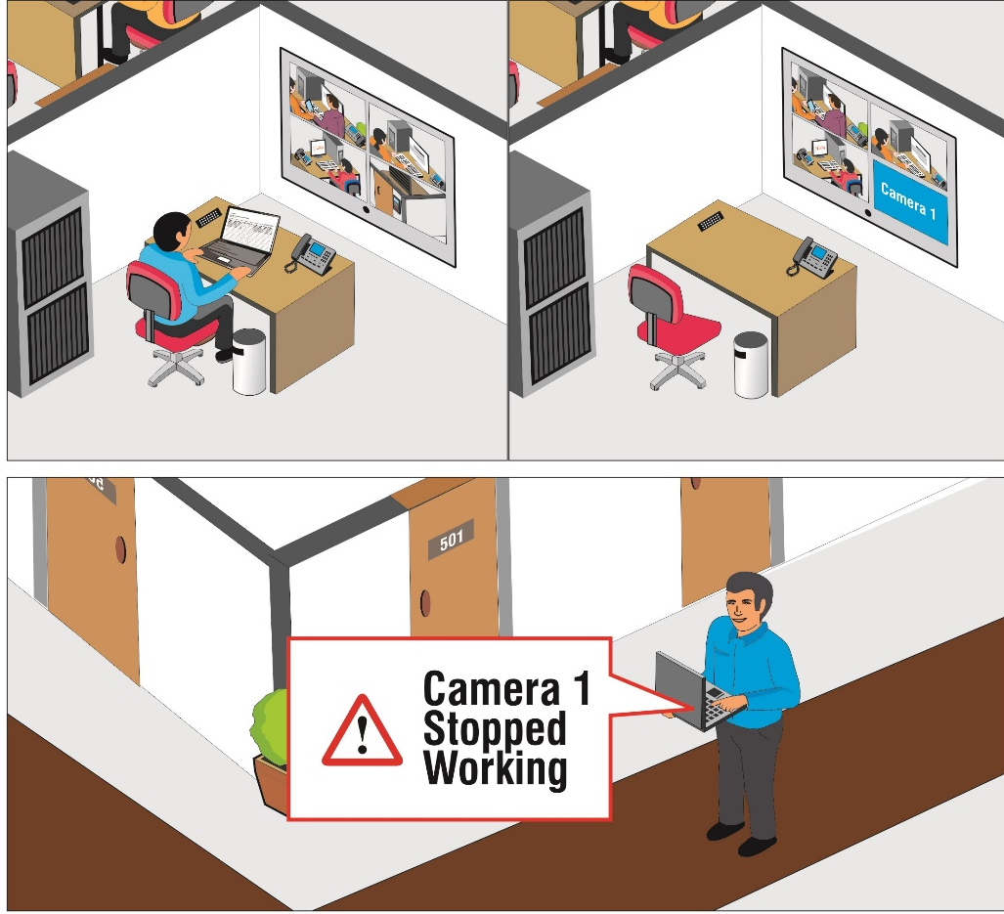
Our Solution
1. Reduced Breakdowns and Downtime

Slide 18
Our Solution
1. Reduced Breakdowns and Downtime
Get notified immediately if your device/camera recording fails with Health status monitoring, TCP based notification & Device monitor app.
Get an alert within 5kbps bandwidth incase of camera tampering at any ATM center in your region.
Get notifications at central location even with low bandwidth through Edge recording.

Slide 19
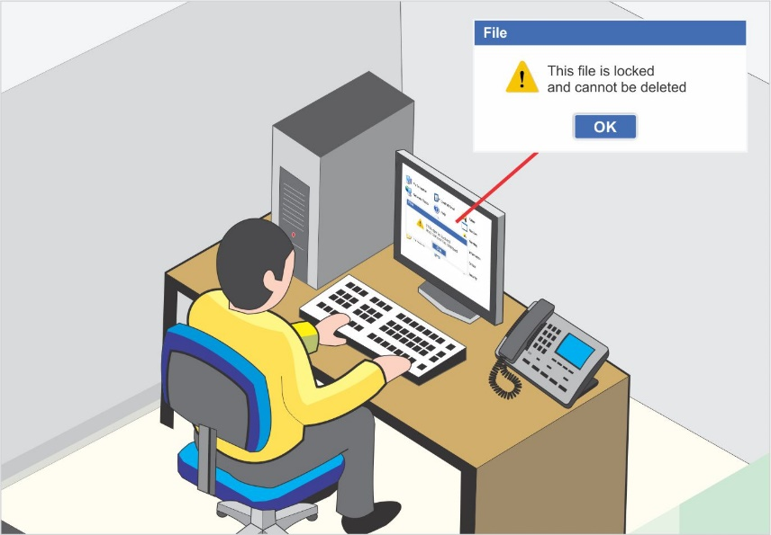

Our Solution
2. Safeguard your Data
Improve data security by Manual/Scheduled back up over NAS and FTP
Secure your data with Evidence lock and Clip Export
Ensure no loss of data by shifting to redundant server during failure of any recording server

Slide 20
Expect More: Value for money Solution
Centralized Control
Greater Security
Process Compliance
Higher Reliability

