Slide 1

Matrix Video Surveillance Solution

Slide 2








Matrix SATATYA: Three Dimensional Benefits
Proficient
Persistent
Preventive
Reduction in solution cost of
bandwidth, storage & manpower
Better reliability against
downtime & breakdowns
Enhanced security
of physical assets
from theft, snooping etc.
Improved productivity, process
compliance and employee discipline
Greater visibility & control
Improved safety of human assets
from accidents, hazards and injuries
Ease of management
Proactive solution with early
detection and instant notification

Slide 3
SATATYA SAMAS: Video Surveillance for Multi-location Enterprise

Slide 4
Product Range: Video Management Software (SAMAS)
CATEGORY | SATATYA SAMAS PLATFORM
 | GE | ME | LE
Inbuilt Cameras | 20 | 50 | 200
Maximum Camera Supported | 100 | 250 | 100000
Inbuilt Simultaneous Users | 2 | 5 | 5
Maximum Simultaneous Users | 1000 | 1000 | 1000
Maximum Number of Cameras per Server | 255 | 255 | 255
Devices per Management Server | 10000 | 10000 | 10000
SAMAS MODULES
1. Intelligent Video Analytics | 2. Multi display | 3. Parking Management | 4. Access Control Integration

Slide 5




SATATYA SAMAS
Scalable: 1,00,000 Cameras, 10,000 Devices, 1,000 Recording Servers
Distributed Architecture: Simultaneous Local & Central Monitoring
with no License required for Recording Server
Flexibility: Cam-wise User Login Roles & Rights, Both IP & Analog
Camera Support and Direct Camera Connection Support
Interoperability: Supports all ONVIF and RTSP compliant cameras.
Web API for third party Integration.

Slide 6
SATATYA SAMAS USP

Slide 7
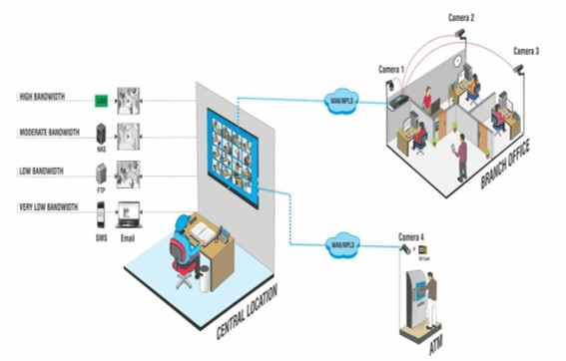
Centralized Visibility
Greater Visibility across Multiple Locations, Easy Centralized Management and Monitoring
Edge Recording with Notification at Central Location

Slide 8
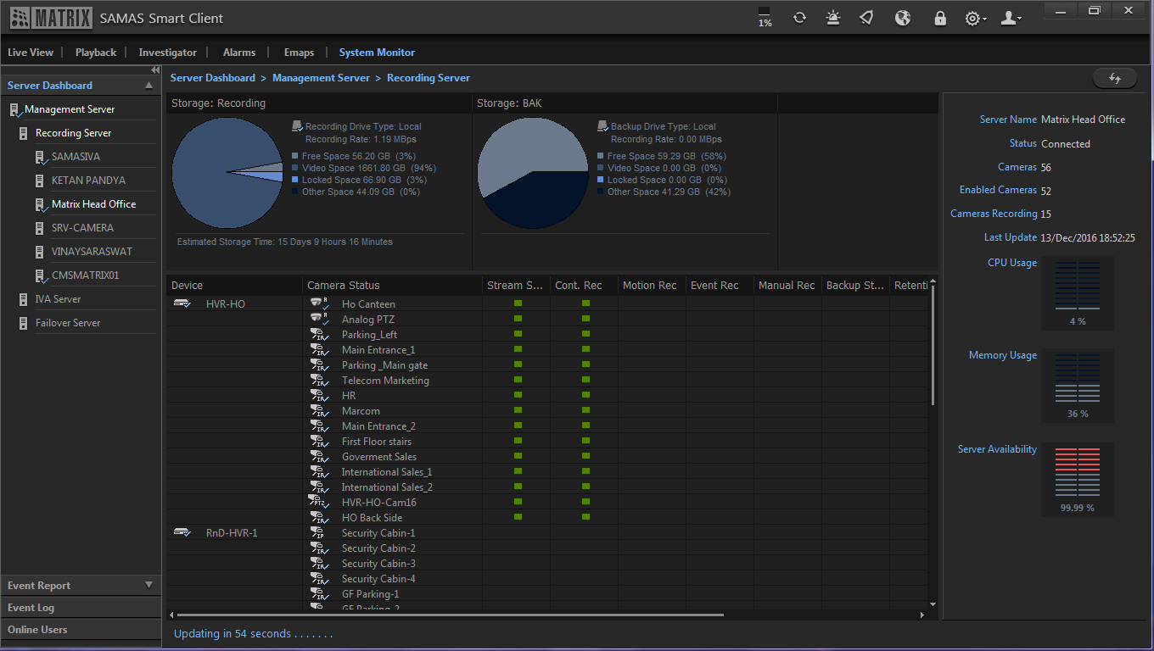
Centralized Control
Greater Control over Functioning of Multiple Cameras Spread Across Multiple Locations
Health Status Report, User-based Roles and Rights, Summary Report

Slide 9
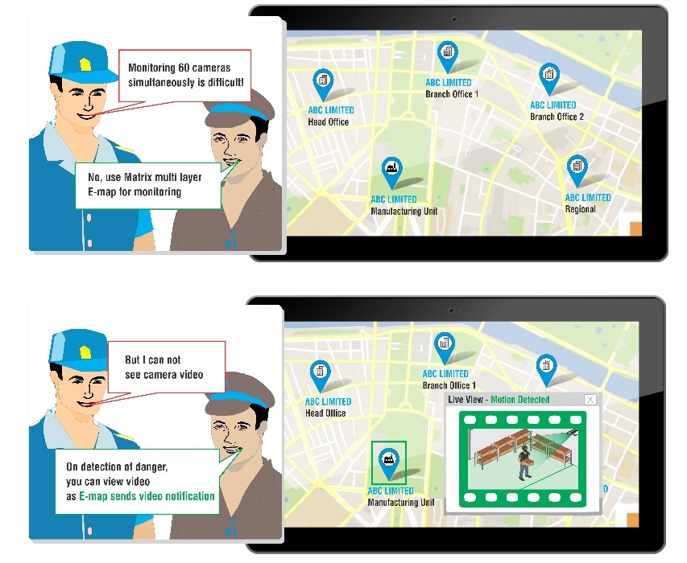
Ease of Monitoring
Easy Centralized Monitoring, Easy Viewing of Multiple Cameras on a Single Screen
E-map, Multi-display, Daily Highlights

Slide 10

Instant Notifications
Proactive Solution, Reactive Security, Notifies the Right Person at the Right Time
Video Pop-up, Email with Snapshot, SMS, Audio Alarms, Buzzers, etc.

Slide 11
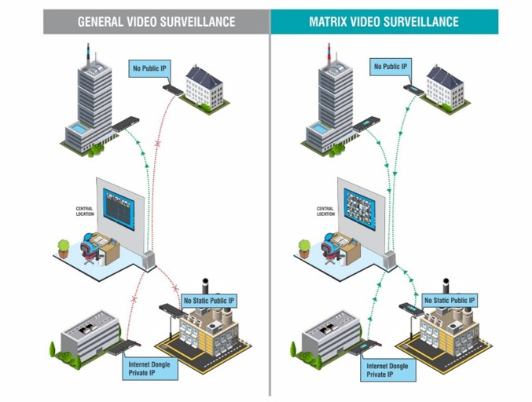
Optimized Bandwidth
Reduce Recurring Cost of Bandwidth, No Public IP Required
Device Initiation, Adaptive Recording, Configurable Bit-rate

Slide 12
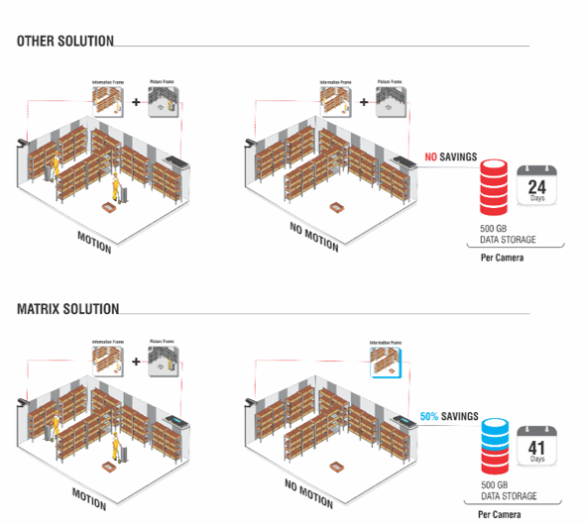
Optimized Storage
Reduce Storage Requirement by up to 50%, Get Higher Storage Days
Adaptive Recording, Camera-wise Recording Retention, Two Level Data Compression & Archiving

Slide 13
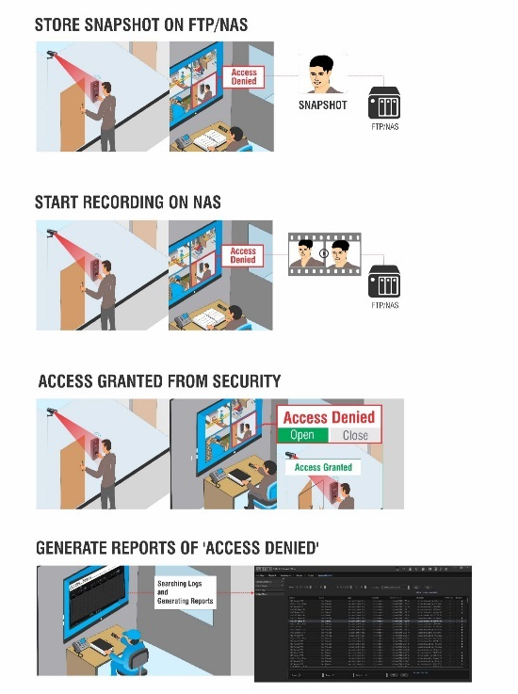
Integrated Security
Synchronous Functioning, Prevent Unauthorized Access, Quick Search of Records, Bookmark Evidence Clips
Integration with Access Control, Fire alarms and other Sensors

Slide 14
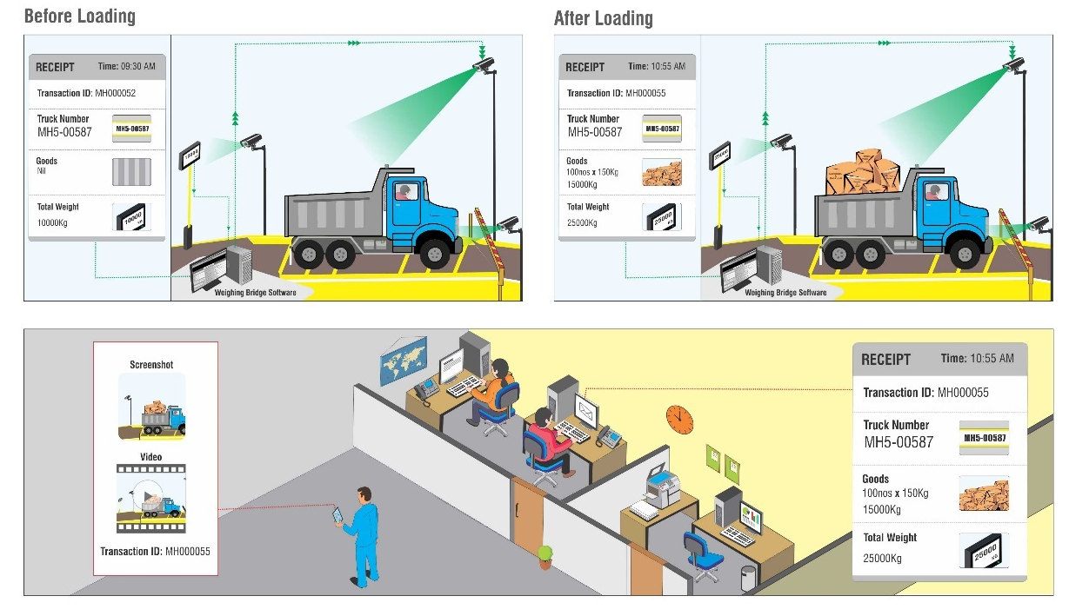
Process Automation
Synchronous Functioning, Automate System, Eliminate Manipulation, Quick Search of Records
Integration with Weigh Bridge, POS, Dispatch System, Visitor Management, etc.

Slide 15
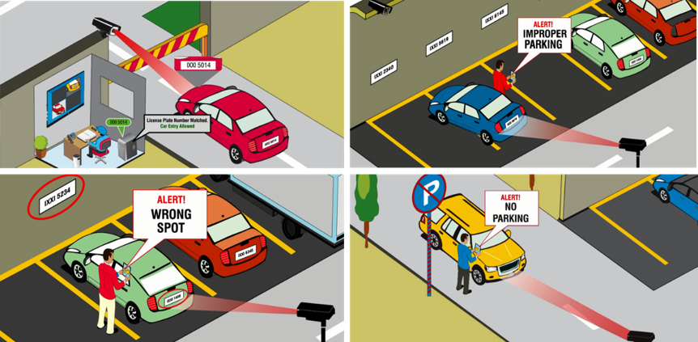
Parking Management
Parking Space Optimization, Automate Parking
License Plate Recognition with Blacklist and Whitelist, Vehicle Counting, Unauthorized Parking, Improper Parking, Wrong Way Parking and Prohibited Parking

Slide 16

Crowd Management
Occupancy Control, Easy Crowd Management, Employee Safety, Avoid Tail-gating
Face Detection, People Counting, Tail-gating Detection and Loitering

Slide 17
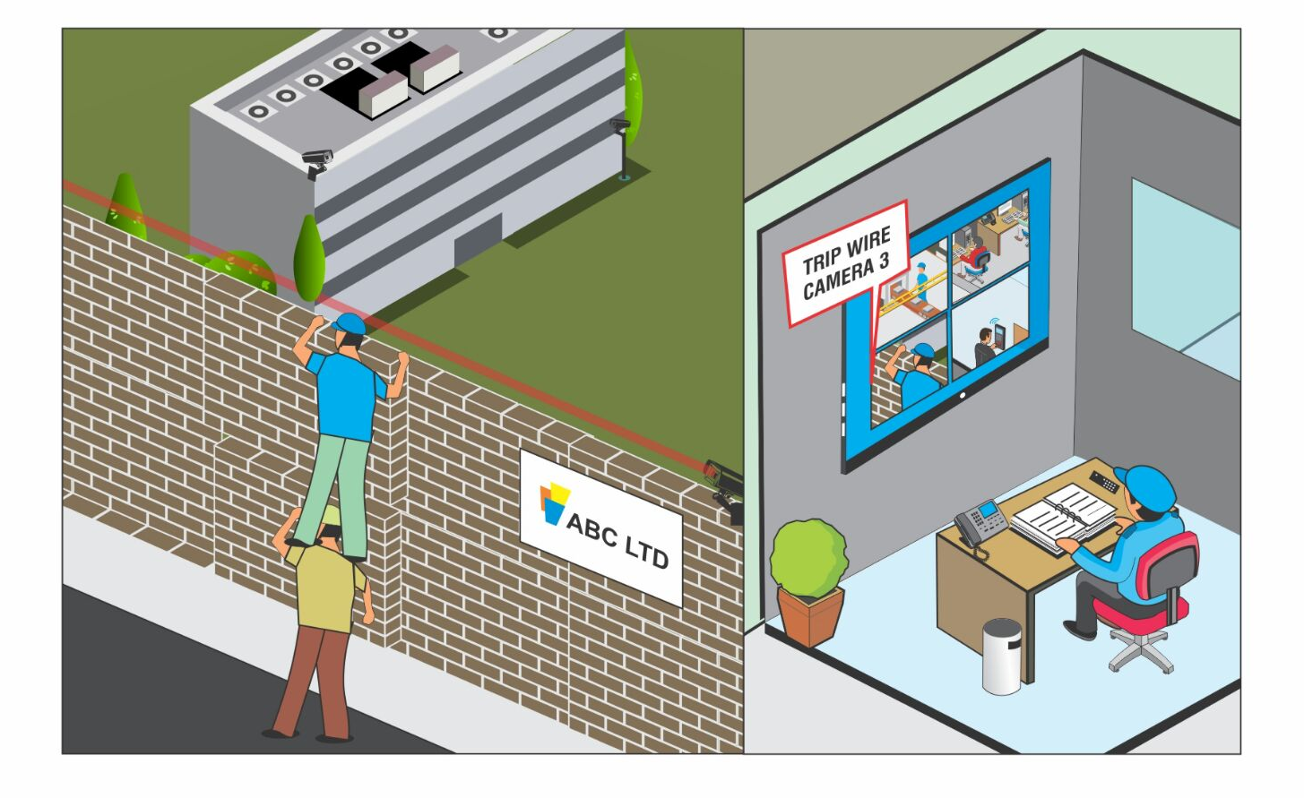
Perimeter Security
24x7 Security of Outdoor Properties, Secure Premises, Asset Protection
Intrusion Detection, Trip Wire, Missing Object Detection and Tail-gating

Slide 18
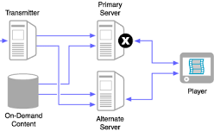
Data Security
Safeguard Data Against Breakdowns, Safeguard Evidence
Redundant Server, Evidence Lock, Clip Export and SSL Communication
Management
Server
Recording
Server
Data Storage
Redundant
Server

Slide 19
Video Recorders

Slide 20



Video Recorders
Recording Resolution: Up to 5MP
Throughput: 48Mbps to 354Mbps(Depending on the number of
channels)
Storage Capability: 6TB-24TB(Depending on the number of channels)
Interoperability: Supports all ONVIF or RTSP compliant cameras

Slide 21


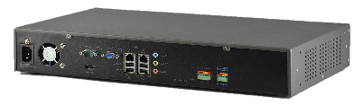
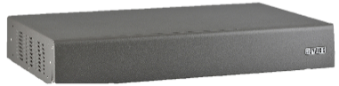




Product Range: Video Recorders
NVR Standard
NVR8S
NVR64S
NVR8S
Rear
NVR8S
Front
NVR Premium
NVR24P
NVR64P
NVR64P
Rear
NVR64P
Front
HVR Standard
HVR0408S
HVR0824S
HVR1624S
HVR1624S
Rear
HVR1624S
Front
HVR Premium
HVR0408P
HVR0824P
HVR1624P
HVR1624P
Rear
HVR1624P
Front

Slide 22
Video Recorder USP

Slide 23
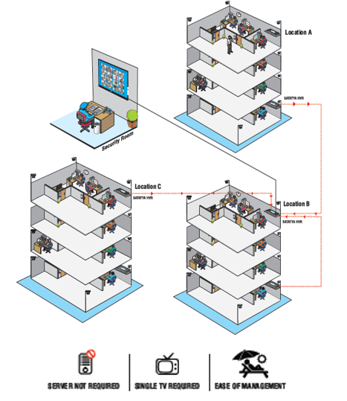
Centralized Monitoring
Easy Centralized Monitoring of Multiple Cameras, Ease of Management
Cascading, Sequencing and Camera Grouping, E-map

Slide 24
Optimized Storage
Reduce Storage Requirement by up to 50%, Get Higher Storage Days
Adaptive Recording, Camera-wise Recording Retention

Slide 25
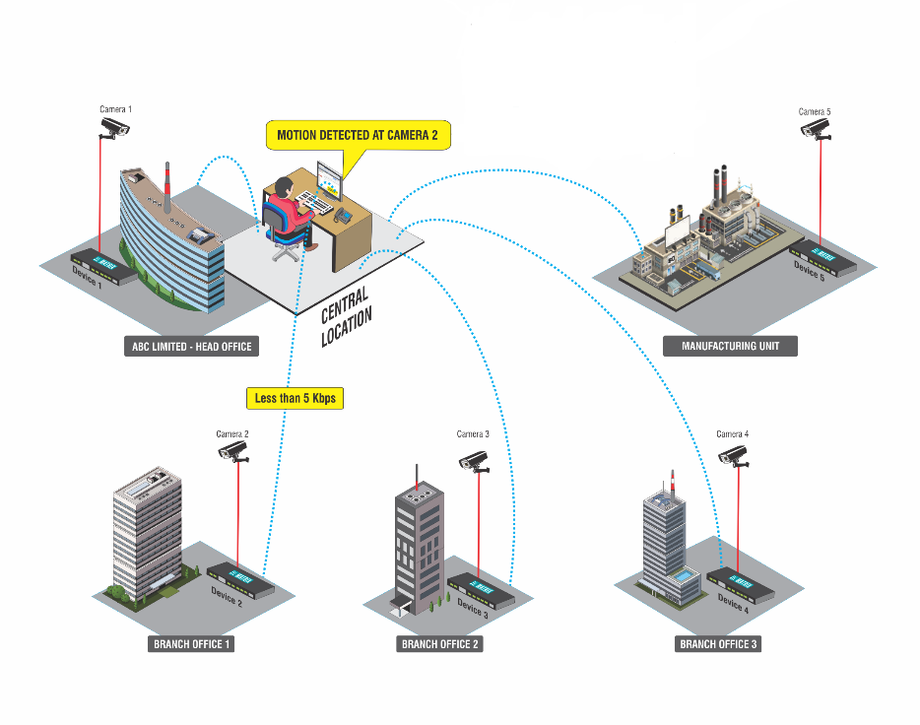
Centralized Control
Greater Control of Multiple Cameras Spread Across Multiple Locations
TCP Based Notifications, Device Monitor, User-based Roles and Rights

Slide 26
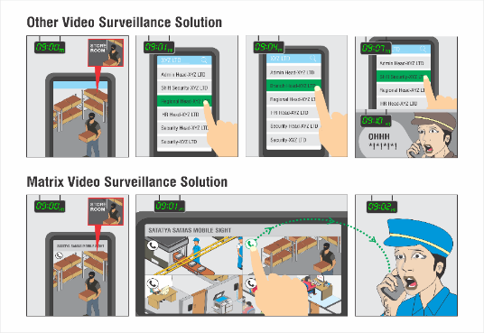
Instant Notifications
Proactive Solution, Reactive Security, Notifies the Right Person at the Right Time
Calling from Mobile App, Email with Snapshot, SMS, Audio Alarms, Buzzers, etc.

Slide 27
Integrated Solution
Eliminate Unauthorized Access, Quick Search of Records
Integration with Access Control

Slide 28
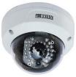


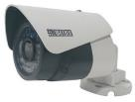

Product Range: Cameras
Dome
PTZ
1.3 MP
2 MP Varifocal
Bullet
2 MP
1.3 MP
2 MP Varifocal

Slide 29
Summary
PROBLEMS
FEATURES
BENEFITS
Lack of
Visibility
Edge Recording with Notification at Central Location
Centralized
Visibility
Lack of
Control
TCP based notifications, Health status monitoring, User-based Roles & Rights
Centralized
Control
Complex
Monitoring
Cascading, Sequencing & Camera Grouping Daily Highlights, Multi display, E-map
Easy Centralized Monitoring
High Storage &
Bandwidth
Adaptive recording, camera-wise recording retention, two level data compression, Multi Streaming, CBR/VBR, No Public IP, Cascading
Optimized Bandwidth & Storage
Disparate
Solution
Integration with Access Control, Weigh Bridge, POS, Parking/Visitor Management, Dispatch System
Data Security
Passive
Security
Face detection, Motion & No Motion Detection, Trip-wire, Missing Object, Intrusion, Loitering, Calling from Mobile, SMS, Email with Snapshot, Video Pop-up, alarm & Buzzer
Proactive Solution
Inefficiency &
Underutilization
Crowd Management, Parking Management
Improved Productivity
Loss of Data
Redundancy, SSL Communication
Data Security

Slide 30
Customer List

Slide 31







Customer List
Customers | Logo
DOMESTIC
Indian Railways
Indian Airforce
Taj Group
Godrej
Customers | Logo
INTERNATIONAL
Qatar Engineering & Construction Company(Oil & Gas EPC and Maintenance Contractor)
NICO International
Bahrain Stock Exchange
Kingston

Slide 32
Case Study: BTI Payments
Requirement
Centralized Management with Limited Bandwidth of 32Kbps at Remote Locations
Reduction in the cost of public IP, because of installation of devices and cameras at 200+ remote locations across India
Solution
TCP Based Notifications
Edge Recording
Device Initiation
Description
TCP Based Notification was installed to obtain Notifications on a Central Server
This Device Monitor takes < 5kbps Bandwidth to Communicate
Alerts on Device/Camera Disc, Motion/Sensor Alerts
Alerts on Hard disk Error, Recording Stop
Pre and Post event based clips sent at central location on occurrence of any event with Edge Recording
Device initiation eliminated the need for static public IP at each location thereby saving on the recurring cost of Public IP(AED 3000x200 = AED600000 per year)

Slide 33
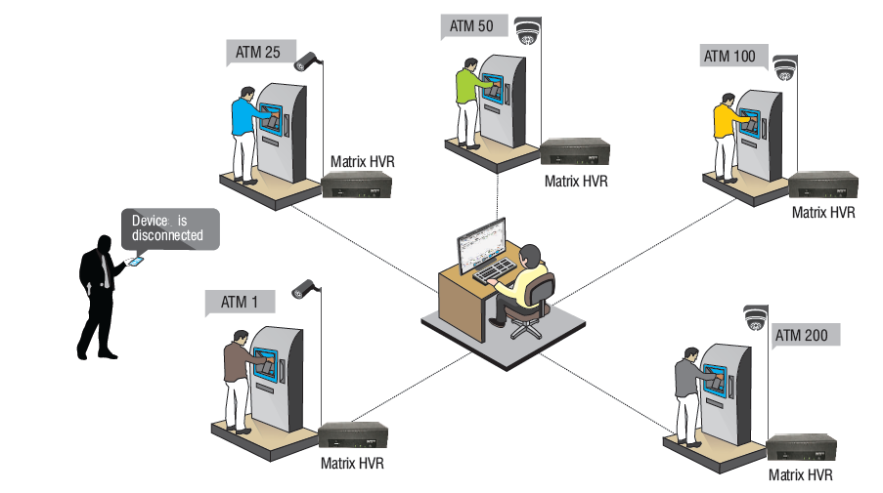

Slide 34
Thank You

