Slide 1


ENTERPRISE
IP VIDEO SURVEILLANCE SOLUTIONS

Slide 2

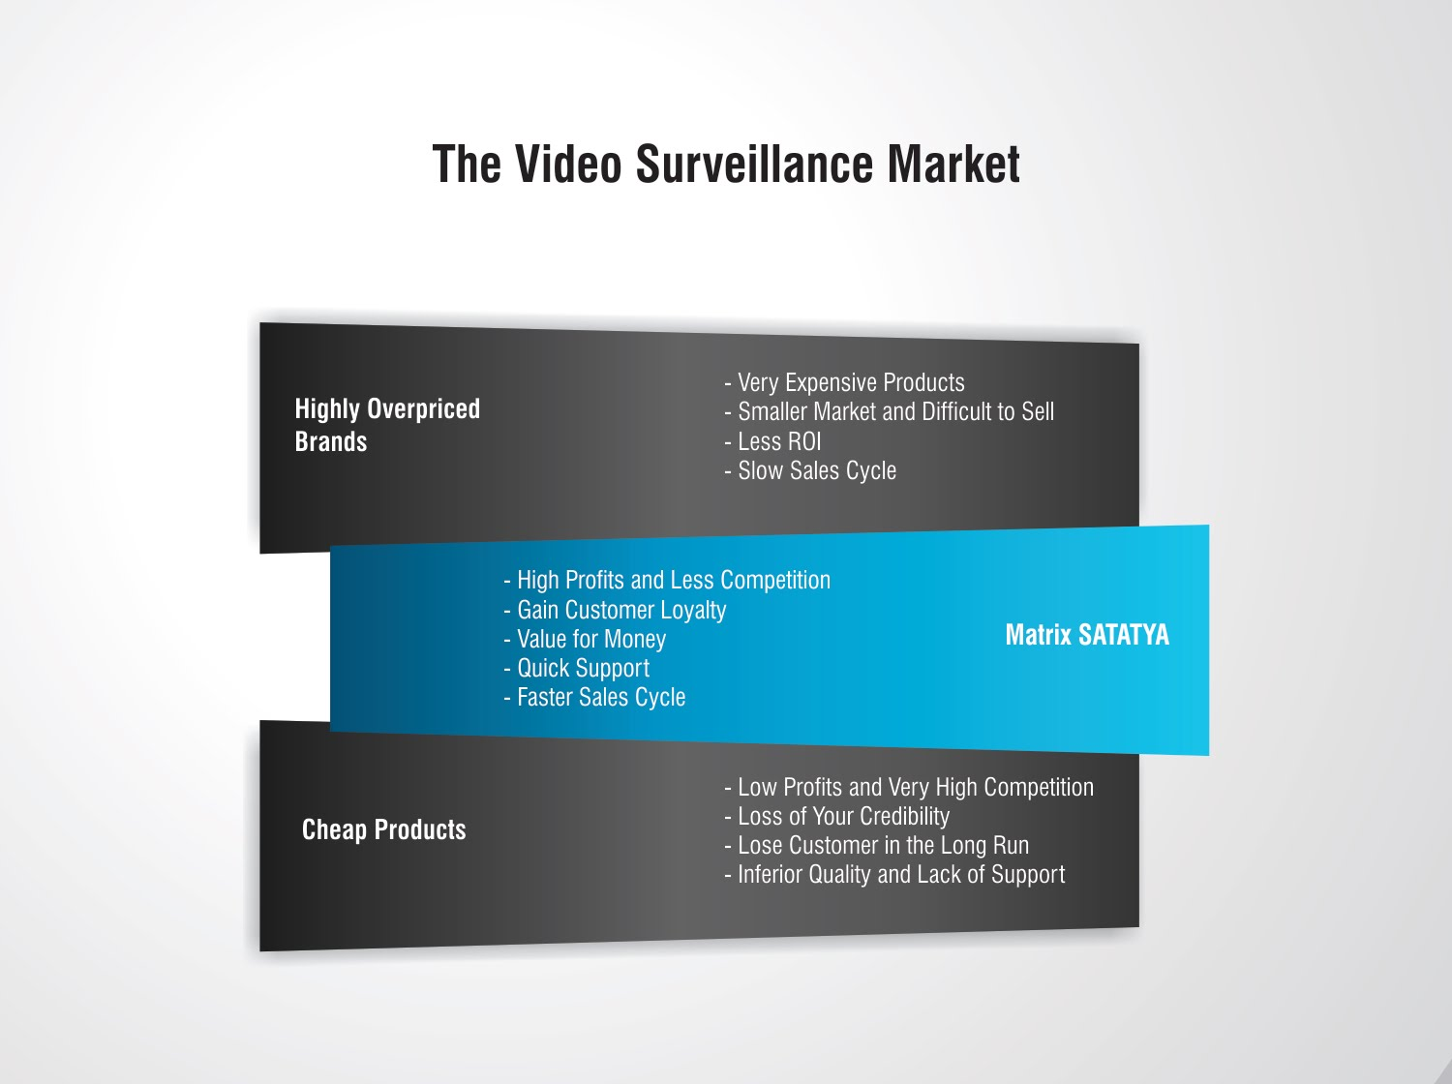

THE VIDEO SURVEILLANCE MARKET
Very Expensive Products
Smaller Market and Difficult to Sell
Slow Sales Cycle
Brand over Product Performance
Overpriced Brands
High Profits and Less Competition
Gain Customer Loyalty
Value for Money
Quick Support
Faster Sales Cycle
Matrix SATATYA
Low Profits and Very High Competition
Loss of Your Credibility
Lose Customer in the Long Run
Inferior Quality and Lack of Support
Cheap Products

Slide 3


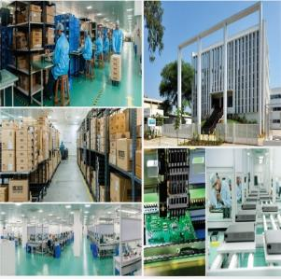
ABOUT MATRIX
Established in 1991
Products: 60+
Telecom and Security Solutions
Global Presence: 40+ Countries
Multi-location Installations with: 500+ Channel Partners
No of Employees: 500+
Awards and Achievements: 25+
for Excellence in Product Engineering,
Design and Innovation
www.MatrixComSec.com
R&D CENTER
77,000 Sq.Ft
More than 40% Manpower in R&D, 700+ Man-years of R&D Experience
World-class Technology Platform and Processes
CORPORATE OFFICE
Based at Vadodara, Gujarat, India
Departments: Marketing, Sales, Product Management, Support, Finance,
Customer Care, Purchase
MANUFACTURING UNIT
73,000 Sq.Ft
100+ Work Stations
International Quality Systems and Processes

Slide 4

MATRIX SATATYA PRODUCT RANGE

Slide 5
PRODUCT RANGE
MATRIX SATATYA
Hardware
Software
Video Management Software
IP Cameras
Network Video Recorders
Centralized Management Software
Device/Web Client
Mobile Client

Slide 6
SAMAS VARIANTS
CATEGORY | SATATYA SAMAS PLATFORM
 | GE | ME | LE
Inbuilt Cameras | 20 | 50 | 200
Maximum Camera Supported | 100 | 250 | 100000
Inbuilt Simultaneous Users | 2 | 5 | 5
Maximum Simultaneous Users | 1000 | 1000 | 1000
Maximum Number of Cameras per Server | 255 | 255 | 255
Devices per Management Server | 10000 | 10000 | 10000
SAMAS MODULES
1. Intelligent Video Analytics | 2. Multi display | 3. Parking Management | 4. Access Control Integration

Slide 7


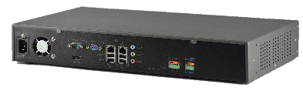
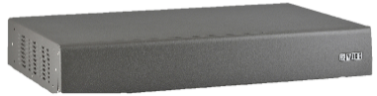
NETWORK VIDEO RECORDERS VARIANTS
NVR Standard
NVR8S
NVR64S
NVR8S
Rear
NVR8S
Front
NVR Premium
NVR24P
NVR64P
NVR64P
Rear
NVR64P
Front

Slide 8
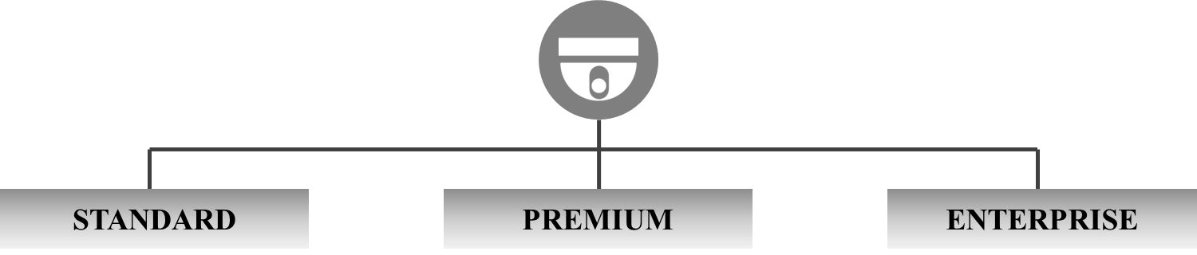

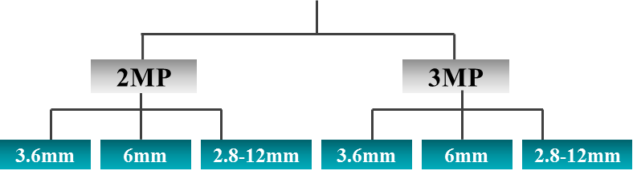
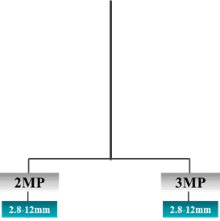
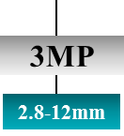
BULLET CAMERA VARIANTS
Motorized Varifocal
Wi-Fi
Manual Varifocal
Manual Varifocal
Motorized Varifocal

Slide 9
DOME CAMERA VARIANTS
4.3-129mm
Manual Varifocal
Manual Varifocal
Motorized Varifocal
Wi-Fi
PTZ Camera
Motorized Varifocal

Slide 10

MATRIX SATATYA USP

Slide 11




SATATYA SAMAS BENEFITS
Scalable: 1,00,000 Cameras, 10,000 Devices, 1,000 Recording Servers
Distributed Architecture: Simultaneous Local & Central Monitoring
with no License required for Recording Server
Flexibility: Cam-wise User Login Roles & Rights, Both IP & Analog
Camera Support and Direct Camera Connection Support
Interoperability: Supports all ONVIF and RTSP compliant cameras.
Web API for third party Integration.

Slide 12
DEPLOYMENTS

Slide 13
DEPLOYMENTS

Slide 14
SATATYA SAMAS USP

Slide 15
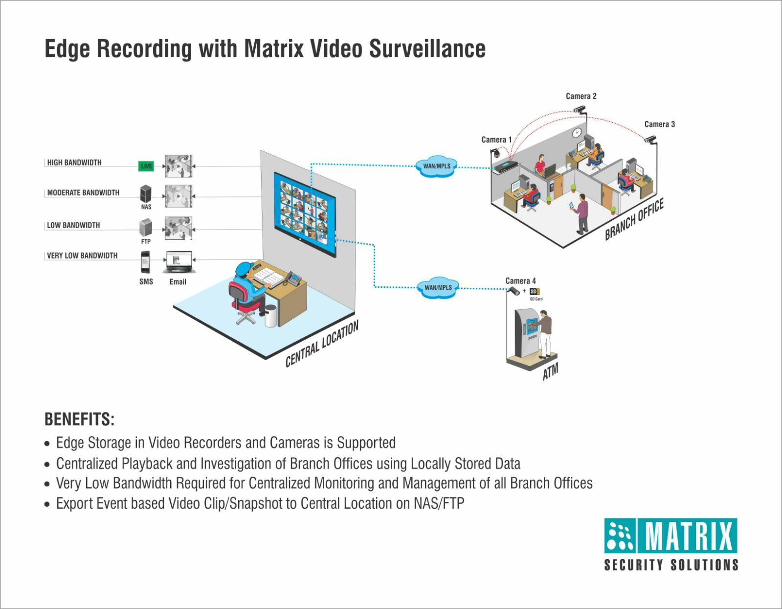
CENTRALIZED VISIBILITY
Greater Visibility across Multiple Locations, Easy Centralized Management and Monitoring
Edge Recording with Notification at Central Location

Slide 16
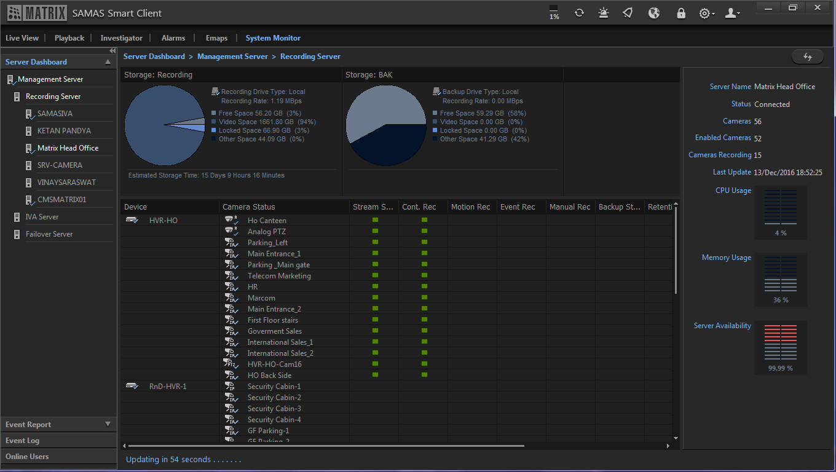
CENTRALIZED CONTROL
Greater Control over Functioning of Multiple Cameras Spread Across Multiple Locations
Health Status Report, User-based Roles and Rights, Summary Report

Slide 17
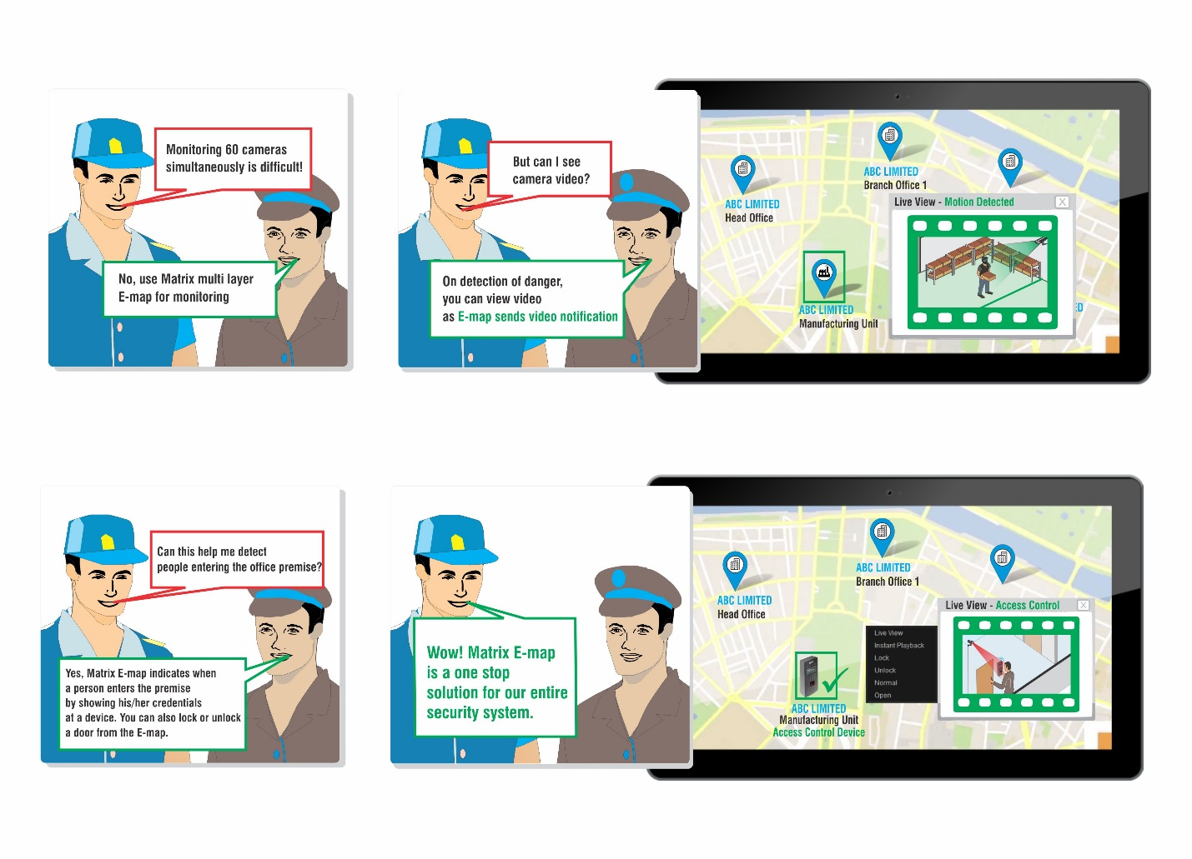
EASE OF MONITORING
Easy Centralized Monitoring, Easy Viewing of Multiple Cameras on a Single Screen
E-map, Multi-display, Daily Highlights

Slide 18

INSTANT NOTIFICATIONS
Proactive Solution, Reactive Security, Notifies the Right Person at the Right Time
Video Pop-up, Email with Snapshot, SMS, Audio Alarms, Buzzers, etc.

Slide 19
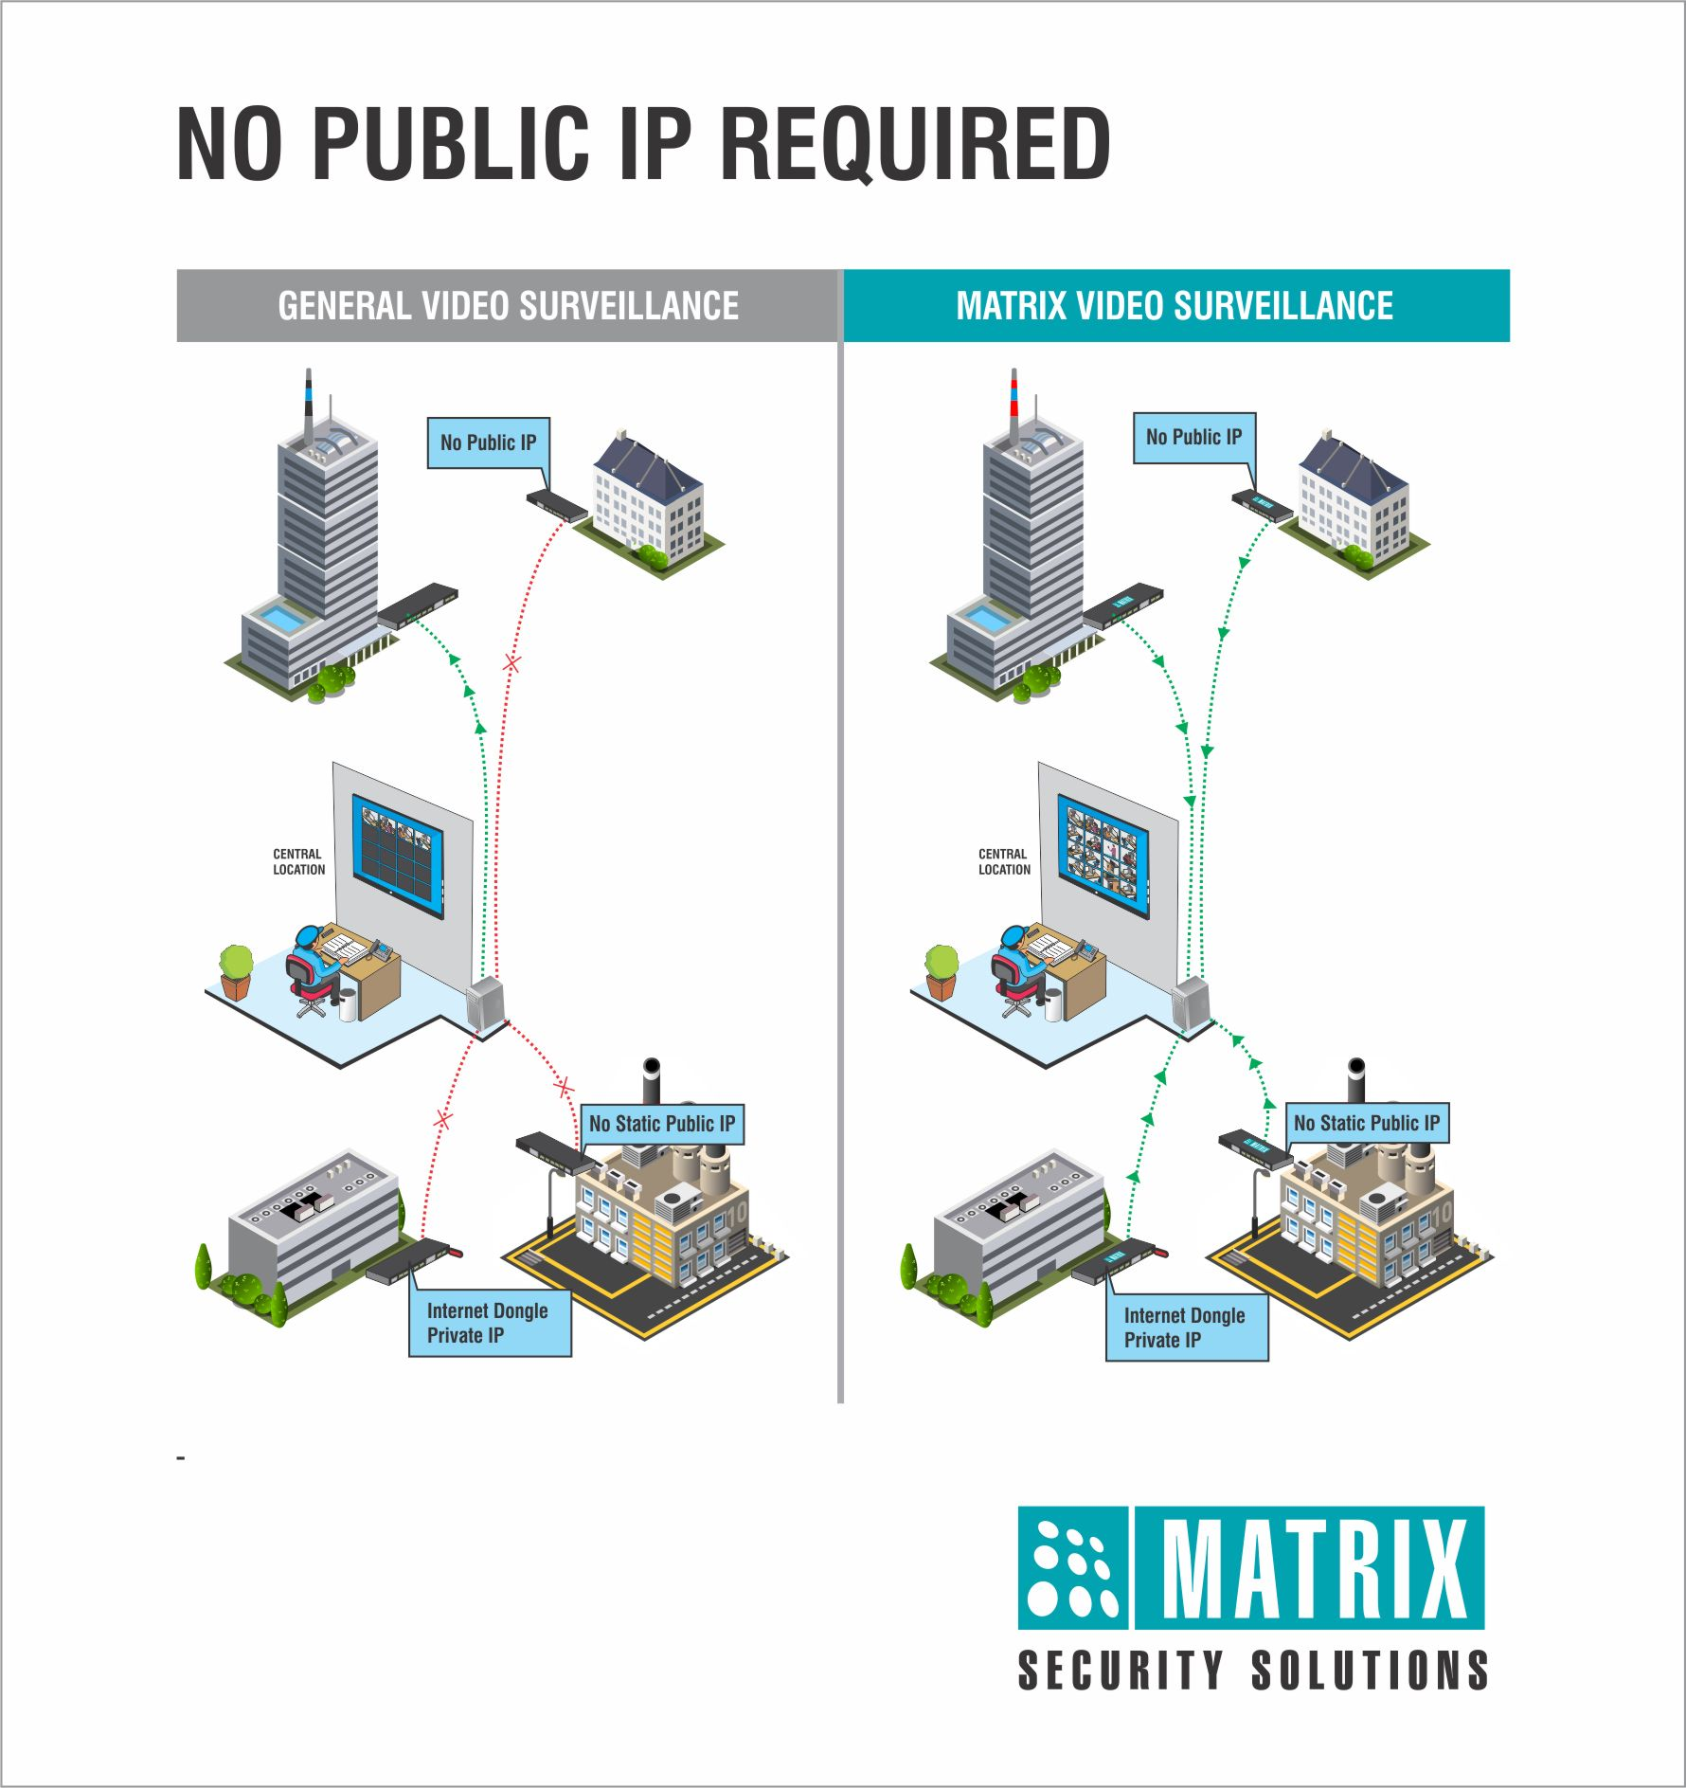
OPTIMIZED BANDWIDTH
Reduce Recurring Cost of Bandwidth, No Public IP Required
Device Initiation, Adaptive Recording, Configurable Bit-rate

Slide 20
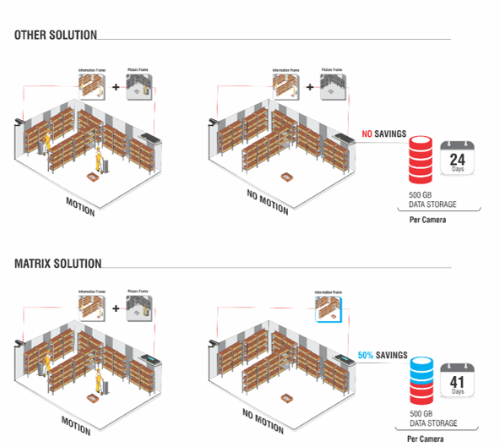
OPTIMIZED STORAGE
Reduce Storage Requirement by up to 50%, Get Higher Storage Days
Adaptive Recording, Camera-wise Recording Retention, Two Level Data Compression & Archiving

Slide 21
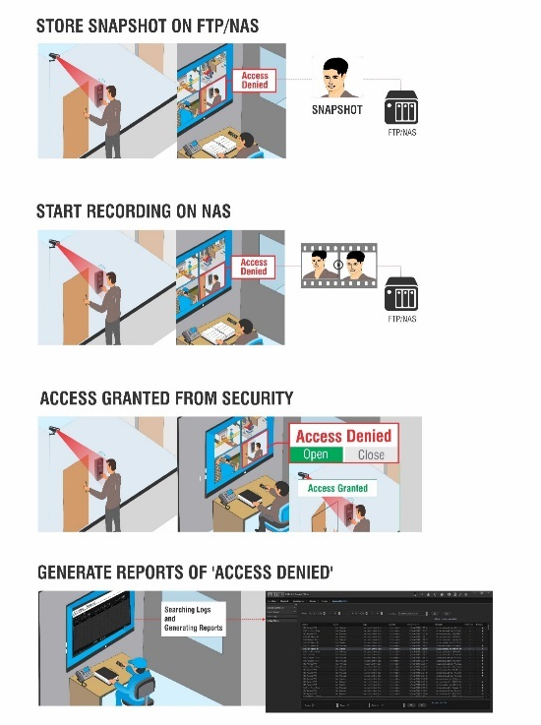
INTEGRATED SECURITY
Synchronous Functioning, Prevent Unauthorized Access, Quick Search of Records, Bookmark Evidence Clips
Integration with Access Control, Fire alarms and other Sensors

Slide 22
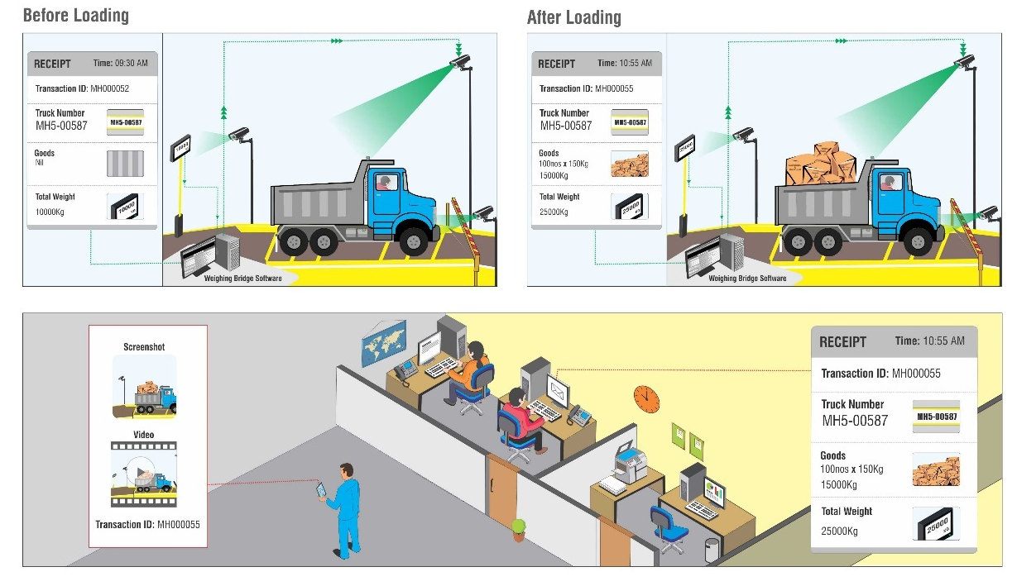
PROCESS AUTOMATION
Synchronous Functioning, Automate System, Eliminate Manipulation, Quick Search of Records
Integration with Weigh Bridge, POS, Dispatch System, Visitor Management, etc.

Slide 23
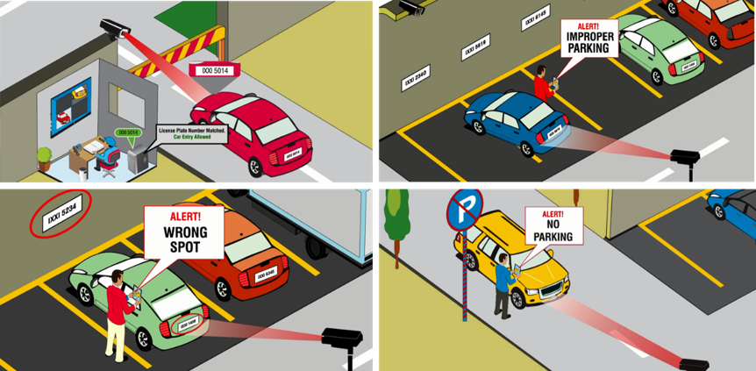
PARKING MANAGEMENT
Parking Space Optimization, Automate Parking
License Plate Recognition with Blacklist and Whitelist, Vehicle Counting, Unauthorized Parking, Improper Parking, Wrong Way Parking and Prohibited Parking

Slide 24

CROWD MANAGEMENT
Occupancy Control, Easy Crowd Management, Employee Safety, Avoid Tail-gating
Face Detection, People Counting, Tail-gating Detection and Loitering

Slide 25

PERIMETER SECURITY
24x7 Security of Outdoor Properties, Secure Premises, Asset Protection
Intrusion Detection, Trip Wire, Missing Object Detection and Tail-gating

Slide 26
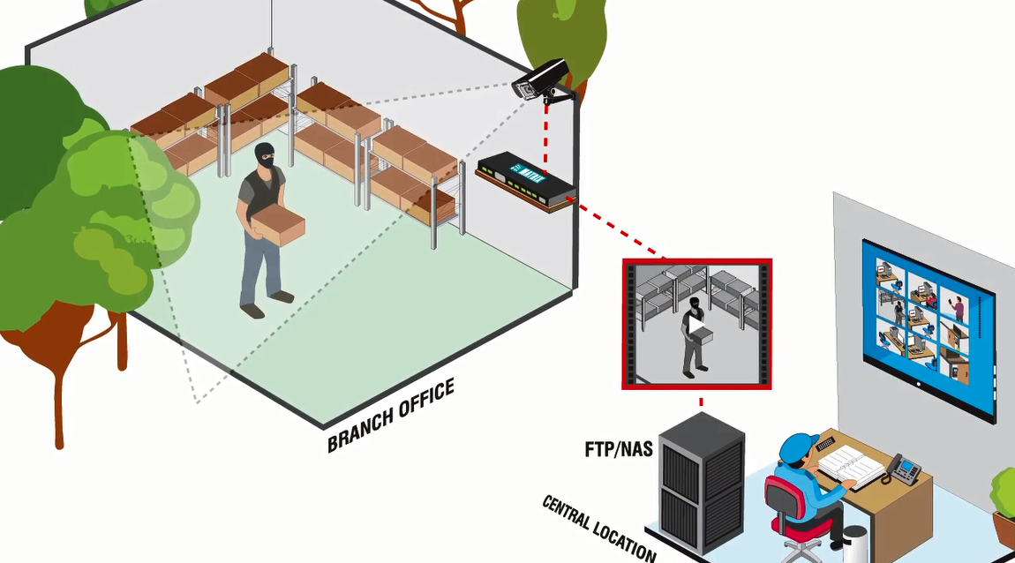
DATA SECURITY
Safeguard Data Against Breakdowns, Safeguard Evidence
Backup over NAS/FTP, Redundant Server, Evidence Lock, Clip Export and SSL Communication

Slide 27
VIDEO RECORDERS USP

Slide 28



MATRIX SATATYA VIDEO RECORDERS BENEFITS
Recording Resolution: Up to 5MP
Throughput: 48Mbps to 354Mbps(Depending on the number of
channels)
Storage Capability: 6TB-24TB(Depending on the number of channels)
Interoperability: Supports all ONVIF or RTSP compliant cameras

Slide 29
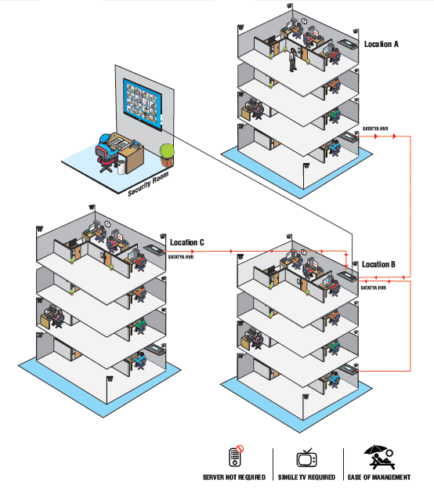
CENTRALIZED MONITORING
Easy Centralized Monitoring of Multiple Cameras, Ease of Management
Cascading, Sequencing and Camera Grouping, E-map

Slide 30
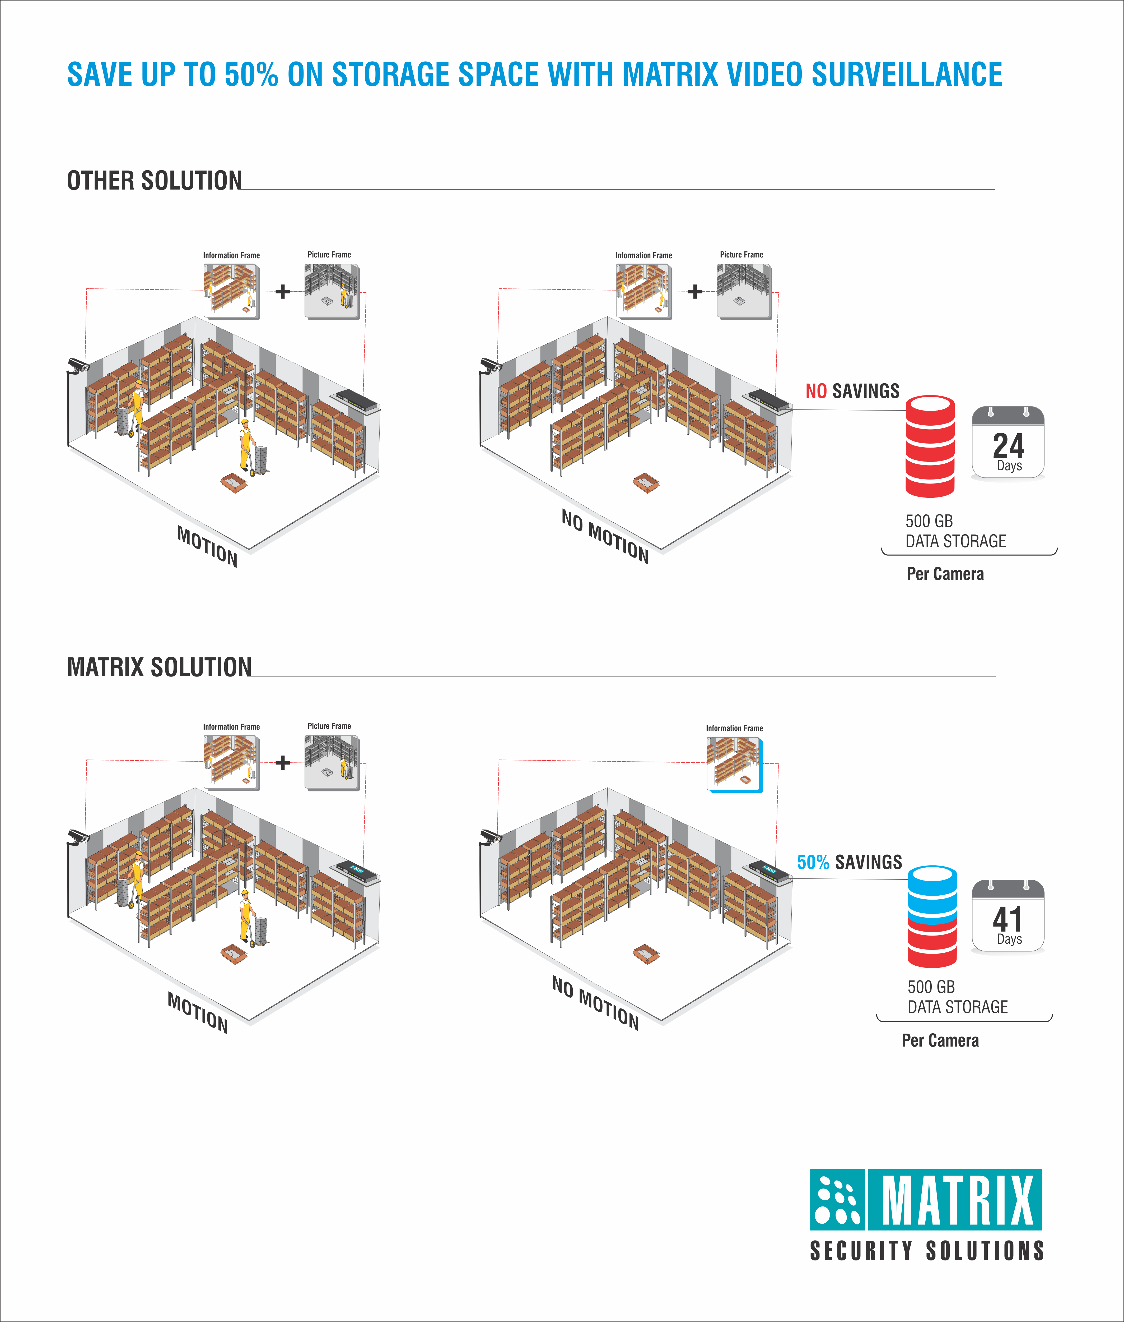
OPTIMIZED STORAGE
Reduce Storage Requirement by up to 50%, Get Higher Storage Days
Adaptive Recording, Camera-wise Recording Retention, Two Level Data Compression & Archiving

Slide 31

CENTRALIZED CONTROL
Greater Control of Multiple Cameras Spread Across Multiple Locations
TCP Based Notifications, Device Monitor, User-based Roles and Rights

Slide 32
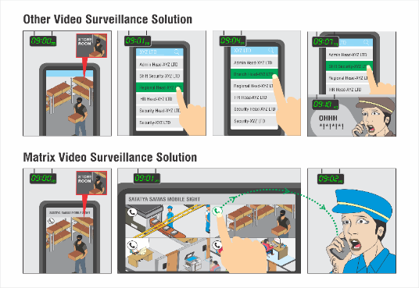
INSTANT NOTIFICATIONS
Proactive Solution, Reactive Security, Notifies the Right Person at the Right Time
Calling from Mobile App, Email with Snapshot, SMS, Audio Alarms, Buzzers, etc.

Slide 33
INTEGRATED SOLUTION
Eliminate Unauthorized Access, Quick Search of Records
Integration with Access Control

Slide 34
IP CAMERAS USP

Slide 35
MATRIX SATATYA IP CAMERAS BENEFITS
Superior Image Quality: Back-illuminated SONY Sensors of STARVIS Series with EXMOR Technology
Push Technology: Camera initiating connection eliminates the cost of Public IP
Storage and Bandwidth Optimization: Smart features like Adaptive Streaming, Quad Stream Support and ROI helps in saving huge bandwidth and storage
Preventive Security: Early detection and instant notifications of
suspicious events

Slide 36
CONNECTIVITY
1. Push Technology: In push technology, communication with the server is initiated from camera’s end, which reduces load on the server and helps in interrupted network connection (In other traditional devices server has to poll at regular interval which increases server load at great extent).
Whenever devices are connected in multi locations, public IP is required only at Server End. This makes multi-location deployment of devices very easy, cost effective and time bound. Push technology reduces server load using limited socket connections as per requirement with poll.
2. Two-way Audio: A mic and a speaker is attached/connected with the camera at the audio-in and out ports respectively and two way functioning can be performed.

Slide 37
IMAGE QUALITY
1. SONY STARVIS series sensors: The sensor is made with SONY’s patent EXMOR Technology wherein the sensor is back-illuminated, which results in less dark current thereby giving exceptionally good color image reproduction at as low as 0.02lux.
2. True WDR: The camera smartly varies its exposure time and rectifies the over-exposed and under-exposed areas in the scene thus giving more informative and clear image.
3. 2D and 3D Noise Reduction Technique: Analyzes frames of video, using special algorithm filter to mitigate the effects of noise. This noise reduction can not only improve the image quality when security cameras work in low light conditions, but also reduce the file sizes of captured video, the reduced file size decreases storage needs, also reduce the bandwidth requirement for video streaming.
4. E-PTZ and Digital zoom functionality: E-PTZ enables pan, tilt and zoom of a camera even though the camera does not physically move. Users are still able to digitally zoom and navigate the camera’s viewable area. This helps users to have an even more detailed and richer surveillance experience.

Slide 38
OPTIMIZATION
1. Adaptive Streaming: Records at lower bit-rate during non-activity period.
2. Smart Streaming: Streaming is a technology which divides a single stream into multiple resolutions based on its importance.
3. Region of Interest: Allows streaming and recording of only critical from the entire image.
4. Four Stream Support: Different streams for viewing storing and recording. This helps in best utilization of allotted bandwidth.
5. H.265: Latest Video Compression Technique
6. SD Card Support: up to 64GB

Slide 39
EVENTS AND ALERTS
EVENTS:
Motion Detection
Intrusion Detection
Trip Wire
Camera Tamper
Network Disconnect
IP Conflict
Storage Alert
ALERTS:
1. Upload Image/Clip
2. Pre and Post Alarm Recording
3. Snapshot Schedule
4. Email with Snapshot
5. SMS

Slide 40
SUMMARY
PROBLEMS
FEATURES
BENEFITS
Lack of
Visibility
Edge Recording with Notification at Central Location
Centralized
Visibility
Lack of
Control
TCP based notifications, Health status monitoring, User-based Roles & Rights
Centralized
Control
Complex
Monitoring
Cascading, Sequencing & Camera Grouping Daily Highlights, Multi display, E-map
Easy Centralized Monitoring
High Storage &
Bandwidth
Adaptive recording, camera-wise recording retention, two level data compression, Multi Streaming, CBR/VBR, No Public IP, Cascading
Optimized Bandwidth & Storage
Disparate
Solution
Integration with Access Control, Weigh Bridge, POS, Parking/Visitor Management, Dispatch System
Data Security
Passive
Security
Face detection, Motion & No Motion Detection, Trip-wire, Missing Object, Intrusion, Loitering, Calling from Mobile, SMS, Email with Snapshot, Video Pop-up, alarm & Buzzer
Proactive Solution
Inefficiency &
Underutilization
Crowd Management, Parking Management
Improved Productivity
Loss of Data
Redundancy, SSL Communication
Data Security

Slide 41

Success Stories
ENTERPRISES WHICH SECURED ITS BUSINESS THROUGH MATRIX IP VIDEO SURVEILLANCE

Slide 42
BTI PAYMENTS
  Requirement
Centralized Management with Limited Bandwidth of 32Kbps at Remote Locations
Reduction in the cost of public IP, because of installation of devices and cameras at 200+ remote locations across India
  Solution
TCP Based Notifications
Edge Recording
Device Initiation
  Description
TCP Based Notification was installed to obtain Notifications on a Central Server
    This Device Monitor takes < 5kbps Bandwidth to Communicate
      Alerts on Device/Camera Disc, Motion/Sensor Alerts
      Alerts on Hard disk Error, Recording Stop
Pre and Post event based clips sent at central location on occurrence of any event with Edge Recording
Device initiation eliminated the need for static public IP at each location thereby saving on the recurring cost of Public IP(AED 3000x200 = AED600000 per year)

Slide 43
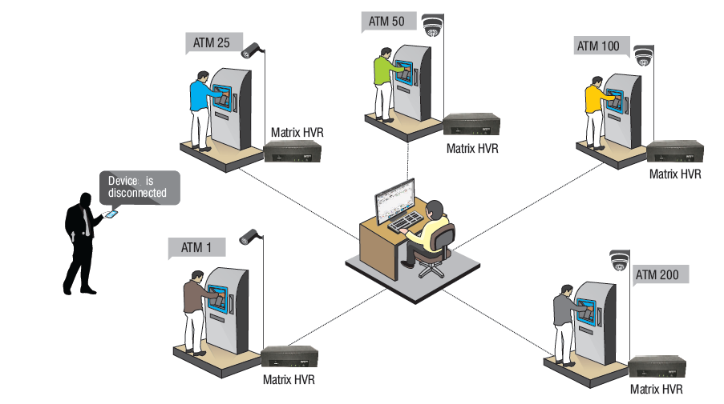

Slide 44

CUSTOMER LIST
Notes:
Add video of investigator and e-map

Slide 45





A FEW CUSTOMERS

Slide 46





A FEW CUSTOMERS

Slide 47






A FEW CUSTOMERS

Slide 48


ADVANTAGE
MATRIX

Slide 49

MORE PROFIT
Margins as
High as
Regular
Schemes &
Discounts
40%
Sizeable
Market Area
for each
Partner
Quick ROI
with
Assistance in
Secondary
Sales

Slide 50

MORE GROWTH
Target
Market
Segment
100+
5+
Products
Launch
Every Year
MORE
GROWTH
Matrix
Partners
Have
Grown by
1000+
Least Partner
Attrition Rate
in the Industry
2%

Slide 51

MORE SUPPORT
24X7 Technical Support
Training Hours per Month
Technical, Sales and Marketing Training
Multiple Training Modes
Classroom, Webex, Chat, Videos, etc.
Brand widely Known for its Prompt Support

Slide 52

MORE MARKETING ASSISTANCE
1000+
Inquiries per Month
3
Press Coverage of Channel Partners
Interview Every Month.
500+
Largest spool of Literature and Promotional Tools
Case Studies, Videos, Product Comparisons, Emailers, etc.

Slide 53

MORE OPPORTUNITY
500,000+
Loyal Customers Base
Very High Scope for Repeat Sales
MORE
OPPORTUNITY
98% Satisfaction Level
Wider Brand Penetration

Slide 54


THANK YOU

