Slide 1


MATRIX SATATYA
IP CAMERAS

Slide 2


AGENDA
01
02
03
04
05
WHY MATRIX?
Three Dimensional Benefits: Proficient, Persistent and Preventive
CAMERA INTRODUCTION
Nomenclature, Camera Range and Camera Type
KEY FEATURES
Analytics, Storage/ Bandwidth Optimization and Superior Image Quality
TECHNICAL SPECIFICATIONS
CONTACT US

Slide 3

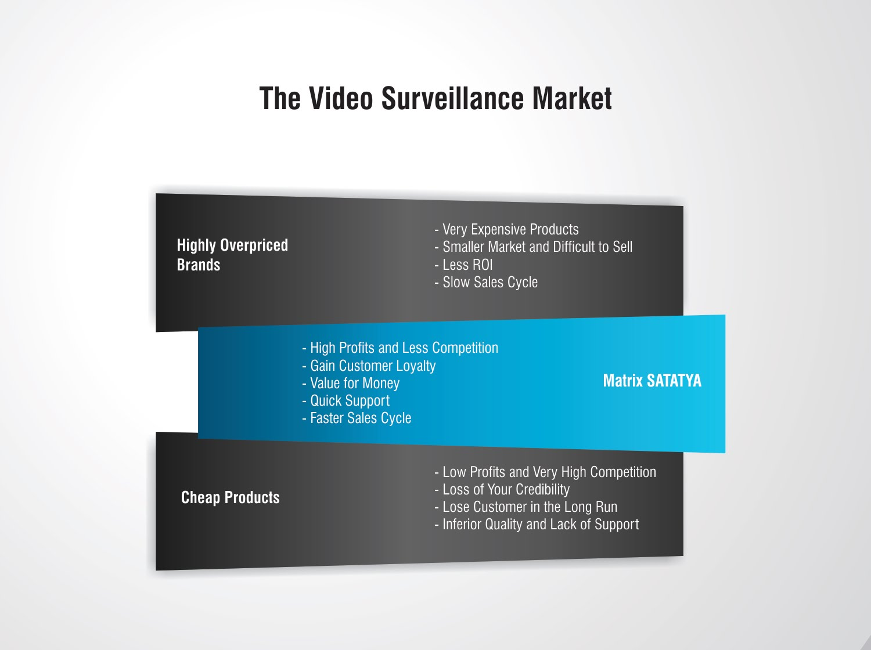
THE VIDEO SURVEILLANCE MARKET
Very Expensive Products
Smaller Market and Difficult to Sell
Slow Sales Cycle
Brand over Product Performance
Overpriced Brands
High Profits and Less Competition
Gain Customer Loyalty
Value for Money
Quick Support
Faster Sales Cycle
Matrix SATATYA
Low Profits and Very High Competition
Loss of Your Credibility
Lose Customer in the Long Run
Inferior Quality and Lack of Support
Cheap Products

Slide 4
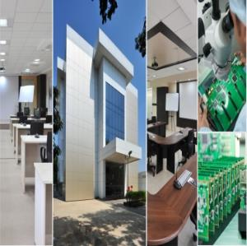

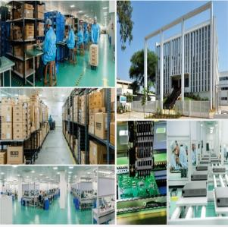
ABOUT MATRIX
Established in 1991
Products: 60+ Telecom and Security Solutions
Global Presence: 40+ Countries
Multi-location Installations with: 500+ Channel Partners
No of Employees: 500+
Awards and Achievements: 25+ for Excellence in Product Engineering,
Design and Innovation
www.MatrixComSec.com
R&D CENTER
77,000 Sq.Ft
More than 40% Manpower in R&D, 700+ Man-years of R&D Experience
World-class Technology Platform and Processes
CORPORATE OFFICE
Based at Vadodara, Gujarat, India
Departments: Marketing, Sales, Product Management, Support, Finance,
Customer Care, Purchase
MANUFACTURING UNIT
73,000 Sq.Ft
100+ Work Stations
International Quality Systems and Processes

Slide 5
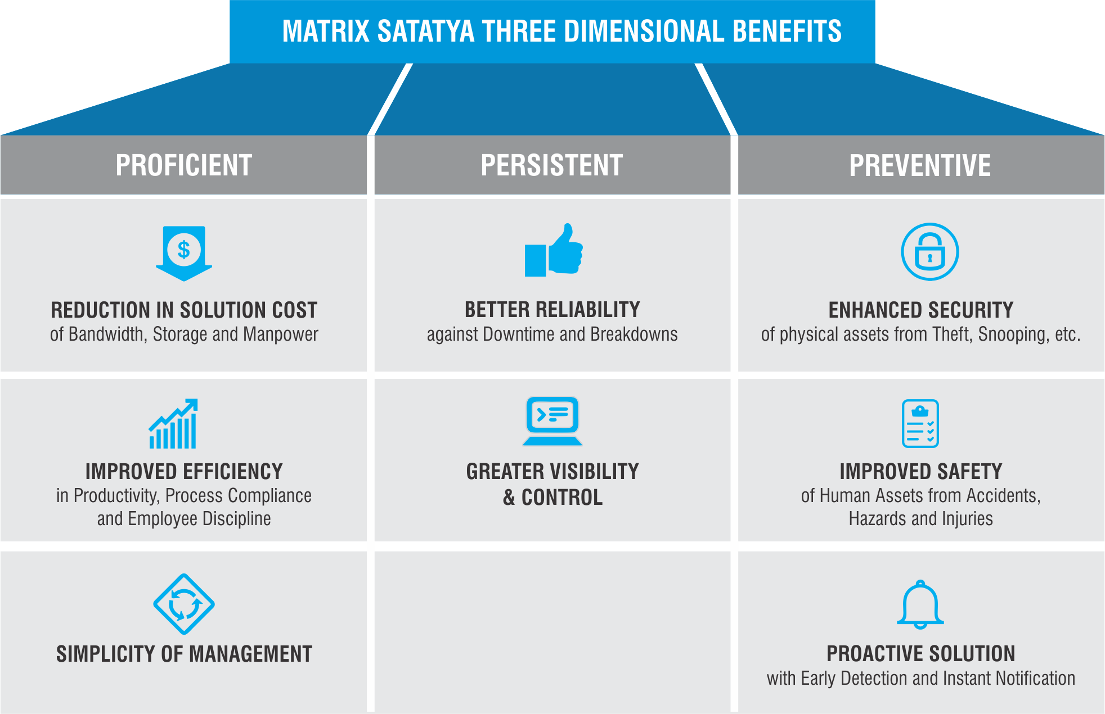
WHY MATRIX?

Slide 6
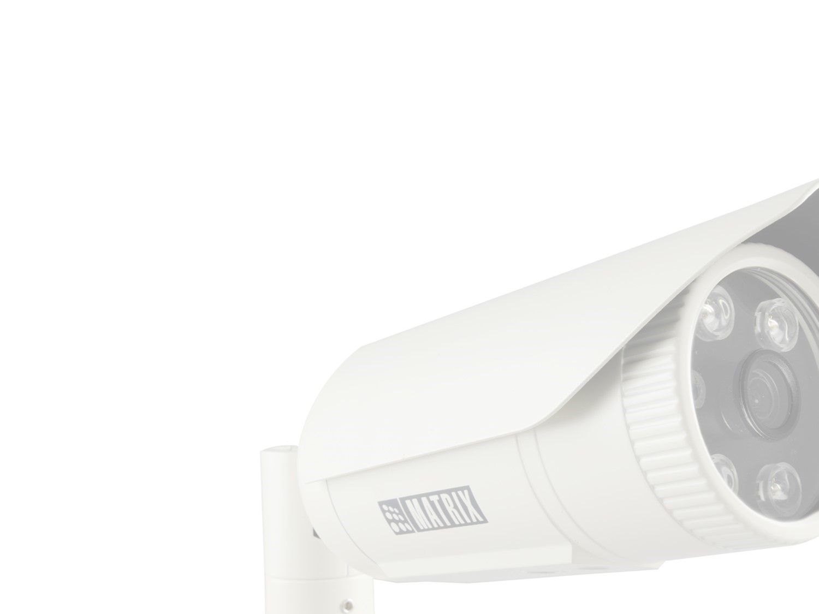
MATRIX SATATYA
CAMERA INTRODUCTION

Slide 7
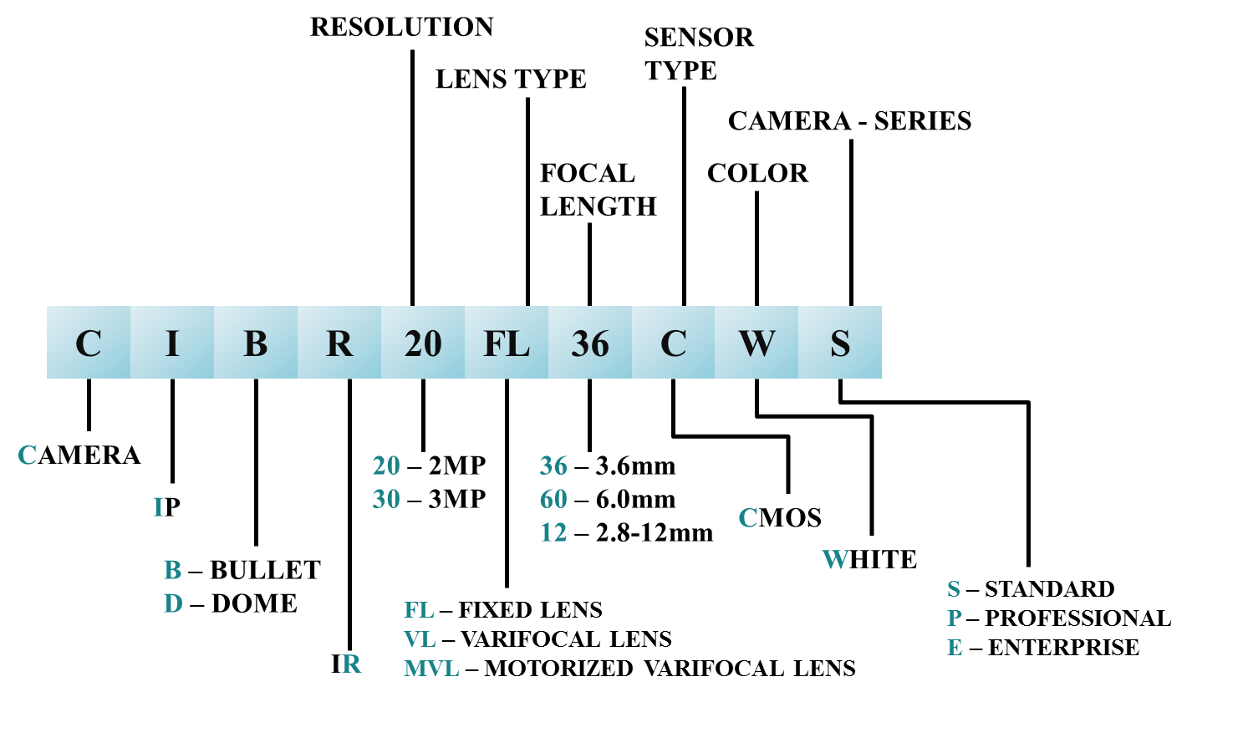
CAMERA NOMENCLATURE

Slide 8
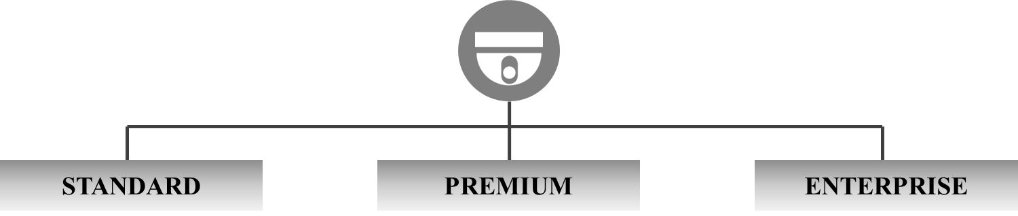

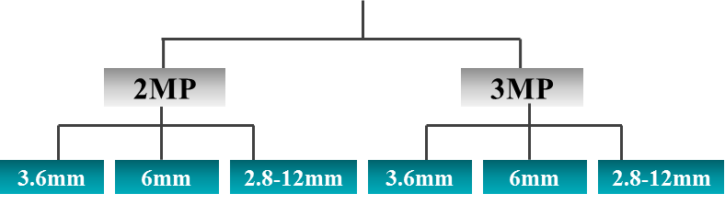
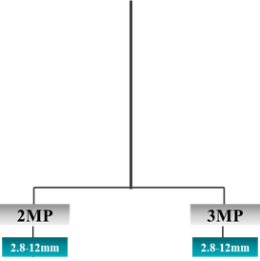
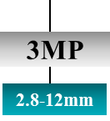
BULLET CAMERA VARIANTS
Motorized Varifocal
Wi-Fi
Manual Varifocal
Manual Varifocal
Motorized Varifocal

Slide 9
DOME CAMERA VARIANTS
4.3-129mm
Manual Varifocal
Manual Varifocal
Motorized Varifocal
Wi-Fi
PTZ Camera
Motorized Varifocal

Slide 10
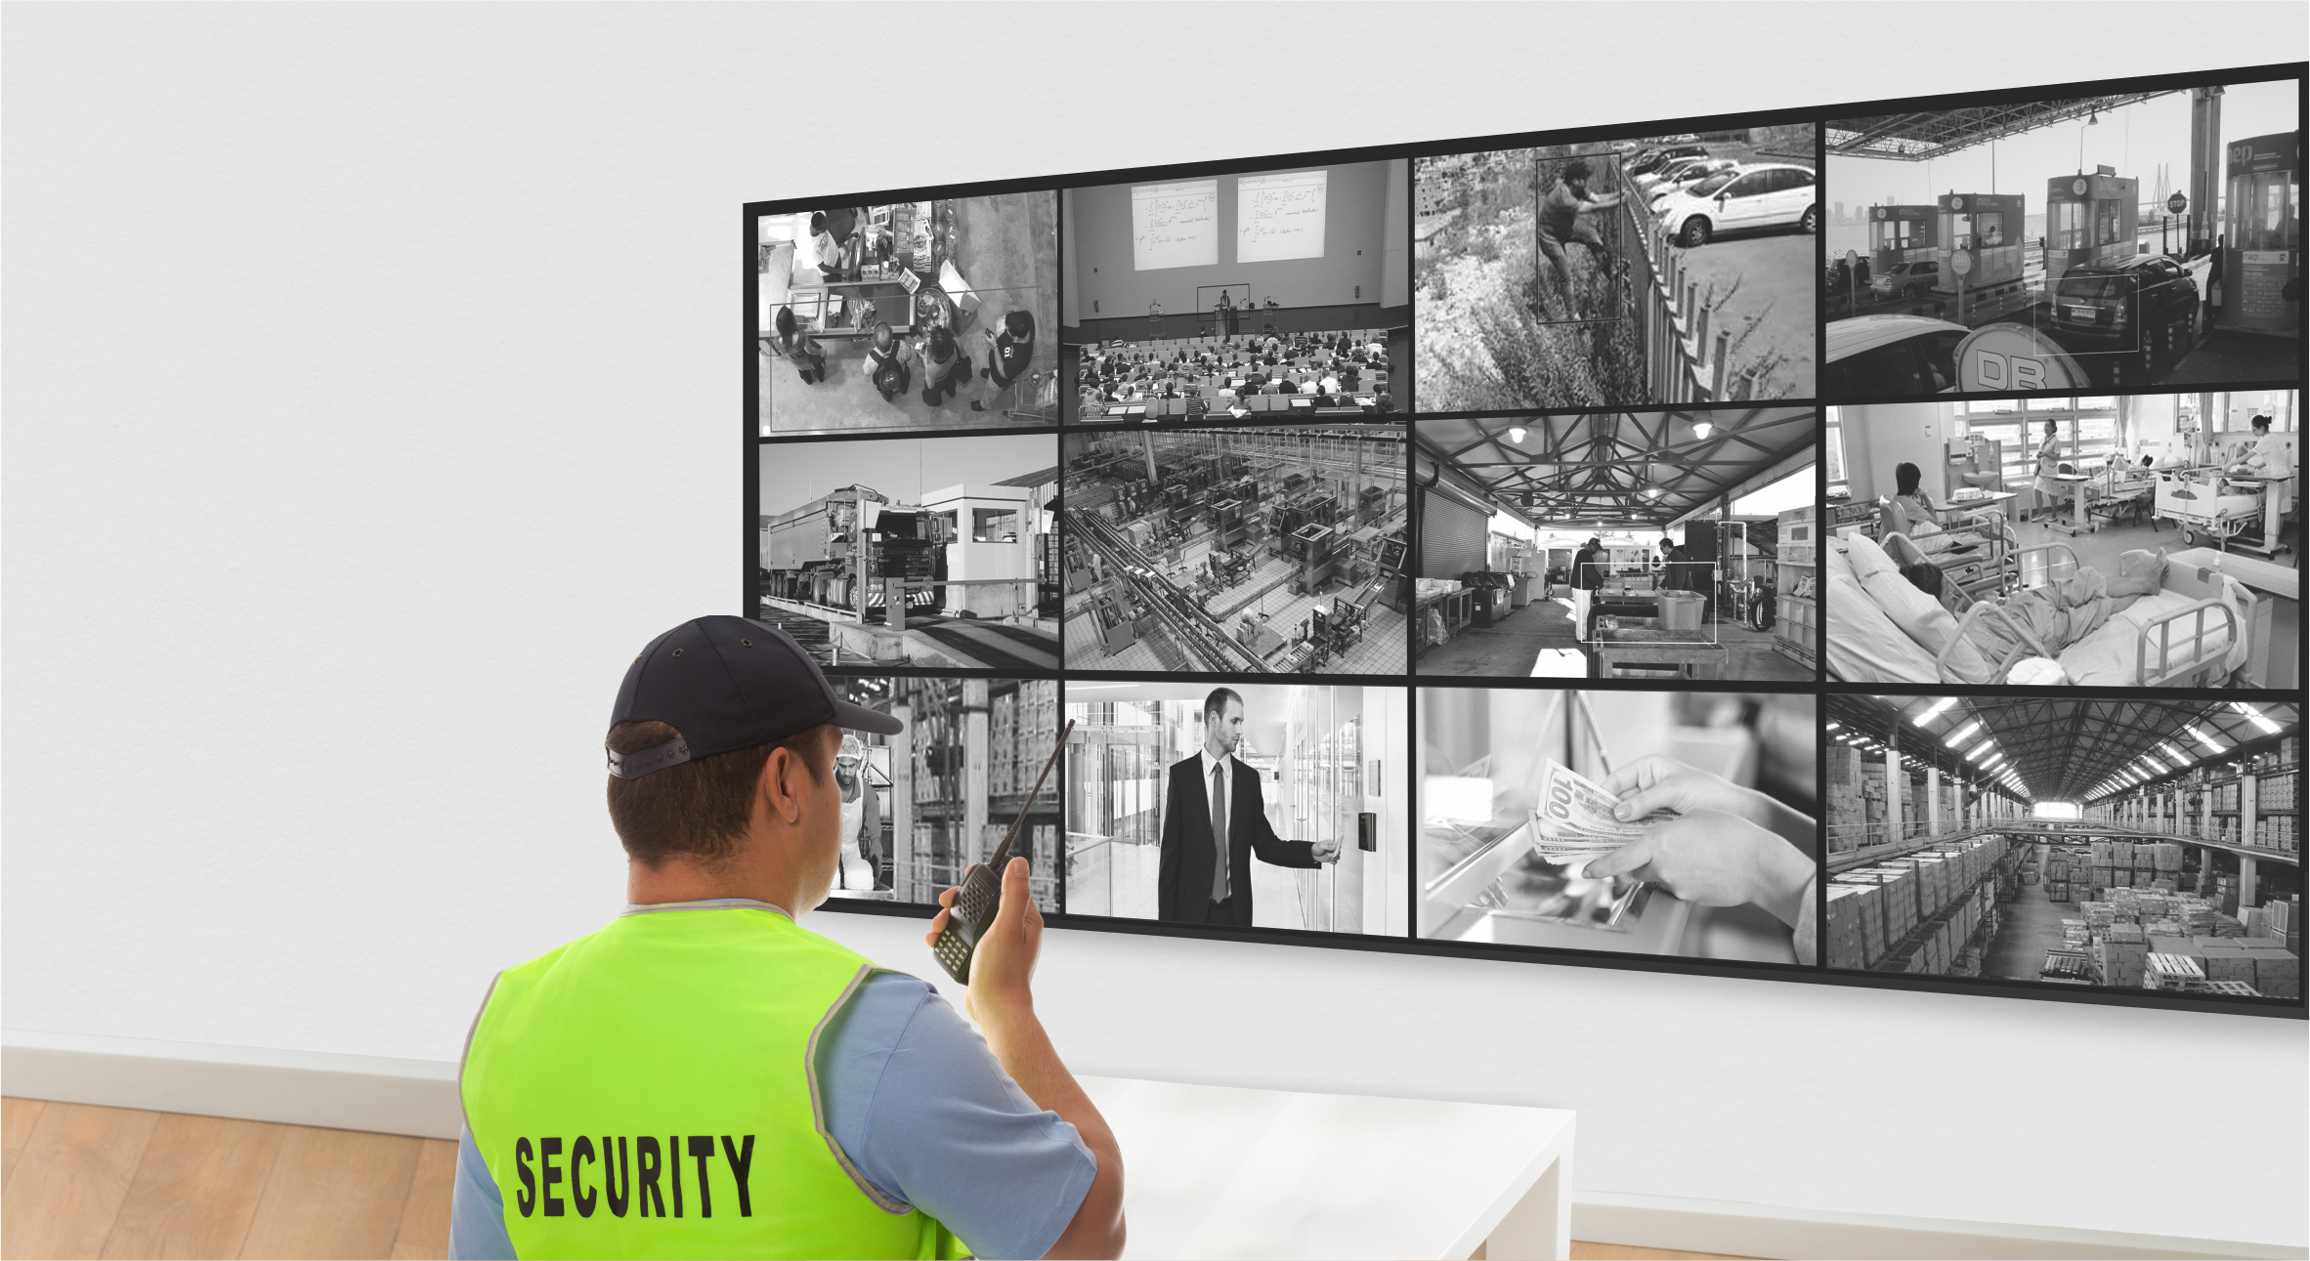
MATRIX SATATYA CAMERAS
KEY DIFFERENTIATORS

Slide 11
CONNECTIVITY
Push Technology: Communication with the server is initiated from camera’s end, which reduces load on the server and helps in uninterrupted network connection (In other traditional devices server has to poll at regular interval which increases server load at great extent)
Whenever devices are connected in multi locations, public IP is required only at server end. This makes multi-location deployment of devices very easy, cost effective and time bound. Push technology reduces server load using limited socket connections as per requirement with poll.

Slide 12
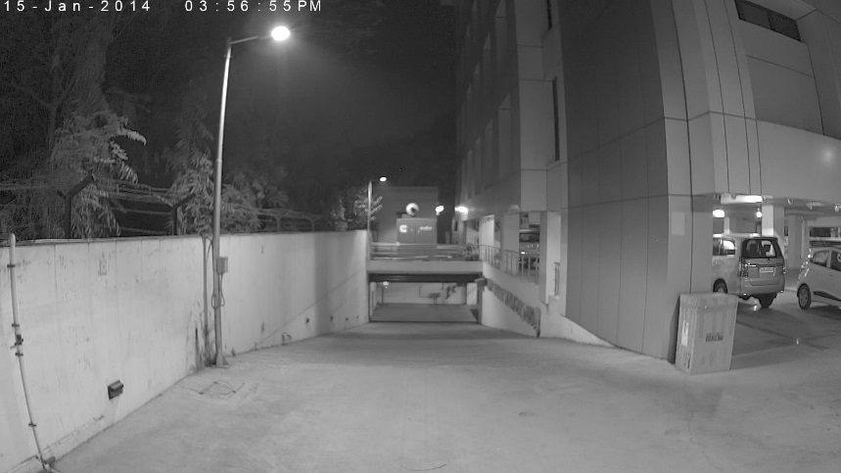
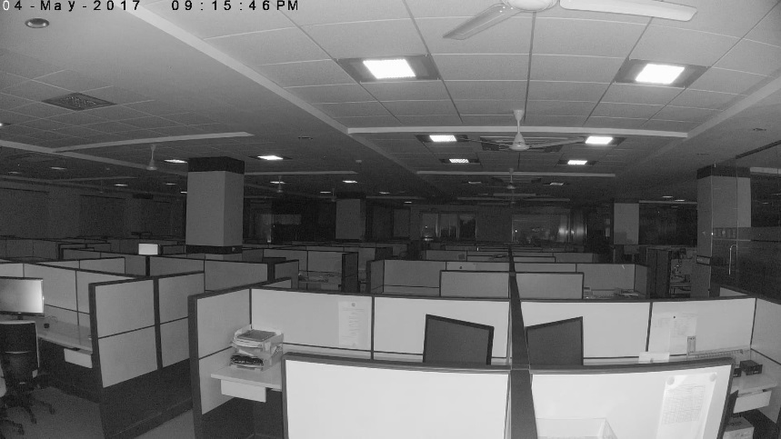
IMAGE QUALITY
1. SONY STARVIS series sensors: The sensor is made with SONY’s patent EXMOR Technology wherein the sensor is back-illuminated, which results in less dark current thereby giving exceptionally good color image reproduction at as low as 0.02lux.
Outdoor
Indoor

Slide 13
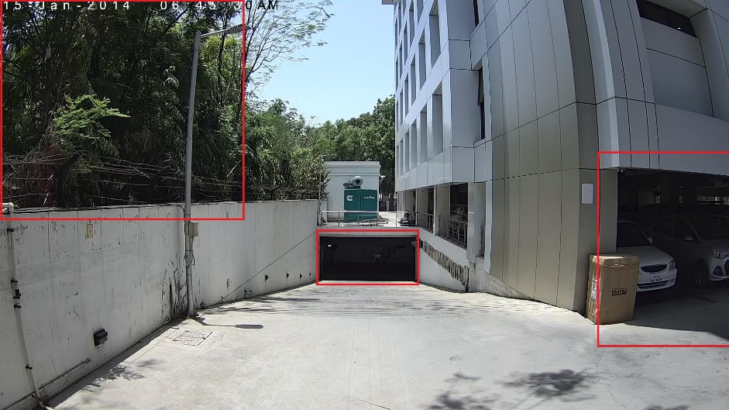
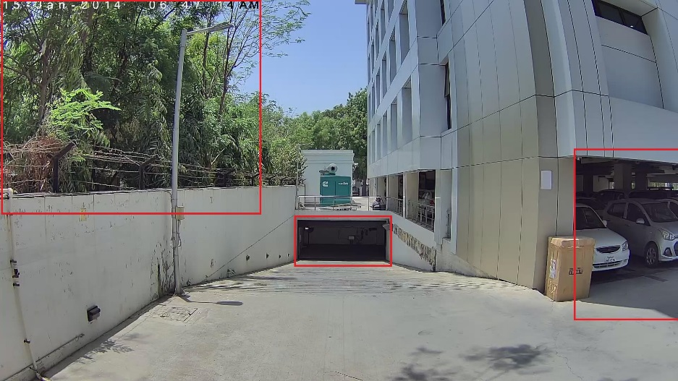

IMAGE QUALITY
2. True WDR: The camera smartly varies its exposure time and rectifies the over-exposed and under-exposed areas in the scene thus giving more informative and clear image.
WDR: OFF
WDR: ON
Double click for video

Slide 14
IMAGE QUALITY
3. 2D and 3D Noise Reduction Technique: Analyzes frames of video, using special algorithm filter to mitigate the effects of noise. In summary, the benefit of noise reduction is:
Improve image quality for better object identification
Reduced file size for lower bandwidth and storage requirements
Fewer false alarms for video motion detection
4. E-PTZ and Digital zoom functionality: E-PTZ enables pan, tilt and zoom of a camera even though the camera does not physically move. Users are still able to digitally zoom and navigate the camera’s viewable area. This helps users to have an even more detailed and richer surveillance experience.

Slide 15
OPTIMIZATION
1. Adaptive Streaming: Records at lower bit-rate during non-activity period.
2. Smart Streaming: Smart Streaming is a technology which divides a single stream into multiple resolutions based on its importance. Here only important scenes are streamed at a higher video quality and other areas of less importance are streamed at a lower resolution, thus saving on network bandwidth, as well as on storage capacity. The result is surveillance video that preserves video quality where it matters, while significantly reducing overall network bandwidth consumption.
Double click for video

Slide 16
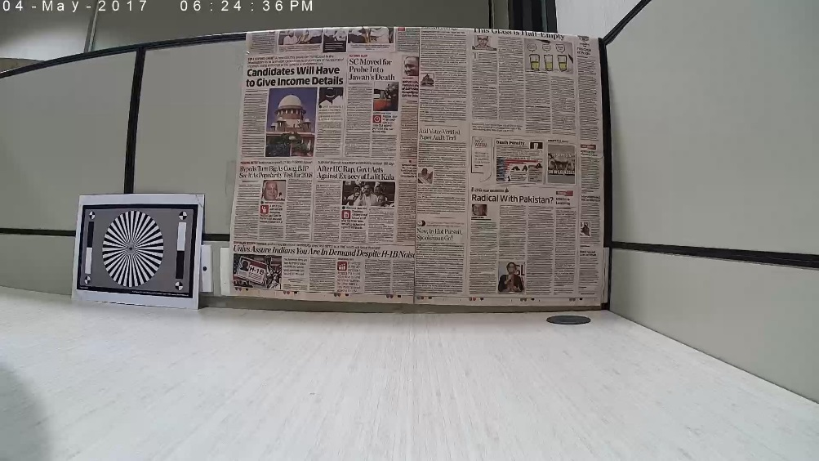

OPTIMIZATION
3. Region of Interest: Allows streaming and recording of only critical areas from the entire image.
4. Four Stream Support: Different streams for viewing storing and recording. This helps in best utilization of allotted bandwidth.
5. H.265: Latest Video Compression Technique
6. SD Card Support: up to 64GB
Regular Stream
ROI Stream
Double click for video

Slide 17
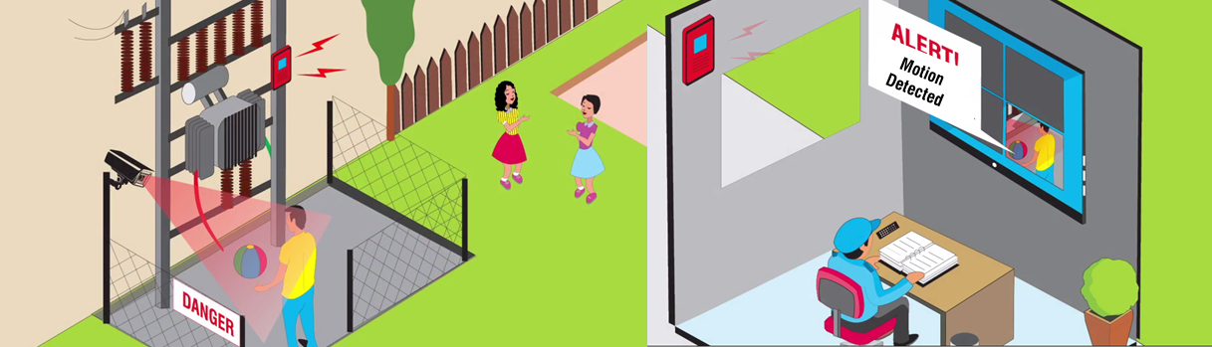
EVENTS
1. Motion Detection: Helps you mark critical areas where motion should not occur. If motion occurs, it sends instant notifications.

Slide 18
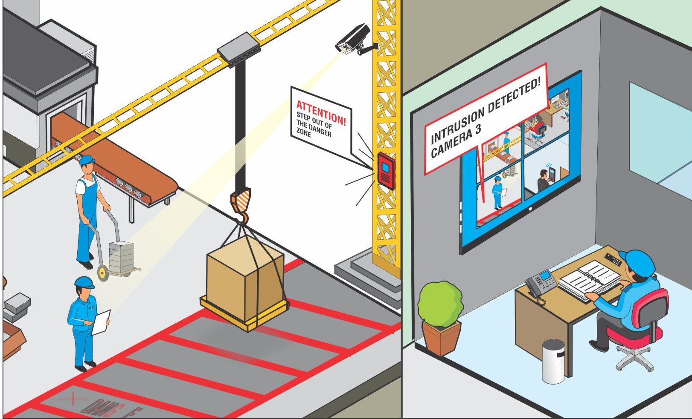
EVENTS
2. Intrusion Detection: Provides notification on entry or exit from a high security or dangerous area. These notifications are in the form of SMS, email, video pop up, audio, alarm etc.

Slide 19
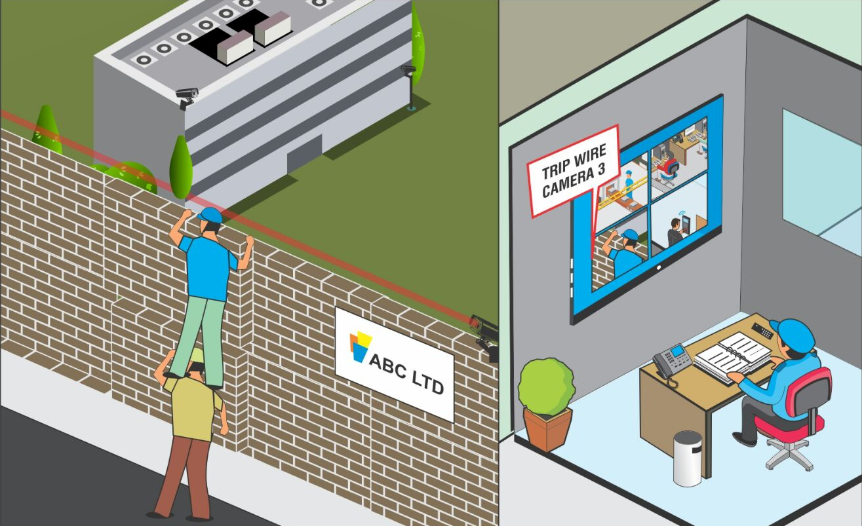
EVENTS
3. Trip Wire: It identifies any motion over a defined virtual line. This can be extremely useful in perimeter security by virtual fencing.

Slide 20
EVENTS
Other Events:
4. Network Disconnect: Provides notification on detection of a network disconnection.
5. IP Conflict: Provides notification in case of more than one camera having the same IP.
6. Storage Alert: Sends out an alert in case the SD card of the camera gets full.

Slide 21
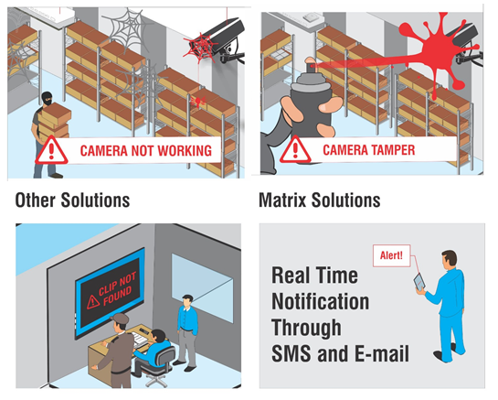
ALERTS
1. Upload Image/Clip: Upload snapshot or clip to a pre-defined path(SD, NAS or FTP) on occurrence of any suspicious event.
2. Pre and Post alarm recording: On the occurrence of any event like motion detection, Pre Alarm based recording from 0-30 seconds and Post Alarm based recordings from 10-300 seconds can be scheduled.
3. Snapshot schedule: Snapshots can be sent at a regular interval irrespective of events taking place to ensure proper functioning of system and processes
4. Email with snapshot: On detection of threat or fault in functioning of cameras, system will send email with snapshot
5. SMS: Sends SMS to the assigned number whenever a threat or event occurs. This does not require any SIM card

Slide 22
MATRIX SATATYA CAMERA
PERFORMANCE

Slide 23




CAMERA PERFORMANCE VIDEOS
Day Indoor
Night Indoor
Day Outdoor
Night Outdoor
NOTE: Double click on the Image to view respective video

Slide 24
MATRIX SATATYA
TECHNICAL SPECIFICATIONS

Slide 25

2MP BULLET CAMERA
 | SATATYA CIBR20FL36CW-S | SATATYA CIBR20FL60CW-S | SATATYA CIBR20VL12CW-S
 | Sensor
Sensor Type and Size | SONY - CMOS 2MP Active Pixel Progressive Scan, Back Illuminated Image sensor(Exmor Technology - STARVIS Series) Size: 1/2.8"
Spectral Response | 300nm - 1000nm
Minimum Illumination(B/W) | 0 Lux with IR LED On
Lens
Lens Type | Fixed Iris |  | Manual Verifocal with P-Iris
Lens Properties | Megapixel IR-corrected Lens
Focal Length | 3.6mm | 6mm | 2.8-12mm
HFOV( degrees) | 86° | 52° | 106° to 32°
Lens Mount | M12x0.5 |  | M14
Minimum Object Distance | 0.3m
Aperture | F 1.2 | F 2.0 | F 1.4
Iris Control | No |  | Yes
Zoom | No |  | Yes(Manual)
Focus | No |  | Yes(Manual)
IR-LED
IR LED type | 4 - Array LEDs
IR range | 20m

Slide 26
2MP BULLET CAMERA
 | SATATYA CIBR20FL36CW-S | SATATYA CIBR20FL60CW-S | SATATYA CIBR20VL12CW-S
 | Stream Parameters
Maximum Resolution | 1920*1080(2MP) @ 30fps
Available Resolutions | 1080p(2MP)/720p/D1/2CIF/CIF
Stream Profiles | Four streams are supported Profile 1: 2MP up to 30fps (H.265/H.264) Profile 2: D1 up to 5fps (MJPEG) Profile 3: D1 up to 30fps (H.265/H.264) Profile 4: 720p up to 30fps (H.265/H.264/MJPEG)
Max. Number of Simultaneous Streams | 4
Bitrate Type | CBR/VBR
Bitrate | 512Kbps - 4Mbps
Video Compression | H.265/H.264/MJPEG
Frame Rate | 1 - 30fps
GOP | 1 - 100
Shutter Speed | 1/12500s to 1/25s
Adaptive Stream | Yes
Smart Stream | Yes (Max. 3 Windows)
ONVIF Profile | S

Slide 27
2MP BULLET CAMERA
 | SATATYA CIBR20FL36CW-S | SATATYA CIBR20FL60CW-S | SATATYA CIBR20VL12CW-S
 | Image Parameters
ROI | Yes
BLC | Yes
White Balance | Auto/Fluorescent/Incandescent/Sunny
Digital Zoom | Yes
E-PTZ | Yes
Digital WDR | Yes
True WDR | Yes
Noise Filter(2DNR) | Yes (Auto/Manual)
3DNR | Yes (Auto/Manual)
Image Enhancement | Saturation/ Contrast/Brightness/Hue/Sharpness/Rotate
Edge Recording | Yes
Network Recording | Yes
Image-Snapshots | Yes
Hardware Parameters
Standard POE | 802.3af
SD card | Yes (Up to 64 GB)
Power Supply | 12V/2A
Power Consumption | Less than 7W
LAN Port Speed | 10/100 Mbps

Slide 28
2MP BULLET CAMERA
 | SATATYA CIBR20FL36CW-S | SATATYA CIBR20FL60CWS | SATATYA CIBR20VL12CWS
 | Video Analytics
Motion Detection | Yes
View Tamper | Yes
Line intrusion/ Directional motion/ Trip Wire | Yes
Zone Intrusion | Yes
IP-Conflict | Yes
Network-Disconnect | Yes
Storage Alert | Yes
Actions | Email/TCP/ SMS Notifications , Alarm Recording & Image/Clip Upload
Environmental
Operating Temperature/Humidity | 0 to 50 Degree Celsius
Storage Temperature | (-)20 to 60 Degree Celsius
Certification(In-House)
CE | Yes
FCC Part-15 Class-B | Yes
Ingress Protection | IP66
Physical Dimensions
Length | 320mm
Height | 84.5mm
Width | 92.5mm
Weight | 920gm

Slide 29
2MP DOME CAMERA
 | SATATYA CIBR20FL36CW-S | SATATYA CIBR20FL60CW-S | SATATYA CIBR20VL12CW-S
 | Sensor
Sensor Type and Size | SONY - CMOS 2MP Active Pixel Progressive Scan, Back Illuminated Image sensor(Exmor Technology - STARVIS Series) Size: 1/2.8"
Spectral Response | 300nm - 1000nm
Minimum Illumination(B/W) | 0 Lux with IR LED On
Lens
Lens Type | Fixed Iris |  | Manual Verifocal with P-Iris
Lens Properties | Megapixel IR-corrected Lens
Focal Length | 3.6mm | 6mm | 2.8-12mm
HFOV( degrees) | 90° | 57° | 106° to 32°
Lens Mount | M12x0.5 |  | M14
Minimum Object Distance | 0.3m
Aperture | F 1.2 | F 1.2 | F 1.4
Iris Control | No |  | Yes(Auto/Manual)
Zoom | No |  | Yes(Manual)
Focus | No |  | Yes(Manual)
IR-LED
IR LED type | 30 - Through-hole LEDs
IR range | 20m

Slide 30
2MP DOME CAMERA
 | SATATYA CIBR20FL36CW-S | SATATYA CIBR20FL60CW-S | SATATYA CIBR20VL12CW-S
 | Stream Parameters
Maximum Resolution | 1920*1080(2MP) @ 30fps
Available Resolutions | 1080p(2MP)/720p/D1/2CIF/CIF
Stream Profiles | Four streams are supported Profile 1: 2MP up to 30fps (H.265/H.264) Profile 2: D1 up to 5fps (MJPEG) Profile 3: D1 up to 30fps (H.265/H.264) Profile 4: 720p up to 30fps (H.265/H.264/MJPEG)
Max. Number of Simultaneous Streams | 4
Bitrate Type | CBR/VBR
Bitrate | 512Kbps - 4Mbps
Video Compression | H.265/H.264/MJPEG
Frame Rate | 1 - 30fps
GOP | 1 - 100
Shutter Speed | 1/12500s to 1/25s
Adaptive Stream | Yes
Smart Stream | Yes (Max. 3 Windows)
ONVIF Profile | S

Slide 31
2MP DOME CAMERA
 | SATATYA CIBR20FL36CW-S | SATATYA CIBR20FL60CW-S | SATATYA CIBR20VL12CW-S
 | Image Parameters
ROI | Yes
BLC | Yes
White Balance | Auto/Fluorescent/Incandescent/Sunny
Digital Zoom | Yes
E-PTZ | Yes
Digital WDR | Yes
True WDR | Yes
Noise Filter(2DNR) | Yes (Auto/Manual)
3DNR | Yes (Auto/Manual)
Image Enhancement | Saturation/ Contrast/Brightness/Hue/Sharpness/Rotate
Edge Recording | Yes
Network Recording | Yes
Image-Snapshots | Yes

Slide 32
2MP DOME CAMERA
 | SATATYA CIBR20FL36CW-S | SATATYA CIBR20FL60CWS | SATATYA CIBR20VL12CWS
 | Video Analytics
Motion Detection | Yes
View Tamper | Yes
Line intrusion/ Directional motion/ Trip Wire | Yes
Zone Intrusion | Yes
IP-Conflict | Yes
Network-Disconnect | Yes
Storage Alert | Yes
Actions | Email/TCP/ SMS Notifications , Alarm Recording & Image/Clip Upload
Environmental
Operating Temperature/Humidity | 0 to 50 Degree Celsius
Storage Temperature | (-)20 to 60 Degree Celsius
Certification(In-House)
CE | Yes
FCC Part-15 Class-B | Yes
Ingress Protection | IP66
Physical Dimensions
Diameter | 158mm
Height | 134mm
Weight | 1400gm

Slide 33




CONTACT US
For further information:
Call us: +91 93744 74302
E-mail: More@MatrixComSec.com
Website: www.MatrixSatatya.com
For Updates:
Follow us, Watch us, Like us

Slide 34
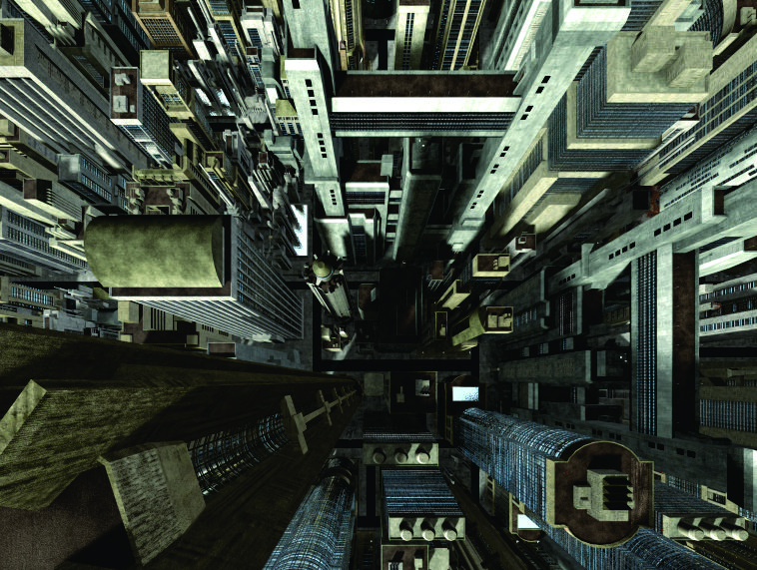

THANK YOU

