Slide 1


Slide 2


Slide 3


Matrix
Comsec
Established in 1991,
Matrix is one of the renowned name in Telecom, IP Video Surveillance and People Mobility Solutions domain. Matrix has gained trust and admiration of customers representing the entire spectrum of industries in more than 50 countries.

Slide 4


Matrix
Customers
400,000+
Customers world-wide comprising of Corporate Offices, Branch Offices, Manufacturing Units, Large Enterprises, Government Institutions, Call Centers, Hotels have trusted Matrix solutions to fulfill their diverse telecom and security needs.

Slide 5


Matrix
Solutions
250+
Well-engineered Security and Telecom workhorses built on robust architecture, and designed to offer More Productivity, More Cost Saving, More Flexibility, More Reliability and More Performance.

Slide 6


Matrix
Partners
500+
Partners world-wide represent Matrix across three solutions domains. No matter where our customer is; we are just a arms reach away.

Slide 7


Matrix
Reach
50+
Countries in Europe, Middle-East, Africa, America, Asia-Pacific, Australia region have an active presence of brand Matrix. Matrix solutions are well accepted and trusted in these countries.

Slide 8
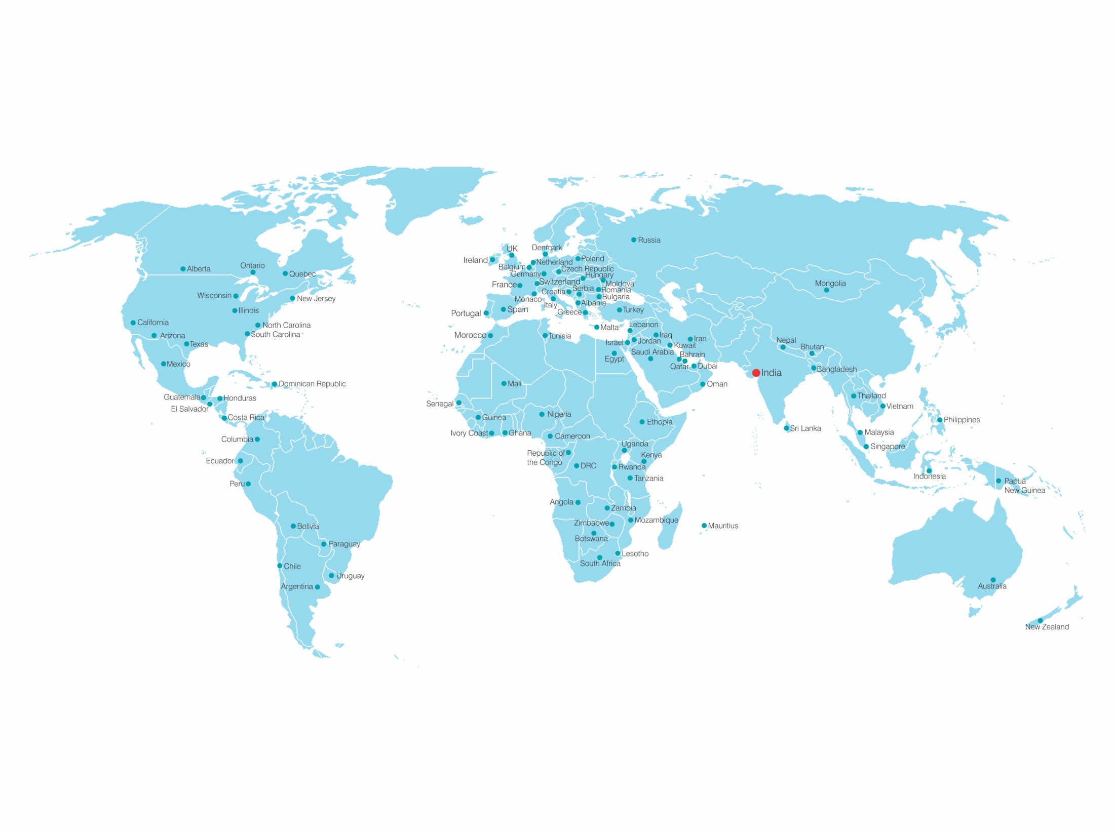

Matrix Global Network

Slide 9


Matrix
R&D Experience
5000+
Man-years of R&D experience, have underlined Matrix’s presence amongst the experienced, high quality and professional solution provider in Security and Telecom solutions domain.

Slide 10
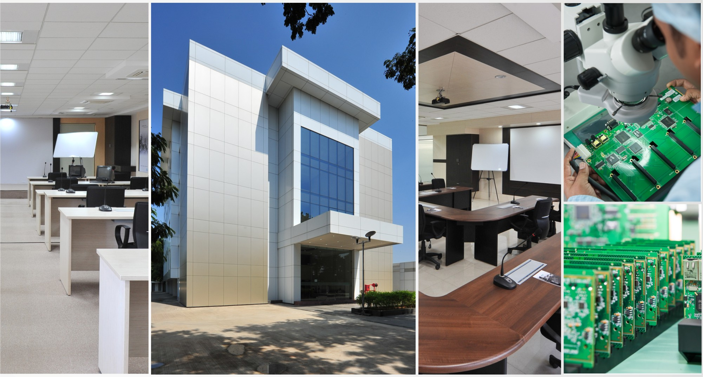
Matrix R&D Center

Slide 11


Matrix R&D Center
77,000 Sq.Ft of R&D Technology Center Housing 200+ R&D Engineers
More than 40% of total Manpower dedicated to R&D of Cutting-edge solutions.
Conferred upon with
10+ Renowned Awards
For World-class R&D
World-class Technology Infrastructure Platform, Solution Experience Center and Processes

Slide 12
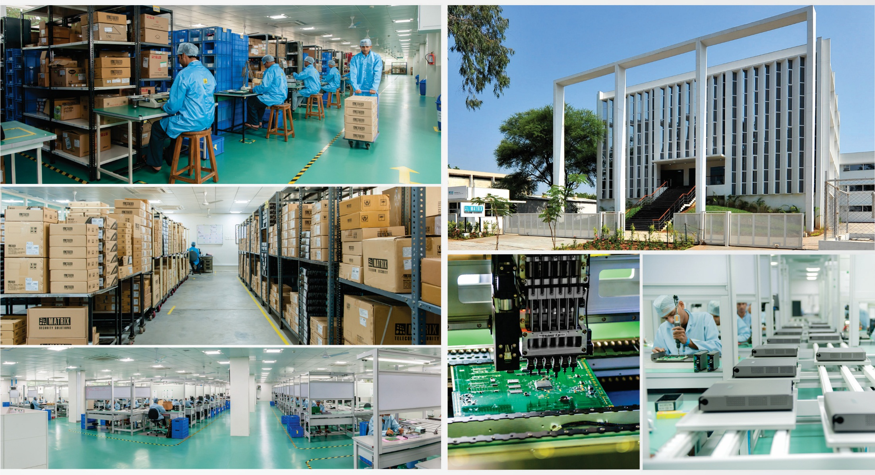
zdvsdfv
Matrix Manufacturing Unit

Slide 13

Matrix Manufacturing Unit
73,000 Sq.Ft World- class manufacturing facility.
More than 100 Production Workstations.
World-class Quality systems and Processes.
Manufacturing Products with International Quality Standard Certifications: CE, FCC, RoHS

Slide 14

Matrix
Awards and Achievements
Matrix have bagged more than 30 renowned national and international awards for quality engineering of its solutions. Some of these include design excellence awards in Germany and Japan. Such awards of international repute are the testimony of world-class quality of Matrix solutions.

Slide 15





Matrix Awards & Achievements
Award for Outstanding Achievements in Research and Development
Corporate Award for Excellence in Computer and Tele-Communication Systems
2016 - ELCINA–EFY
2016 – Institution of Electronics & Telecommunication Engineers
Best Intelligent Security Solutions Award
India Design Mark Award
for Innovative Product Design
2015-16
Electronics Maker Magazine
2016 – India Design Council

Slide 16




Matrix Awards & Achievements
Best Access Control Solution
Excellent Innovation in Telecom Technology and Products
2016 – Security Consultant Association of India
2015 - TEMA
India’s 100 Innovative
SME Company
The Good Design Award for Excellence in Product Design
2015 – INC. Magazine
2013 – Japan Institute of Design Promotion

Slide 17


Matrix Awards & Achievements
One of the India’s Fastest Growing SME
India Design Mark Award
for Innovative Product Design
2012 – INC. Magazine
2012 – India Design Council
Excellence in Product Design and Engineering
Excellence in Product Design and Engineering
2010 – The Red Dot Award
2010 – The IF Design Award

Slide 18



Matrix Awards & Achievements
Best SSI Unit Award
Corporate Award for Excellence in Computer and Telecommunication
2008 – Federation of Gujarat Industries
2007 – Institution of Electronics & Telecommunication Engineers
Best Electronics Company Award
Excellence in Professional Electronics
2004, 2005, 2006, 2007, 2010 and 2011 – EFY Magazine
2004 – Govt. of India

Slide 19


Matrix Range of Solutions
IP Video Surveillance Solution
People Mobility
Solution
Telecom
Solutions

Slide 20
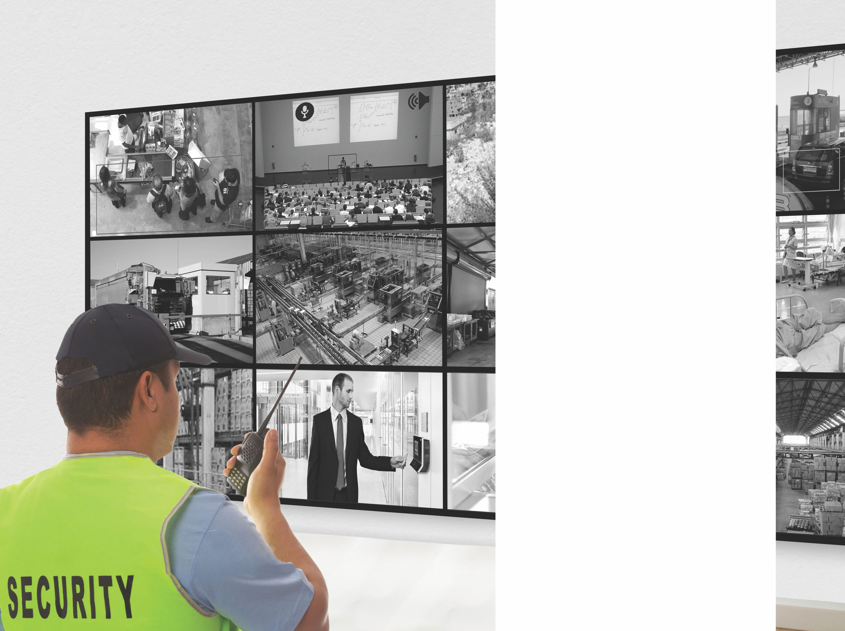
Matrix
IP Video Surveillance Solution
3-Dimensional Security: Proficient, Persistent, Preventive
Matrix SATATYA is a family of flexible, modular and scalable video surveillance solutions specifically designed for enterprises on four pillars of visibility, control, intelligence and integration.

Slide 21
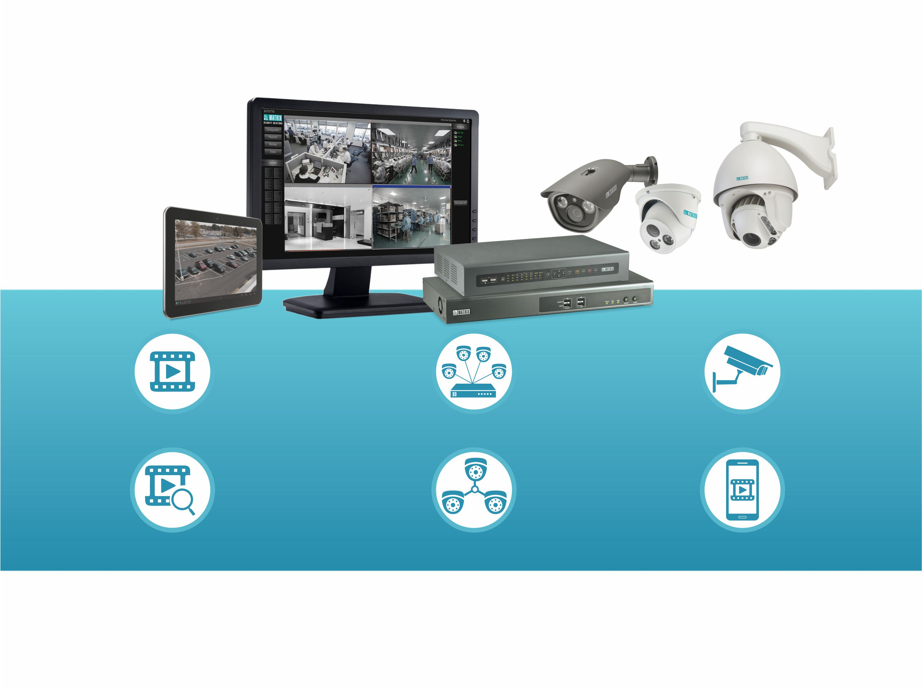
Matrix IP Video Surveillance Solution
Video Management Software
Network Video Recorder
IP Cameras
Intelligent Video Analytics
Centralized Management Software
Mobile Application

Slide 22
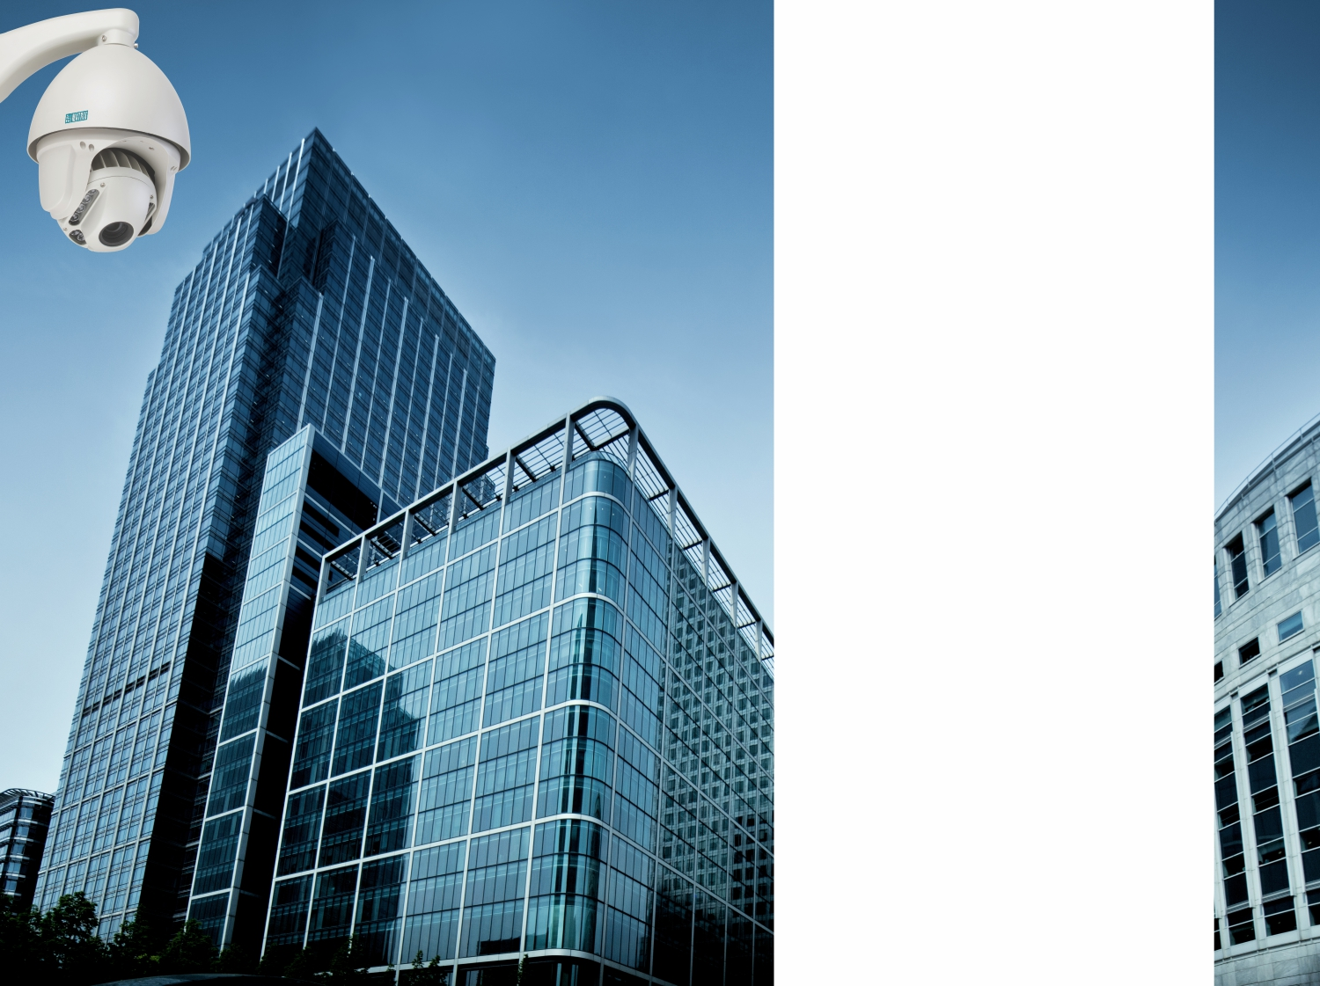
Why Matrix
IP Video Surveillance Solution
is best suitable
for
Enterprises?

Slide 23
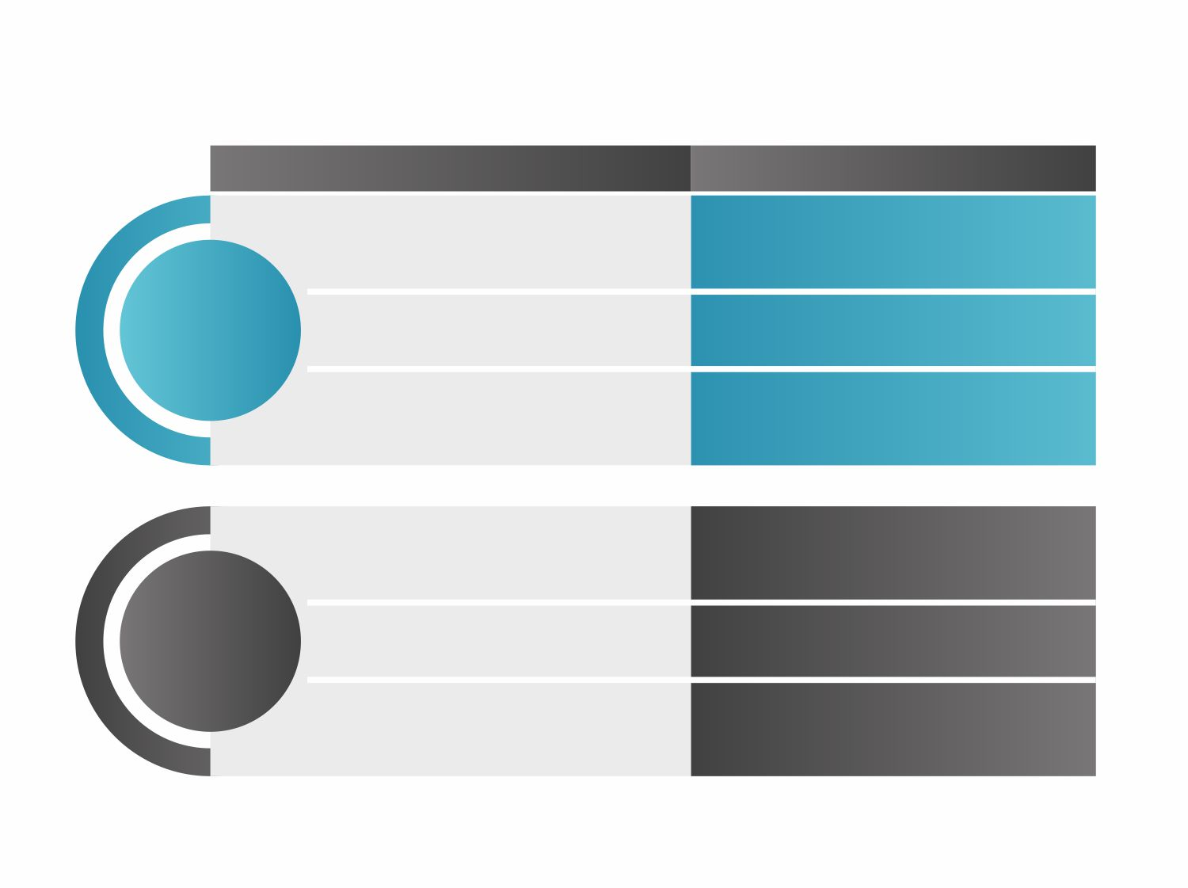


Why Matrix IP Video Surveillance Solution is best suitable
for Enterprises?
Threat Identification with IVA like Face Detection, Intrusion, Loitering, Missing Object
Range of Intelligent Video Analytics
Snapshot/video to Central Location on Occurrence of Event
Event based Clip Export and Scheduled Backup
AVOID DAMAGE
Local and Remote Instant Notification
Calling, SMS, Email, Video Pop-up
No Server for Central Monitoring with Master-slave Architecture
Cascading
Auto Add Cameras using DHCP
Auto Configuration of Cameras
EASY MANAGEMENT
Event based Monitoring of all Security Solutions on a Map
E-map with Third Party Integration

Slide 24



Why Matrix IP Video Surveillance Solution is best suitable
for Enterprises?
Redundant Server to Manage Recording
Redundant Servers
REDUCE BREAKDOWNS
Search and Bookmarks with IVA based Investigator
Investigator
LOWER INVESTIGATION TIME
Quick Summary of Selected High Interest Camera
Daily Highlights

Slide 25
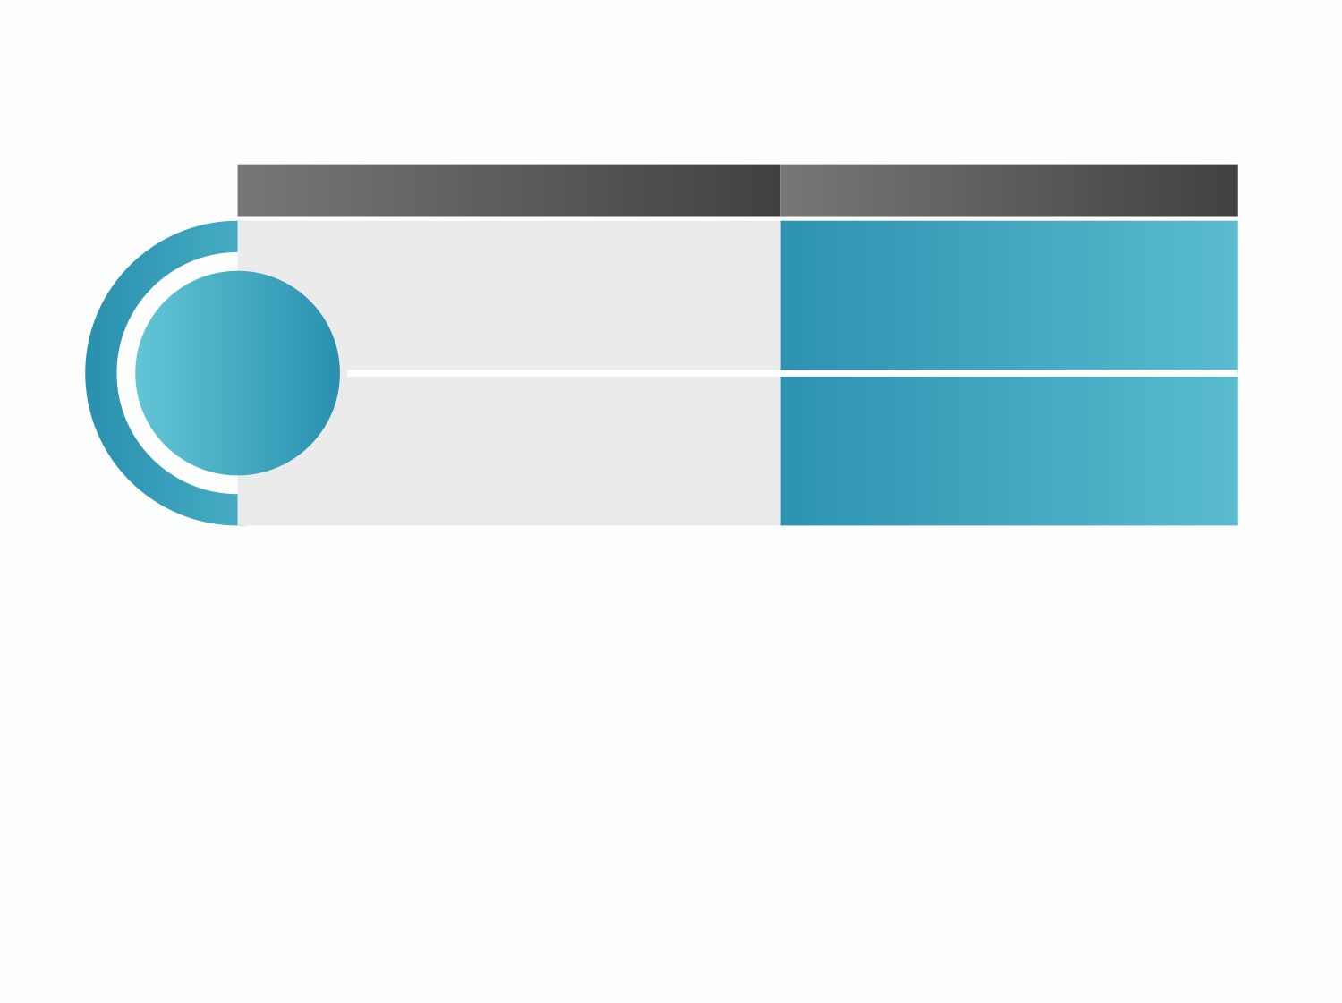

Why Matrix IP Video Surveillance Solution is best suitable
for Enterprises?
Storage Cost Reduction:
Flexibility of camera-wise storage days, auto adjust FPS based on motion in front of camera.
Camera-wise Recording Retention and Adaptive Recording
REDUCE SOLUTION COST
Bandwidth Cost Reduction:
Flexibility to define resolution to different areas of a scene.
Smart Streaming and ROI

Slide 26
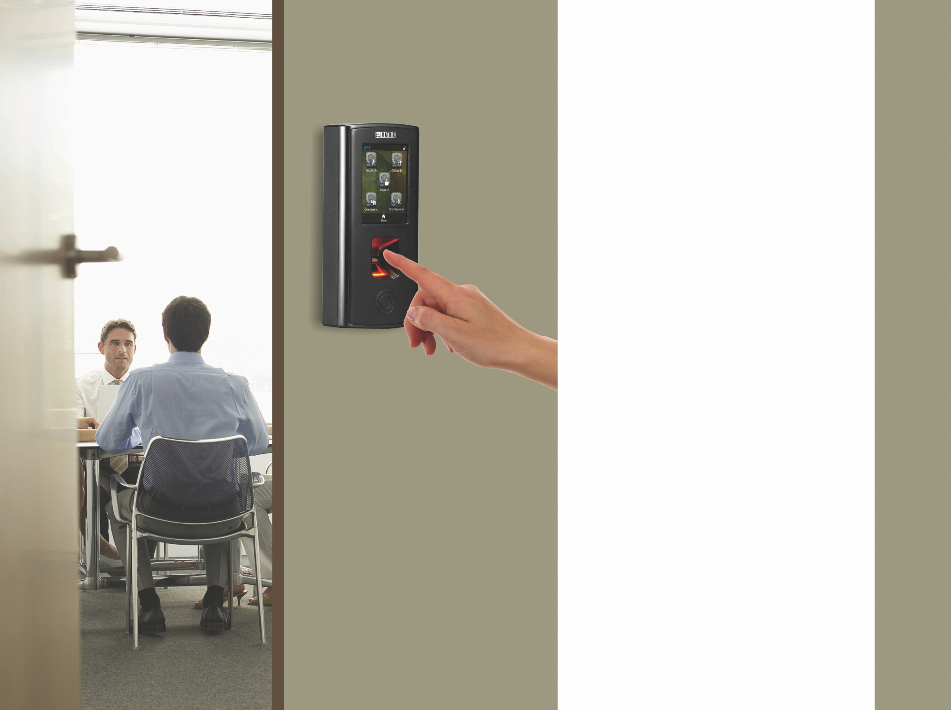
Matrix
People Mobility Solutions
Right People, in Right Place at Right Time.
Matrix COSEC is an adaptive, modular, scalable and function-rich Access Control and Time-Attendance solution designed for modern organizations.

Slide 27
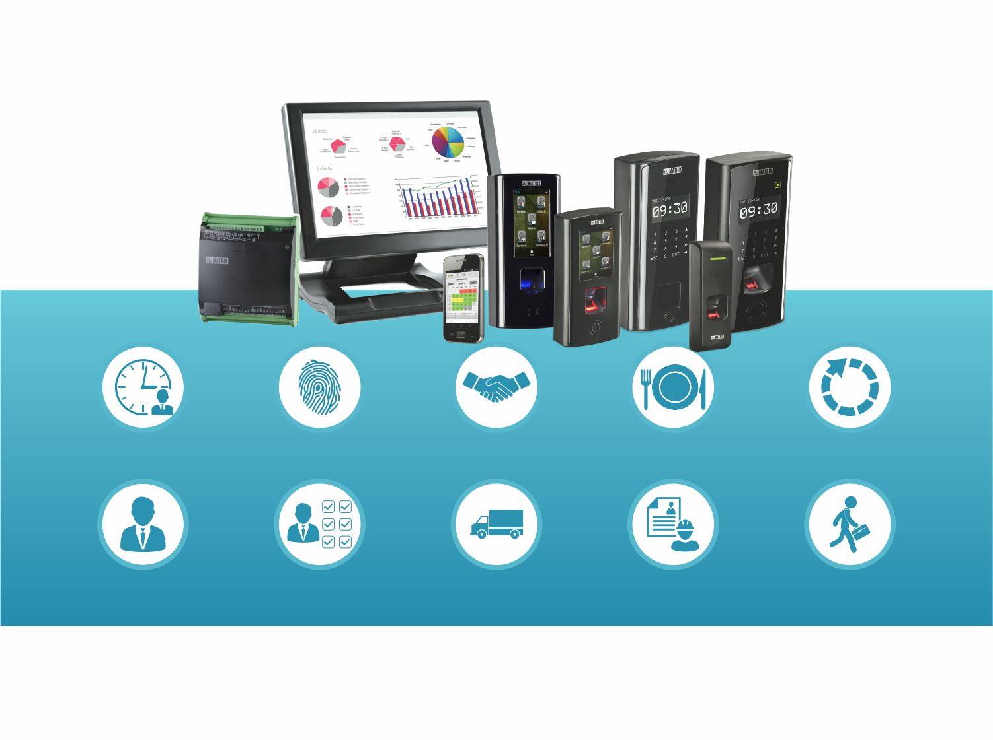
Matrix People Mobility Solution
Time-Attendance
Access Control
Visitor Management
Cafeteria Management
Job Processing & Costing
Employee Self Service
Roster Management
Vehicle Access Management
Contract Workers Management
Field Visit Management

Slide 28

Matrix
People Mobility Solution:
Multiple Identification
Technologies

Slide 29

Matrix People Mobility Solution:
Multiple Identification Technologies
PALM VEIN
FINGER PRINT
MULTI SPECTRAL
FINGERPRINT
RFID CARD

Slide 30

Matrix People Mobility Solution: USP
Scalable Upto 65000 Devices and 1 Million Users
Automatic Fingerprint Distribution
Scheduler Service
200+ Customized Reports and Charts
Auto Push from Device to Server
Real Time SMS and Email Notification
4G, 3G, Wi-Fi, LAN Connectivity
Integration with Third Party Hardware and Software

Slide 31

Matrix
Telecom Solutions
Matrix offers a comprehensive range of telecom solutions built on cutting-edge technologies and designed for performance, flexibility and reliability.

Slide 32
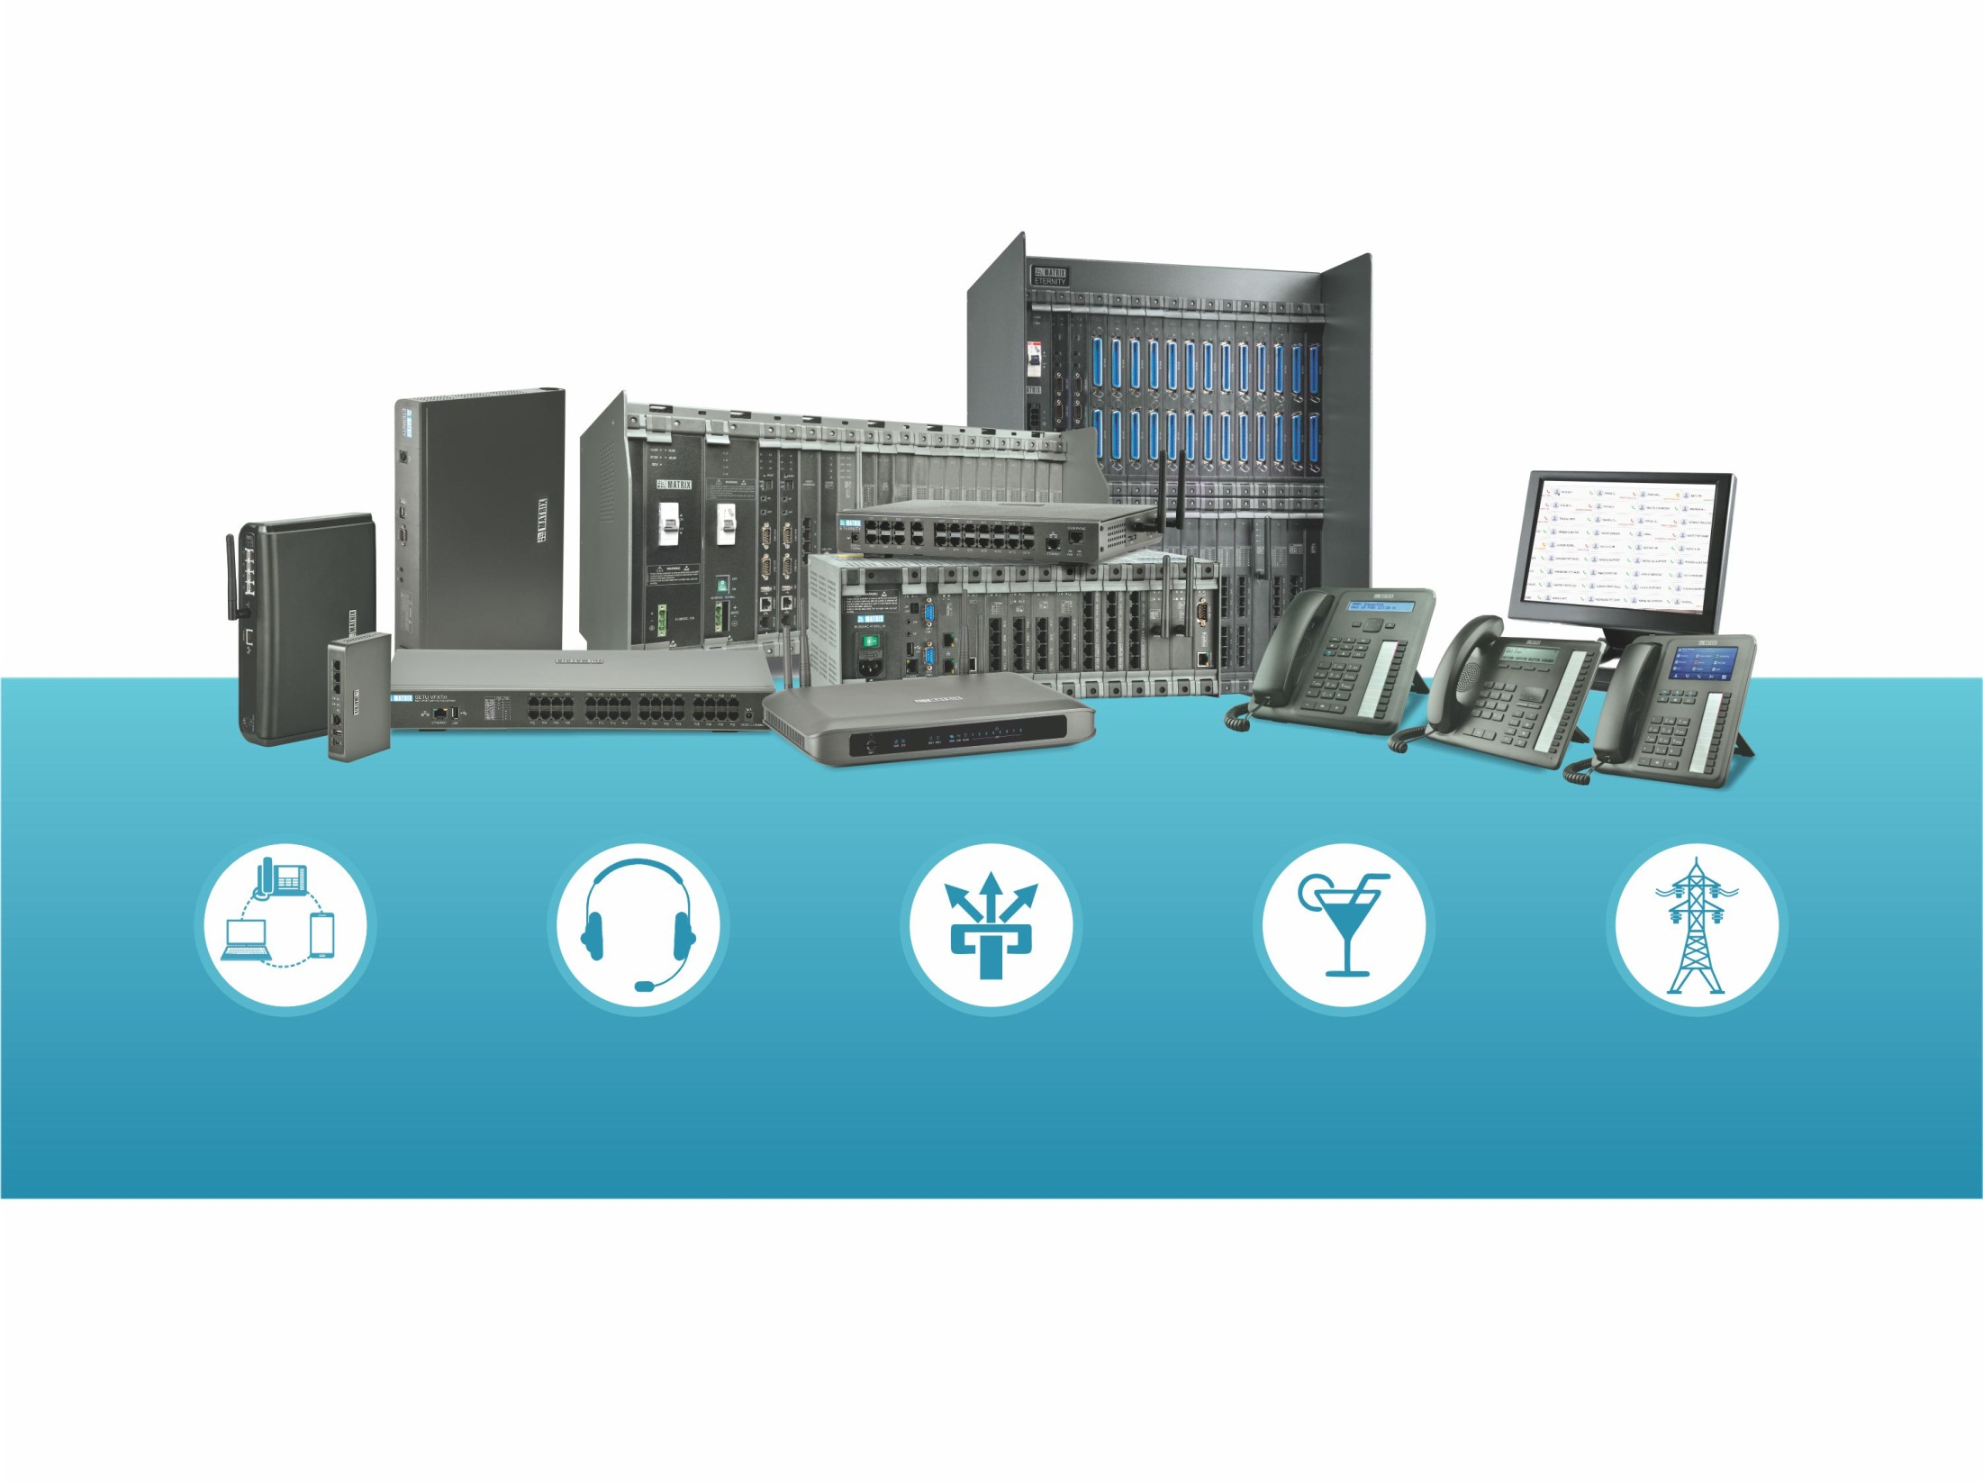
Matrix Telecom Solutions
Unified Communication
Server
IP-PBX
VOIP-GSM Gateways
Hotel-Motel
PBX
PLCC EPAX

Slide 33
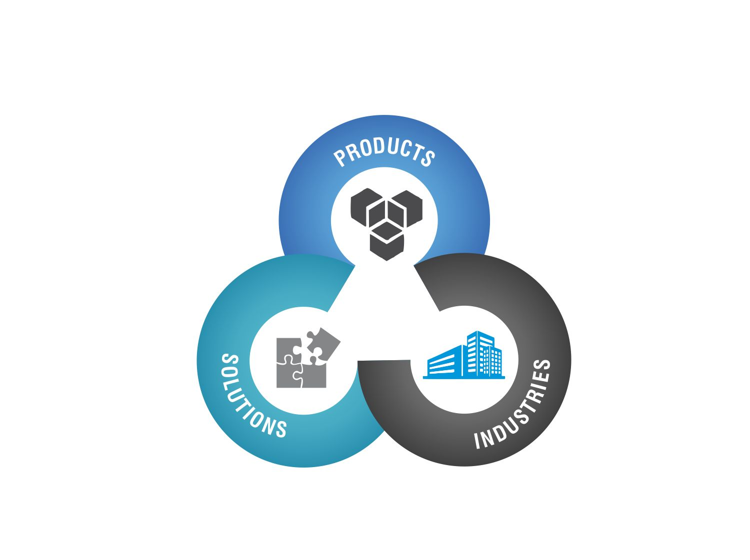
Matrix Telecom: Products - Solutions - Industries
SOHO IP-PBX SME-ENT UC TERMINALS GATEWAYS
UNIFIED COMMUNICATIONS
MULTI-LOCATION COMMUNICATIONS
MOBILITY SOLUTION
SIP TRUNKING GATEWAYS
ENTERPRISES
BANKING
MANUFACTURING
RETAIL CHAINS
HEALTHCARE
HOSPITALITY

Slide 34

  One Solution – Many Opportunities
  Simple-Agile-Robust
  ENTERPRISES
  BANKING
  MANUFACTURING
  Connect, Communicate, Collaborate
  Creating More Business
  Opportunities
  Simplifying the Communication Complexities
  Flexible Scalability
  One Number Reach
  Video Calling
  Easy Multi-Party Conference Set-up
  - Establish Anytime Connectivity
  with Valued Customers
  - No Communication Delay with
  Control over Operational Costs
  - Increase Banker/Trader
  Productivity and Responsiveness
  - Flexible Scalability for
  Continual Growth
  - Seamless Integration of
  Multiple Locations
  - Uniform Customer Service
  Regardless of the Location

Slide 35

  One Solution – Many Opportunities
  Simple-Agile-Robust
  RETAIL
  HEALTHCARE
  HOSPITALITY
  Simplify Multiple Location Communication
  Revitalize Patient Care Capabilities
  Advance Communication Solution for Modern Hotels-Motels
  - Extend Mobility to Service Staff
  - Improve Patient Care by Reducing
  Communication Delays
  - Streamline Communication and
  Control Telephony Costs
  - All-in-One Hotel Communication
  Solution
  - Automate Hotel Routine Activities
  - Boost Staff Productivity
  - Enrich Guest Experience
  - Seamless Integration of
  Multiple Locations
  - One Touch Connectivity to
  Retail Outlets
  - Easy Manageability
  - Control over Operational Costs

Slide 36


Slide 37
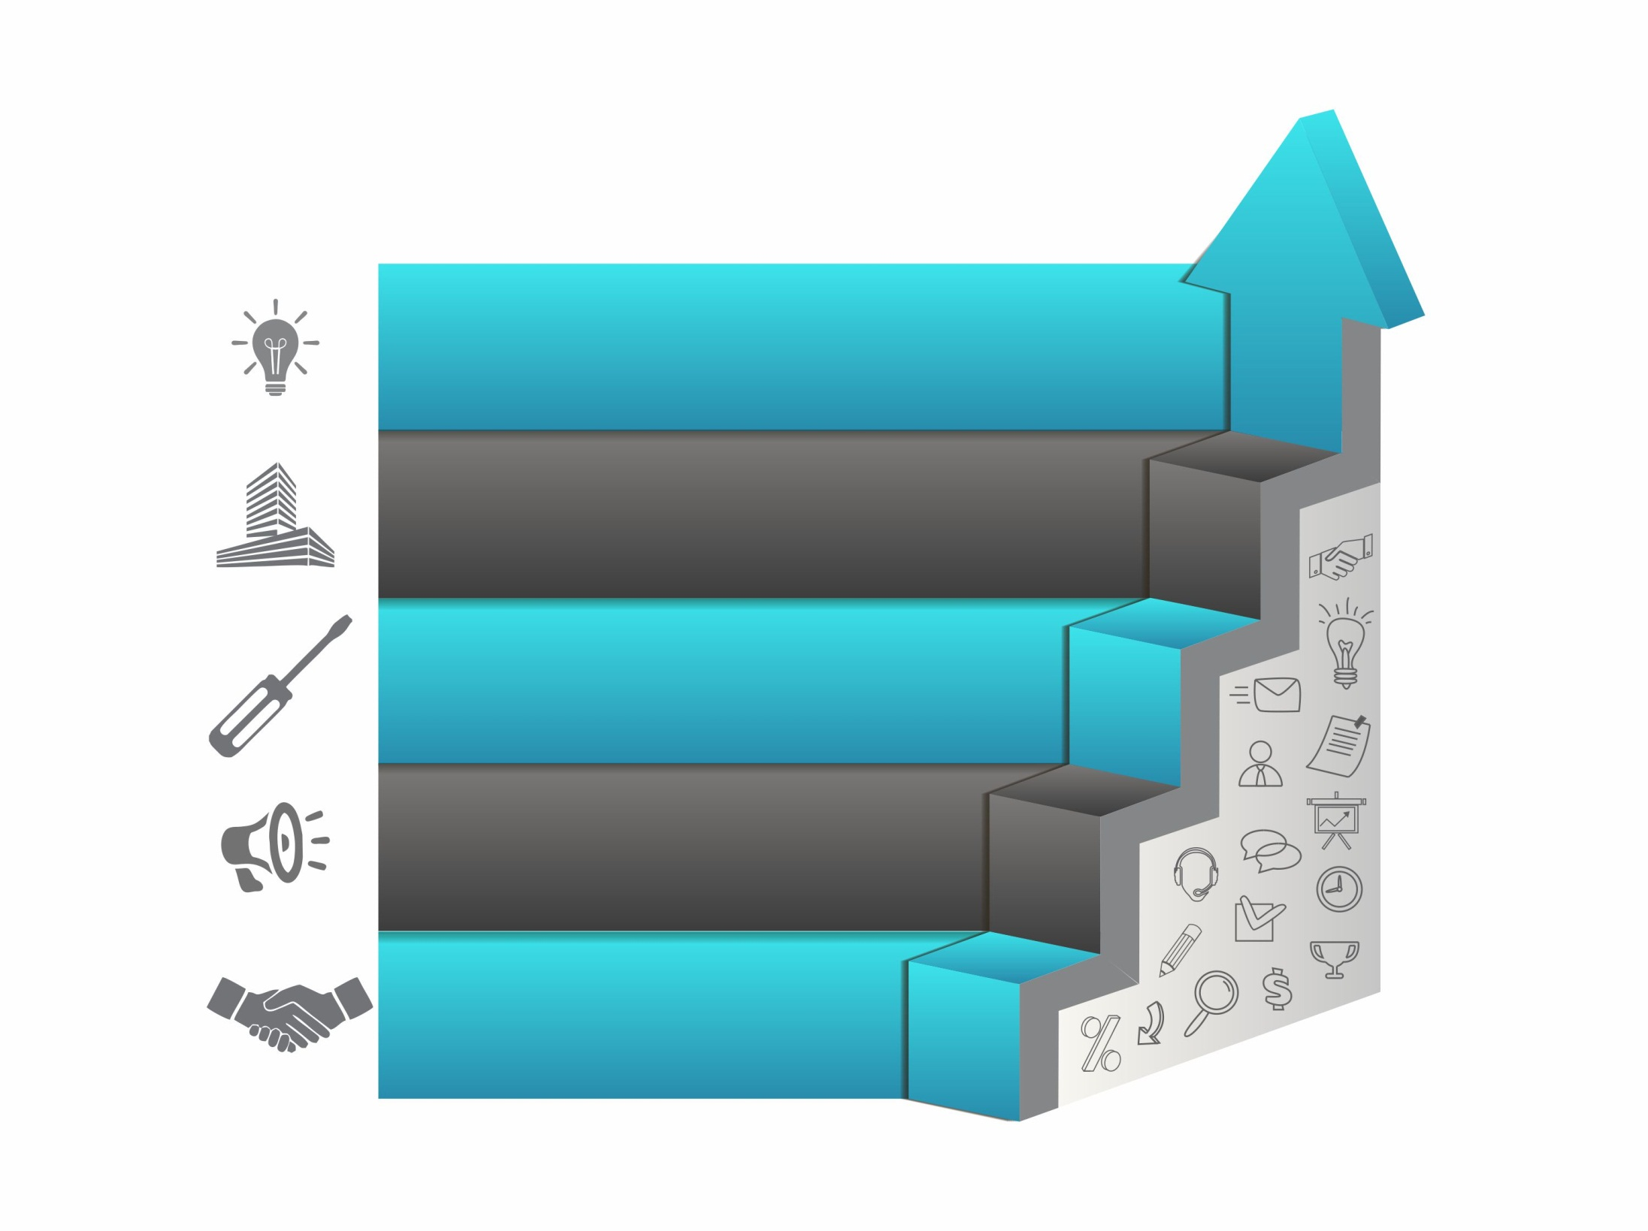
Partner Matrix. Expect More.
More Innovative Solutions
More Customers
More Technical Support
More Sales-Marketing
Assistance
More Sustained
Business Growth

Slide 38
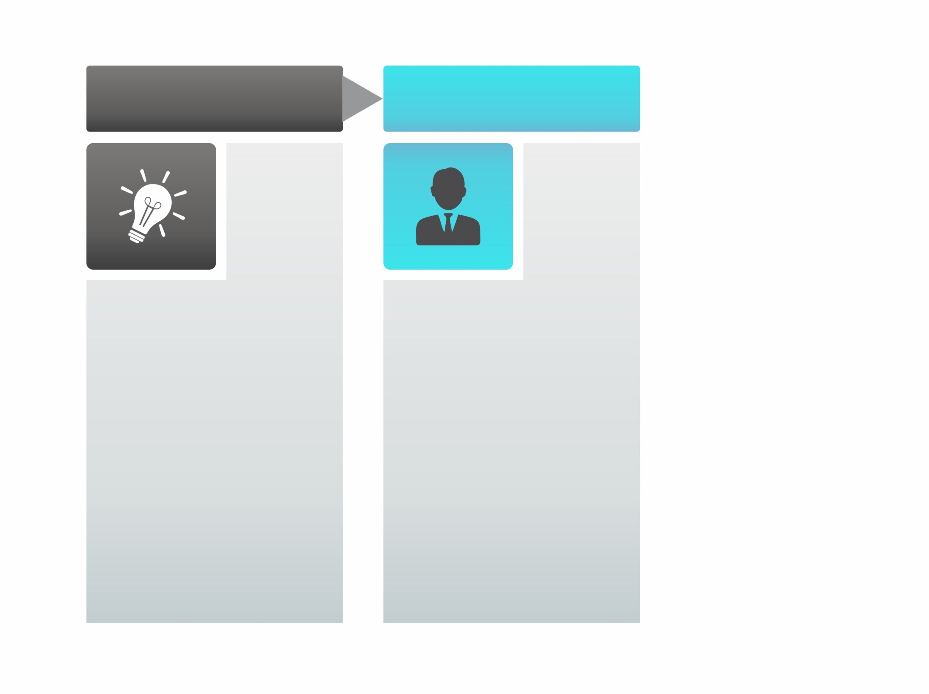
MATRIX OFFERS MORE…
YOU GET MORE…
MORE INNOVATIVE SOLUTIONS
MORE MARKETS TO ENTER
250+ Telecom and Security Solutions
Backed by Award Winning R&D
New Solutions Introduced Regularly
Telecom and Security = Growing Industries;
High Profitability
Business Opportunities in 20+ High Net-worth Market Segments
Cross Selling Opportunities

Slide 39

MATRIX OFFERS MORE…
YOU GET MORE…
MORE CUSTOMERS
MORE PROFITABILITY
Offering catering to large spectrum of customer requirements.
High worth Business Opportunities in enterprise and large projects segment.
High Repeat Sales
Single point source for any IPVS, People Mobility and Telecom solutions requirement.
Enterprise and Large Projects oriented solutions.
Established reference base of 400,000+ customers.

Slide 40

MATRIX OFFERS MORE…
YOU GET MORE…
MORE TECHNICAL SUPPORT
MORE CUSTOMER DELIGHT
Pre-sales Support: Solution Design, Tender Compliance, Proof of Concern
Post-sales Support: Installation, Servicing,
Warranty, Quick RMA, Online and On-field
Technical Support
Low Support Cost
Quick Problem Solution
Retain Customers Trust and Loyalty
Stay Well Versed about Latest Technology and Trends

Slide 41

MATRIX OFFERS MORE…
YOU GET MORE…
MORE PROMOTIONAL
ASSISTANCE
MORE RAPID BUSINESS GROWTH
Presentation and Demonstration to Customers
100+ Marketing Promotional Tools.
Regular Promotional Activities like Exhibitions, Product Expos,
Advertisements.
More Lead Generation
Higher Sales Conversion
Faster Sales
Less Selling Cost
More Market Reach

Slide 42

MATRIX OFFERS MORE…
YOU GET MORE…
MORE BUSINESS FRIENDLY POLICIES
MORE SUSTAINED BUSINESS GROWTH
Less Internal Competition
Return on Time-Efforts-Money Investments
Safe Guard Business Growth
Earn Reputation and Credibility of a Reliable Solution Provider
100% Business through Partners
Uniform Pricing
100% AMC with Partners
Stock Availability at Supply Points
Transparent Accounting

Slide 43


Slide 44

Matrix Comsec
Head Office
394-GIDC, Makarpura,
Vadodara-390 010, India
Ph: +91 265 2630555
R&D Center
190-GIDC, Makarpura,
Vadodara-390 010, India
Ph: +91 81286 80291/2
Manufacturing Unit
19-GIDC, Waghodia
Dist. Vadodara-391 760, India
Ph: +91 2668 263172/73
Customer Care
Customer.Care@MatrixComSec.com
Technical Support
Support@MatrixComSec.com

