Slide 1


Warm Welcome

Slide 2


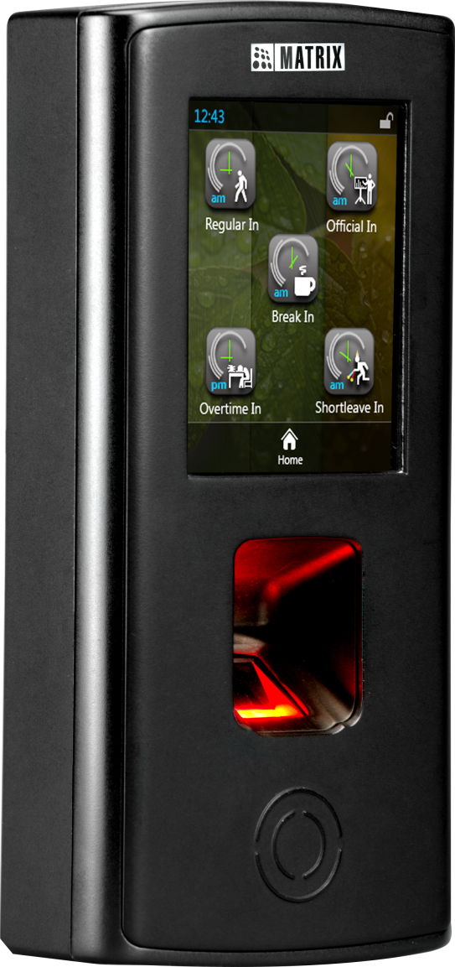
COSEC VEGA

Slide 3

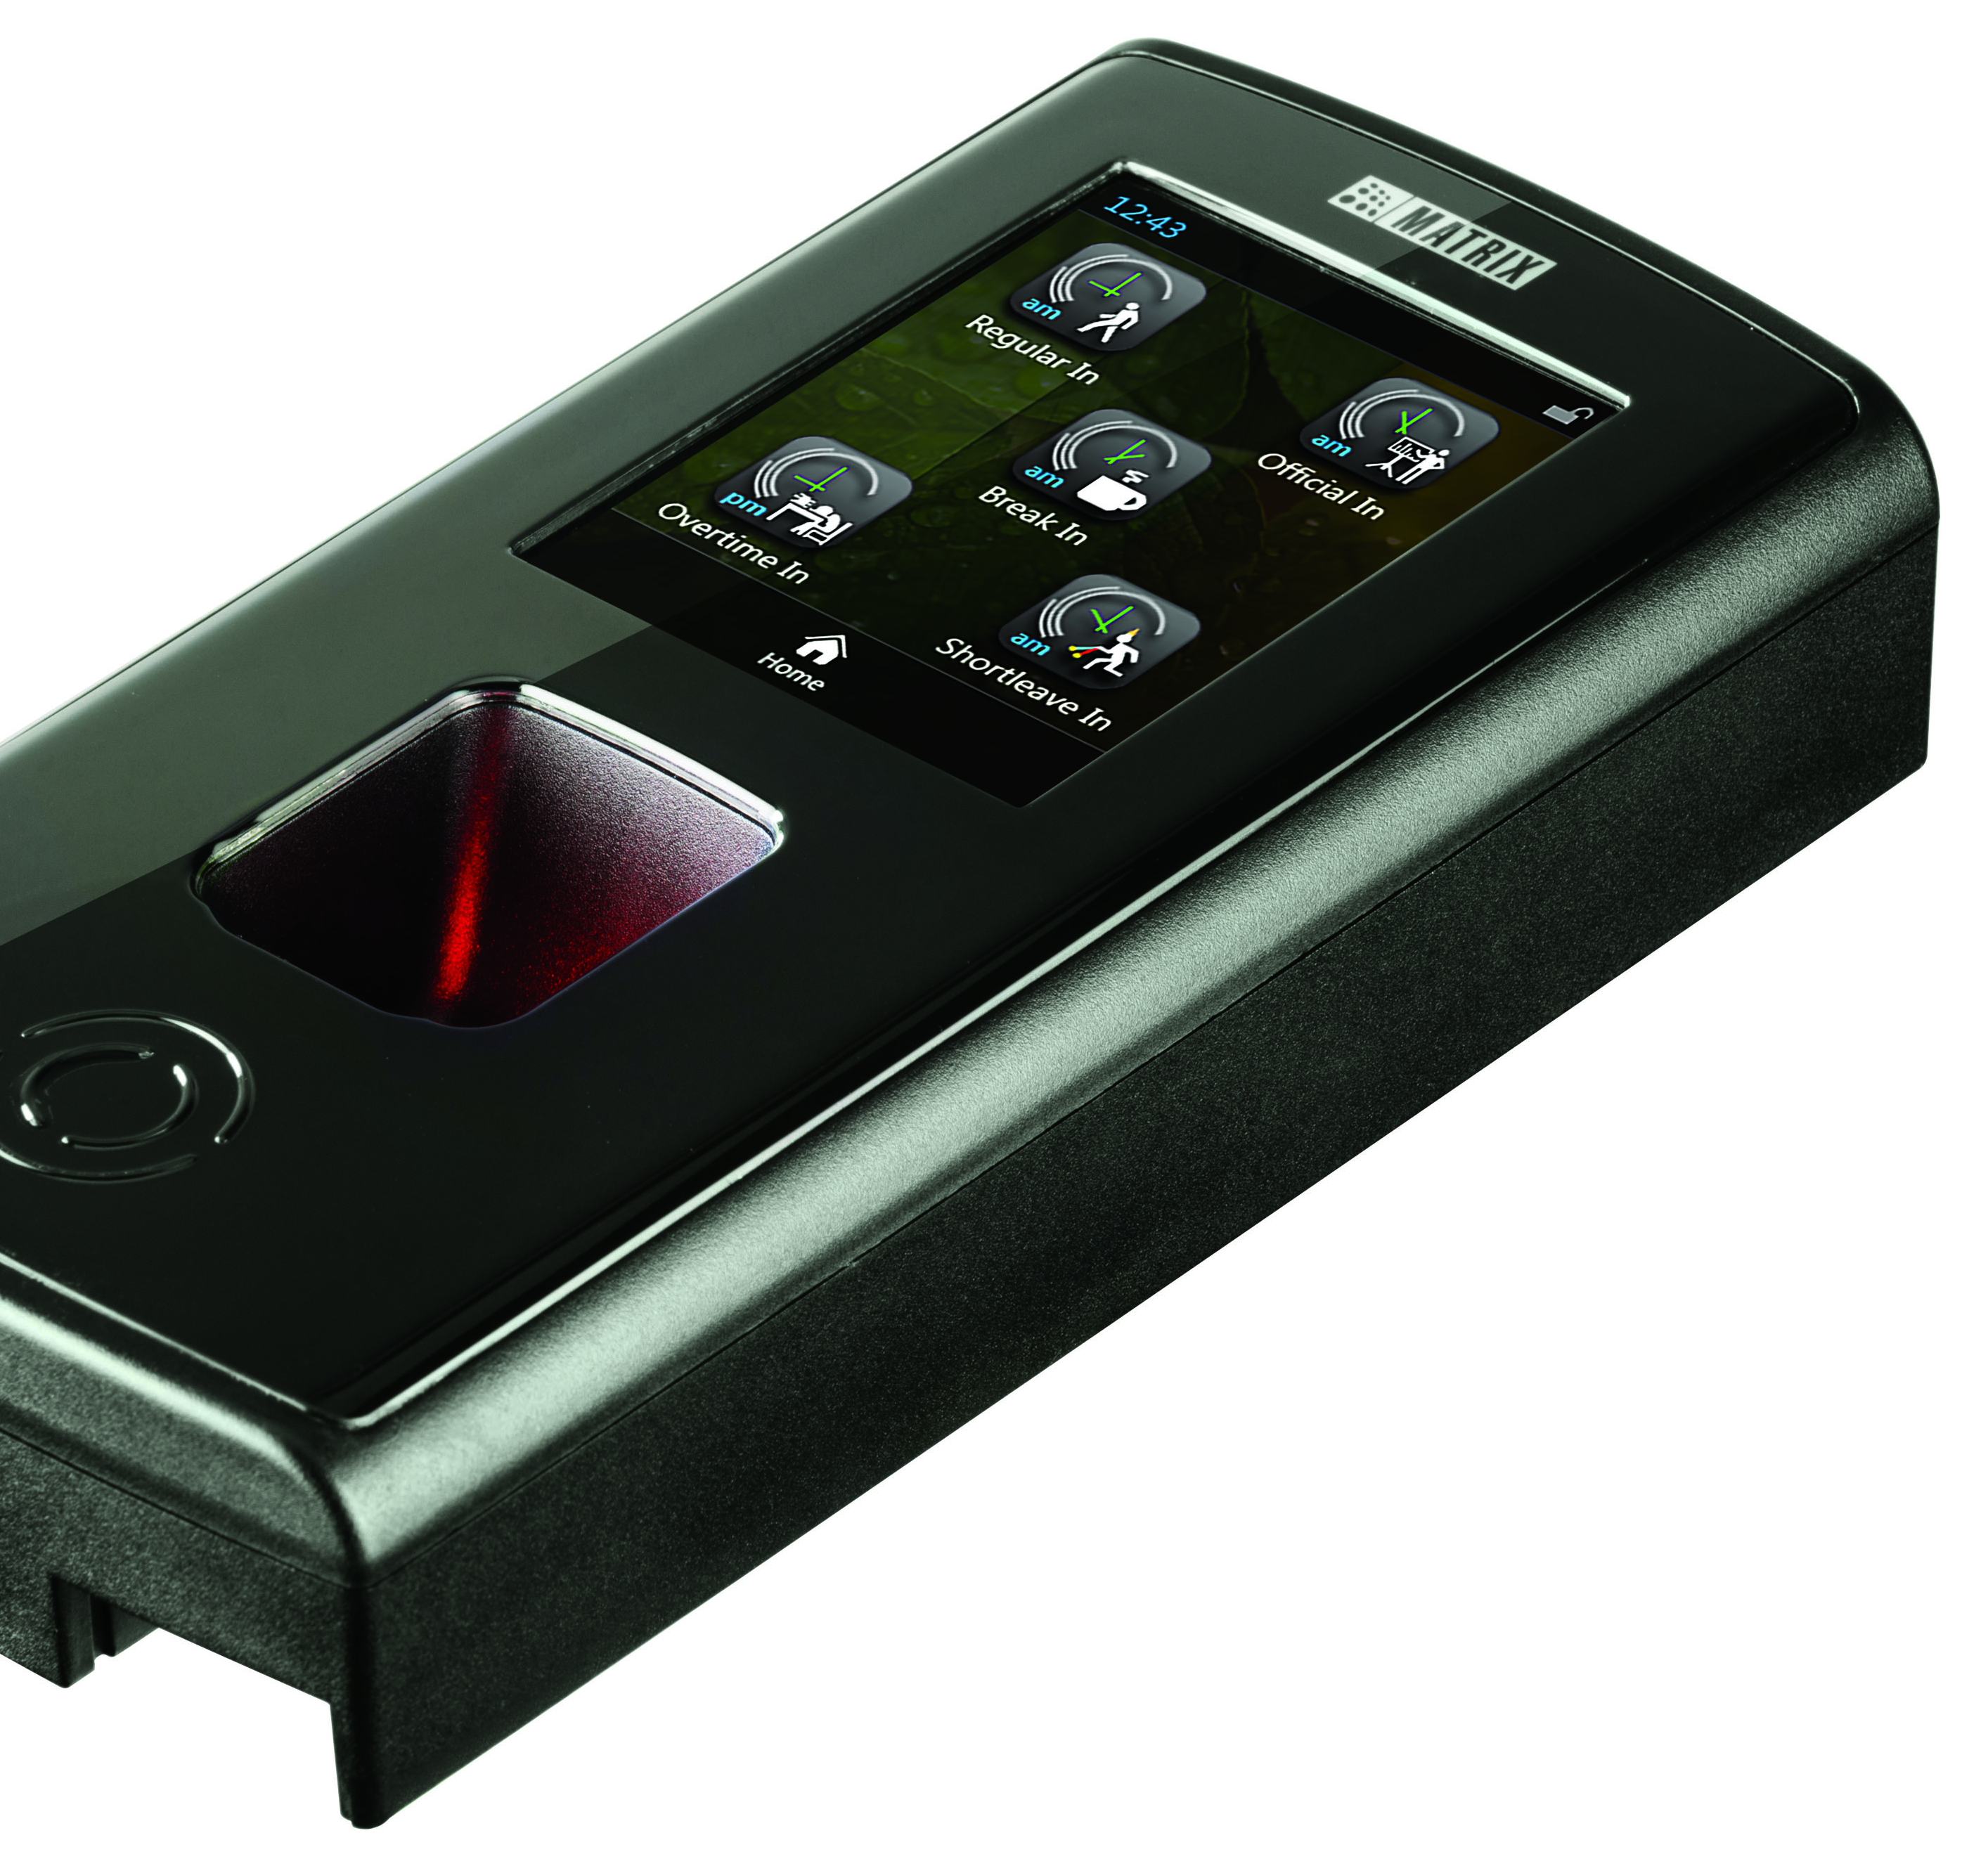
What is COSEC VEGA?
Technically Advanced Door Controller
For Access Control, Time-Attendance, Visitor and Cafeteria Application
Fingerprint, Card and PIN
3.5” TFT Display with Touchscreen
9600 Fingerprint Templates
5,00,000 Event Storage

Slide 4
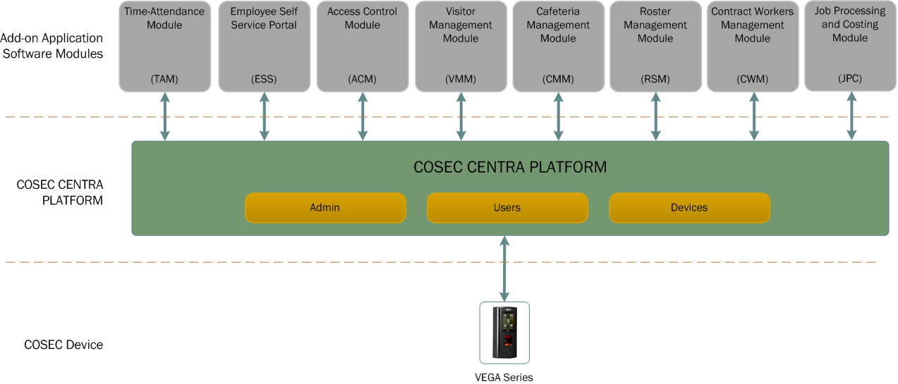
COSEC Architecture

Slide 5




Time-Attendance
Access Control
Cafeteria
Roster

Slide 6




50,000 Users
9,600 in 1:N Mode
100,000 in 1:1 Mode
500,000 Transactions

Slide 7
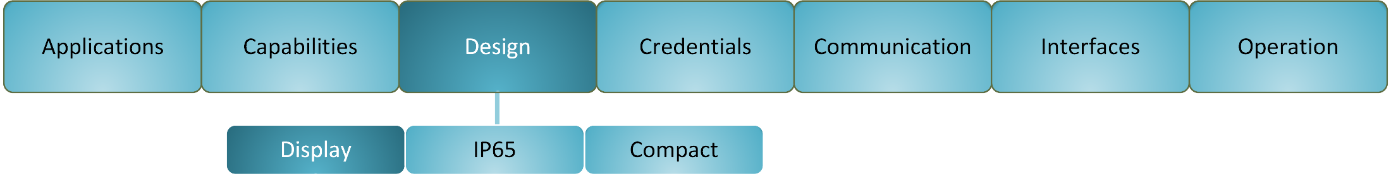
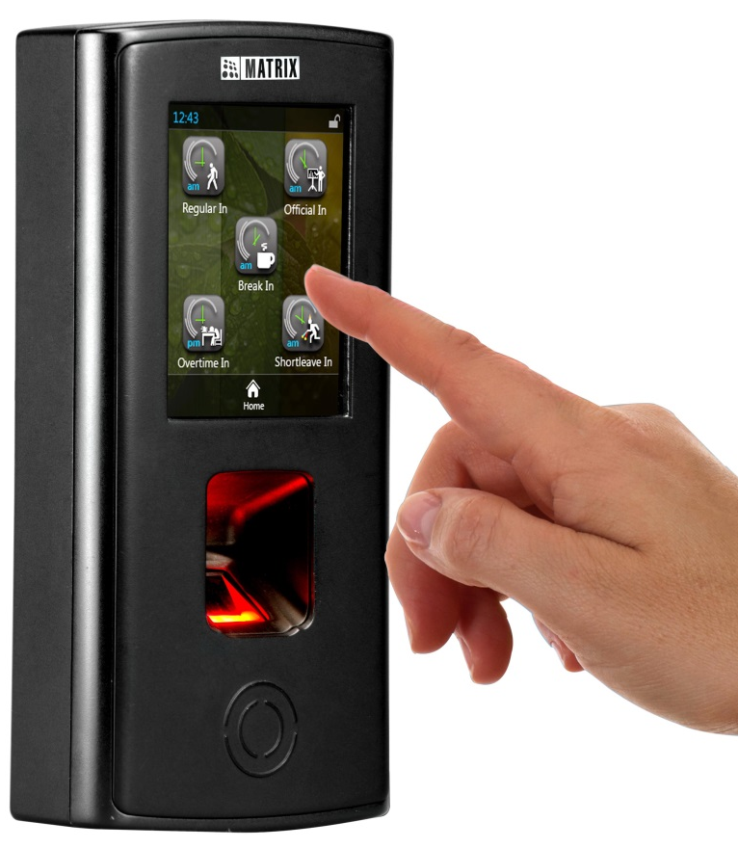
3.5" Touch Screen Capacitive Display
Excellent Image Quality
Faster Response Time
Use Time-Attendance and Access Control Functions

Slide 8
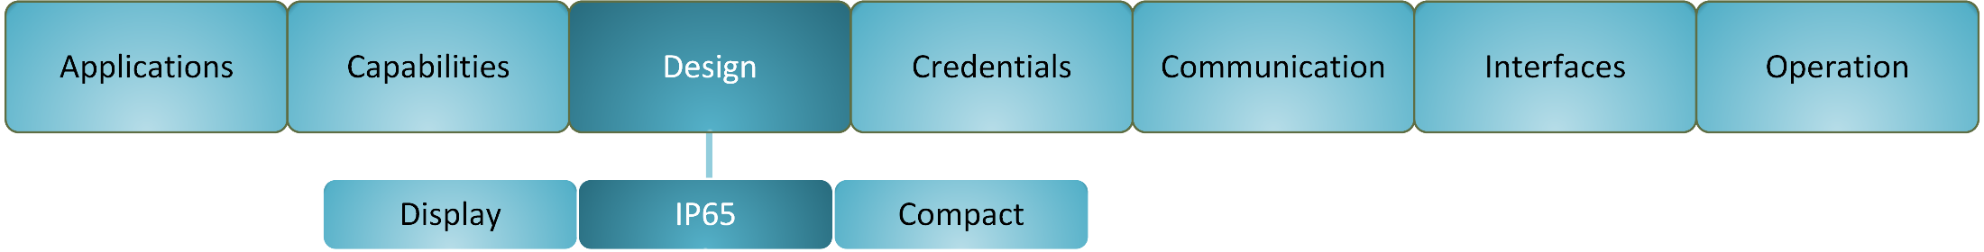
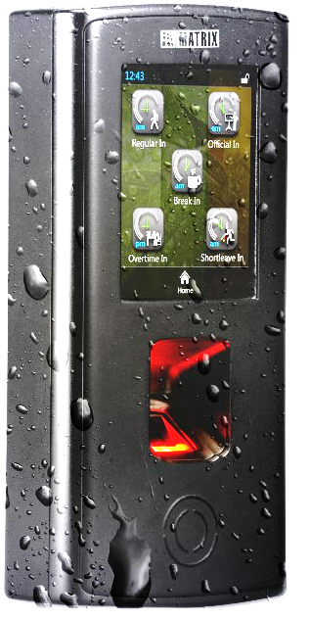
IP65 Ratings
Convenient for Demanding Environment

Slide 9
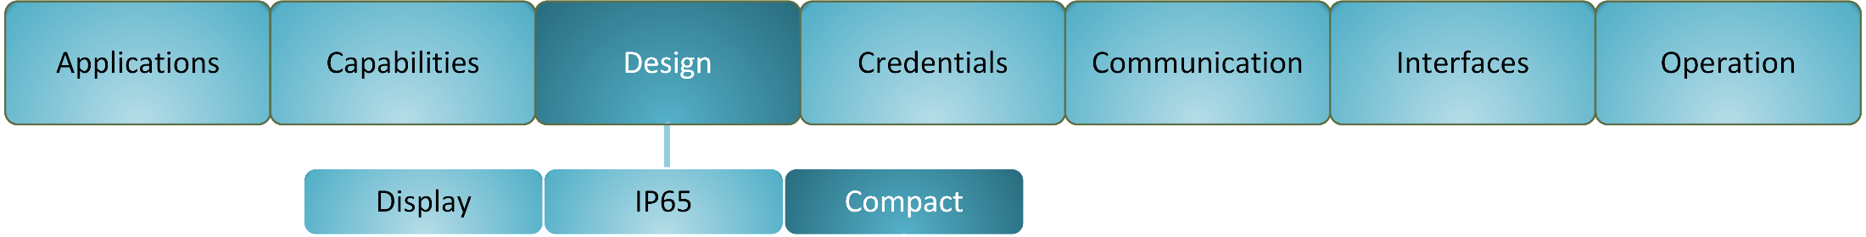
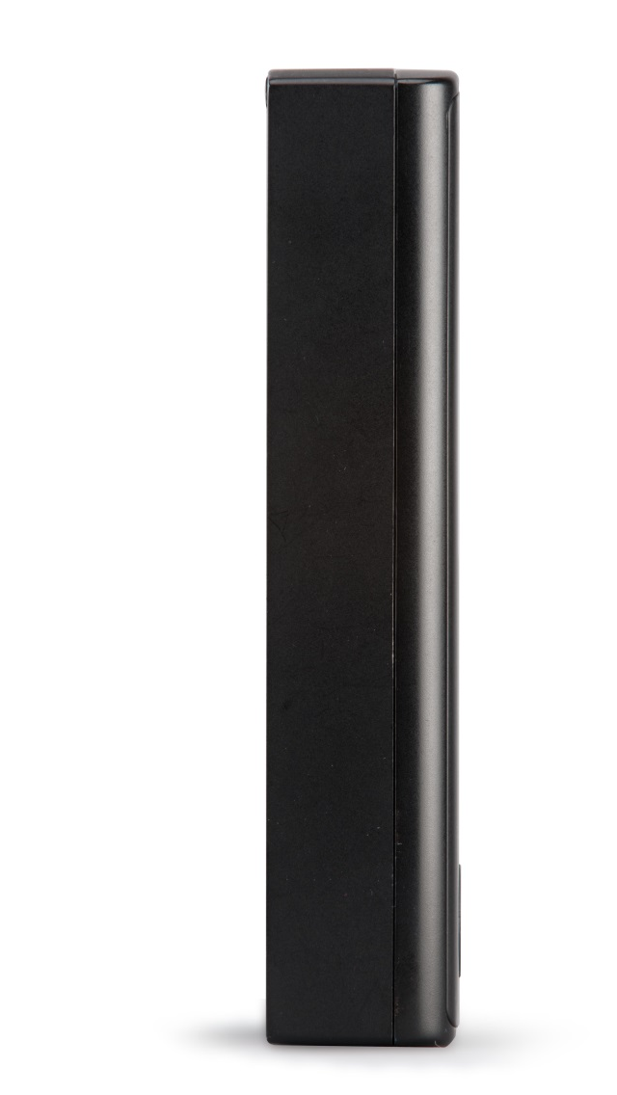
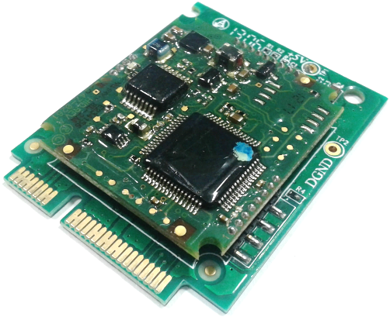
Compact Design
Suitable for any Interior
Pluggable Card Reader Module

Slide 10

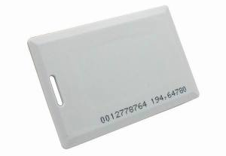
Optical Fingerprint Sensor
Smart RF Card: Mifare and HID iCLASS
Proximity RF Card: EM Prox and HID Prox
Near Field Communication (NFC)
PIN

Slide 11
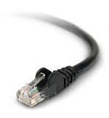

Wired and Wireless Connectivity
Wired: Ethernet and PoE
Wireless: Wi-Fi, 3G/4G/LTE
USB

Slide 12
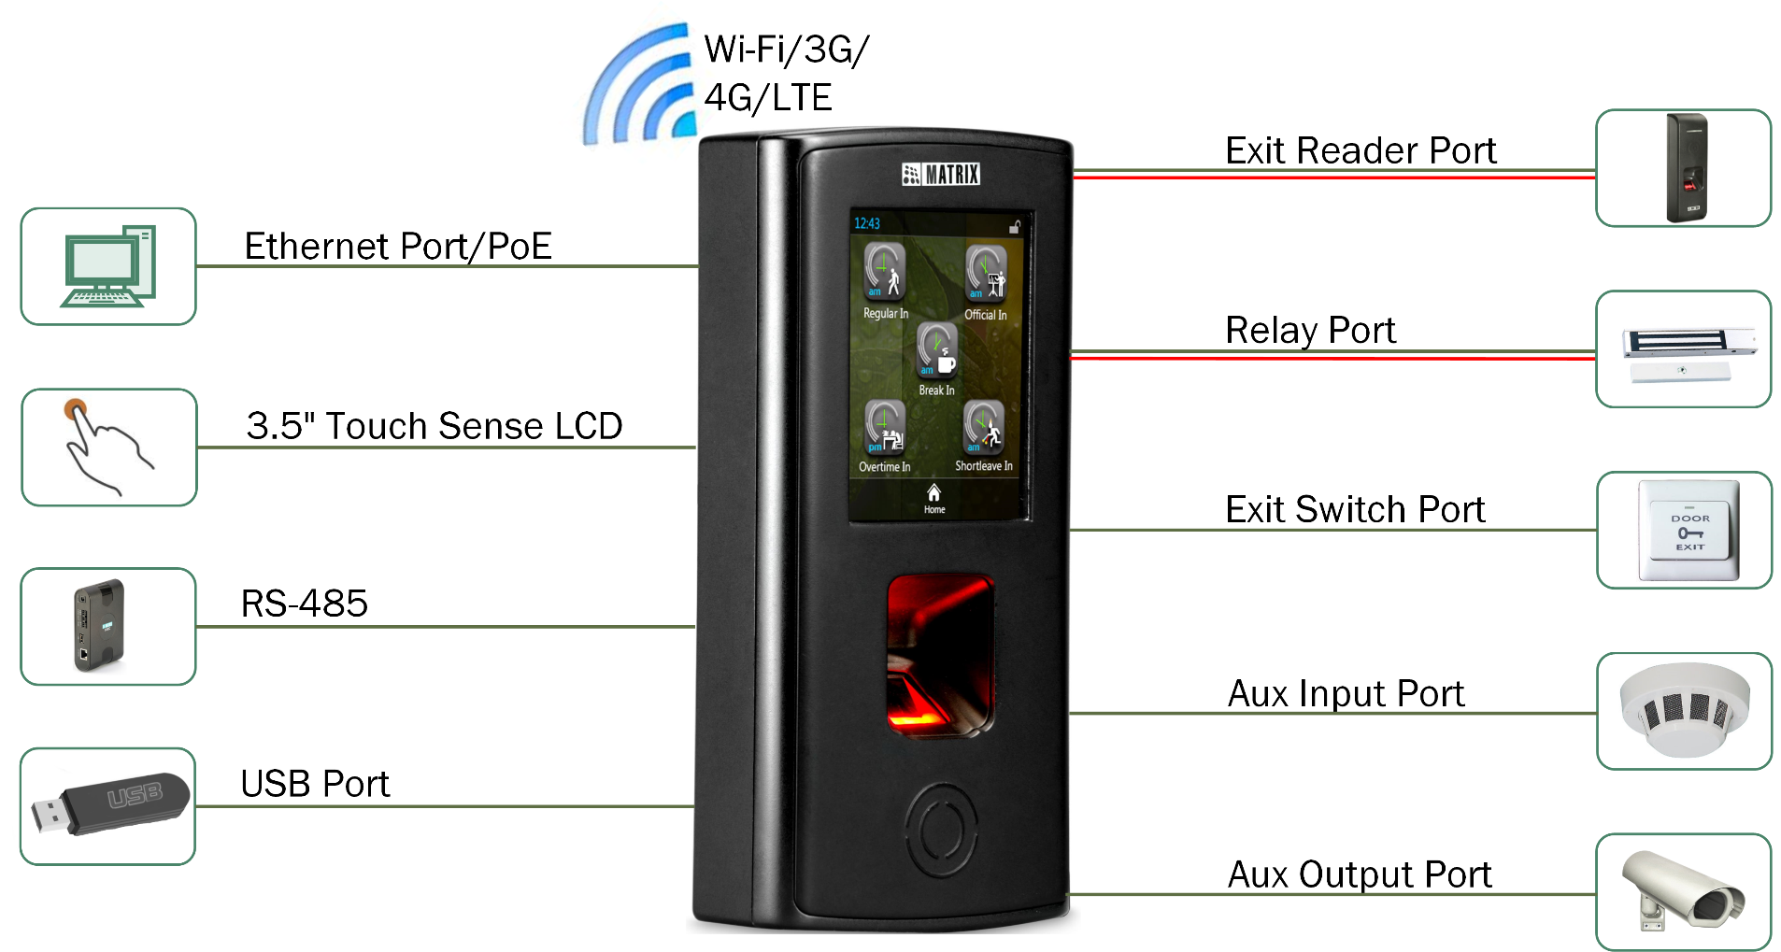

Slide 13
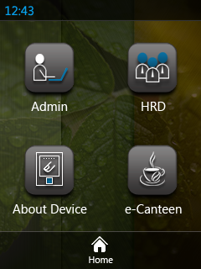
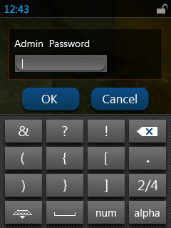
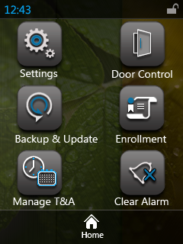
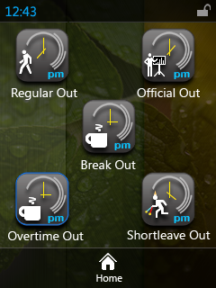
Standalone and Network Operation
Easy Mounting on Back Plate
User Friendly GUI
Leverage Existing Network Infrastructure
Minimum Wiring

Slide 14
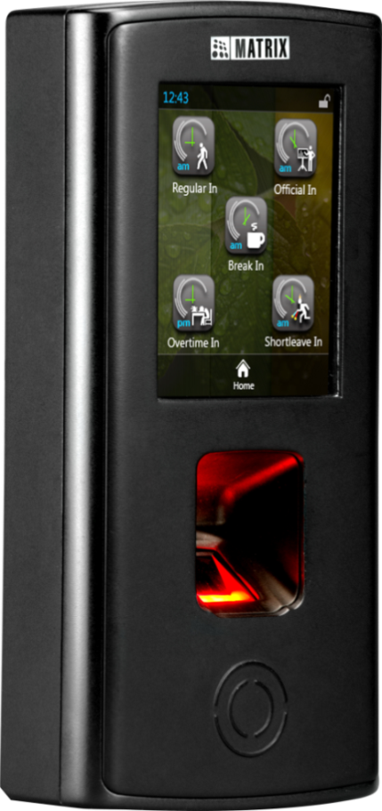
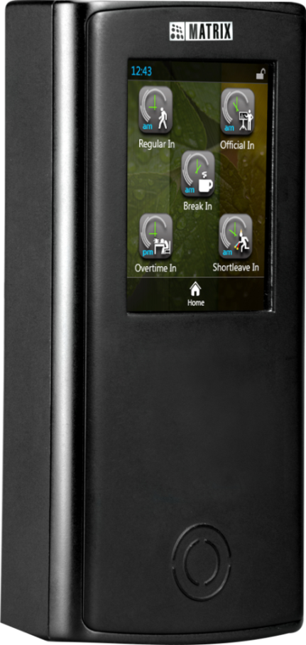
COSEC VEGA Series
COSEC VEGA FAX
COSEC VEGA CAX

Slide 15
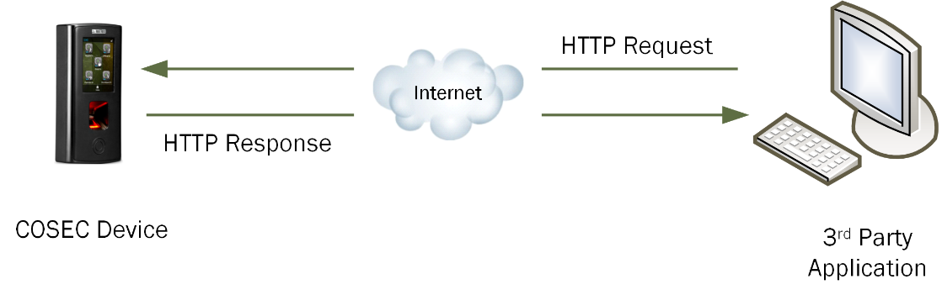
Integration via Device API
Communicate with 3rd Party Software Directly
Integration with 3rd Party Application Such as Time-Attendance, Access Control, HRM, Payroll etc

Slide 16
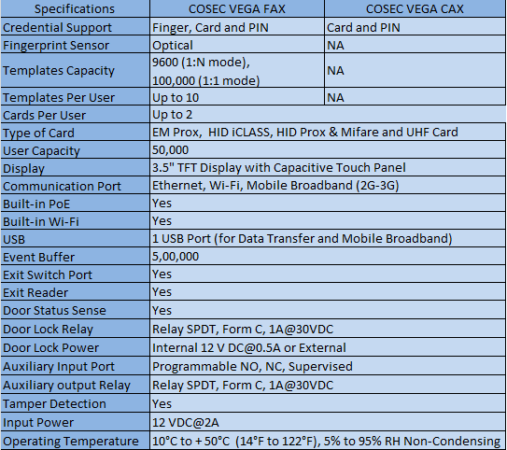
Technical Specifications

Slide 17
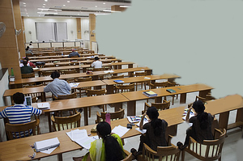



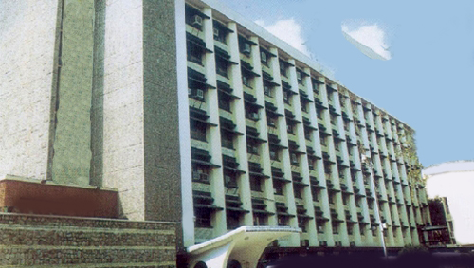


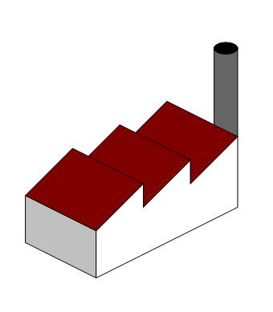
Target Customers...
Educational
Institutes
Clubs
Corporate Offices
R & D Labs
Government
Organizations
Remote Sites
Shopping Malls
Factories

Slide 18
Applications

Slide 19

Corporate Offices
Increases Security of Assets, Employees and Data
Most Suitable Compact Design
Display to Put Product Photo/Event News/Message

Slide 20

Factories
Increases the Security of Assets and Employees
IP65- More Convenient for Demanding Environment
TFT Display to Put Event News/Message

Slide 21
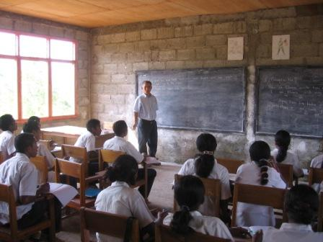
Educational Institutes
Create Environment of Event with Display Picture/Message
Increase the Security of Assets, Students and Faculties

Slide 22

Remote Sites
Wireless Connectivity for Remote Site
IP65- Convenient for Demanding Environment
Less Wiring

Slide 23


Slide 24
For Further Information Please Contact:
Email ID: Security@MatrixComSec.com
Tel: +91 265 2630555
Visit us at www.MatrixComSec.com
Version: V1R1

