Slide 1


Warm Welcome
Warm Welcome

Slide 2

COSEC Cafeteria Management

Slide 3

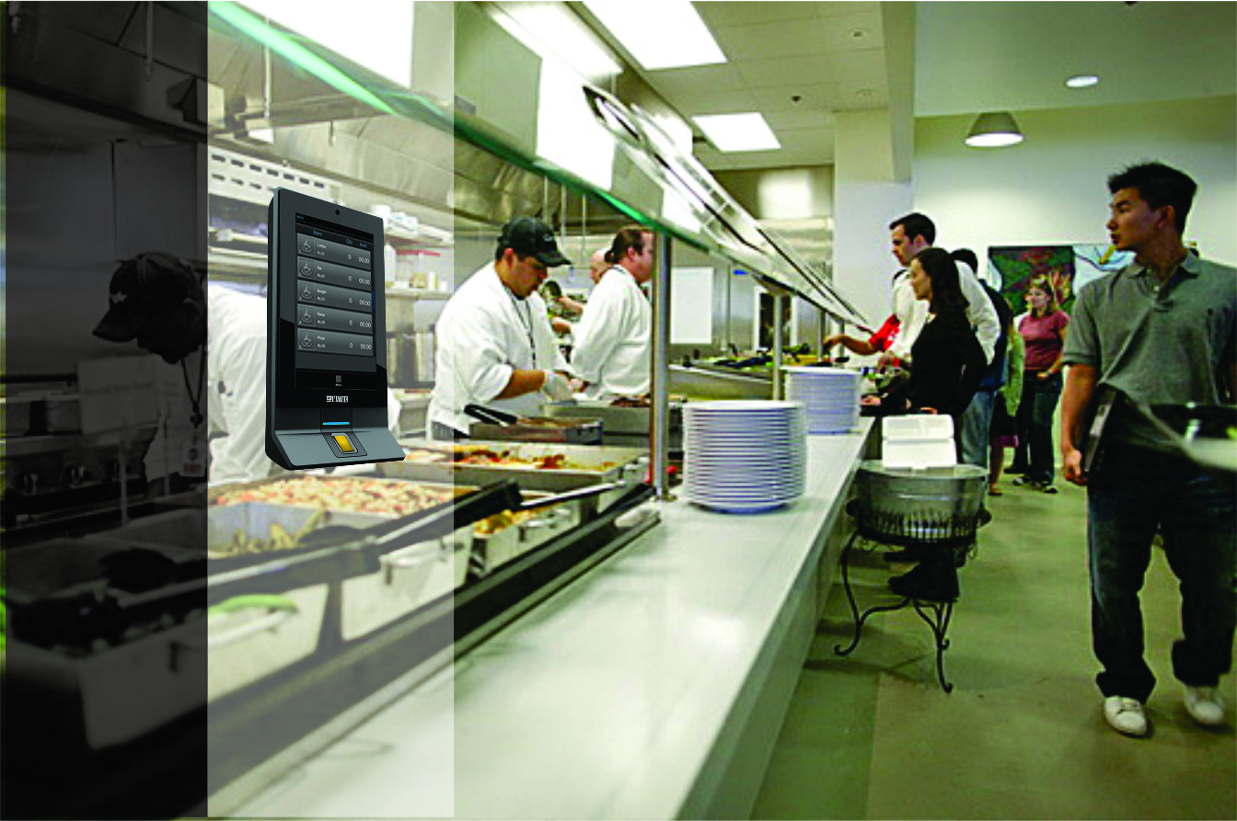
Cafeteria

Slide 4


What is Cafeteria Management?
Completely Automated Cafeteria Process
Combination of Hardware and Software
Hardware to Order Food using User’s Credential
Software to Process the Payment for Ordered Item
System Generates Various Consumption and Sales Reports
User Data Sent to Payroll/Billing Software for Further Action

Slide 5
Matrix Cafeteria Management
Define Items, Customize Menu and Menu Schedule
Item Tracking to Prevent Wastage of Food
Secure and Speedy Transaction
Prepaid and Postpaid User Accounts
Item-wise and Department-wise Report Generation

Slide 6

Benefits of Cafeteria Management
Eliminates Human Error in Accounting and Item Orders
Increases Efficiency by Reducing Time and Cost of Planning
Significantly Increases User’s Satisfaction by Authenticated Data
Faster and Secure Process through Cashless Transactions
Monitors and Analyzes Food Usage to Prevent Wastage
Allows Admin to Focus on More Productive Tasks
Allows Customization and Updating of Menu
Reports for Faster Interpretation of Consumption

Slide 7
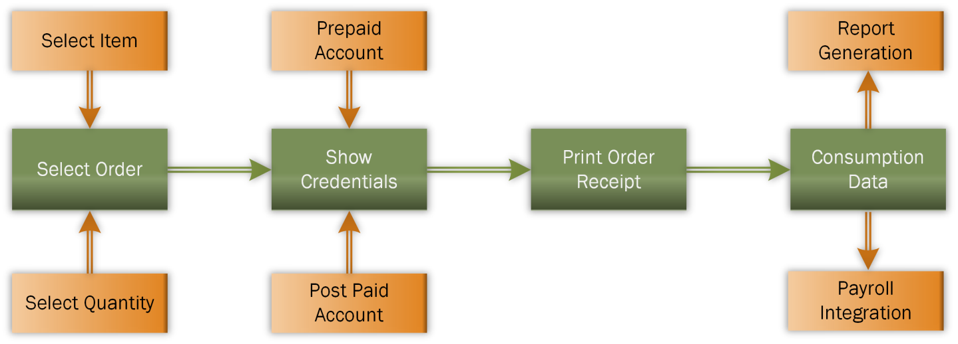
How Cafeteria Process Works?

Slide 8

Why COSEC CMM?
Comprehensive Solution for All Establishments like Corporates, Hostels, Hospitals etc.
Completely Scalable and Flexible
Cashless Transactions
Customizable Menu and Menu Schedule
Fingerprint and Card as Credentials for Ordering of Food
Prepaid and Postpaid Accounts
Refund on Unavailable Ordered Items
Export Data to Existing Payroll/Billing Software
Various Reports in Multiple Formats

Slide 9

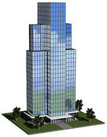




Target Customers…
Hospitals
Corporate Offices
Educational Institutes
Factories
Hostels
Hotels

Slide 10
Hardware Compatibility
COSEC DOOR Series
COSEC NGT Series
COSEC VEGA Series

Slide 11
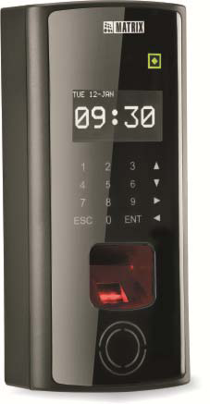

COSEC DOOR Series Models
FOP: Access Control & Time-Attendance Terminal
FOT: Time-Attendance Terminal

Slide 12

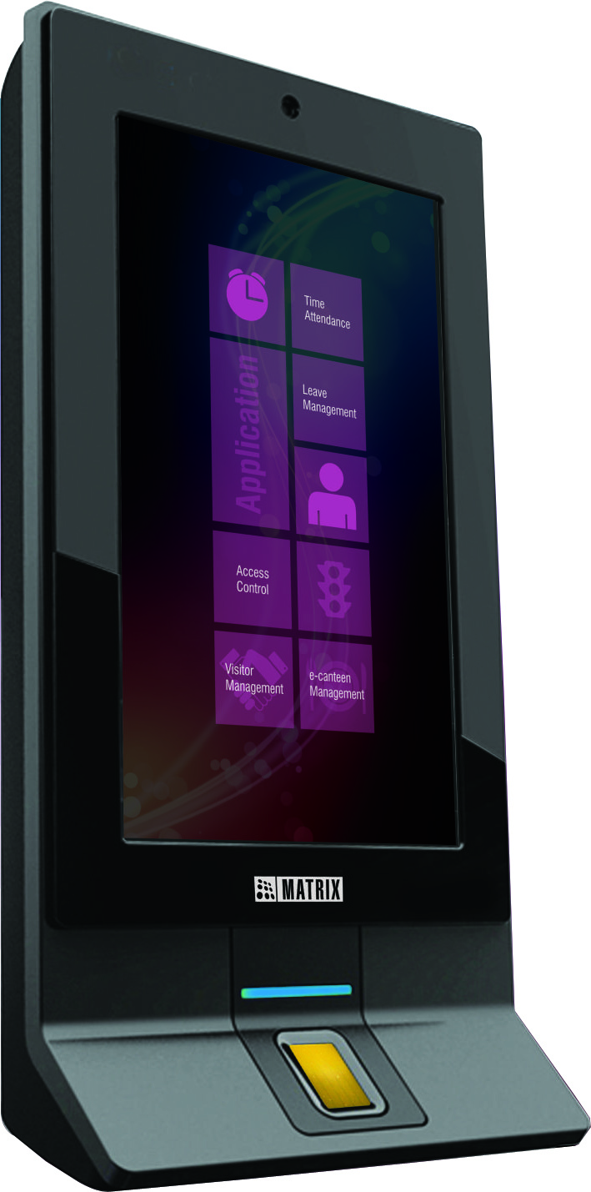

COSEC NGT Series Model
NGT FCX

Slide 13
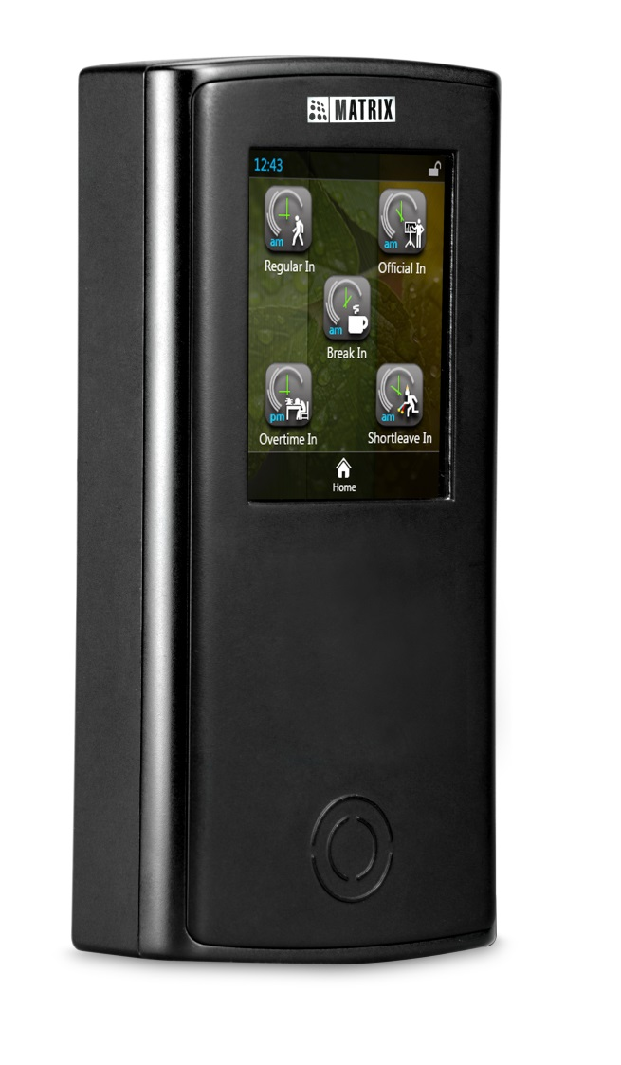
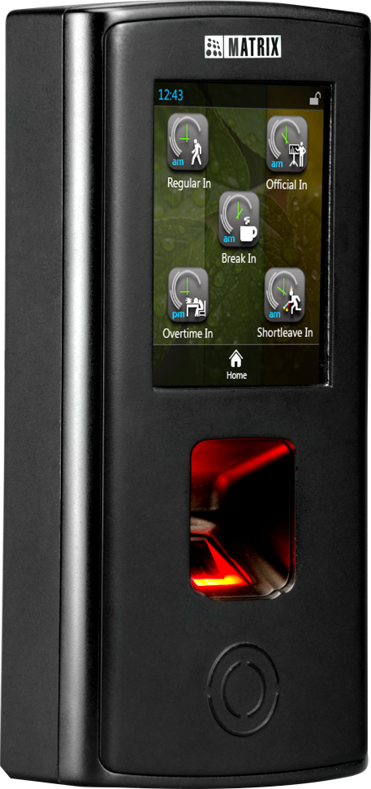
COSEC VEGA Series Model
FAX
CAX

Slide 14
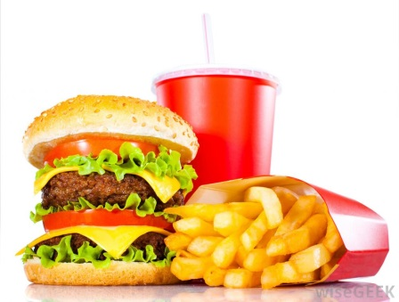
Cafeteria Process
Define Items
(Up to 255)
Define Menus
(9 Menus with 30 Items in Each)
Schedule Menus
(48 Different Menus)

Slide 15
Define Items
Define all Available Items
Define Prices and Discounts if Available
Define Up to 255 Items
Tea Rs 10
Pizza Rs 150
Noodles Rs 120
Coffee Rs 10
Sandwich Rs 40
Burger Rs 60

Slide 16
Define Menus
Define Different Menus
Like Breakfast, Lunch, Dinner
Define 9 Different Menu with 30 Items in Each Menu
Breakfast
Tea
Coffee
Sandwich
Dinner
Noodles
Pizza
Burger
Frankie
Lunch
Rice
Curd
Burger
Pizza

Slide 17
Schedule Menus
Schedule Different Menus at Different Time and Date
Define 48 Different Menu Schedule per Device
Put an Item as a Default Item and others as Selective

Slide 18


Key Features

Slide 19

Cashless Transactions
Prepaid or Postpaid Account
Reduces Human Error in Accounting
Direct Deduction from Payroll
Addition to Billing
Simple Recharge

Slide 20

Auto-Selected Item
First Item in Each Menu as Default Item
Saves Time as Browsing of Menu is not Required
Increased Efficiency with Smaller Queues
Useful for Cafeteria Serving Fixed Breakfast/Lunch/Dinner
Most Selling Item can be Set as Default Item

Slide 21


Food Planning
Tracks Item-wise Consumption of Food
Provides Concrete and Consistent Data for Planning
Reduces Wastage of Food
Helps Increase Productivity by Proper Planning

Slide 22
Postpaid Account
Biometric Fingerprint, Smart or Proximity Card
Define Maximum Credit Permitted per User per Month
Define a Blocking Limit
No Need of Managing Cash at all Times
Bill Deducted Directly from Salary

Slide 23
Prepaid Account
Smart Card to Store Balance Information
Simple Recharge Option
Recharge as and When Needed
No Need to Keep Cash at all Times
Maximum Recharge Allowed at a Time is Defined

Slide 24
Blocked Users
Monitors Postpaid Users
Helps to Avoid Treacherous Users
Blocks User if Amount Due Exceeds a Fixed Set Up Limit
Two Ways to Reinstate a Blocked User
Pay Full or Part of the Due Amount
Increase the Usage Limit

Slide 25
Export to Payroll/Billing
User Need not to worry About Paying their Dues Separately
Exports Data to Third Party’s Software
Various Formats Like CSV, XML, Text and Excel
Helps to Save a Lot of Time for Corporates, Institutes and Others

Slide 26
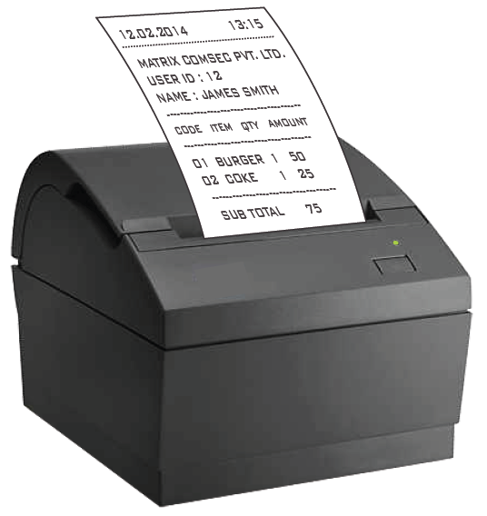
Integration with Printer
Directly Prints Receipt for Ordered Food
Printer Can be Connected Using
USB Port
LAN
RS-232

Slide 27

ESS for Cafeteria Activity
Web based Portal for Employees
Check Account Balance in Real-Time
Helps to Decide the Menu Order in Advance
Helps in Monitoring the Expenditure
Apply/Approve for Expenditure Correction .

Slide 28

Reports

Slide 29
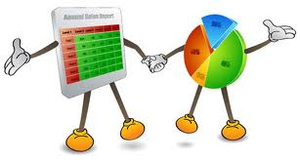
COSEC Reports and Charts
Wide Range of Reports for Diverse Needs
Item-wise and Department-wise Reports
Consumption Reports
Option to Print and Export Report

Slide 30
Report File Formats
Export Report in Various File Formats
PDF
XML
Rich Text Format
MS Excel
MS Excel (Data Only)
Crystal Report (RPT)
MS-Word
MS-Word Editable

Slide 31
COSEC Cafeteria Reports
Cafeteria Reports
Item-wise Consumption
Department-wise Consumption
Head Count
Sales
User Consumption
Credit Due
Blocked Users
User Account Details

Slide 32
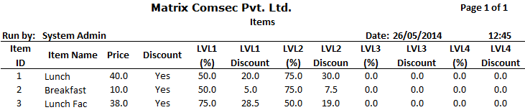
Item Report

Slide 33
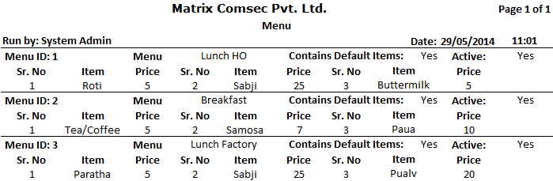
Menu Report

Slide 34
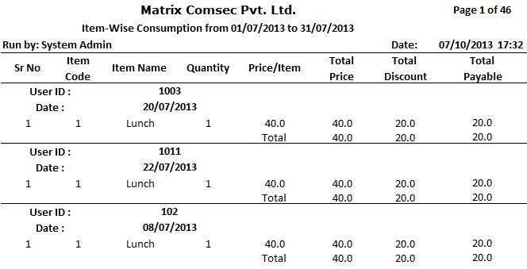
Item-wise Consumption Report

Slide 35
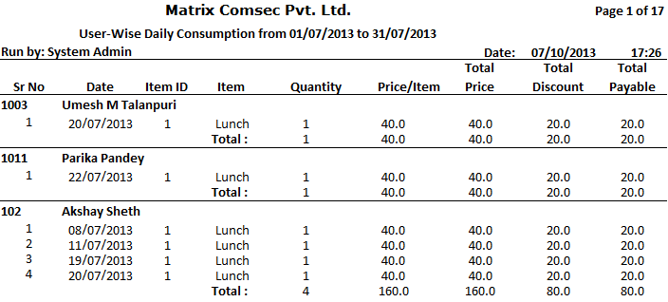
User-wise Daily Consumption Report

Slide 36
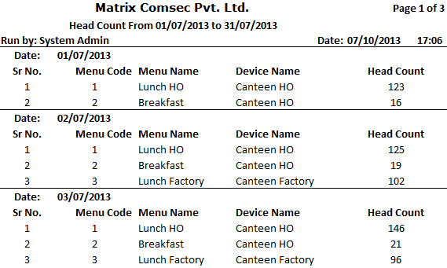
Head Count Report

Slide 37
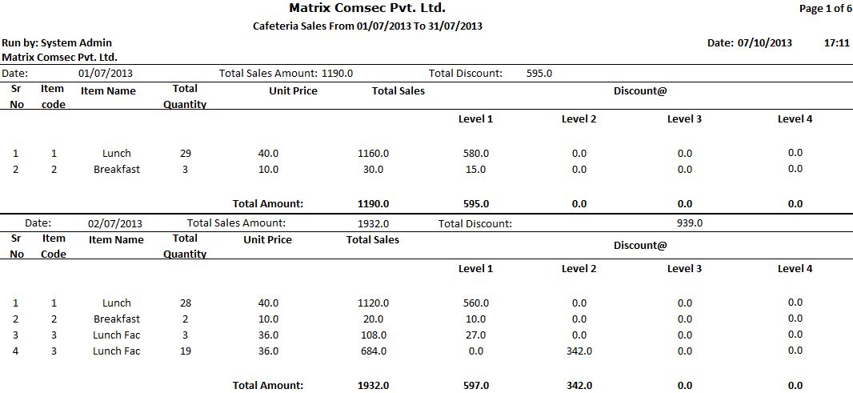
Cafeteria Sales Report

Slide 38



Slide 39
For Further Information Please Contact:
Email ID: Security@MatrixComSec.com
Tel: +91 265 2630555
Visit us at www.MatrixComSec.com
Version: V2R1

