Slide 1

COSEC Visitor Management
Right People in Right Place at Right Time

Slide 2
WHY Visitor Management?
Lack of Professional Approach towards Visitors
Require Easy, Fast and Error Free Visitor Registration
No Proper Live Visitor Tracking Mechanism
No Maintenance of Digital Record of Visitor’s Data
Easy Retrieval of Past Visitor’s Data
Improve Organization's Security

Slide 3
WHAT is Matrix Visitor Management?
Desktop based Visitor Management Software
Store Visitor’s Personal, Official and Visit Information
Automatically Notifies the Hosts about a Visitor’s Arrival
Generates Customized Visitor Pass
Limit Visitor Access in Particular Areas only
Live Tracking of Visitors
Store Visitor’s Record for Future Purpose
Generates Detailed Reports of Visitor Movement

Slide 4
Benefits
Saves Time of the Visitors by Fast Registration
Create Professional Image of the Organization
Enhance Security in the Organization
Digital Record of Visitor Data for Future Use
Manage Multi Gates from Single Centralized Software Itself

Slide 5
Applications

Slide 6
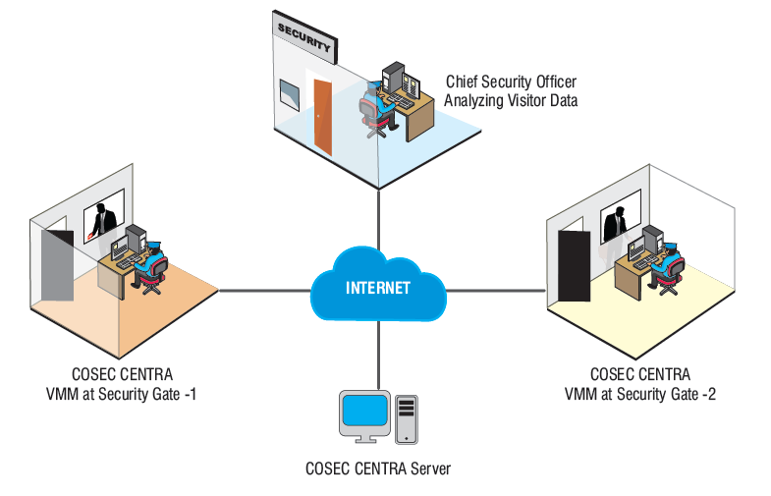
Multi Gates Visitor Management

Slide 7
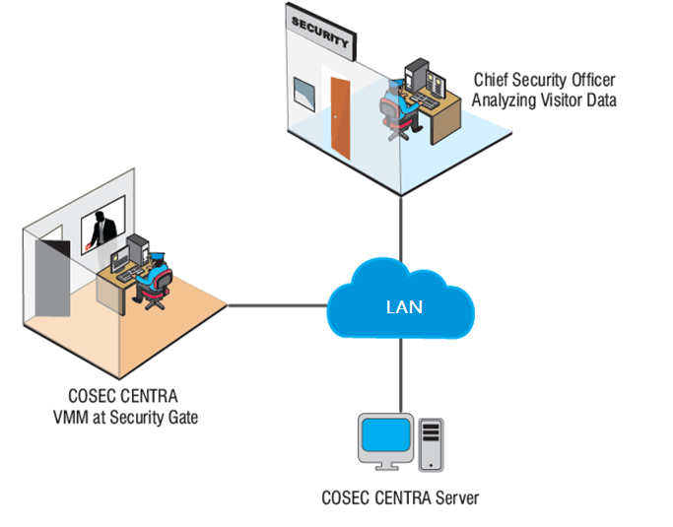
Single Gate Visitor Management

Slide 8
Matrix Visitor Management Process
Spot Registration
E-Pass
Palm Vein, Fingerprint, RFID Cards
Visitor Registration
Create Visitor Pass
Visitor Access
Surrender Pass
Visitor Reports
Pre-Registration
Paper Pass
Check Access Policies

Slide 9
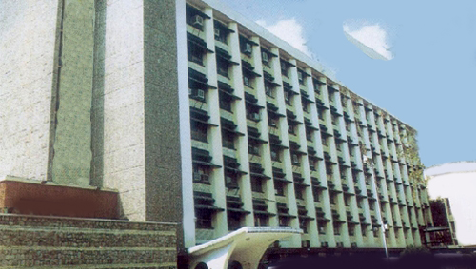
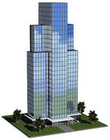




Target Customers
Government
Organizations
Corporate Offices
Educational Institutes
Factories
Hostels
Financial Institutes

Slide 10




Integration with other Hardware
Integrate VMM with:
Web Camera
Printer
Scanner
Signature Pad
Capture visitor snapshot
Printing visitor Pass
scanning visitor ids
Capture visitor signature

Slide 11
COSEC VMM at Vishakha Containers
Applications:
Visitor Management for Manufacturing
Solutions Offered:
Integration with Tripod
Visitor Fingerprint Enrolment with Photo Capture
Daily Visitor Report Generation
Technology:
Fingerprint
Smart Card
Benefits:
Increase Security by 30%
Reduce time of Security Department using Centralized Control and Monitoring
Enhance Security by Integration
Matrix Offering:
Devices: 10+
Pass Creation: 200+ Passes Per Day
Location: Single Location

Slide 12
COSEC VMM at Adani
Applications:
Visitor Management for Manufacturing
Solutions Offered:
Visitor Fingerprint Enrolment with Photo Capture
Daily Visitor Report Generation
Technology:
Fingerprint
Smart Card
Benefits:
Increase Security by 45%
Multi-Location Report Generation from Centralized Place
Matrix Offering:
Devices: 824
Pass Creation: 120+ Passes Per Day
Location: 12 Locations

Slide 13

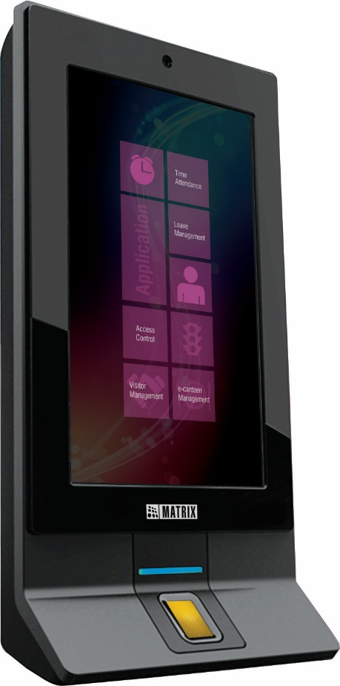
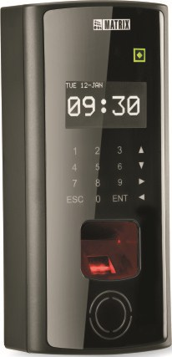
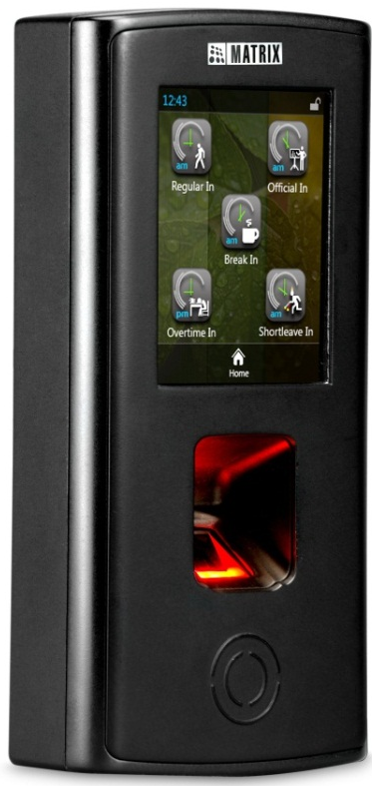
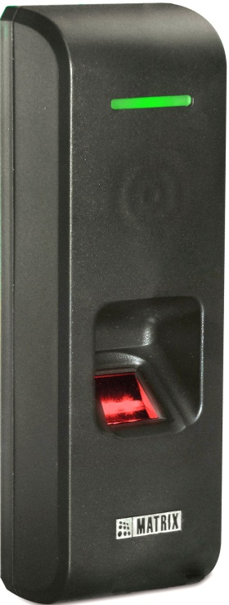
COSEC Door Controllers
DOOR Series
PATH Series
VEGA Series
NGT Series

Slide 14

COSEC Readers
Fingerprint and Card based
Card based

Slide 15
Key Features

Slide 16
Visitor Registration
Feed Visitor Information Like Name, Address, Organization, Contact, Purpose of Visit, Escort User, Vehicle Details etc.
Capture or Upload Photo of a Visitor
Scan Visitor’s Documents and Capture Signature
Registration through:
Spot
ESS
VMM Utility

Slide 17
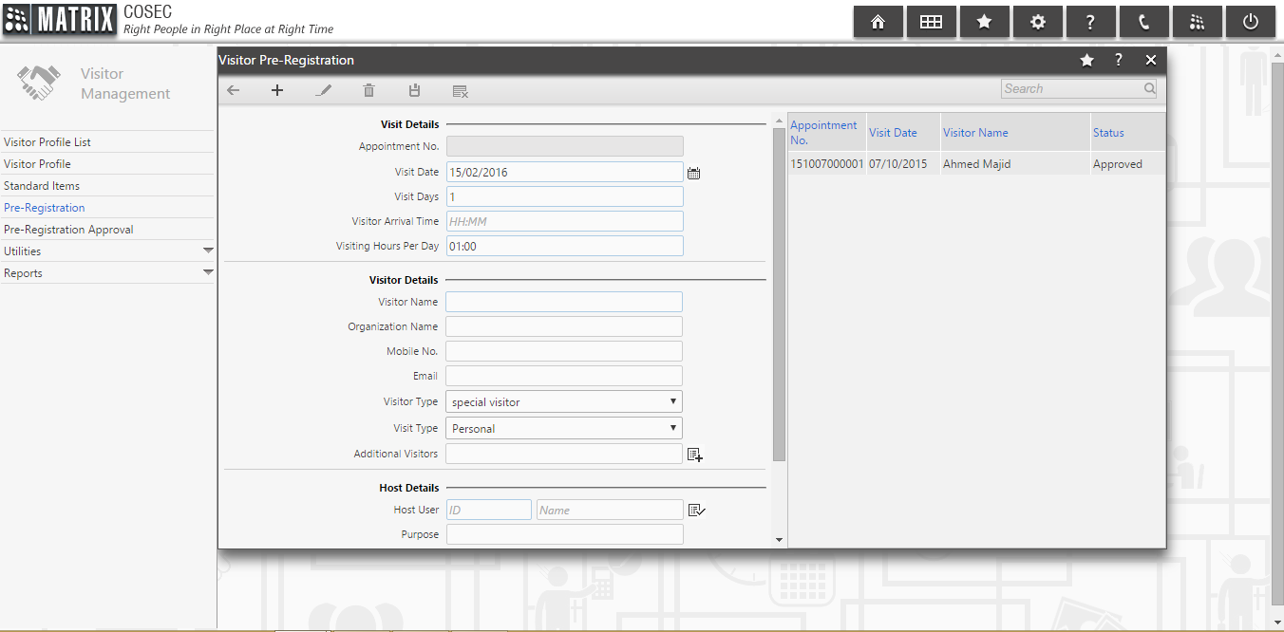
Visitor Spot Registration

Slide 18
Visitor Pre-Registration through ESS
Register Visitor’s Details in Advance Using ESS
Add Personal & Contact Details, Date & Time of Visit etc
Creates Pass Before the Actual Visit
Faster Registration of Visitor
SMS Notification when Visitor Arrives

Slide 19
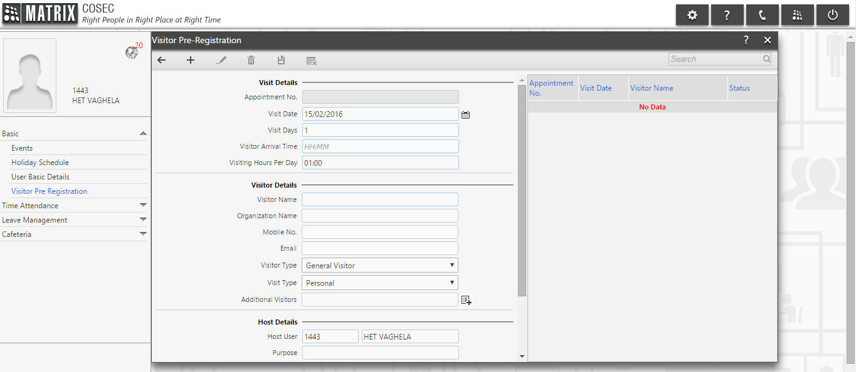
Visitor Registration through ESS

Slide 20
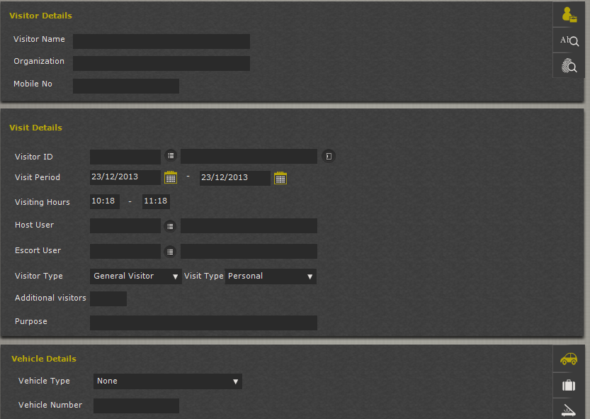
Visitor Registration through VMS

Slide 21
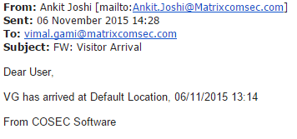
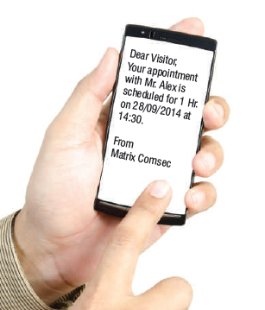
Notifications
SMS or Email Notification on Pre-registration of Visitors.
Notification to Host when the Visitor Checks-in to the Premises

Slide 22


Visitor Enrollment
Visitor Card and Finger Enrollment
Define Time of the Visitor Access
Allow Access to Limited Areas only
Improve Security of the Organization

Slide 23
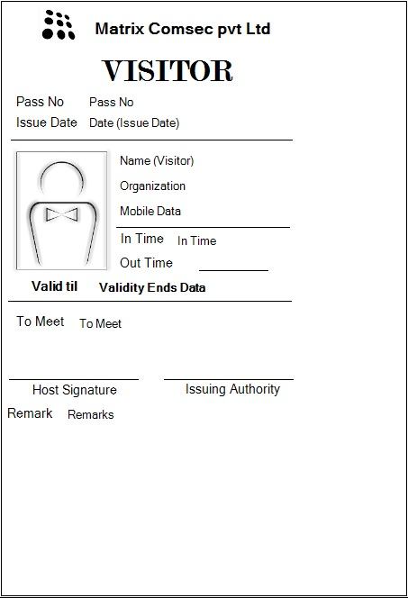
Customized Visitor Pass
Creation an E-pass with Access Rights or a Paper Pass for Visitors
Create Customized Pass with information such as:
Visitor Name
Photograph
Organization Name
Contact Details
Escort Name

Slide 24



Visitor Escort
Provides an Option to Select an Escort along with the Visitor
Access to Visitor only after Showing Escort’s Credential
Ensures Higher Level of Security
Visitor
Escort

Slide 25

Frequent Visitors
Keeps Database of Past Visitors
No Need to Enter Same User Details every Time
E-Pass for a Defined Time Period For Frequent Visitors Like Courier boy, Office Boy etc
Welcome
We already know you Mr. John!
Mr. John

Slide 26
Live Status of Visitors
Shows Current Status of all Visitors in a Single Window Who…
Are Pre-Registered
Are New
Are in the Premises
Have Surrendered Pass
Display Visitor whose Pass is Expired
Improve Efficiency of the Security Person

Slide 27
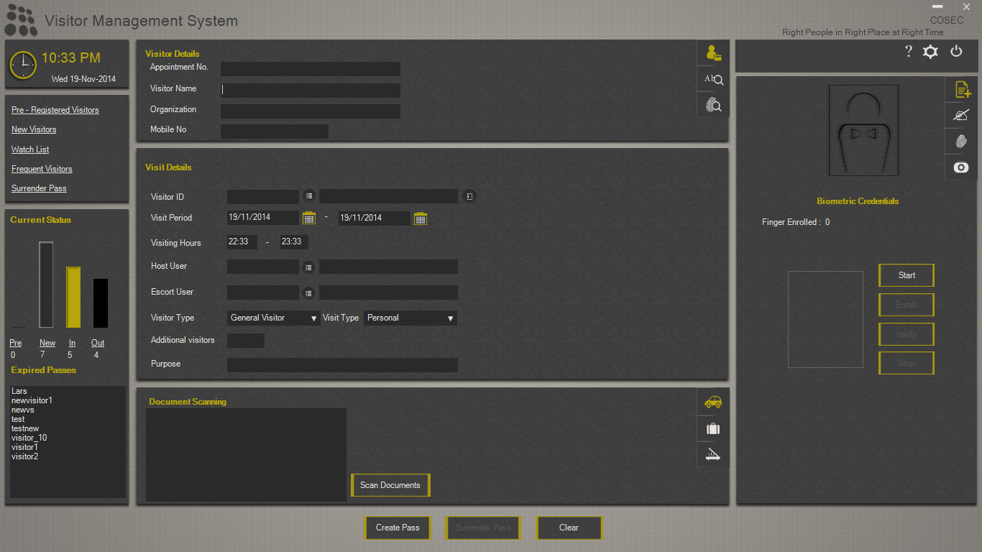
Live Status Window

Slide 28
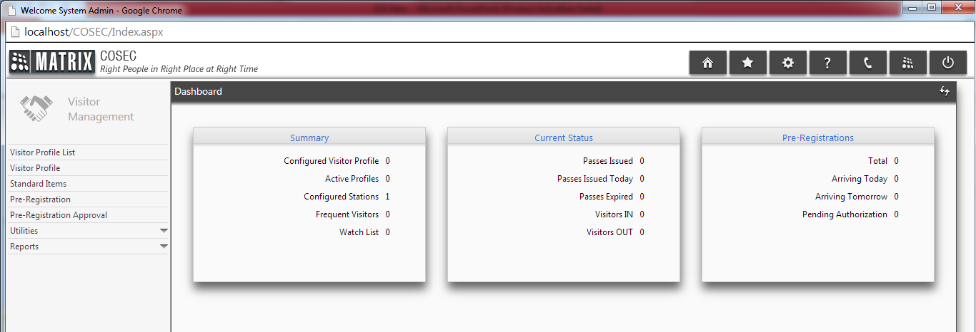
Visitor Dashboard
Provides Information such as:
Live Data of Visitors inside the Premises
Status of Visitor Passes
Pre-Registered Visitors
New Visitors, etc.

Slide 29
Visitor Watch List, Blocked Visitors
Add Particular Visitor to Visitor Watch List
Block Watch Listed Visitor
Revoke Access Rights to Blocked Users
Blocked User
Access Denied

Slide 30
Surrender Pass
When Visitor Going Out He has to Surrender Pass to the Security
If Visitor Surrenders the Pass | If Visitor Doesn’t Surrender the Pass
Visitor Information will be Noted Down and his/her Enrolled Credential would be Discarded from the Premises | A Notification will be sent to Visitor as well as Concerned Authority about Visitor need to Surrender the Pass

Slide 31
Expired Pass
Displays Visitors whose Visit Hours have been Expired but Pass is not Surrendered
Security Person Identify Such Visitor to Improve Security
Keeps Records of Such Visitors

Slide 32





Reports
Generates Reports Like
Visitor Punch Details
Visitor Access Denied
Pre-Registered Visitors
Visitor Pass Validity
Visitor Enrollment Status
MS-Excel
MS-Excel Data
PDF
XML
Rich Text Format
MS-Word
MS-Word Editable

Slide 33
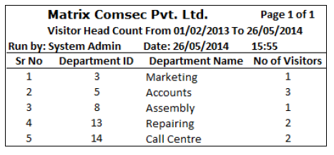
Report – Department wise Head Count

Slide 34
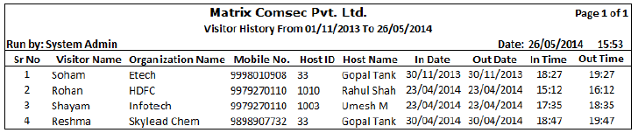
Report – Visitor History

Slide 35
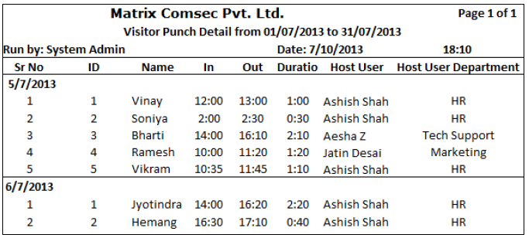
Report – Visitor Time Duration

Slide 36
For Further information, Please Contact
Email | More@MatrixComSec.com
Contact No | +91 265 2630555
Website | www.MatrixSecuSol.com
Address | 394-GIDC Makarpura, Vadodara-390010, Gujarat, India

Slide 37


