Slide 1
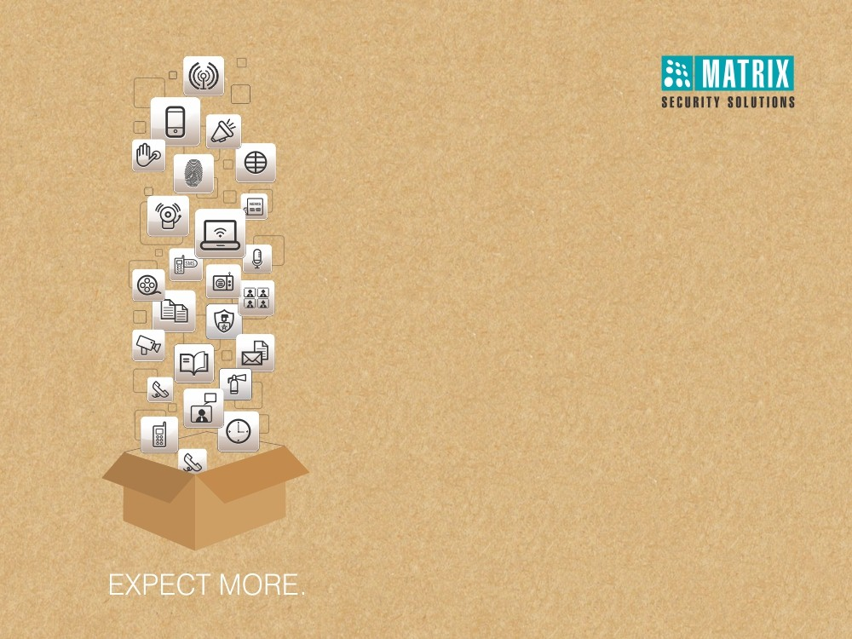
COSEC Access Control
Right People in Right Place at Right Time

Slide 2
WHY to Choose Access Control?
Still Relying on Security Personal for Organization Security
Using Traditional RFID Card Solution
Using Access Control with Basic Features
Taking Actions After the Incident Happens
Managing Devices from Separate Locations
Want to Integrate Other Devices
Absence of Big Data, answering Questions to Who, When, Where

Slide 3
WHAT Access Control Does?
Restrict Unauthorized Access in Secured Area
User Access on Advance Biometric Technology
Restrict User Access based on User, Zone and Time
Require Advance Access Control Features
Centralized Monitoring and Control
Real-Time Notifications on Exception
Integrate with Video Surveillance and other Devices
Conglomerates Multiple branches into One Platform

Slide 4
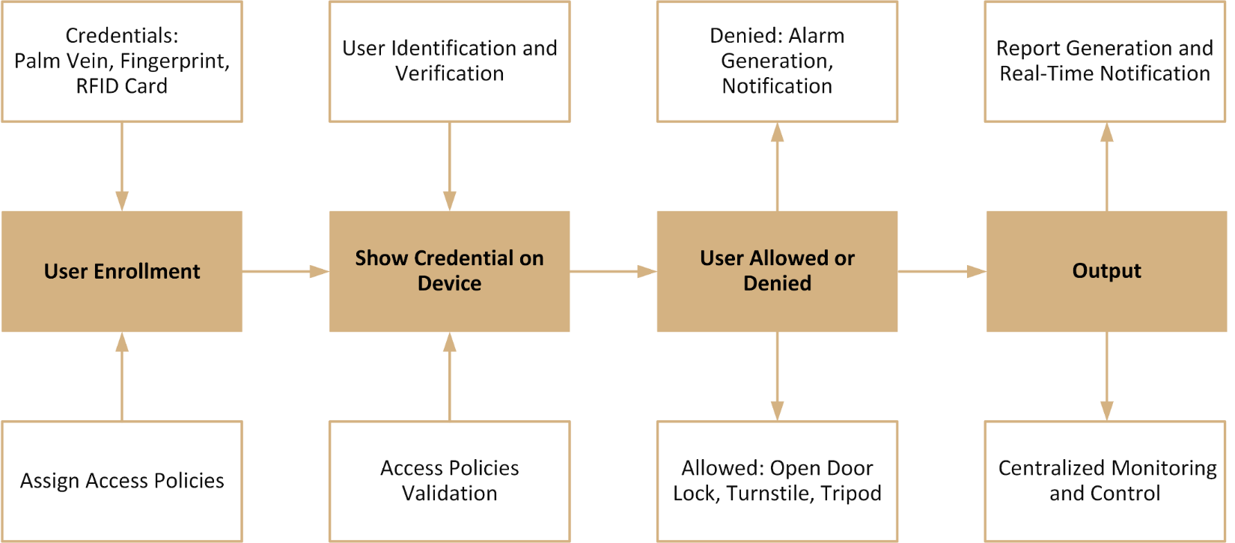
HOW Access Control Works?

Slide 5






COSEC Access Control Solution
Higher Security
Restricts Unauthorized Access
Intacts Security of Multiple Location in Single Software
Protects Dimension of Time, Organization Hierarchy and Asset Classification

Slide 6
COSEC Access Control Solution
Multiple Credentials
Multiple Credential Access
Biometrics: Palm Vein and Fingerprint

Slide 7
COSEC Access Control Solution
Easy Scalability
Scalable Solution
Supports up to 65,000 Devices

Slide 8
COSEC Access Control Solution
Higher Flexibility
Higher Security with 3rd Party Hardware Integration
Inbuilt “Alerts” Functionality Sending Notifications when Required

Slide 9
COSEC Access Control Solution
More Reliability
A Comprehensive Solution for Enterprises, SME and SOHO
Rich Functionality with Simple Configuration

Slide 10
COSEC Access Control Solution
Advance Features
25+ Access Control Security Features

Slide 11
COSEC Access Control Architecture

Slide 12
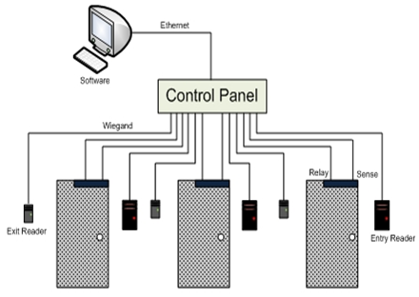
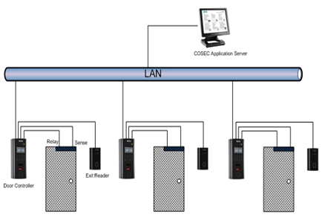
COSEC Architecture
Conventional Systems
Centralized Connectivity
Matrix COSEC
Distributed Connectivity

Slide 13




COSEC Architecture Benefits
Scalable in the Smallest Factor of One Door Controller
Protect Investment
Standard CAT5-CAT6 Wiring
Reduce Cabling Cost and Maintenance Cost
Standalone Independent Device Architecture
Improve Network Reliability and Performance
Plug and Play Device
Easy and Fast Installation

Slide 14

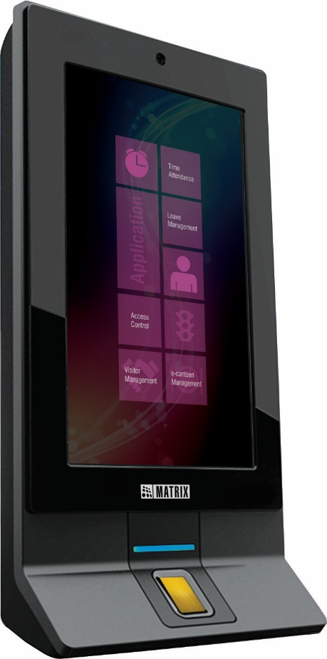
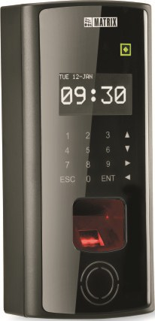
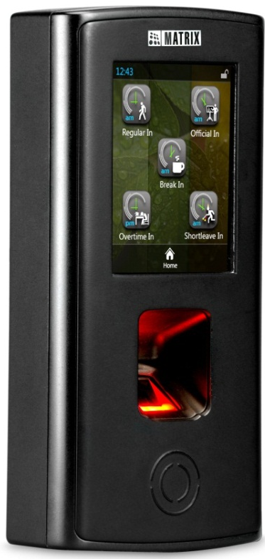
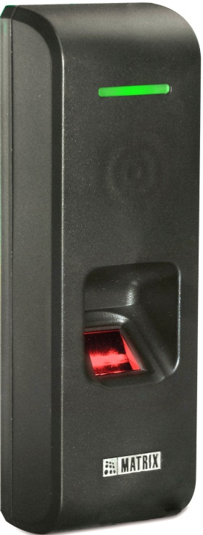
COSEC Door Controllers
DOOR Series
PATH Series
VEGA Series
NGT Series

Slide 15
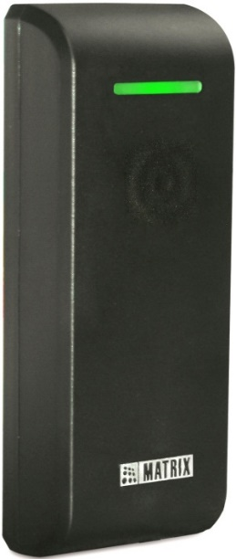
COSEC Readers
Fingerprint and Card based
Card based

Slide 16
Application

Slide 17
COSEC Access Control Application
S
Standalone
N
Network
For
SME, SMB and SOHO
Enterprises and SME
Location
Single Location
Multiple Locations
Software
Built-in with COSEC PANEL LITE
Web based COSEC CENTRA
Capacity
255 Doors,
25,000 Users
65,000 Doors,
1 Million Users

Slide 18
Access Control Standalone Mode
Access Control Solution without any Software
Up to 255 Devices and 25,000 Users
Devices: Site Controller (COSEC PANEL LITE), Door Controller and Readers
Access from PANEL GUI
Door Configuration
Policy Configuration and Assignment
User Profile Creation and Enrollment
Alarm Monitoring and Control
Generation of Reports

Slide 19
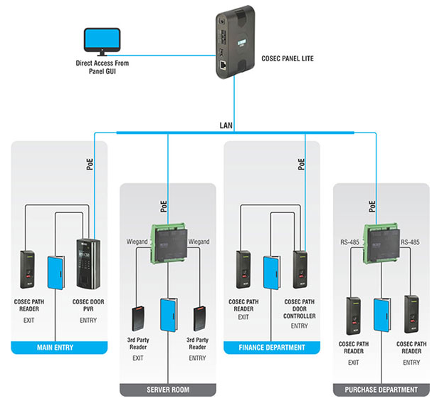
Standalone Mode - Architecture

Slide 20
Standalone Mode – Benefits
Advantages | Benefits
Control up to 255 Doors from a Single IP Panel | Eliminate Need for Multiple Panels
Leverage IP Technology | Standard Structured Cabling, Higher Reliability
Connect Existing 3rd Party Readers | Protect Investment in Existing Readers
PoE Door Controller for Powering Readers and Lock | Simplified Installation, High Reliability
Standalone Operation without Server | Eliminate Server Cost
Scalable for Future Expansion | Optimum Investment

Slide 21
Access Control Network Mode
Centralized Monitoring and Control from Web based Server
Access Control for 65,000 Devices and 1 Million Users
Real Time Data Transfer to Server
Advance Features Like Guard Tour, 2-Person Rule, Man Trap etc.
Integration with 3rd Party Hardware
Informative Reports like
Access Zone
Time Zone
Guard Tour
Door Held Open
Who Is In

Slide 22
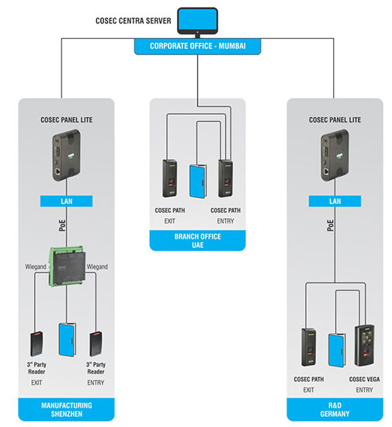
Network Mode - Architecture

Slide 23
Network Mode – Benefits
Advantages | Benefits
Integration of All Locations | Complete Visibility and Better Control
Centralized Management with Local Execution | Facilitate Centralized Process as well as Local Activities Like Enrollment
Real-Time Dashboard Views, SMS and E-Mail Notifications | Faster Response to Exceptional Situations
Connect 3rd Party Readers | Protect Existing Investment
Advance Access Control Features Like 2-Person, First-In User, Guard Tour, Man Trap for Sensitive Zones | Additional Security for Sensitive Zones
Integration with Video Surveillance and Other Applications | Tighter Integration for Value-Added Functions and Enhanced Security

Slide 24
Single Door Access Control Solution

Slide 25



Single Door Access Control Benefits
Scalable
Scalable in the Smallest Factor of One Door
Up to 255 Devices with PANEL LITE
Flexible
Install Near the Door
Reduce Complex Wiring
High Security
Biometric Palm Vein and Fingerprint Reader
Advance Access Control Features
Reliable
Single Independent Door with Distributed Architecture
Standard IP based Wiring
`
Eliminate Extra Cost
Control 255 Devices without Installing any Server
No Need of Local Power Point or Backup, Having PoE

Slide 26
Single Door Panel Vs Multi Door Panel
Single Door IP Panel | Traditional Multi Door Panel
Distributed Architecture; Robust Security | Single-Point of Failure
Compact, Modular and Easy to Scale | Location of a Multi-Door Panel Restricts adding New Doors Due to Distance and Wiring Constraints
Industry-Standard DIN Rail Mounting | Non-Standard Wall Mounting
COSEC PANEL Integrates Up to 255 Door Controllers with Value-Added Features | Support for 4, 8 and 16 Readers are Most Common Configurations
Centralized Management Using COSEC PANEL Web Pages from anywhere | Dedicated Software to Manage Multiple Panels

Slide 27
Single Door Panel Vs Multi Door Panel
Single Door IP Panel | Traditional Multi Door Panel
IP Technology on Existing LAN-WAN | Non-Standard and Proprietary Networking
Industry-Standard CAT5 and CAT6 Wiring | Proprietary, Non-Standard Multi-Core, Long and Expensive Wiring
Installation Near the Door Reduces Wiring and Improves Reliability | Panel Installed in a Central/Server Room Far from all the Doors
PoE Powers PANEL, Readers and Lock; no Need of Local Power Point or Backup | Power is Fed either from Central Location or Multiple Power-Points
Neat, Elegant, Reliable and Easy-To-Maintain Installation | Clumsy, Failure-Prone Installation

Slide 28
Case Study

Slide 29
COSEC Access Control at Ellams, Kenya
Applications:
Access Control for Manufacturing Unit
Solutions Offered:
Integration with Beam Detector
Access based on 2-Person Rule
Allow Entry/Exit based on Occupancy in Zone
Route based Access Control
Restrict Intruder from Escaping Using Man-Trap
Alarm on Access Rule Violation
Control, Acknowledge, Clear and Monitor Alarm in a Real-time
Integration with Video Surveillance
Arm and Dis-Arm Cameras based on Occupancy
Dead Man Alarm for Security Cabin’s Access Rule Violation
Technology:
Fingerprint
Smart Card
Matrix Offering:
Devices: 30+
Users: 100+
Location: Single (Kenya)
Benefits:
Fool-Proof Security in Premises
Proactive Access Control
Enhance Security by Integration

Slide 30
COSEC Access Control at Adani
Applications:
Access Control for Multi - Location Site
Solutions Offered:
Integration with Boom Barrier and Turnstile
Access based on 2-Person Rule
Route based Access Control
Restrict Intruder from Escaping Using Man-Trap
Alarm on Access Rule Violation
Control, Acknowledge, Clear and Monitor Alarm in a Real-time
Dead Man Alarm for Security Cabin’s Access Rule Violation
Technology:
Fingerprint
Smart Card
Matrix Offering:
Devices: 600+
Users: 1200+
Location: 25+ Business Units
Benefits:
Increase Security of Business by 15%
Reduce time of Security Department using Centralized Control and Monitoring
Enhance Security by Integration

Slide 31
Our Prestigious Customers
Adani Enterprises Ltd.
Real Image Media Technologies Pvt. Ltd.
Apollo Micro Systems Pvt. Ltd.
Tata Motors Ltd.
Gujarat Ambuja Exports Ltd.
ABB India Ltd.
RG Group
Greenko Power
Cygnet Infotech Pvt. Ltd.

Slide 32
Advance Access Control Features Keeping Organizations Secure!

Slide 33
Feature List
Access Mode
2-Person Rule
First-In User
Guard Tour
Anti-Pass Back
Alarm
Occupancy Control
Reports
Hardware Integration
Live Monitoring
Tamper Detection
VIP Access
Man Trap
Dead Man Zone
Duress Detection
Smart Access Route
Smart Identification
Access Level, Access Zone
Blocked User
… and many MORE

Slide 34
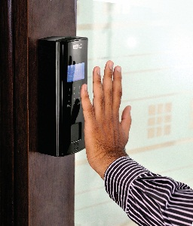
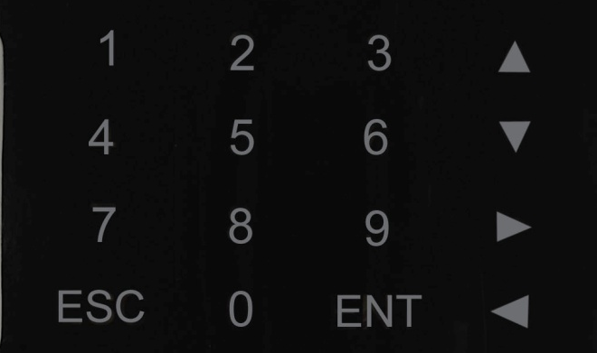

Access Mode
Various Access Modes for Accessing Area
More than One Mode for High Security
Card
Biometric
PIN + Card + Biometric
Card + Biometric
Card + PIN
Biometric + PIN
Any
S
N
Biometric: Fingerprint & Palm Vein

Slide 35

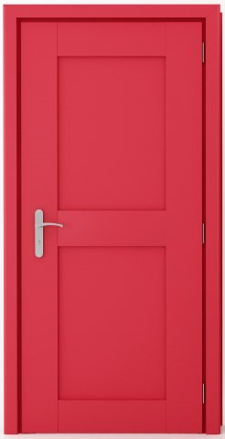




2-Person Rule
Access when Two Authorized Users Use Access Rights within a Specified Time
Up to 16 Groups with 20 Users in Each Group
Useful for High Security Areas like ATM, Server Room, Safe Deposit Vault, R&D Lab etc.
S

Slide 36


First-In User Rule
Restrict User till Authorized User Makes First Entry
Other Users can Enter Only For Specific Time After First User Access
4 First-in User Lists with 25 Users in Each List
Useful for Chemical Plant, Hazardous Areas etc
S

Slide 37
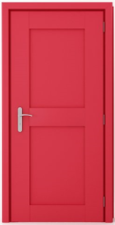


Guard Tour
Enforce Vigil Patrol of Security Guards
Guard has to Show Credential at Defined Check Points on Specified Time Period
Any Deviation Triggers Alarm or Notifications for Instant Security Action
`
1:00
12:00
2:30
4:00
N

Slide 38
Anti-Pass Back
Prevent a Card Holder from Passing his Card to a Second Person to Gain Entry in a Controlled Area
Second Entry Using the Same Card is Allowed Only After an Exit is Registered for Every Entry
Two Modes:
Anti-Pass Back Local
Anti-Pass Back Global
Two Types:
Hard Anti-Pass Back
Soft Anti-Pass Back
S

Slide 39
Alarm on Access Rule Violation
Various Alarms on Pre-defined Situations
Available on both Door Controllers and Site Controller
Built-in Alarm Detection and Management
Alarm on Access Rule Violation Like Guard Tour, Dead Man Zone, Access Route Violation
Helps to Take Immediate Security Actions
Real-Time Notification on SMS & E-mail
S

Slide 40
Occupancy Control
Controls Number of Users in a Designated Zone
Restricts the Entry After Count Reaches Maximum Limit
Useful in Conference Hall, Cafeteria, Seminar Hall etc.
S

Slide 41
Integration with other Hardware
Automatically Activate O/P Port on Activation of I/P Port to Notify Authorized Person
Ensure Higher Security with:
Unlock Door on Fire Detection
Capture User Photo when He is Allowed
Generates Siren on Fire Detection
Start Video Recording on any Motion Detected
S
N

Slide 42
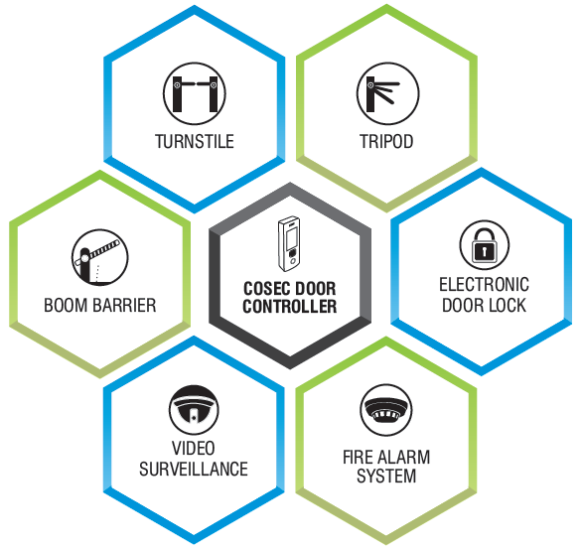
Integration with Other Hardware

Slide 43
Live Monitoring Window
Real-Time Events Monitoring and Control
Live Status of Door Controllers and Site Controller
Alarm Monitoring and Control
Temporary Deactivate Function/Features
Auxiliary Input and Output Status
Automatic Events Download
S
N

Slide 44
Tamper Detection
System Generates Alarm on Detection of any Tampering
Generates Alarm for Instant Security Actions
Alarm can be Disabled Temporarily for Maintenance Purpose
N

Slide 45
VIP Access
Highest Level of Access Privilege
Allow Access to Any Controlled Area Without Checking Access Rights
Any Person Holding VIP Access has Highest Access Level (15)
Useful For Director, CEO and any VIP Guest
N

Slide 46
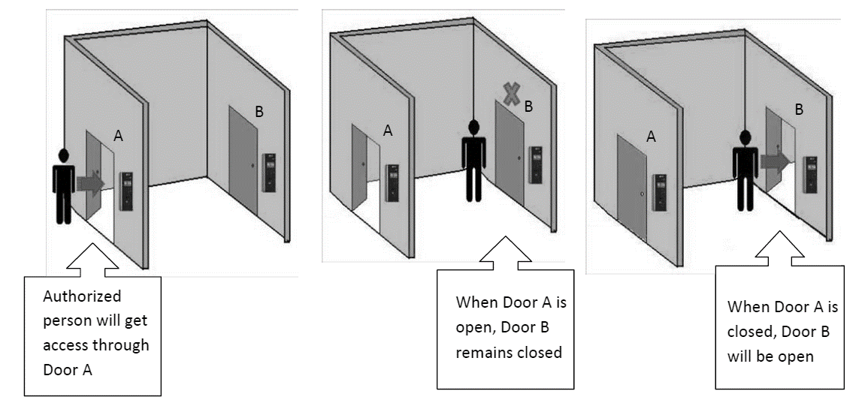
Man-Trap
Useful When Multiple Doors are Arranged in a Sequence
2nd Door Opens Only After 1st Door gets Closed Completely
Manage Traffic, Control Dust and Heat
Restrict Intruder from Escaping the Premises Quickly
S

Slide 47
Dead-Man Zone
User has to Show Credential at Pre-defined Time Interval to Ensure his Presence
Alarm is Activated If User Fails to Punch at Pre-defined Time
Useful in Mines, Chemical Plants, Nuclear Lab etc.
S

Slide 48
Duress Detection
User Need to Dial his Access Code Followed by a Secret Code for Duress Detection
Useful Feature When User is Forced to Use his Access Rights Under Threat
System Opens the Door and at the Same Time Notifies Concerned Person without Giving any Local Alarm
S

Slide 49
Access Route
User can Access Devices in a Specific Sequence (Route) only
Route Information is Stored in Smart Card
User’s Information Stored in the Smart Card is Verified
Cannot Access Devices which are not Part of His Route or Out of Sequence
Useful for Large and Sensitive Areas Like Ports, Mines, Pharmaceutical Labs and R&D Centers
S

Slide 50
Smart Identification
Useful When Number of Users Exceeds the Device Capacity
User’s Credential Details are Stored in Card
User has to First Show Smart Card Following His Credential
COSEC Allows Access and Mark Attendance based on Result
S

Slide 51
Access Level
Allow User If User Access Level is Higher or Equal to Zone Access Level
Up to 15 Access Levels for Zones and Users
Different Access Levels During Working Hours, Break Hours and Non-working Hours
S
N

Slide 52


Access Level
User Access Level =>8
Zone Access Level = 8

Slide 53
Access Zone
Controlled Area to Keep Out Unauthorized Users
Creation of Sub Zones or Logical Zones Inside a Single Zone
Time based Access Policies can be Assigned to a Zone
`
S

Slide 54
Blocked User
Blocked Users are Restricted to Enter in Specified Zones
User is Treated as a Deactivated User and, All Access Privileges are Withdrawn Temporarily
System Blocks User for
User is Absent for More Than a Predefined Time Period
Consecutive Attempts to Access Unauthorized Zone
Access Attempts Exceeds the Maximum No. of
Attempts Allowed Within a Time Limit
N

Slide 55
Do Not Disturb (DND) Zone
User Entry is Restricted in a DND Zone
Zone Access Level is Changed to Highest
VIP User Can Override the Rule
Useful for Business Meeting, Seminar, Operation Theater etc.
`
S

Slide 56
Additional Security Code
Unique Number Encoded on Smart Card
Common Code for Entire Organization
System Identify User based on his Basic Identity (Additional Security Code) to Grant Permission
Very Useful when System is in a Degraded Mode
Prevents Duplication or Fraudulent Use of Card
23248235641254620
S
Additional Security Code

Slide 57
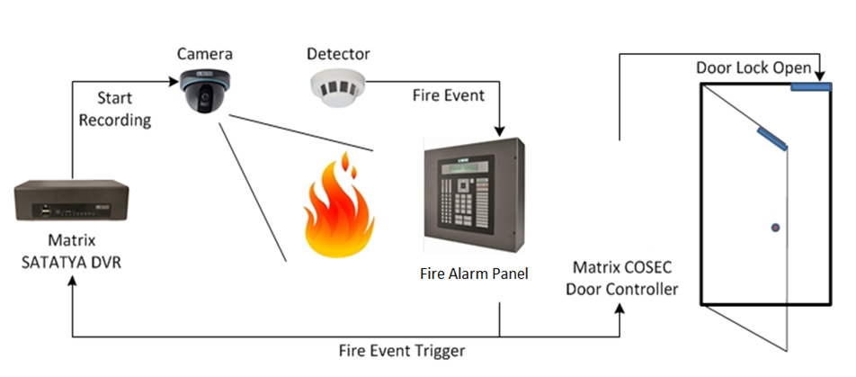
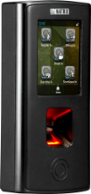
Integration with Other Hardware
S
N

Slide 58
Trigger O/P Device on Specified Time
Automatically Activate O/P Port based on Pre-defined Time
Used for Many Time based Applications
School Bell, Siren, Camera Recording, Door Unlock Can be Activated without any Manual Involvement
S
N

Slide 59
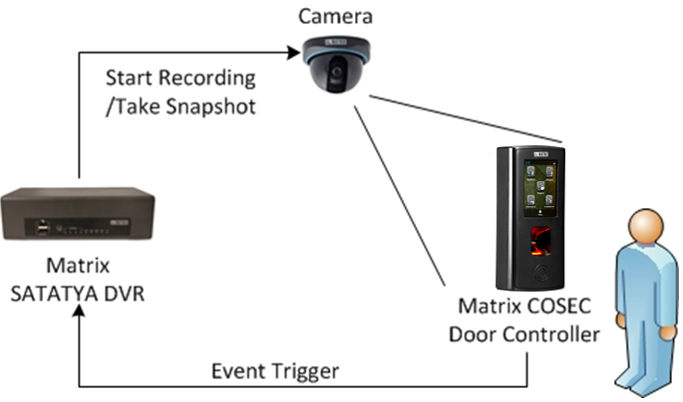
Time Stamping
Integration with Video Surveillance Solution
Takes a Snapshot of Person Accessing a Door
Generates Reports with Photograph
Ensures Security and Accurate Attendance Marking
S
N

Slide 60






Reports in Various File Formats
MS-Excel
MS-Excel Data
PDF
XML
Rich Text Format
RTP
MS-Word
MS-Word Editable
S
N

Slide 61
Reports
Access Zone
Time Zone
Access Group
Functional Group
2-Person Group
Input Port Group
Output Port Group
First-In User
2-Person Access
Who Is In
Guard Tour
Emergency Evacuation
Door Held Open
Alarm Details

Slide 62
For Further information, Please Contact
Email | More@MatrixComSec.com
Contact No | +91 265 2630555
Website | www.MatrixSecuSol.com
Address | 394-GIDC Makarpura, Vadodara-390010, Gujarat, India

Slide 63


