Slide 1
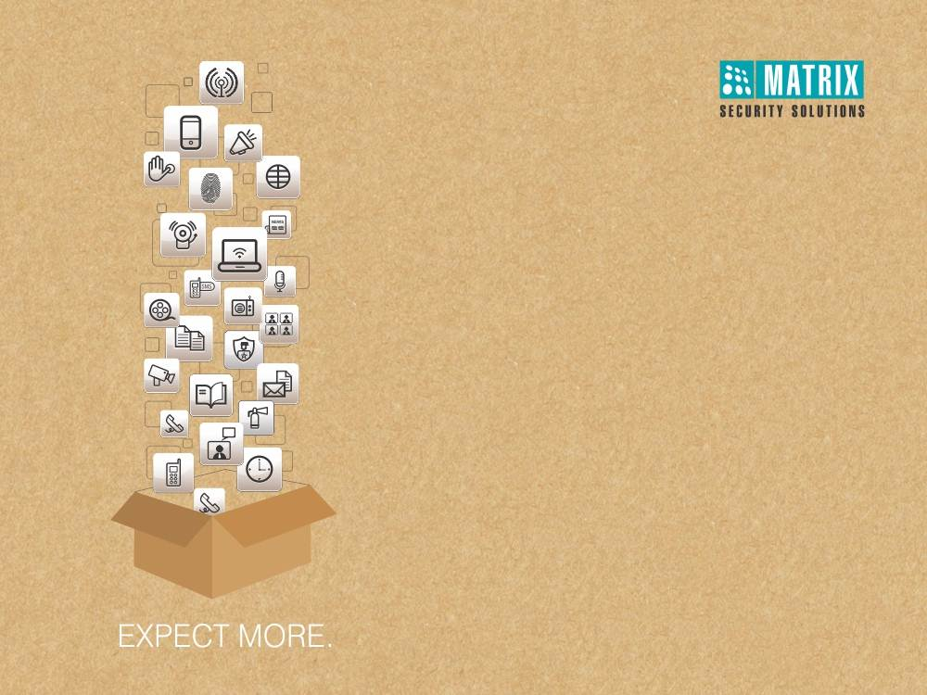
Matrix COSEC Contract Workers Management
Right People in Right Place at Right Time

Slide 2

Why Contract Workers Management
Key Features

Slide 3













Why Contract Workers Management
!
Productivity Issues due to Improper Tracking of Work Orders

Slide 4
Why Contract Workers Management
!
Issues of Workers’ Absence

Slide 5
Why Contract Workers Management
!
Overpayments due to Erroneous Work Hours Data

Slide 6
Why Contract Workers Management
!
Finger Identification Issue

Slide 7
Why Contract Workers Management
!
Difficulty in Maintaining Workers’ Database

Slide 8
Why Contract Workers Management
!
Difficulty in Maintaining Contractors’ Database

Slide 9
Why Contract Workers Management
!
Tackling with Unwanted Workers

Slide 10
Why Contract Workers Management
!
Legal Issues of Workers/Labourers

Slide 11
Matrix COSEC CWM
Key Features

Slide 12


WHY VAM in Corporates?
Matrix COSEC CWM
Web based Solution for Contract Workers Management

Slide 13

WHY VAM in Corporates?
Matrix COSEC CWM
Centralized Data Management Solution for Multiple Locations

Slide 14



WHY VAM in Corporates?
Matrix COSEC CWM
Palm Vein, Fingerprint, and RFID Card based Attendance Marking

Slide 15

WHY VAM in Corporates?
Matrix COSEC CWM
Managing Multiple Entities at a Single Time
Work Order
Worker
Contractor

Slide 16


WHY VAM in Corporates?
Matrix COSEC CWM
Contractor Self Service Web Portal for Managing Workers

Slide 17

WHY VAM in Corporates?
Matrix COSEC CWM
Real-time Notifications for Exceptional Situations

Slide 18


WHY VAM in Corporates?
Matrix COSEC CWM
System Retrieves Events to Calculate the Work Hours

Slide 19

WHY VAM in Corporates?
Matrix COSEC CWM
Various Contract Workers’ Time-Attendance Reports

Slide 20

WHY VAM in Corporates?
Matrix COSEC CWM
Integration with any Third Party Payroll Software

Slide 21

Matrix COSEC CWM: Process
Validity
Contractor Type
Worker Induction, Enrolment
Fingerprint, Palm Vein, RF Card
Report Generation
Work Order Creation
Assign To Contractor
Create Workers
Worker Attendance
Working Hours Data
Maximum Workers
Contractor Profile
Worker Profile
Attendance Policies
Payroll Integration

Slide 22




Target Audience
Construction
Manufacturing
IT/Call Centres

Slide 23
Advantages & Benefits
Advantages | Benefits
Tracking Work Orders | Control Project Progress and Cost
Automated, Fool-proof Attendance Capturing | Increase in Productivity and Minimize Overpayments
Flexible Time-Attendance, Shifts, Overtime Policies | Meets Disparate Needs of Different Functions, Locations, and Individuals
Web based Contractor Portal | Saves time, Better Planning of Workers
Access Control for Worker | Enhance Security of the Organization
Informative Reports | Easy Interpretation and Decision Making
SMS and Email Notifications | Faster Response to Exceptional Situations
Integration with Third Party Payroll Software | Accurate and Quick Salary Payments

Slide 24
COSEC CWM at Adani Enterprises Ltd.
Applications:
Managing Contract Workers across multiple locations
Solutions Offered:
COSEC Contract Workers Management Solution across Four Locations
Centralized Attendance Management Solution
Tracking Work Orders’ Progress
Contractor’s Self-Service Portal for Managing Workers
Worker Enrolment with Photograph, Documents, Credentials, and Induction Details
Integration with SAP using Database to Database Linking
Real-time Notification in cases of Exceptional Situations
Technology:
Biometric Fingerprint
Mifare (Smart RFID)
Wireless Connectivity
Project Highlights:
900+ Contractors
50,000+ Workers
1,400+ Work Orders
Location: Four across Gujarat, Maharashtra, and Rajasthan
Benefits:
Error Free Man-hours Computation for Quick and Effective Wages’ Calculation
Smooth Monitoring of Workers and Contractors
Easy Tracking of Work Orders

Slide 25
Key Features
Key Features

Slide 26















Work Orders’ Management

Slide 27
Work Orders’ Management
Create and Assign Work Orders to Contractors
Details like Total Assigned Workers, Validity, Contractor Details, Skill Information, Access Rights
Assign Work Orders to Pre-registered Workers
Track Status of Work Orders

Slide 28
Contractor Profile

Slide 29
Contractor Profile
Create Contractor’s Profile
Details like Name, Address, Contact Number, Validity Date
Create Multiple Work Types and link it with Contractors
Assign Tasks to Different Contractors

Slide 30
Contractor Web Portal

Slide 31
Contractor Web Portal
Dedicated Web Portal for Contractors to Manage Work Orders and Workers
Check Work Orders Assigned to Workers
Update Work Order Status, Add New Workers, Generate Various Reports
Admin gets Centralized Data from All Contractors
Admin
Contractor1
Worker1
Worker2
Contractor2
Worker1

Slide 32
Worker Profile

Slide 33
Worker Profile
Worker Information with all Required Details at Central Place
Details like Personal Information, Contact, Bank, Contractor
Prevents Proxy or Blacklisted Workers Entering the Premises
Anytime Access on Worker Information with Few Clicks

Slide 34
Worker Enrolment

Slide 35
Worker Enrolment
Pre-enroll Workers in Advance from Project Head/HR/Admin Offices
Enrolment on Site Reporting
Enroll Multiple Credentials for Enhanced Security
Accurate Attendance Marking and Faster Payroll Process

Slide 36
Worker Pass Creation

Slide 37

Worker Pass Creation
Create and Issue a Pass in Advance
Issue a Pass at the Gate on First Day
Customize Worker Pass Formats and Layouts
Information like Name, Profile, Location, Department

Slide 38
Worker Induction

Slide 39

Worker Induction
Create Multiple Induction Levels like Document Proofs, Medical Test, Safety Test, Equipment handling, etc.
Link Induction Levels to Work Orders and Approving Managers
Get Skilled Workers for Various Tasks
Ensures Quality, Productivity and Safety by Induction Programs

Slide 40
Worker Time-Attendance

Slide 41
Worker Time-Attendance
Built-in Flexible and Comprehensive Time-Attendance Features
Create and Assign Multiple Attendance Policies such as Late-In, Early-Out, Overtime, C-OFF, Shifts-Schedules
Generate Detailed and Informative Attendance Reports
Directly Send Attendance Data to any Payroll Software, HRMS or ERP
COSEC VEGA BBU, a Portable Attendance Marking Unit for Construction or Makeshift sites having Power failure issues

Slide 42

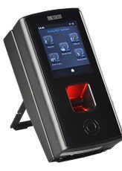
Attendance Marking using COSEC VEGA BBU

Slide 43
Import Database

Slide 44
Import Database
Directly Import Data in Contract Workers Management Module
Allows Importing Contractor, Work Orders and Other Data from Excel or CSV Files
Prevents Errors Avoiding Manual Data Entry

Slide 45
Access Control

Slide 46
Access Control
Access After Identification via Biometric Credentials or an RFID card
Ensure Security of Physical Assets and Safety of Workers and Others
Prevents Workers From Entering Unassigned Areas and Routes
First-In User, Time-Zone-User-Route based Access, Guard Tour

Slide 47
Blacklist Workers

Slide 48
Blacklist Workers
Create and Store the list of Black listed Workers
Blacklist Workers due to their Behavior, Theft, Skill Deficits
Prevents Worker from entering through Other Contractors
Alerts on their Pass Generation

Slide 49
SMS and Email Notifications

Slide 50
SMS and Email Notifications
SMS and Email Notifications to Contractors, Workers, Admin
Alerts for Events like Worker Assignment or Approval, Monthly Attendance, Missing Punch
Take Immediate Action for Exceptional Events
Saves Time of HR and Admin in Resolving Exceptional Events

Slide 51
Informative Dashboard

Slide 52
Informative Dashboard
Overview to Managers about Work Orders and Workers
Information on Work Orders’ Status, Active Contractor Details, Attendance Summary and Notifications
Faster Access of Information from a Single Window

Slide 53
Informative Reports

Slide 54






Vehicle Profile
Informative Reports
Generate Various Reports
MS-Excel
MS-Excel Data
PDF
Worker
Contractor
XML
Rich Text Format
Work Order
Time-Attendance
RTP
MS-Word
MS-Word Editable

Slide 55
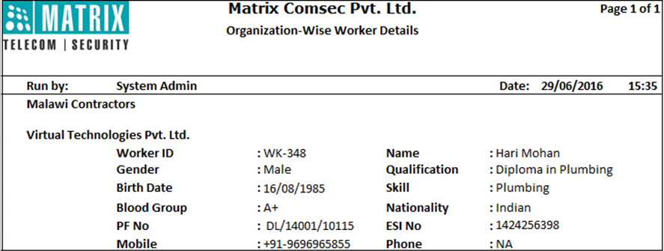
Vehicle Profile
Worker Details

Slide 56
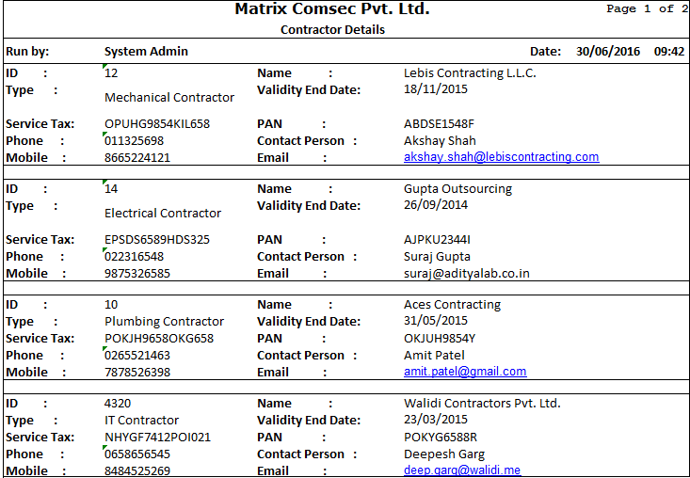
Vehicle Profile
Contractor Details

Slide 57
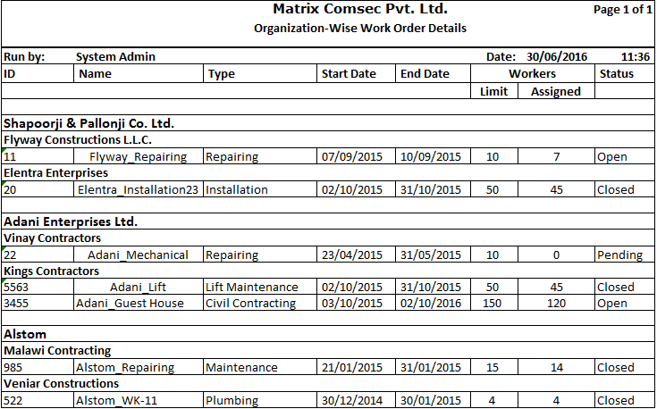
Vehicle Profile
Work Order Details

Slide 58
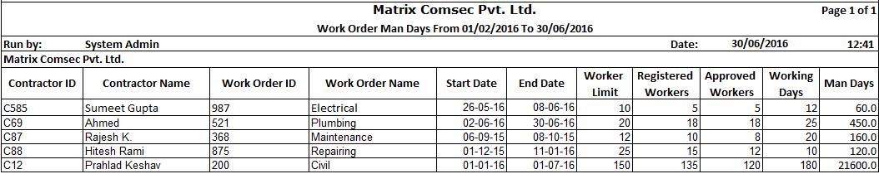
Work Order Man Days

Slide 59
Vehicle Profile
COSEC Demo Link
Link
: http://116.72.250.74:818/COSEC
: sa
User Name
Password
: admin123
Notes:
Self Introduction.

Slide 60
Vehicle Profile
For Further Information, Please Contact -
Email | More@MatrixComSec.com
Contact No | +91 265 2630555 | +91 99987 55555
Website | www.MatrixSecuSol.com
Address | 394-GIDC Makarpura, Vadodara-390010, Gujarat, India

Slide 61


