Slide 1
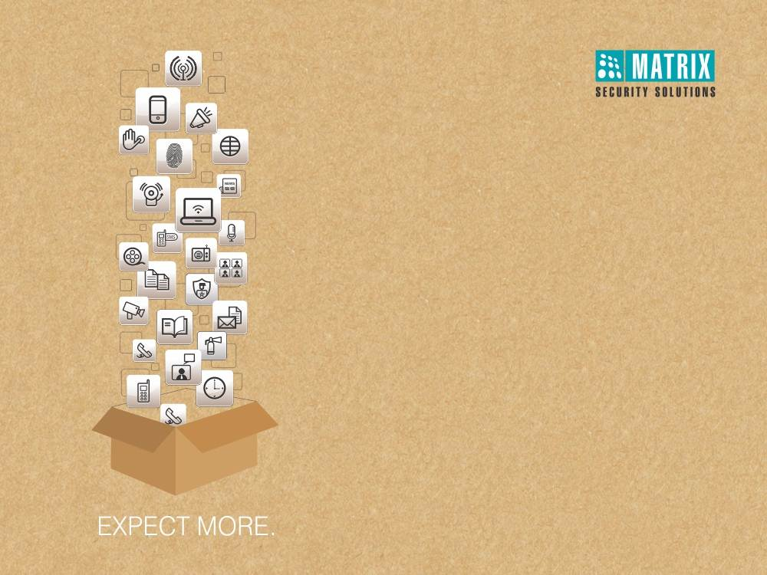
COSEC DOOR FMX
High Performance Door Controller with
Multispectral Fingerprint Reader
Notes:
Self Introduction.

Slide 2







  Demanding Working Conditions
Fingerprint Identification Issues of workers
Damaged
Dry
Wet
Dirty
Elderly
Upper Layer of Fingerprint is not Readable
Problem
Reason
Cause

Slide 3




  Demanding Working Conditions
Application Areas:
Manufacturing
Mining
Construction
Chemical

Slide 4


  What is the Solution?
Demanding Working Conditions

Slide 5
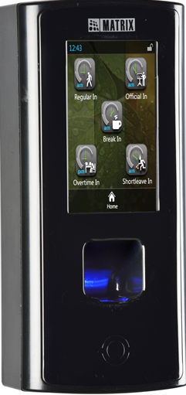
  The Solution
COSEC DOOR FMX
High Performance Door Controller with Multispectral Fingerprint Reader

Slide 6
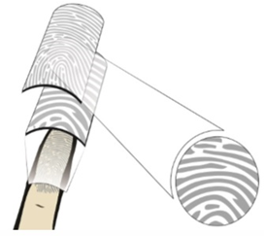
  Reads Two Layers of a Finger
Multiple Scanning Wavelengths
Different Optical Geometries
Surface and Subsurface Feature Identification
Surface Penetration up to 1500 Microns Deep
Capable Enough to Deal with Almost any Finger
Technology

Slide 7











  Reads Two Layers of a Finger
 | Damaged Finger | Light Pressure | Dry Finger | Wet Finger | Dirty Finger | Elderly Finger | Incorrectly Placed | Enrolment Failure
Conventional Optical Sensor
Multispectral Sensor
Image Quality Read by Conventional and Multispectral Sensor

Slide 8
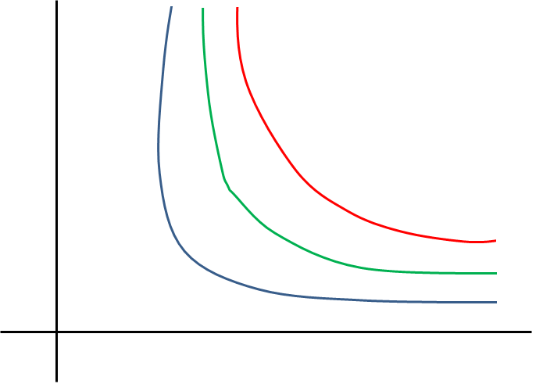
  Differential Factor
High
Higher Performance
More Convenient
False Rejection Rate (FRR)
Optical Sensor
Capacitive Sensor
Low
More Secure
Multispectral Sensor
Low
False Acceptance Rate (FAR)
High

Slide 9
  Usage Conditions
Finger Condition | Usage Area | Industry
Dry | Deserts | Construction, Manufacturing
Wet or Oily | Humid, Rainy | Gym, Chemical, Manufacturing
Dirty | Dusty Regions, Outdoor Application | Manufacturing, Mines, Transportation
Bright Light | Outdoor Application | Construction
Variable Pressure | Children and Aged Users | Education, Club, Health Care

Slide 10
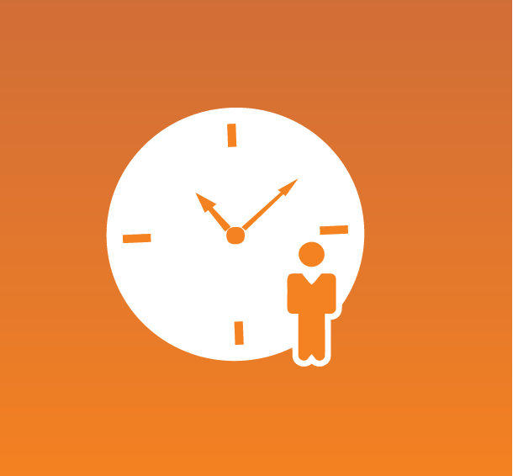
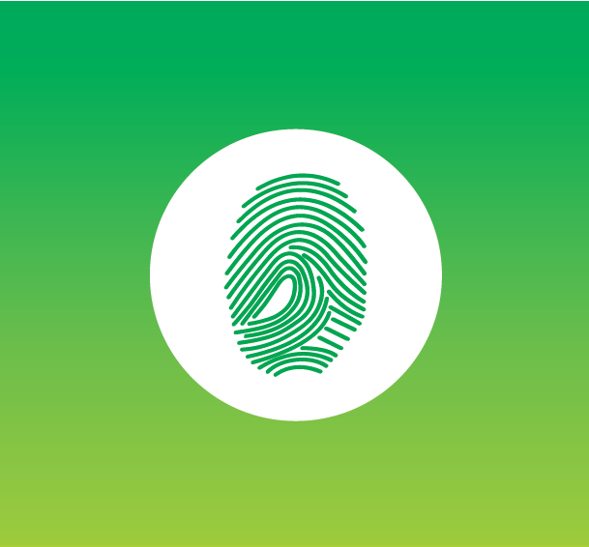


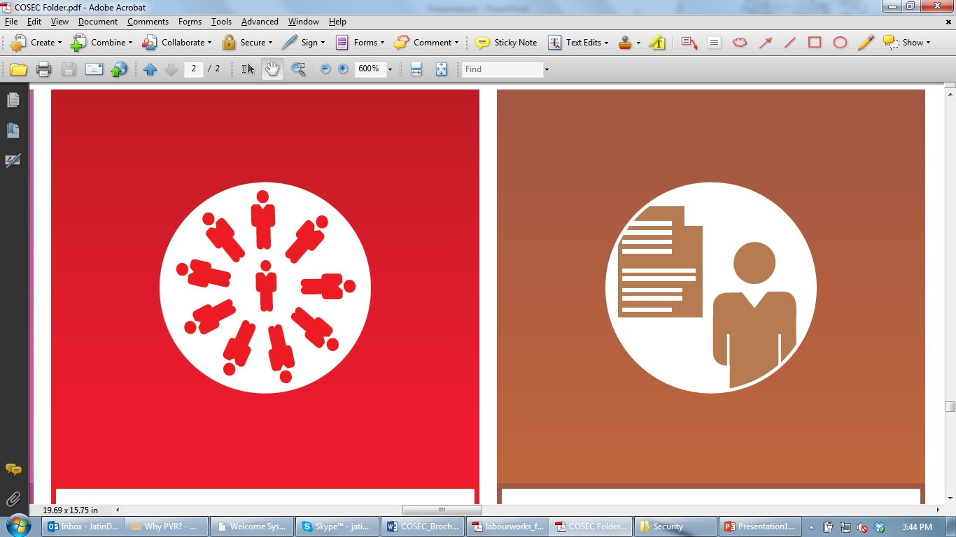
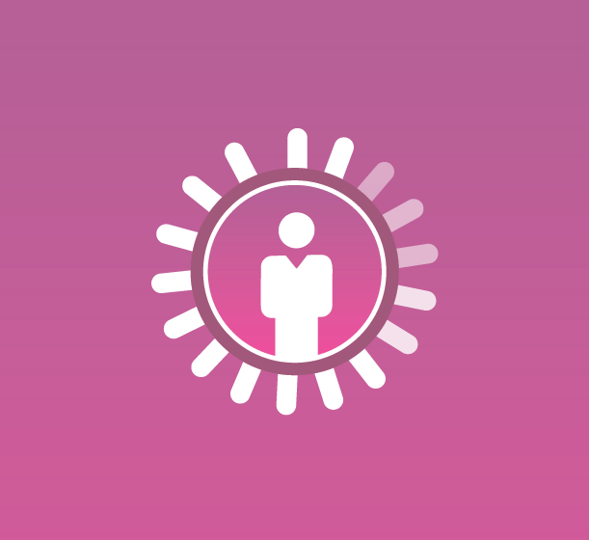


Time-Attendance
Access Control
Visitor Management
Cafeteria Management
Contract Workers Management
Roster Management
Job Processing and Costing
Employee Self Service
Vehicle Access Management

Slide 11




Fingerprint
RFID Card
PIN
RFID Credential Supports EM Prox, HID iCLASS, Mifare Smart

Slide 12



10,000 Users in 1:N Mode with 1:1000 Matches in 3 Sec
50,000 Users in 1:1 Mode
500,000 Transactions
10,000 in 1:N Mode
100,000 in 1:1 Mode
NOTE: It is Recommended to Use 1:1 Matching for Above 1000 Users

Slide 13
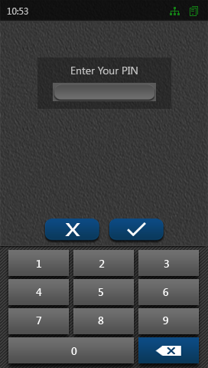
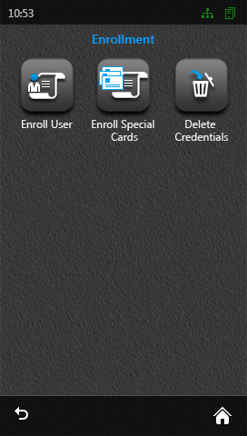
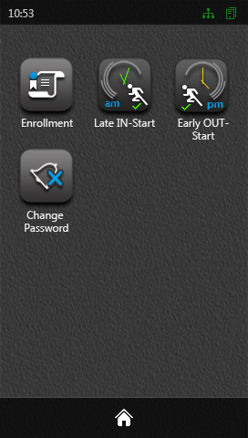
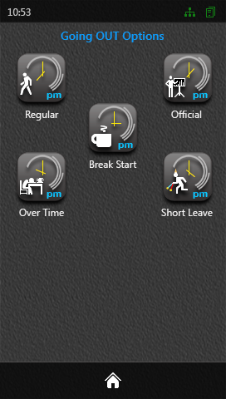
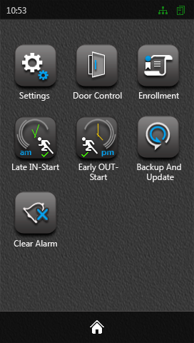
4.3" Touch Screen Capacitive Display
Excellent Image Quality
Faster Response Time
Use Time-Attendance and Access Control Functions

Slide 14



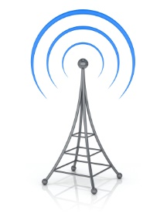

Ethernet
PoE
Wi-Fi
4G/LTE/3G
USB
Wired
Wireless

Slide 15
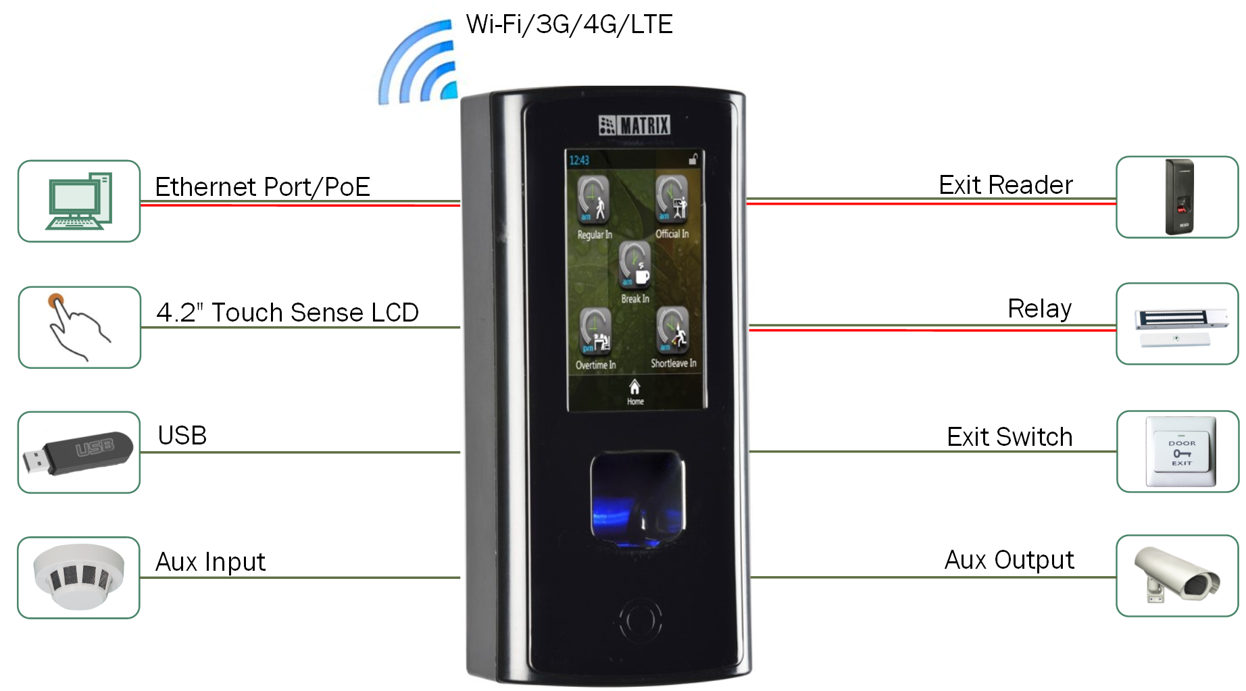

Slide 16
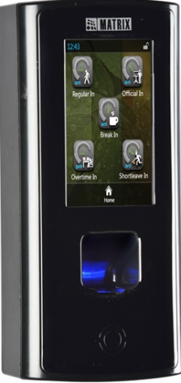
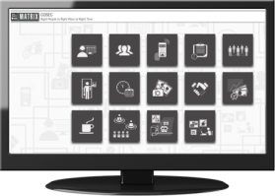

Third Party
Applications
Server Mode with COSEC CENTRA
Device API with other Applications

Slide 17
  Contact Us
Email | More@MatrixComSec.com
Contact No | +91 265 2630555
Website | www.MatrixSecuSol.com
Address | 394-GIDC Makarpura, Vadodara-390010, Gujarat, India

Slide 18


