Slide 1

Matrix Time-Attendance for BFSI
Right People in Right Place at Right Time

Slide 2
BFSI Challenges

Slide 3
WHY VAM in Corporates?
Challenges
1
Centralized Attendance Management of Multiple Locations
Time Spent on Trivial Tasks like Attendance Correction, etc.
Attendance of Field Employees
4
2
Inaccurate and Late Payroll
3

Slide 4
WHY VAM in Corporates?
Time-Attendance as a Solution
Advantages
Benefits
Automated, Fool-proof Attendance Capturing
Increase in Productivity and Minimize Overpayments
Flexible Time-Attendance Policies, Shifts, Overtime Policies
Meets Disparate Needs of Different Functions, Locations, and Individuals
Web based Access
Saves time, Better Planning of Employees
Reports and Charts
Easy Interpretation and Decision Making
SMS and Email Notifications
Faster Response to Exceptional Situations
Integration with Third Party Payroll
Smooth and Timely Salary Payments

Slide 5


Centralized Attendance Management of Multiple Locations

Slide 6
WHY VAM in Corporates?
Solution Offered
Centralized Data Monitoring
Web Based Management
Flexible Time-Attendance Policies
Error-free Attendance Data
Reports and Charts Generation
Holidays and Restricted Holidays
Leave Management

Slide 7
WHY VAM in Corporates?
Centralized Data Monitoring
What
How
Monitoring of attendance data of multi-locations
Real-time monitoring of employee attendance data captured from multiple branches at a central location using web based software
Benefits
Application
Reduce time in events download from various locations
Quick Action on exceptions
Increase in productivity
Ease in managing complex and large number of attendance data
Banks and financial institutes having multiple branches

Slide 8
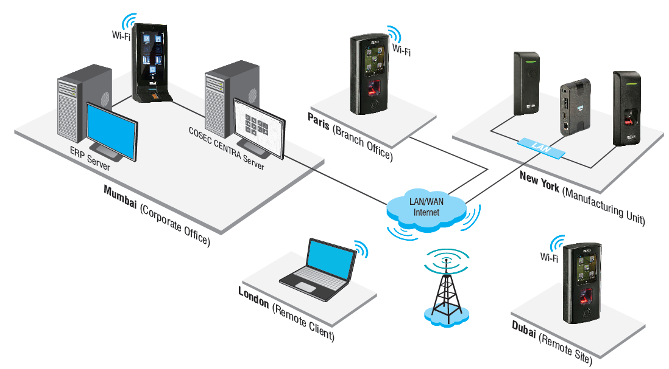
WHY VAM in Corporates?
Centralized Monitoring and Control

Slide 9
WHY VAM in Corporates?
Web based Management
What
How
Attendance management using web from anywhere
Connect all devices to the central server using WAN
Automatic data push from devices to central server
Benefits
Application
Reduce manual interventions and error
Increases productivity
Organizations with multiple branches

Slide 10
WHY VAM in Corporates?
Flexible Time-Attendance Policies
What
How
Comprehensive and flexible time-attendance policies, absenteeism, overtime, compensatory off, late-in/early-out policies
Facilitates the institutions to meet disparate needs of different branches, functions, departments, and individuals offering flexibility in configuring complex time-attendance policies
Benefits
Application
Uniform compliance
Meets diverse needs of organizations with multi-level hierarchies
Institutes with higher level of hierarchies
Large organization having multiple branches

Slide 11
WHY VAM in Corporates?
Error-free Attendance Data
What
How
Managing error-free attendance data for salary processing
Offers accurate and automatic attendance data for quick and smooth salary processing
Benefits
Application
Quick and accurate salary processing
Increase employee morale
Organizations with late and inaccurate salary payment issues

Slide 12
WHY VAM in Corporates?
Reports and Charts Generation
What
How
Generation of various time- attendance reports and charts wiz. branch wise, department wise, etc.
Allows creating 150+ various time-attendance and leave related reports and colorful charts using various filters and formats.
Benefits
Application
Renders easy interpretation
Helps in decision making
Banks, financial institutes

Slide 13






Vehicle Profile
Reports and Charts Generation
Generate up to 150+ Reports and Charts
MS-Excel
MS-Excel Data
PDF
Time - Attendance Reports
Leave Management Reports
XML
Rich Text Format
Time - Attendance Charts
Daily, Monthly, Yearly
RTP
MS-Word
MS-Word Editable

Slide 14
WHY VAM in Corporates?
Holidays and Restricted Holidays
What
How
Various holidays and holiday schedules for multiple branches
Allows creating 30 holiday schedule groups with 32 holidays in each group
Benefits
Application
Increases employee morale
Ease in configuring multiple holiday schedules for branches located at various geographies
Organizations with multi-cultured employees
Organizations having branches at varied locations

Slide 15
WHY VAM in Corporates?
Leave Management
What
How
Manages leave by offering comprehensive leave policies
Offers flexible options to create various leave types with parameters viz. balance check enable/disable, paid/unpaid leave, lay off, accumulation, etc.
Benefits
Application
Reduction in errors caused in salary processing due to unorganized leave data
Increase in morale due to transparency
Organizations with varied leave policies

Slide 16



2
Attendance of Field Employees

Slide 17
WHY VAM in Corporates?
Solution Offered
Attendance Tracking through GPS
Attendance on Move
Time-Attendance on Mobile

Slide 18
WHY VAM in Corporates?
Attendance Tracking through GPS
What
How
Tracking of field employees and their attendance data using GPS
Offers field employee to mark attendance from field, which can be verified by his reporting manager tracking his location through GPS signals received, along with punch details
Benefits
Application
Increase in employee productivity
Reduction in loss of time wastage by field employees
Organizations having field force, viz. insurance agents, sales personnel, etc.

Slide 19
WHY VAM in Corporates?
Attendance on Move
What
How
Automatic attendance marking of employees using mobile
Facilitates automatic attendance marking on entering/exiting a predefined area using smartphone through GPS/Wi-Fi
Benefits
Application
Less time spent after trivial tasks such as attendance corrections
Improves employee morale
Organizations with field staff
Organizations facing issue of missed punches
Organization with HR dept. facing numerous attendance correction requests

Slide 20
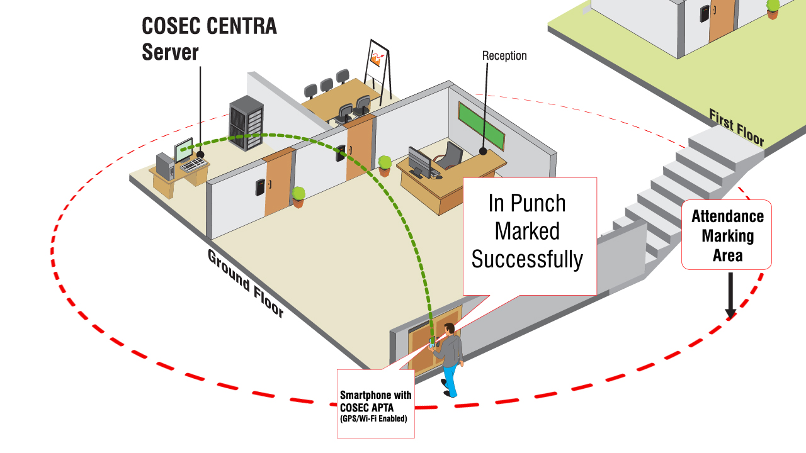
WHY VAM in Corporates?
Attendance on Move

Slide 21
WHY VAM in Corporates?
Time-Attendance on Mobile
What
How
View attendance, shift, leave details
Apply leave/tour/attendance correction through mobile application
Facilitates employees to view their attendance details through mobile application
Employees can apply leave/tour that can be approved by his reporting manager through mobile portal
Benefits
Application
Avoid lengthy procedures of applying tour/leave
Ease at monitoring individual’s attendance
Organizations with field force

Slide 22
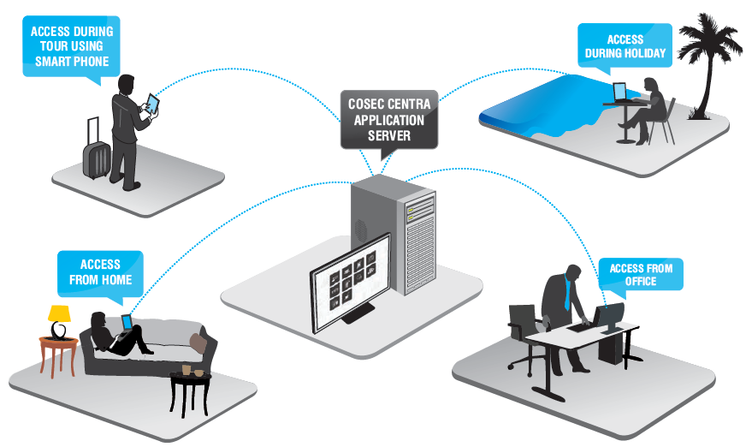
WHY VAM in Corporates?
Time-Attendance on Mobile

Slide 23


Inaccurate and Late Payroll

Slide 24
WHY VAM in Corporates?
Integration with ERP/Tally/Payroll Software
What
How
Integration of time-attendance application with ERP/Tally/Payroll software
Offers smooth integration with third party payroll software for timely salary computation
Benefits
Application
Accurate and quick salary payments
Increase in employee morale
Organizations with inaccurate and late salary payment issues

Slide 25
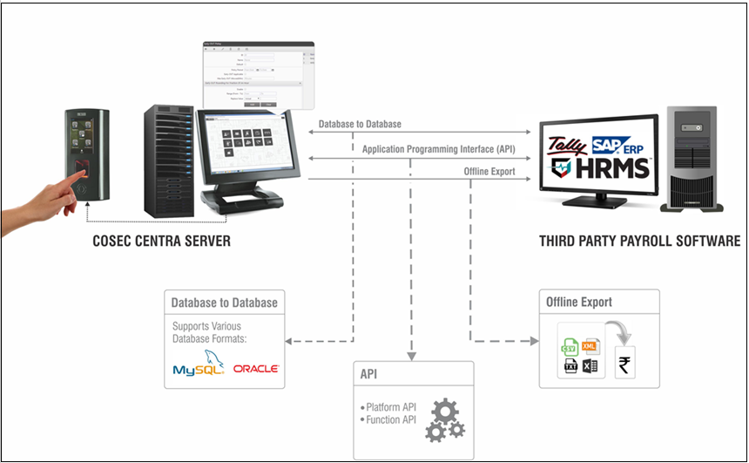
WHY VAM in Corporates?
Integration with ERP/Tally/Payroll Software

Slide 26


4
Time Spent on Trivial Tasks like Attendance Correction, etc.

Slide 27
WHY VAM in Corporates?
Solution Offered
Employee Self Service Portal (for Employees)
Employee Self Service Portal (for Reporting Managers)
SMS and Email Notifications

Slide 28
WHY VAM in Corporates?
Employee Self Service Portal (for Employees)
What
How
Portal for applying leave, tour, attendance correction; marking attendance; viewing attendance, leave, shift details.
Offers employees to mark attendance, apply leave-tour-attendance correction from anywhere, to view attendance, leave, shift details.
Benefits
Application
Avoids time-consuming paperwork and follow-ups
Increase in transparency and trust among employees
Increase in employee morale
Institutes having numerous employees
Organizations having field force, viz. insurance agents, sales personnel, etc.

Slide 29
WHY VAM in Corporates?
Employee Self Service Portal (for Reporting Managers)
What
How
Portal for approving/rejecting leave, tour, attendance correction; authorizing attendance; viewing team’s attendance, leave, shift details.
Offers reporting managers to authorize attendance, approve/reject leave-tour-attendance correction from anywhere, to view team’s attendance, leave, shift details.
Benefits
Application
Decrease in conflicts among reporting managers and their employees
Increase in employee morale
Smooth attendance management
Institutes having numerous employees
Organizations having field force, viz. insurance agents, sales personnel, etc.

Slide 30
WHY VAM in Corporates?
SMS and Email Notifications
What
How
Alerts for various events viz. leave-tour-attendance correction application/approval/rejection, missing in/out punch, user entry/exit, daily-monthly attendance, etc.
Sends SMS and Email notifications to employees and reporting managers for various time-attendance, leave, shift related events
Benefits
Application
Immediate response to exceptional situations
Increase in employee morale and productivity
Institutes having numerous employees in-house and on field

Slide 31



Notifications
Real-time notifications on exceptional situations
Notifications
SMS and Email notifications
Missing Punch
Custom alerts on pre-defined contact number or Email Id
Shift Change
Daily/Monthly Attendance
Email
Leave Application/Approval
Tour Application/Approval
SMS
Centralized
Server
Attendance Correction Application/Approval
… and more

Slide 32
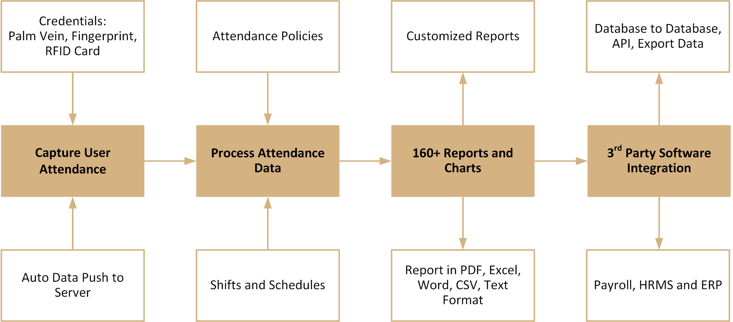
Time-Attendance: Process

Slide 33
BFSI Customer List

Slide 34
WHY VAM in Corporates?
BFSI Customer List
Gruh Finance Ltd
Money Matters Securities Pvt. Ltd.
Reserve Bank of India
MF Global
Shriram Transport Finance Co. Ltd.
State Bank of India
NBQ Bank (UAE)
Surat Peoples Co-operative Bank
Mahindra & Mahindra Financial Services Ltd.
Islamic Development Bank (Iraq)
Vijaya Bank
India Nivesh
Surat Co-operative Bank
… and more

Slide 35
Case Reference

Slide 36
Shriram Transport Finance Company Ltd.
Applications:
Time-Attendance for BFSI Segment
Solutions Offered:
Seamless Integration between COSEC and Shriram HRMS and payroll applications
Single COSEC platform and user enrolment for time-attendance
Smooth Attendance data capturing through Biometric devices
Attendance data management of multiple branches from a single location
MIS reports for faster & better decisions
Technology:
Fingerprint
Matrix Offering:
Devices: 1000+
Users: 24,000+
Location: Across India
Benefits:
Online and error-free and time-attendance data
Salary calculation time reduced by 25%
Significant increase in employees’ productivity

Slide 37
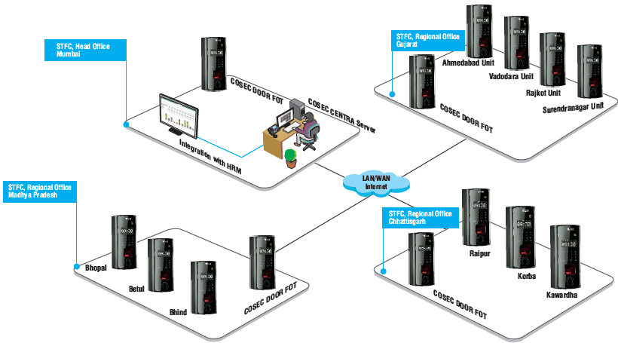
Solution Diagram

Slide 38
Matrix Hardware

Slide 39

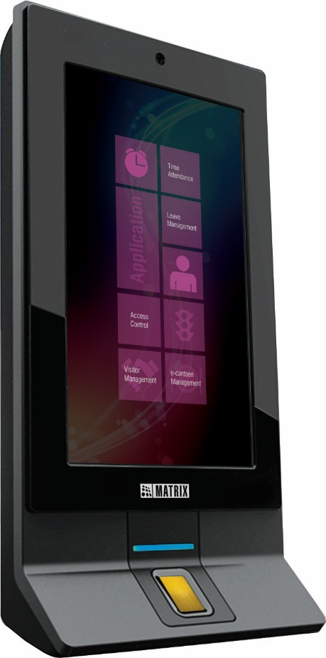
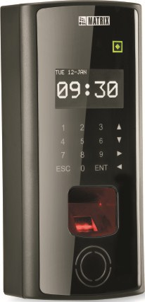
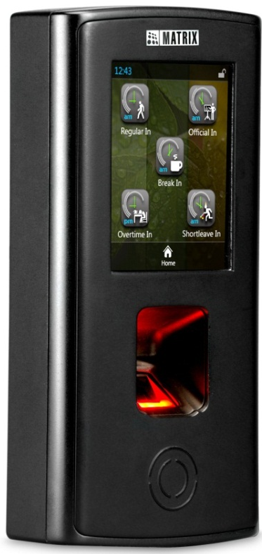
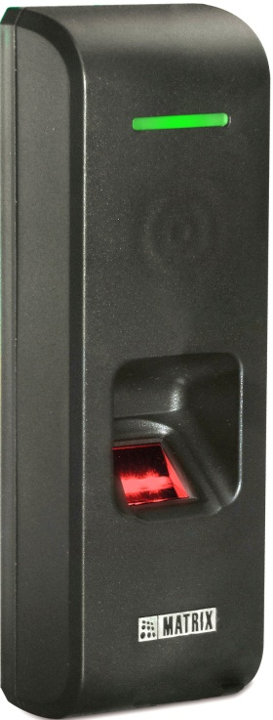
Door Controllers
DOOR Series
PATH Series
VEGA Series
NGT Series

Slide 40
Matrix Software

Slide 41








Software
Time -Attendance
Access Control
Visitor
Management
Cafeteria
Management
Job Processing and Costing
Employee
Self - Service
Roster Management
Vehicle Access Management
Contract Workers Management

Slide 42
Vehicle Profile
For Further Information -
Email | More@MatrixComSec.com
Contact No | +91 265 2630555
Website | www.MatrixSecuSol.com
Address | 394-GIDC Makarpura, Vadodara-390010, Gujarat, India

Slide 43


