Slide 1
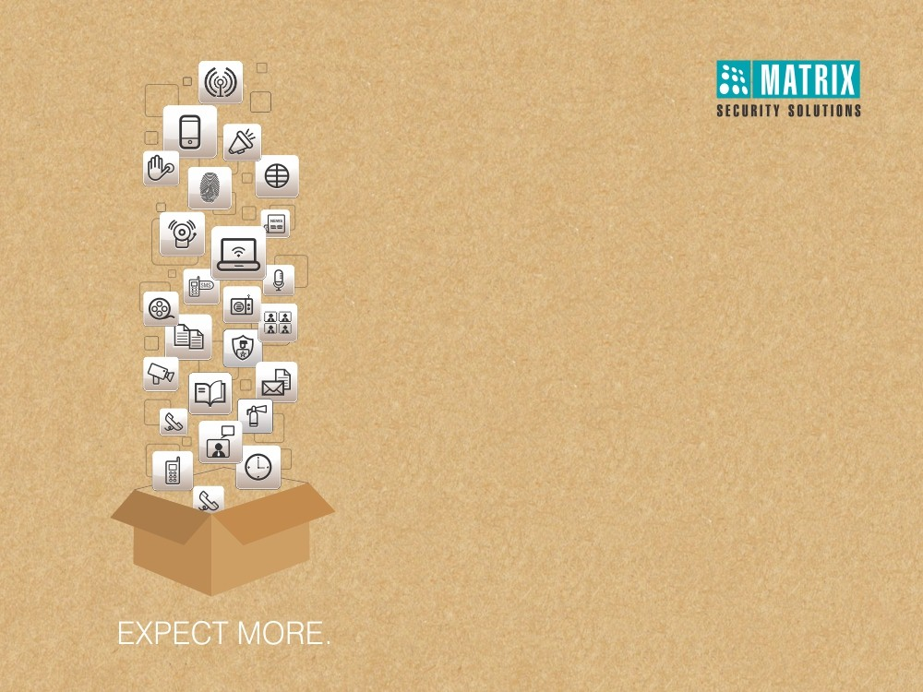
Matrix Time-Attendance for Healthcare
Right People in Right Place at Right Time

Slide 2
Healthcare Challenges

Slide 3
WHY VAM in Corporates?
Challenges Faced
1
Unhygienic Practices in Attendance Marking
Managing Attendance with Flexible Timings
Inaccurate and Late Payroll
4
2
Attendance Management
3

Slide 4
WHY VAM in Corporates?
Time-Attendance as a Solution
Advantages
Benefits
Automated, Fool-proof Attendance Capturing
Increase in Productivity and Minimize Overpayments
Flexible Time-Attendance Policies, Shifts, Overtime Policies
Meets Disparate Needs of Different Functions, Locations, and Individuals
Web based Access
Saves time, Better Planning of Employees
Reports and Charts
Easy Interpretation and Decision Making
SMS and Email Notifications
Faster Response to Exceptional Situations
Integration with Third Party Payroll
Smooth and Timely Salary Payments

Slide 5


1
Unhygienic Practices in Attendance Marking

Slide 6
WHY VAM in Corporates?
Solution Offered
Contactless Palm Vein Reader
High Quality Sensor

Slide 7
WHY VAM in Corporates?
Contactless Palm Vein Reader
What
How
Palm vein reader for user identification and attendance marking
Palm vein reader reads the vascular pattern of user’s palm from a distance using IR technology; thus offering contactless biometric recognition solution
Benefits
Application
Contactless reader maintains proper hygiene
Smooth and quick attendance capturing
ICUs/Neo-natal ICUs
Maternity wards
Special wards
Pharmaceuticals labs

Slide 8

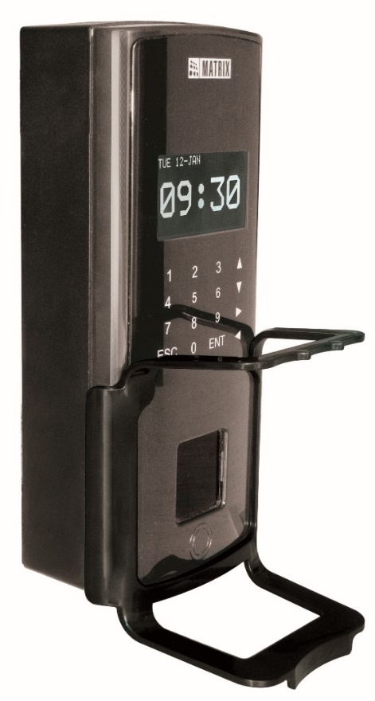
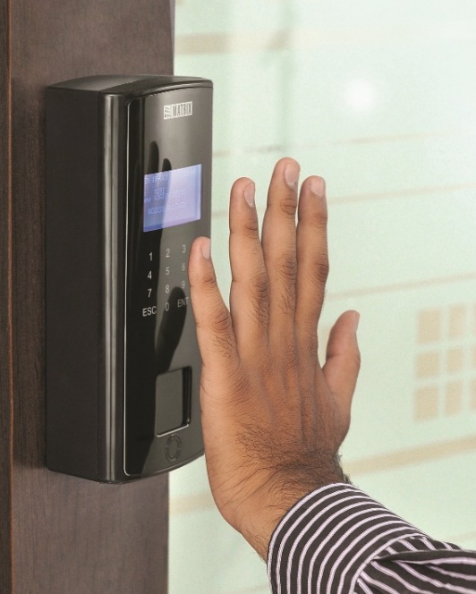
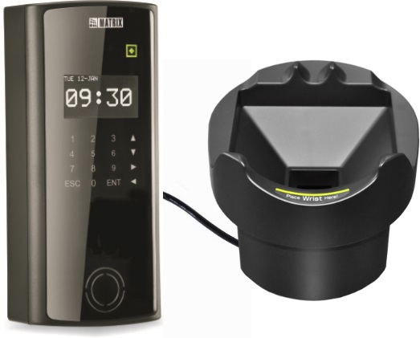

Contactless Palm Vein Reader
COSEC DOOR PVR
COSEC DOOR PVR ES

Slide 9
WHY VAM in Corporates?
High Quality Sensor
What
How
High quality sensor offers quick and accurate attendance marking
User can mark their attendance accurately in less than a second without investing in multiple devices
Benefits
Application
Reduces overall punching time
Increases employee satisfaction
Hospitals or such institutes with numerous staff personnel
Professionals like Doctors

Slide 10



Managing Attendance with Flexible Timings

Slide 11
WHY VAM in Corporates?
Flexible Time-Attendance
What
How
Flexible time-attendance feature allows the admin to frame flexible attendance policy for employees
Offers employees to have flexible working hours, by fulfilling various criteria of minimum working hours per day/ per month, etc.
Benefits
Application
Increase in morale and productivity
No stringent attendance policies
Ease in salary calculations
Doctors
Nurses
Compounders
Housekeeping staff
Medical store staff

Slide 12
Attendance Management

Slide 13
WHY VAM in Corporates?
Solution Offered
Comprehensive Time-Attendance Policies
Centralized Data Monitoring
Web based Management
Error-free Attendance Data
Shifts-Schedules
Leave Management
COSEC Tracker
Reports and Charts Generation
COSEC Scheduler
SMS and Email Notifications
Attendance on Move
Time-Attendance on Mobile

Slide 14
WHY VAM in Corporates?
Comprehensive Time-Attendance Policies
What
How
Comprehensive & Flexible Time-Attendance Policies, Absenteeism, Overtime, Compensatory Off, Late-In/Early-Out Policies
Facilitates the institutions to meet disparate needs of different branches, functions, departments, and individuals offering flexibility in configuring complex time-attendance policies
Benefits
Application
Uniform compliance
Meets diverse needs of organizations with multi-level hierarchies
Units with higher level of hierarchies
Large organizations having varied time-attendance policies

Slide 15
WHY VAM in Corporates?
Centralized Data Monitoring
What
How
Monitoring of attendance data of multi-locations
Facilitates the monitoring of attendance data captured of various employees from multiple locations at central location
Benefits
Application
Increase in discipline
Ease in managing complex and large number of attendance data
Hospital chains
Pharmaceutical organizations

Slide 16
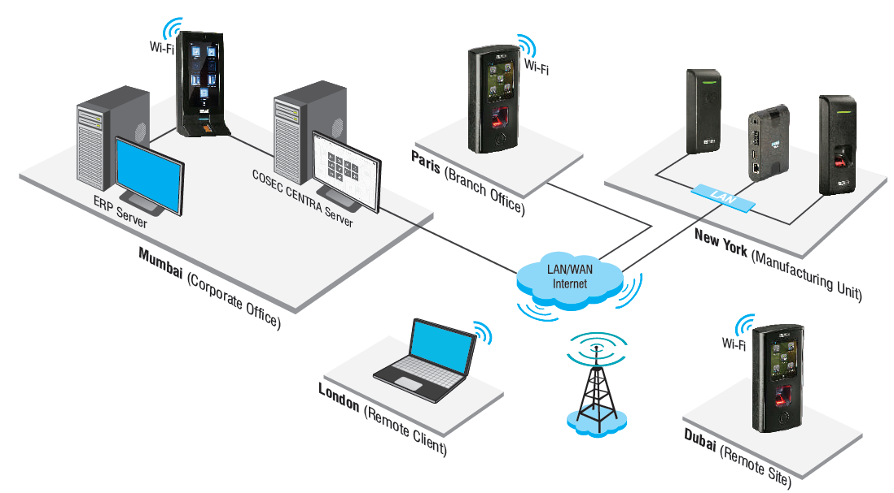
Conglomerates Multiple Locations into One

Slide 17
WHY VAM in Corporates?
Web based Management
What
How
Attendance management through public IP, using central server
Real-time monitoring and control from one place
Automatic data push from devices to central server
Benefits
Application
Reduces manual interventions and error
Organizations with multiple units/sections like Labs, Operation theatre, Medical store, etc.

Slide 18
WHY VAM in Corporates?
Error-free Attendance Data
What
How
Managing error-free attendance data for salary processing
Offers accurate attendance data for quick and smooth salary processing
Benefits
Application
Quick and accurate salary processing
Increased employee morale
Organizations with late and inaccurate salary payment issues

Slide 19
WHY VAM in Corporates?
Shifts-Schedules
What
How
Creates unlimited different shifts and 999 schedules as per requirement
Allows creating multiple shifts and shift schedules with break time, grace time, off day, repeat days, etc.
Benefits
Application
Smooth and accurate attendance management in spite of multiple shifts
Enhances morale and productivity of employees due to transparency
Doctors
Nurses
Housekeeping staff
Pharmaceutical units

Slide 20
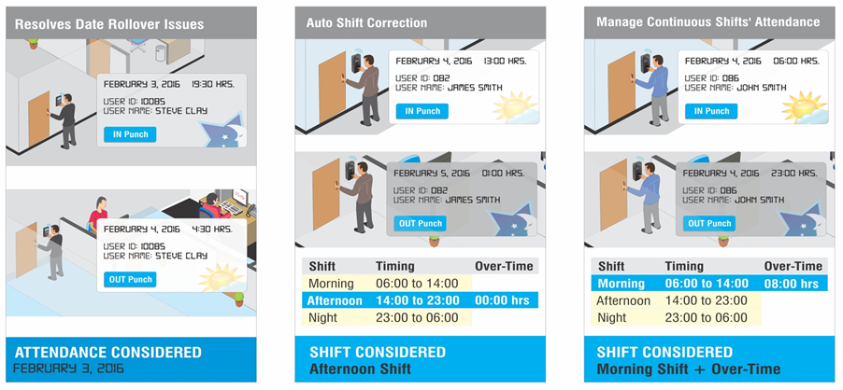
WHY VAM in Corporates?
Shifts-Schedules

Slide 21
WHY VAM in Corporates?
Leave Management
What
How
Manages leave by offering comprehensive leave policies
Offers flexible options to create various leave types with parameters viz. balance check enable/disable, paid/unpaid leave, lay off, accumulation, etc.
Benefits
Application
Reduction in errors caused in salary processing due to unorganized leave data
Enhances productivity
Increase in morale due to transparency
Organizations with varied leave policies

Slide 22
COSEC Tracker
Live head count of employees/doctors in the premises at any time
Shift View
Site View
Who’s IN View

Slide 23
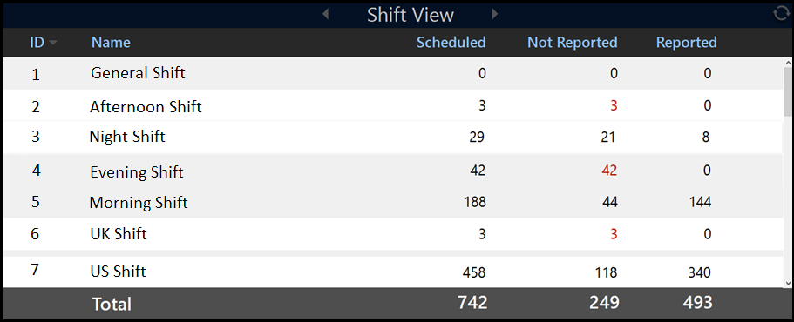
COSEC Tracker - Shift View

Slide 24
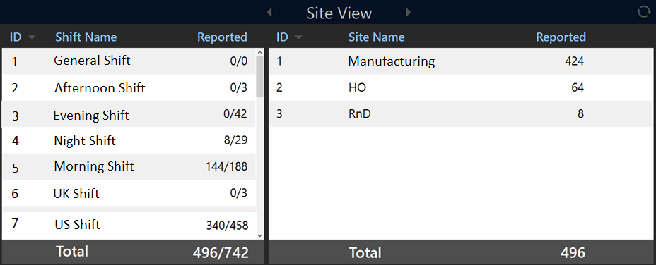
COSEC Tracker - Site View

Slide 25
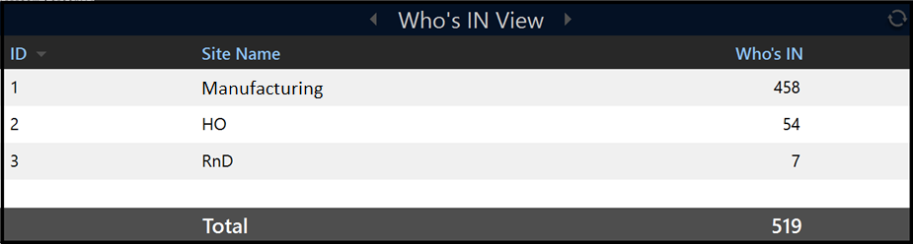
COSEC Tracker - Who’s IN View

Slide 26
WHY VAM in Corporates?
Reports and Charts Generation
What
How
Generation of various time- attendance reports and charts wiz. monthly attendance, daily attendance, branch wise, department wise, etc.
Allows creating 150+ various time-attendance and leave related reports and colorful charts using various filters and formats
Benefits
Application
Renders easy interpretation
Helps in decision making
Hospitals
Pharmaceutical units

Slide 27






Vehicle Profile
Reports and Charts Generation
Generate up to 150+ Reports & Charts
MS-Excel
MS-Excel Data
PDF
Time - Attendance Reports
Leave Management Reports
XML
Rich Text Format
Time - Attendance Charts
Daily, Monthly, Yearly
RTP
MS-Word
MS-Word Editable

Slide 28











COSEC Scheduler
Attendance Report
(Department – 2)
HR/HOD
Attendance Report
(Department – 1)
Shifts
Leave Credit
COSEC CENTRA
Server
Automated Backup
Doctors/Employees
Admin

Slide 29
WHY VAM in Corporates?
SMS and Email Notifications
What
How
Alerts for various events viz. leave-tour-attendance correction application/approval/rejection, missing in/out punch, user entry/exit, daily-monthly attendance, etc.
Sends SMS and Email notifications to employees and reporting managers for various time-attendance, leave, shift related events
Benefits
Application
Immediate response to exceptional situations
Increase in employee morale and productivity
Institutes having numerous employees

Slide 30



Notifications
Real-time notifications on exceptional situations
Notifications
SMS and Email notifications
Missing Punch
Custom alerts on pre-defined contact number or Email Id
Shift Change
Daily/Monthly Attendance
Email
Leave Application/Approval
Tour Application/Approval
SMS
Centralized
Server
Attendance Correction Application/Approval
… and more

Slide 31
WHY VAM in Corporates?
Attendance on Move
What
How
Automatic attendance marking of employees using mobile
Facilitates automatic attendance marking on entering/exiting a predefined area using smartphone through GPS/Wi-Fi
Benefits
Application
Less time spent after trivial tasks such as attendance corrections
Ease in attendance marking
Improves employee morale
Convenient for high designated personnel
Institutes facing issue of missed punches
Organization with HR dept. facing numerous attendance correction requests
Doctors, Medical representatives, Ambulance staff, HODs, etc.

Slide 32
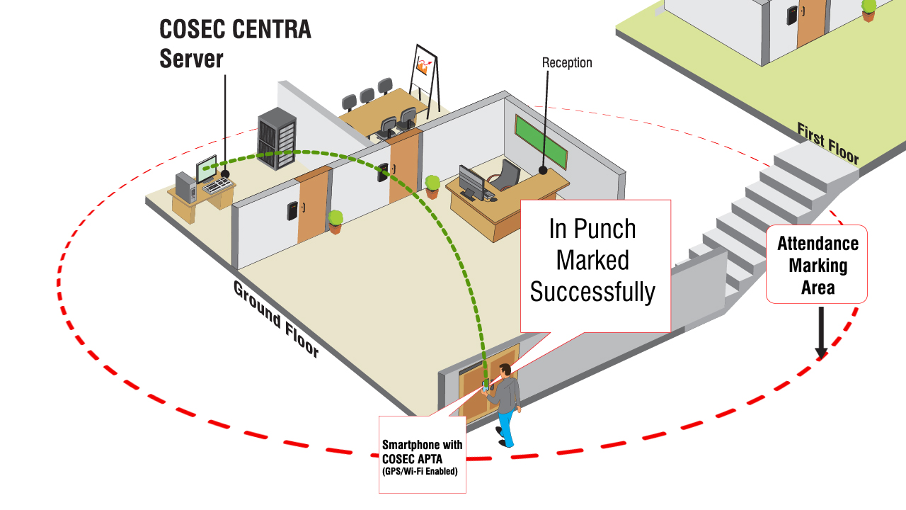
WHY VAM in Corporates?
Attendance on Move

Slide 33
WHY VAM in Corporates?
Time-Attendance on Mobile
What
How
View attendance, shift, leave details
Apply leave/tour/attendance correction through mobile application
Facilitates employees to view their attendance details through mobile application
Employees can apply leave/tour that can be approved by his reporting manager through mobile portal
Benefits
Application
Avoid lengthy procedures of applying tour/leave
Ease at monitoring individual’s attendance
Institutes with highly professional personnel

Slide 34
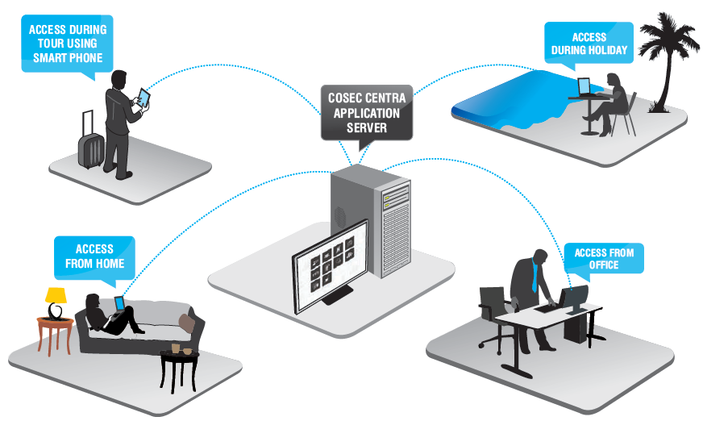
WHY VAM in Corporates?
Time-Attendance on Mobile

Slide 35

4
Inaccurate and Late Payroll

Slide 36
WHY VAM in Corporates?
Integration with ERP/Tally/Payroll software
What
How
Integration of time-attendance application with ERP/Tally/Payroll software
Offers smooth integration with third party payroll software for timely salary computation
Benefits
Application
Accurate and quick salary payments
Increase in employee morale
Organizations with inaccurate and late salary payment issues

Slide 37
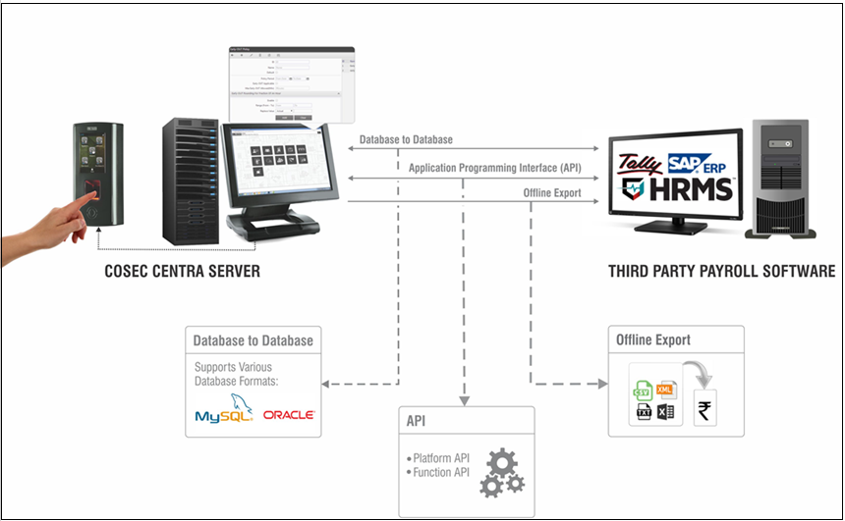
WHY VAM in Corporates?
Software Integration

Slide 38
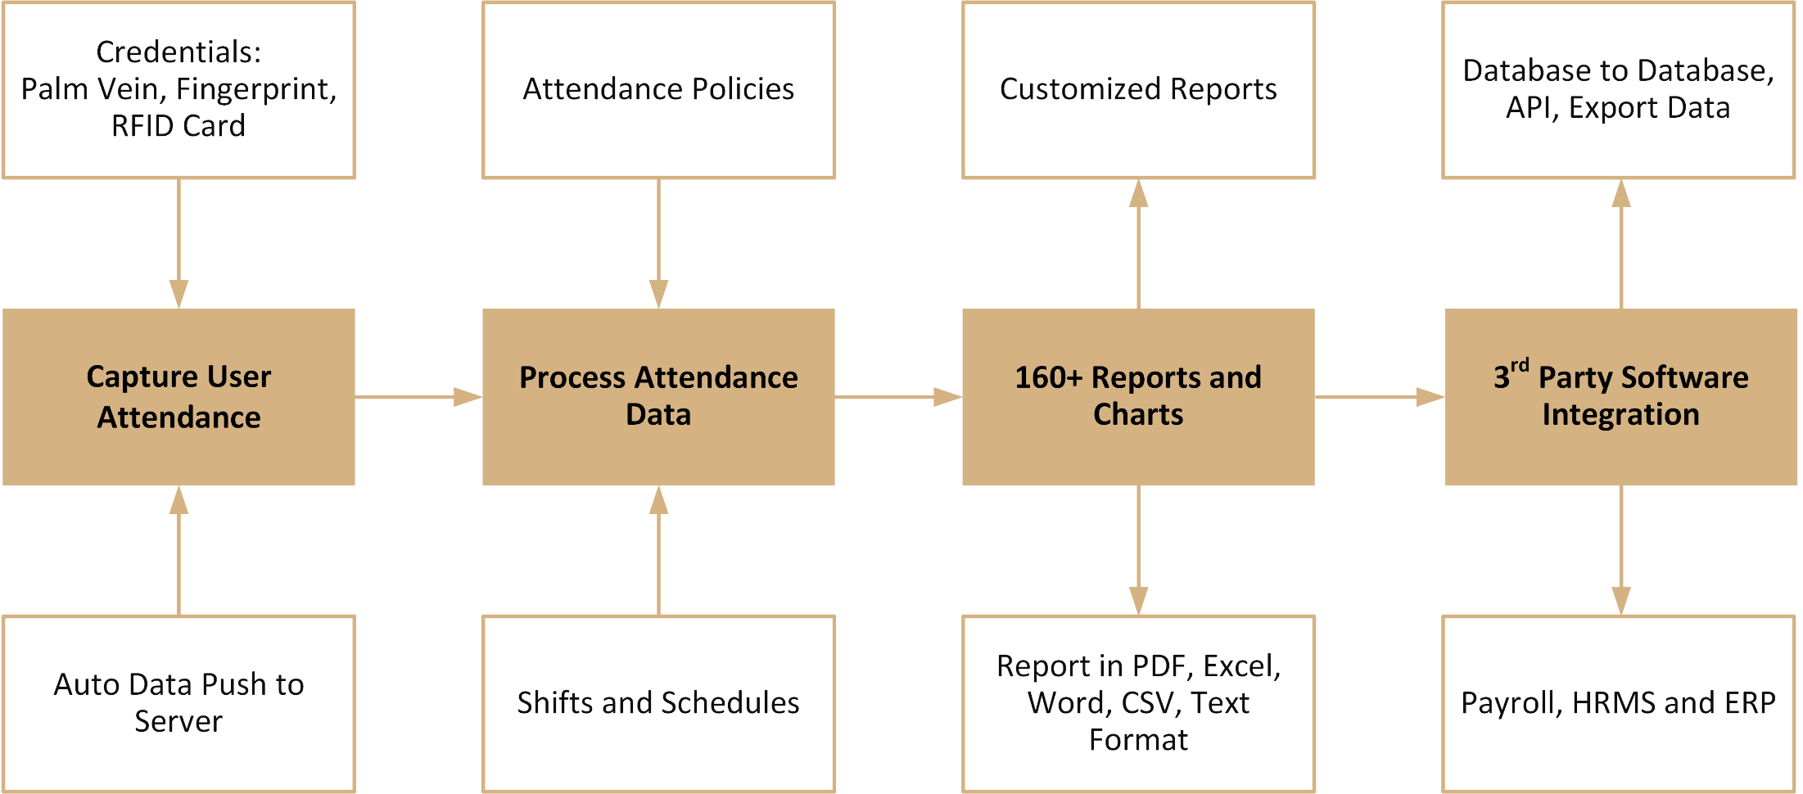
Time-Attendance: Process

Slide 39
Healthcare: Customer List

Slide 40
WHY VAM in Corporates?
Healthcare: Customer List
Micro Labs Ltd.
Gold’s Gym
Alkem Laboratories Ltd.
Apollo Hospital
Dr. Reddy’s Foundation
Fortis Memorial Research Institute
Surien Pharmaceuticals Pvt. Ltd.
Viva Gym (South Africa)
Rottapharm Co. Ltd. (Thailand)
Al Kamal Pharma & Medical Services (KSA)
Biotech Vision Care
Riaz Medical Center (Sharjah)
… and more

Slide 41
Case Reference

Slide 42

Micro Labs (Himachal Pradesh)
Application:
Time-Attendance
Technology:
Biometric Fingerprint
Wireless Connectivity
Matrix Offering:
Users: 900+
Locations: Three (in Himachal Pradesh)
Devices: 150
Solutions Offered:
Web based time attendance solution
Fingerprint based device for attendance capturing
Centralized attendance management of all the employees
Customized reports and charts for easy interpretation
Notifications for responding to exceptional situations
Benefits:
Accurate attendance data capturing
Smooth & quick salary payments
Ease in decision making process on the basis of customized reports generated
Increase in productivity

Slide 43
Matrix Hardware

Slide 44
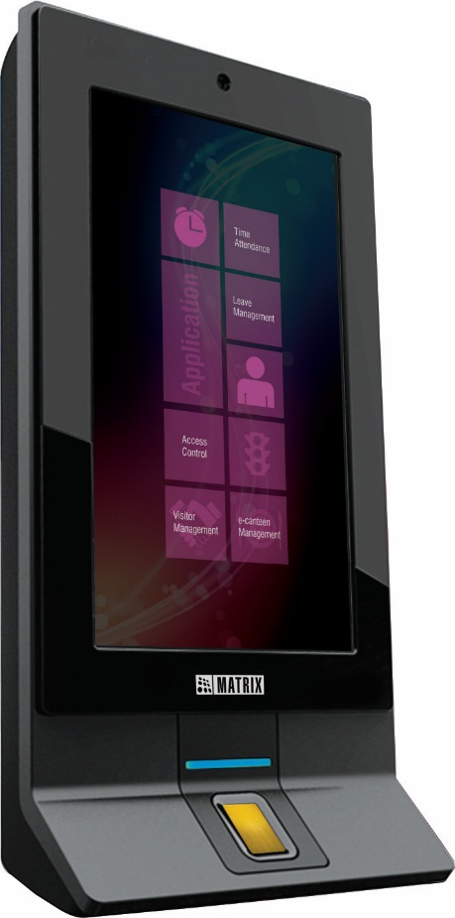
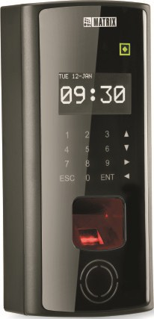
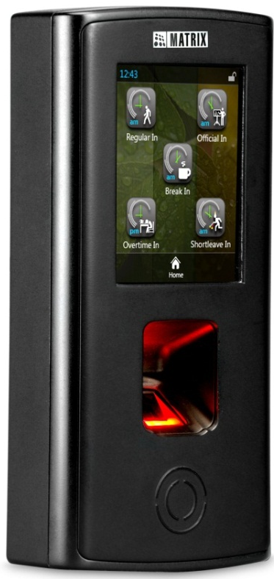
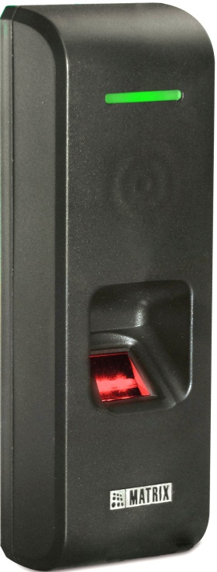
Door Controllers
DOOR Series
PATH Series
VEGA Series
NGT Series

Slide 45
Matrix Software

Slide 46








Software
Time -Attendance
Access Control
Visitor
Management
Cafeteria
Management
Job Processing and Costing
Employee
Self - Service
Roster Management
Vehicle Access Management
Contract Workers Management

Slide 47


