Slide 1
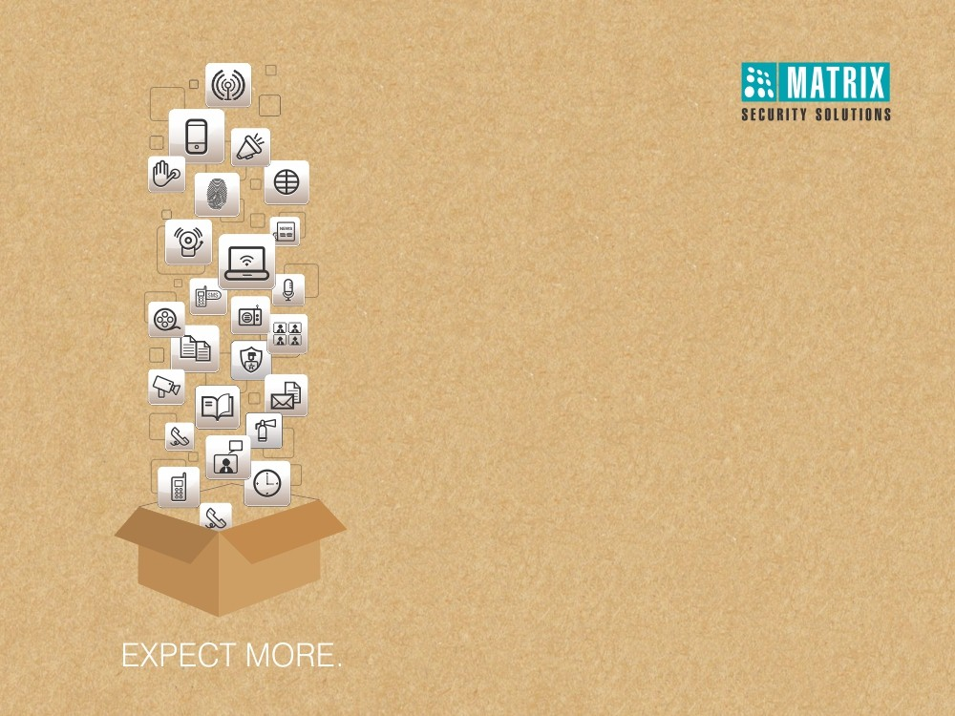
Matrix People Mobility Solution for Transportation and Logistics
Right People in Right Place at Right Time

Slide 2
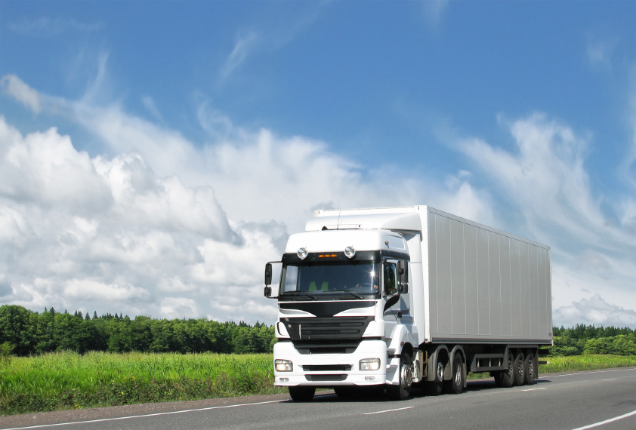
MATRIX PEOPLE MOBILITY SOLUTION FOR TRANSPORTATION & LOGISTICS

Slide 3

  Pain Areas

Slide 4
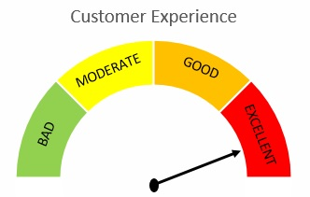


  Pain Areas
Productivity and
Customer Service
Security of Assets

Slide 5




  Pain Areas
Restrict Unauthorized Entry in Secured Areas
Security of Assets and Manpower
Monitor each Movement in Secured Areas
Third Party Integration

Slide 6


  Pain Areas
Timely Employee Management
Productivity and Customer Service
Timely Delivery
Third Party Integration

Slide 7
Security of Assets Manpower
Restrict Unauthorized Entry in Secured Areas

Slide 8




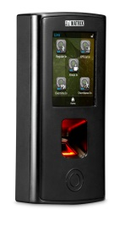

  2 Person Rule - Dual Authentication
Inventory Room
Inventory Room
Restrict access at key sensitive areas like inventory rooms

Slide 9



  User, Zone and Time based Access
sauna
User Access only During Particular Time Period
User Access to Limited Areas
Define Zone for Users
To ensure there is no intrusion

Slide 10
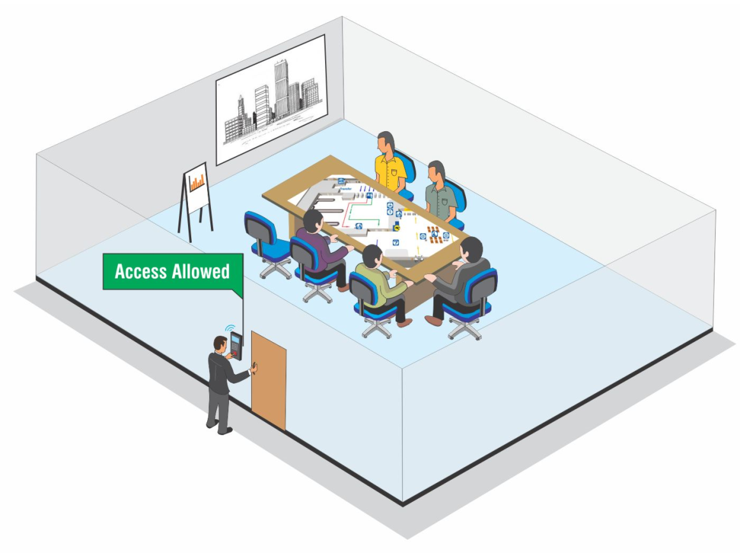
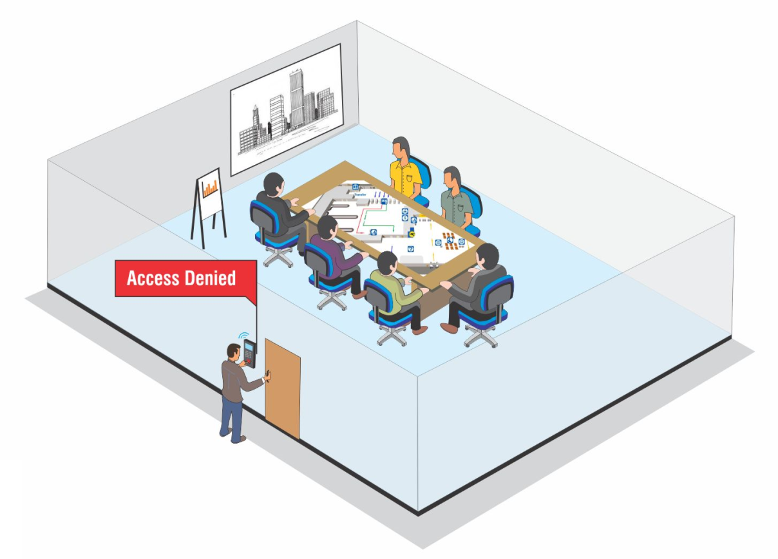
  Occupancy Control
Occupancy: 6
Controls number of users in a particular area

Slide 11


  Duress Detection
Dials with Access Code Followed by a Secret Code
System opens the door and at the same time notifies concerned person without giving any local alarm

Slide 12
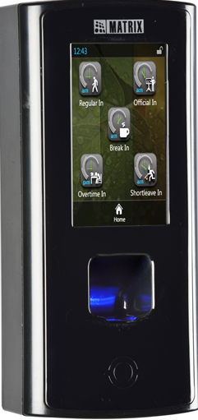
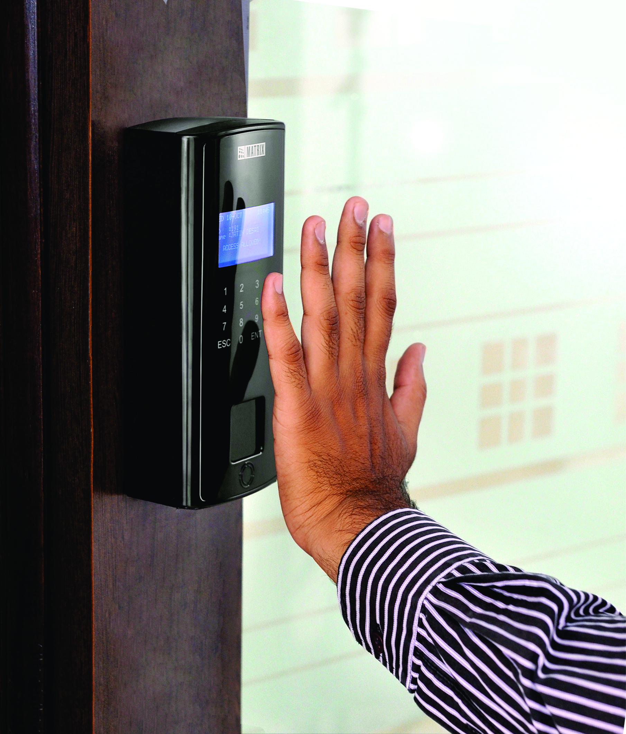
  Biometric Access Control
Use biometric credentials like fingerprint and palm-vein print

Slide 13
Security of Assets and Manpower
Monitor each Movement in Secured Areas

Slide 14
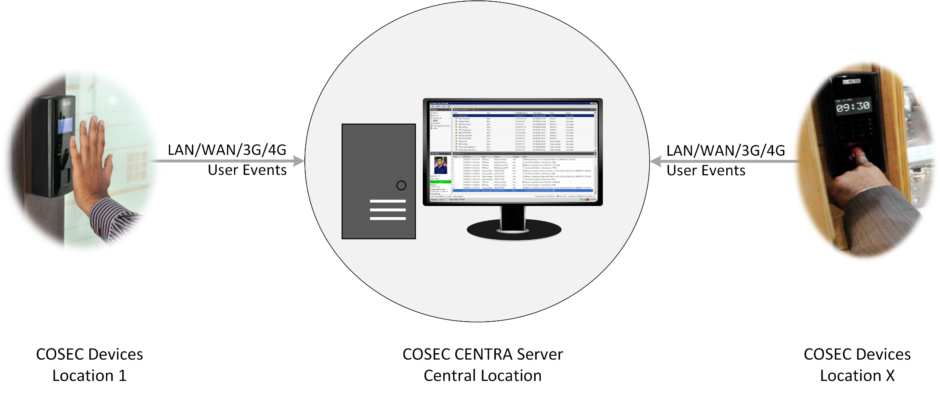
  Time Stamping
User events noted and sent to server through auto push technology

Slide 15
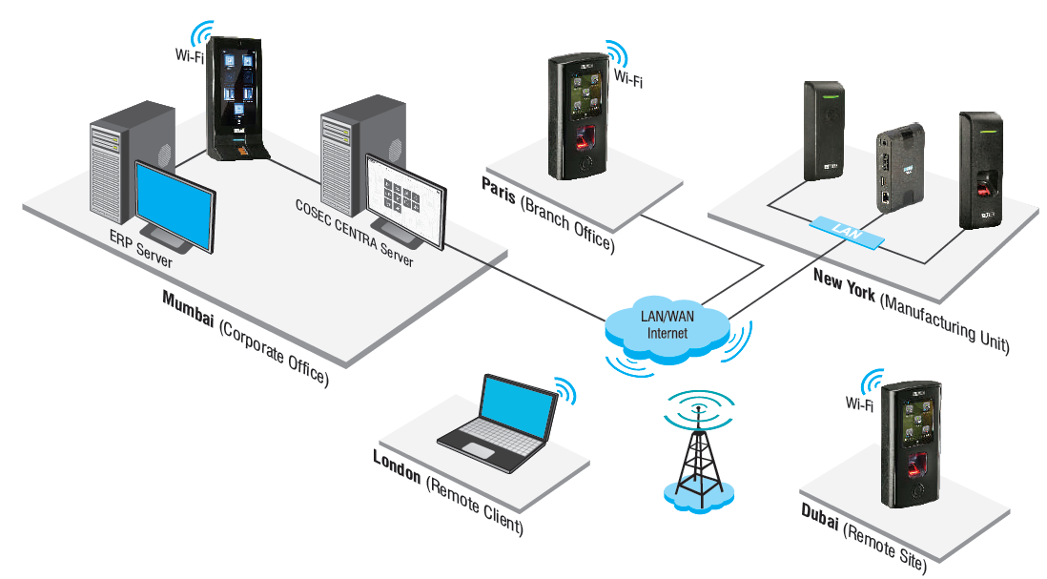
  Centralized Monitoring
Keep a track of every event occurring across every branch from one place

Slide 16

  Guard Touring
Guards keeps punching on regular interval

Slide 17




  Real-Time SMS and Email Notifications
Door Kept Open For More than Normal Time
Door Forcefully Opened
Threats and Casualties
Dead Man Zone Violation
SMS and email alerts to respond quickly on situations

Slide 18
Security of Assets and Manpower
Integration of Third Party Hardware

Slide 19
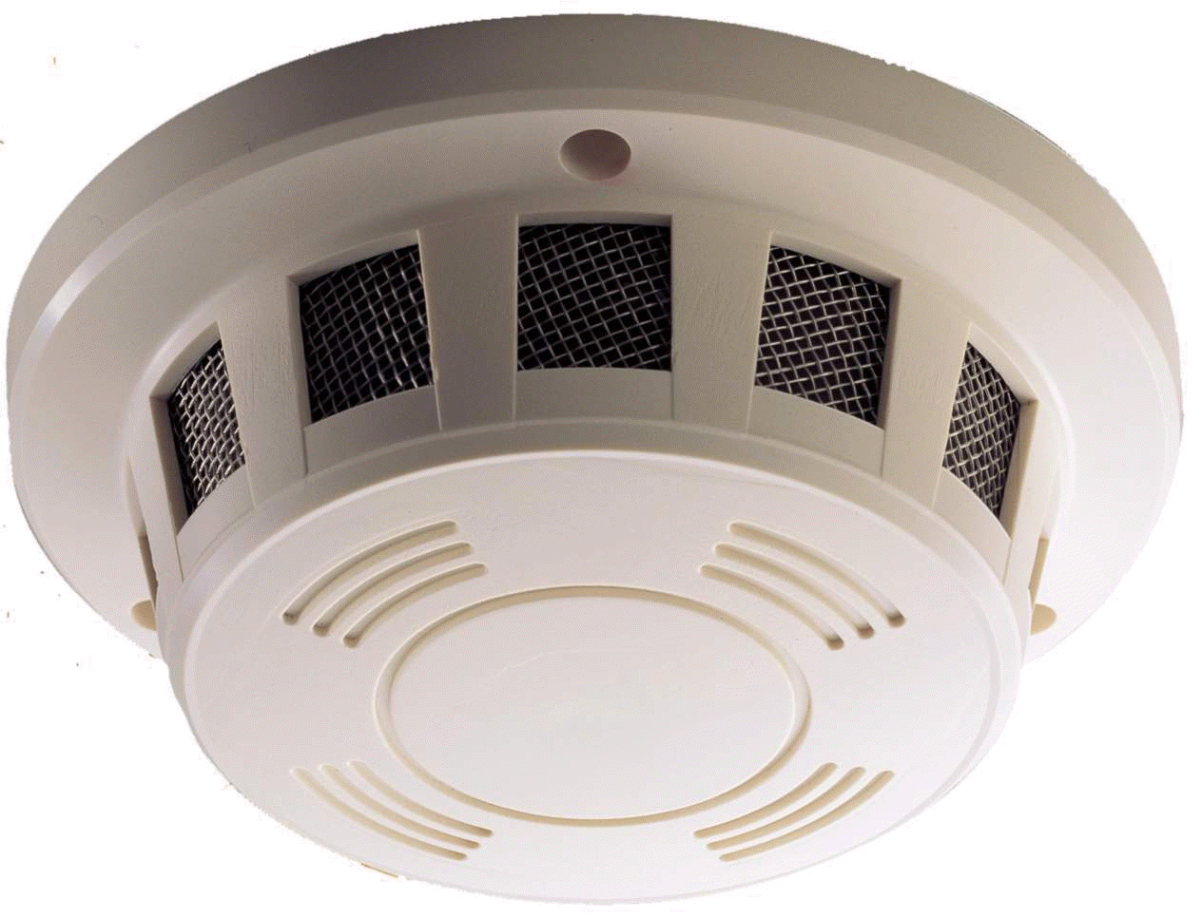
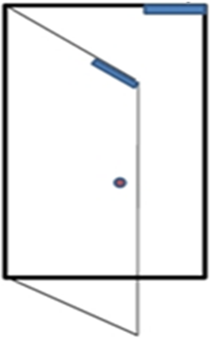

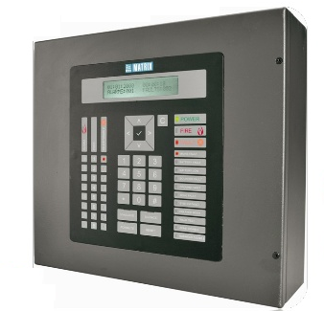
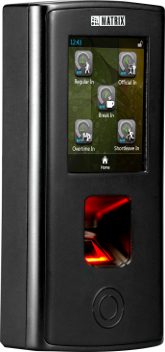
  Integration with Fire Alarm
Detector
Door Lock Open
Fire Event
Fire Alarm Panel
Matrix COSEC Door Controller
Fire Event Trigger

Slide 20
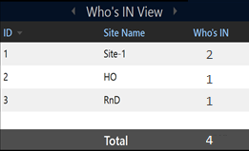



  Get Count of Members Present during Hazardous Situations
Manufacturing Unit
Site-1
There’s a Fire. We need to save 4 Members who are inside the premises
HO
R&D
Presents live head count of users according to shift, site or who’s in

Slide 21
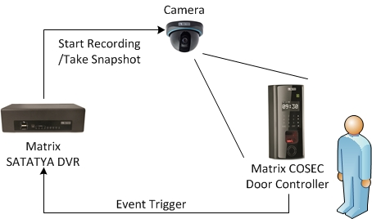
  Integration with Video Surveillance System

Slide 22
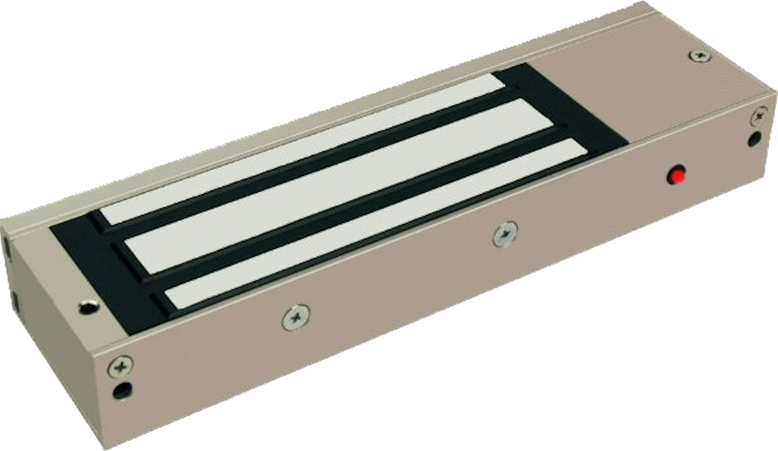

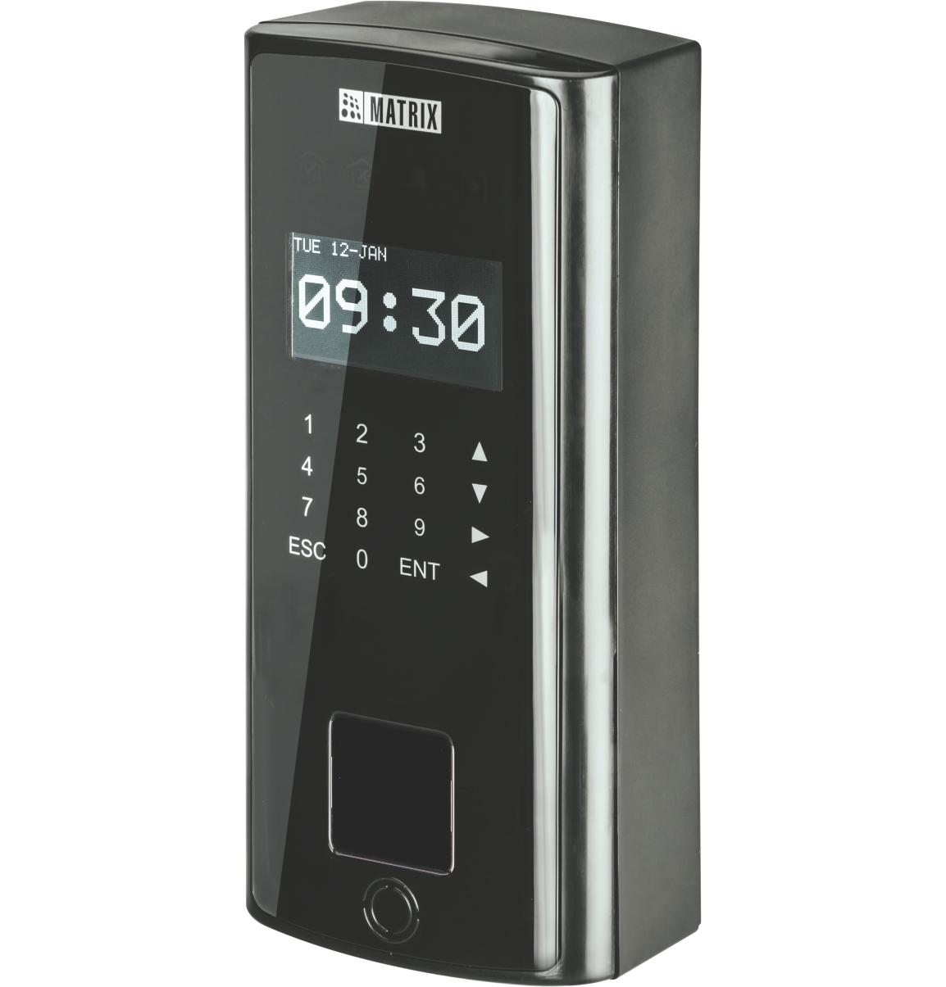

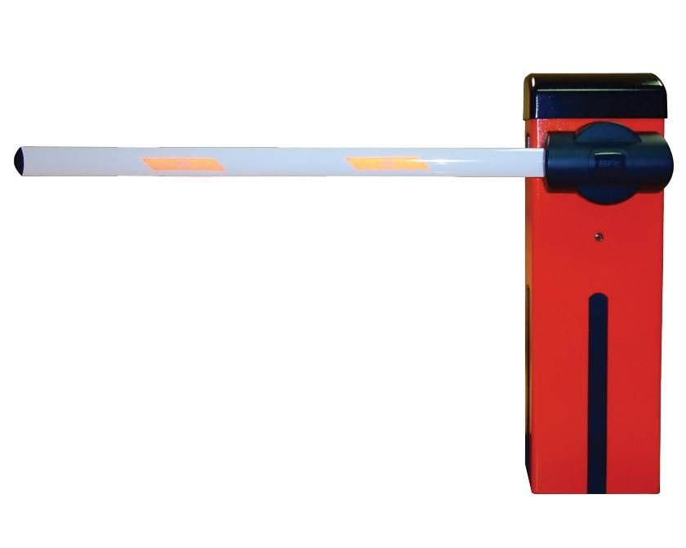
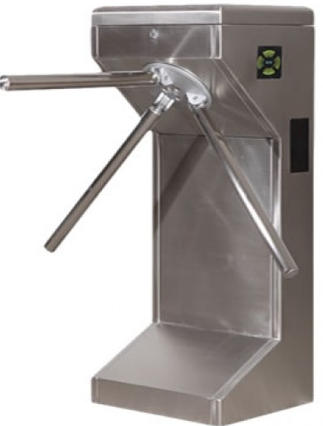
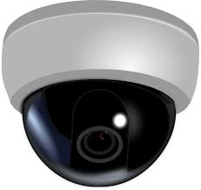
  Integration with Other Hardware
Electronic Door Lock
Smoke Detector
Boom Barriers
Alarm
Tripod
Video Surveillance

Slide 23
Productivity and Customer Service
Timely Employee Management

Slide 24




  Flexible Attendance Policies
Late IN/OUT
Early IN/OUT
Overtime
C-OFF Policies
Consistent and transparent attendance policies without manual intervention

Slide 25
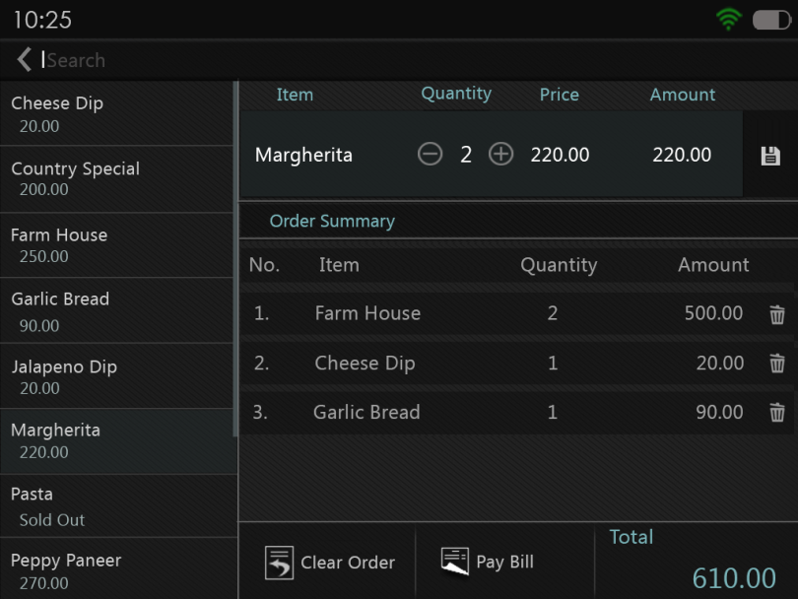
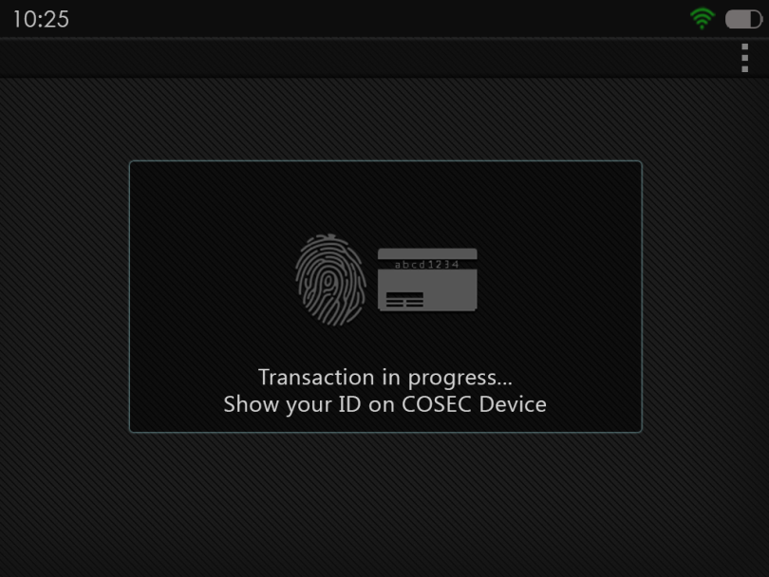
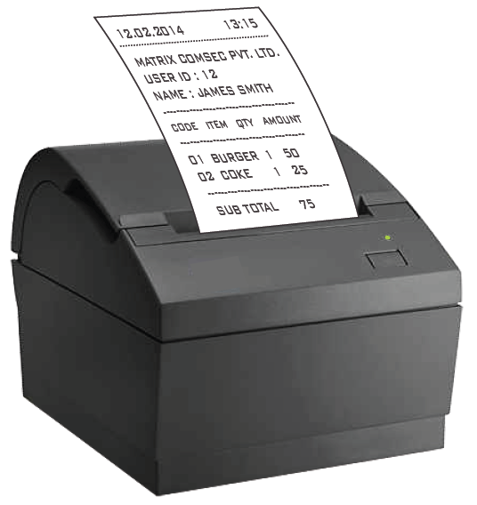
  Cafeteria Management
Select Item quantity from COSEC Device
Show Credentials on COSEC Device
Directly Print Receipt for Ordered Food

Slide 26


  Cafeteria Management: Cashless Transactions
Pre-paid Transactions:
Smart Card to Store Balance
Recharge As and When Needed
Post-paid Transactions:
Through Fingerprint, RFID
Define Maximum Credit Permitted per User per Month

Slide 27
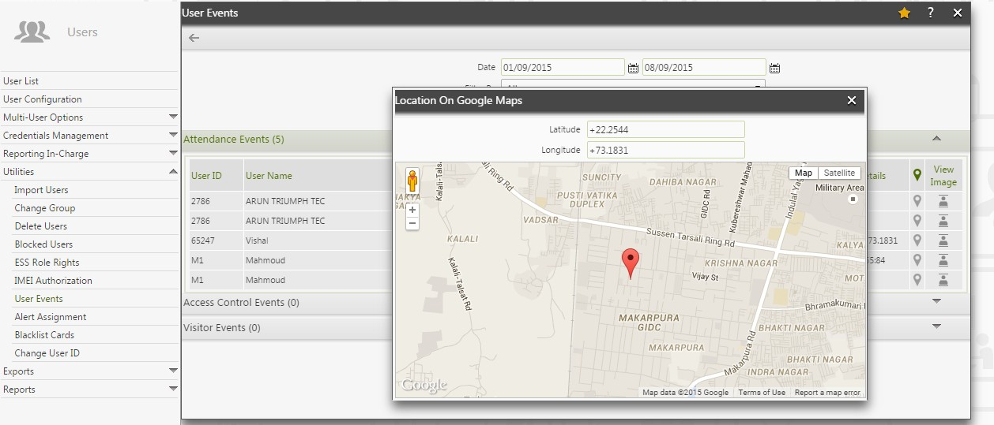
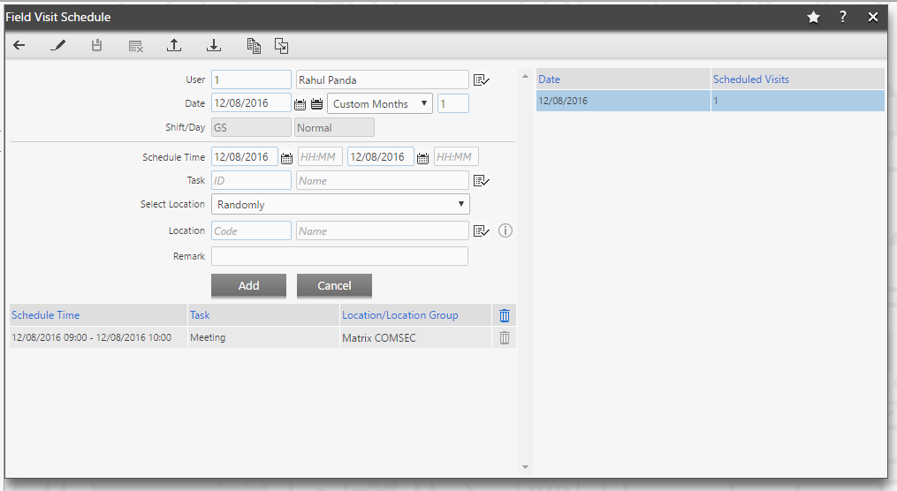
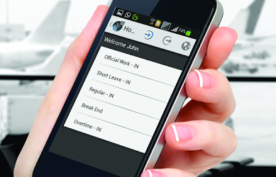
  Field Staff Management
Schedule visits of field employees and attendance marking from mobile application and keep a track through GPS location

Slide 28



  Attendance of Field Employees
Mobile application attendance punching will send location coordinates

Slide 29
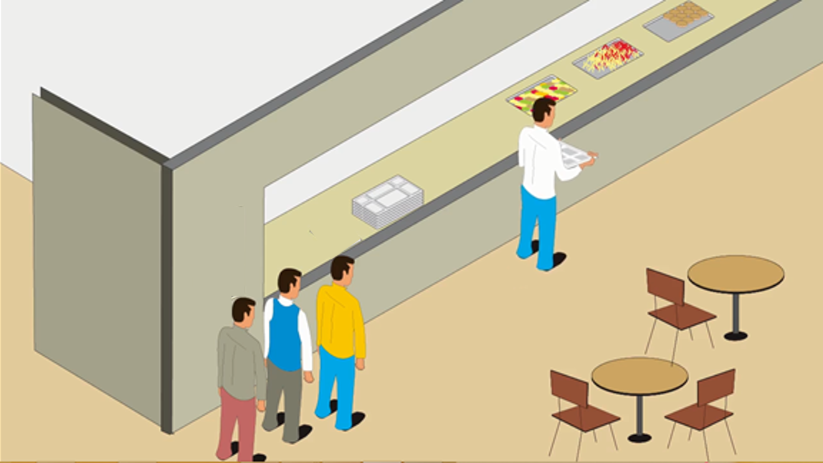
  Break Management
Through N-punch feature, decide break time for employees

Slide 30
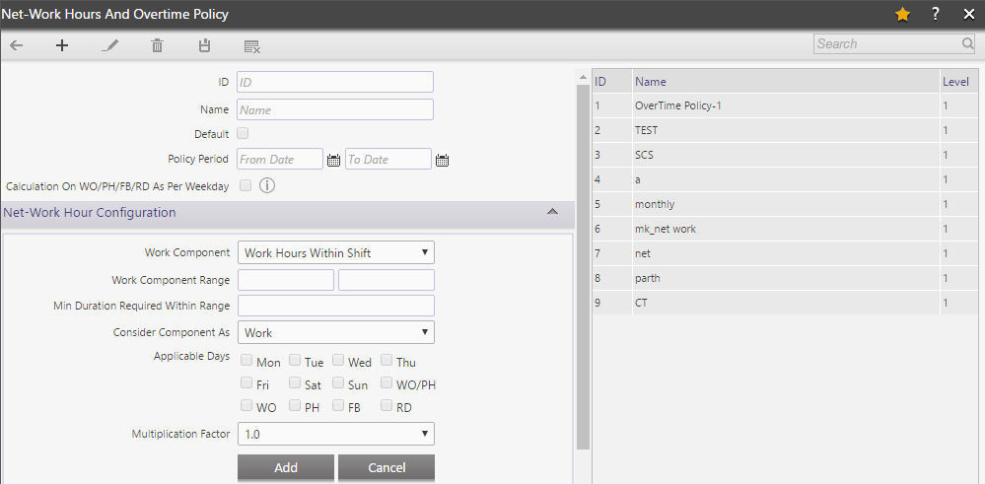
  Actual Work Hours Calculation
Configure and calculate exact work hours to maintain transparency

Slide 31
Customer Service
Timely Delivery

Slide 32
  Define Route
Punch-1
Punch-3
Route-1
Punch-2
destination
Route-2
Decide what route the driver should take

Slide 33
  Track vehicle
Decide time range to reach each of the locations

Slide 34
Third Party Integration
Integration of Third Party With Software

Slide 35
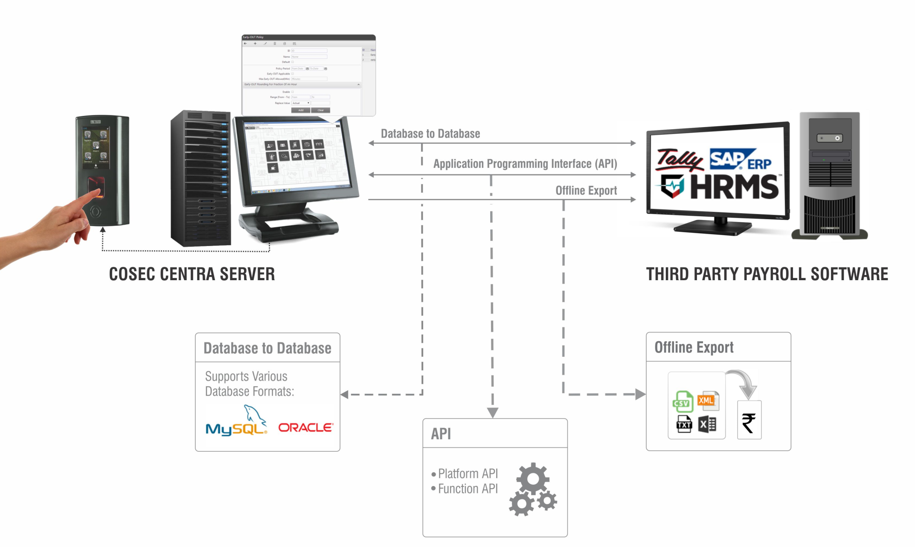
  Integration with Inventory Management Software
Inventory management software
Third Party Inventory Management Software
One liner if needed

Slide 36





  Benefits with Matrix
Increase Productivity
Automate Attendance
Process
Increase Safety and Security
ERRORS
Reduce Payroll
Errors
Reliability
Higher Customer
Satisfaction

Slide 37
  Case Study: TCI Logistics
Applications:
Solutions Offered:
Centralized Wireless Connectivity
COSEC Biometric devices with solutions for 110
+ locations with centralized monitoring and integration with Payroll.
Technology:
Fingerprint
Smart card
Matrix Offering:
Users : 4000+
Location: Multi-location(110+)
Benefits:
Capturing biometric attendance of all employees has smoothened HR’s task
Centralized attendance management.

Slide 38








  Clientele
 | FedEx (Dhaka) |  | Linfox Pvt. Ltd. (Mumbai)
 | Gojavas Logistics (Delhi) |  | The Professional Couriers (Chennai)
 | Schenker (Kolkata) |  | Adecco India Pvt. Ltd (Bangalore)
 | Parekh Integrated Services Pvt. Ltd. (Maharashtra) |  | TCI Supply Chain (Gurgaon)

Slide 39
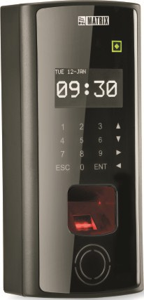

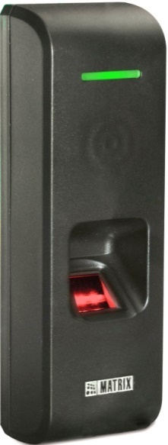
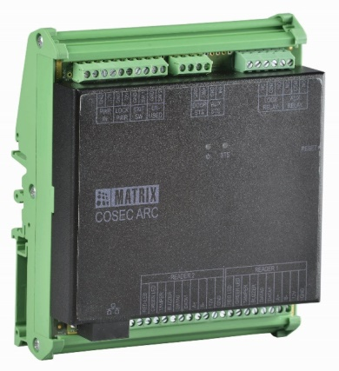
  Matrix COSEC Product Range
VEGA Series
DOOR Series
PATH Series
ARC Series

Slide 40
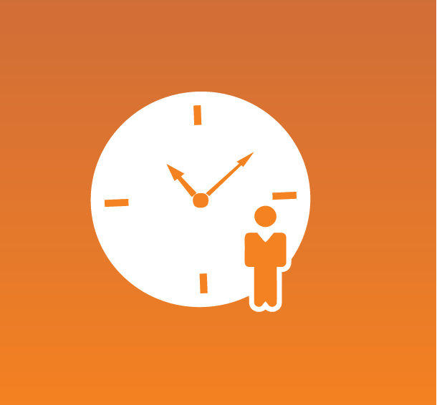



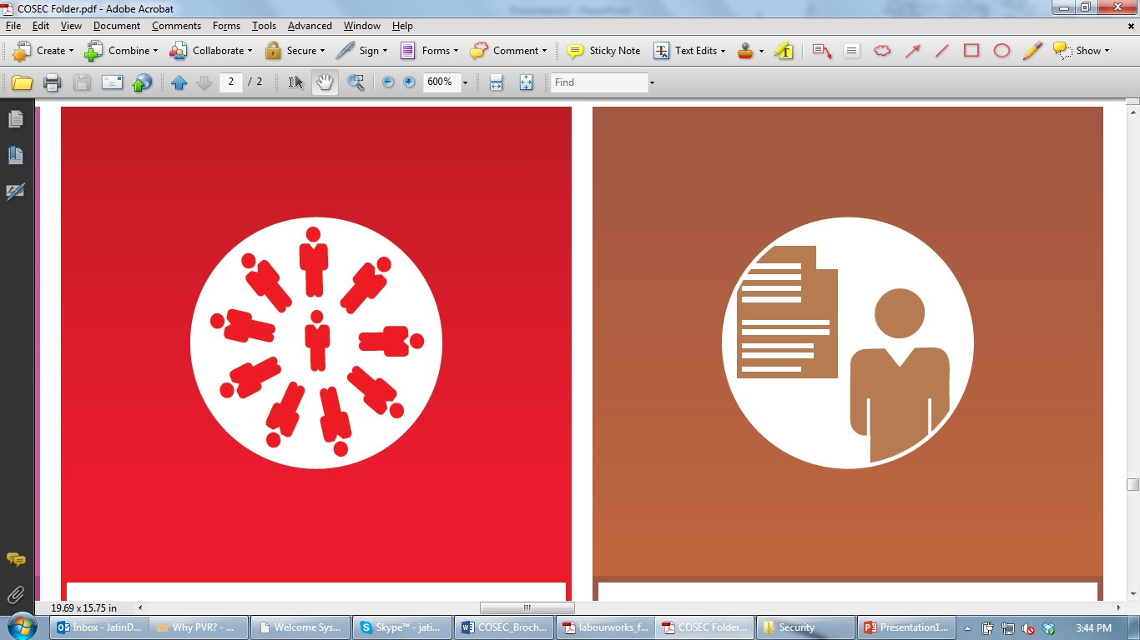




  Matrix COSEC Solutions
Visitor Management
Cafeteria Management
Contract Workers Management
Time-Attendance
Access Control
Roster Management
Job Processing and Costing
Employee Self Service
Vehicle Access Management
Field Visit Management

Slide 41
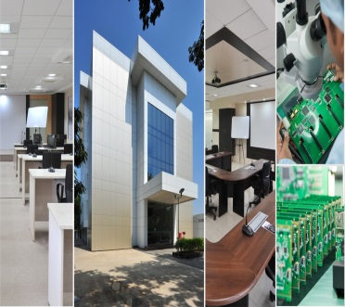

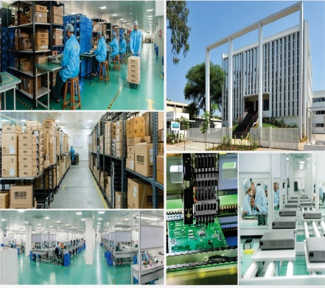
  About Matrix
1991
60+
40+
500+
400+
25+
We Established
Products
Telecom & Security
Countries we Present
Channel Partners
No. of Employees
Awards and Achievements
R&D Center
Corporate Office
Manufacturing Unit
www.MatrixSecuSol.com

Slide 42


