Slide 1
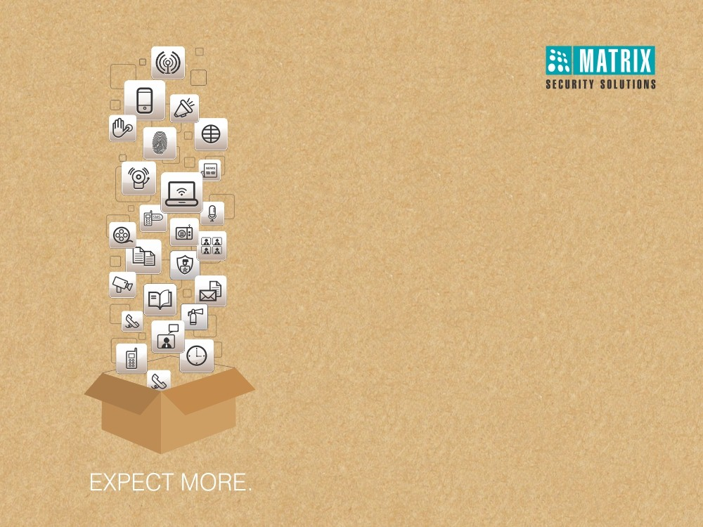
Matrix People Mobility Solution for Retail
Right People in Right Place at Right Time

Slide 2

MATRIX PEOPLE MOBILITY SOLUTION FOR RETAIL

Slide 3
  Pain Areas

Slide 4




  Pain Areas
Managing Employees’ Attendance
Security of Manpower and Assets
Improving Customer Satisfaction

Slide 5





  Pain Areas
Centralized Attendance Management
Managing Employees’ Attendance
Restrict Outlet-wise Roles and Rights
Timely and Accurate Employee Salary

Slide 6






  Pain Areas
Restrict Unauthorized Entry in Sensitive Areas
Security of Manpower and Assets
Avoid Proxy Punching by Staff Members
Easy Escape from Premises in Case of Fire

Slide 7



  Pain Areas
Timely Customer Attention
Improving Customer Satisfaction
Leave Management of Employees
Proper Shift - Scheduling of Staff

Slide 8
Solutions

Slide 9
Managing Employees’ Attendance
Centralized Attendance Management

Slide 10
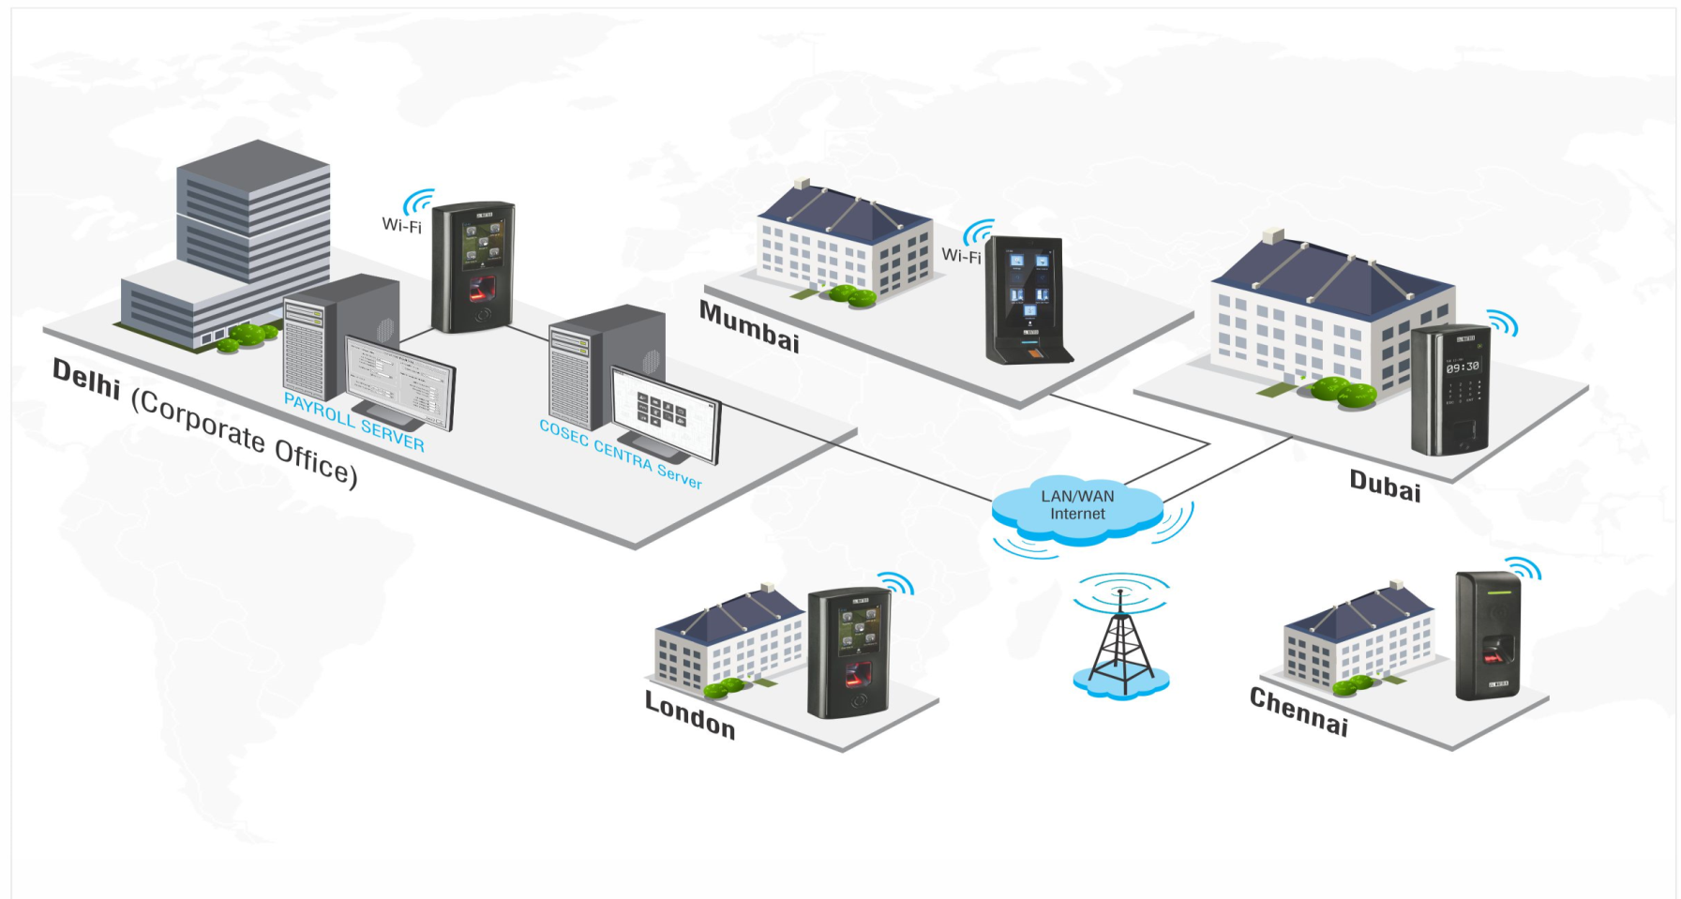
  Multi-locations’ Attendance Management

Slide 11



  Scalable Architecture
Expand Up to 65,000 Devices and 1 Million Users

Slide 12

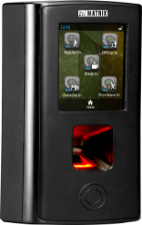
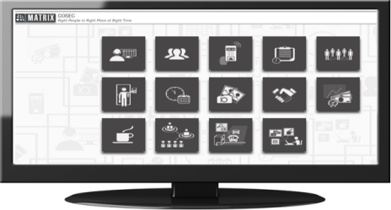
  Real-time Data Transfer to Server
LAN/WAN/3G
Events
Events
LAN/WAN/3G
COSEC Door Controller
Location 1
COSEC CENTRA Server
COSEC Door Controller
Location X
Data Transfer from Device to Server in <1 Sec
Auto Push Technology
No Manual Download Required
Notes:
Push Technology – If the devices are not IP then you have to install a server at all different locations and it would cost more. Whereas with IP based controllers you just need to have a COSEC Platform with which the devices communicated directly with the server on Real Time basis and it also saves the cost.
Also, in push technology the devices constantly communicates with the server.

Slide 13

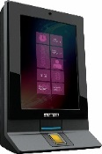
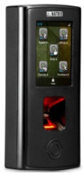



  Automatic Template Distribution
COSEC CENTRA Server
No Need to Enrol again on other Locations
LAN/WAN/3G
Enrolment from Location 1
Location 2
Location 3
Location X

Slide 14




  Multiple Connectivity
3G/4G
Wi-Fi
Ethernet/PoE
USB

Slide 15

Managing Employees’ Attendance
Restrict Outlet-wise Roles and Rights

Slide 16
  Enterprise Structure
Define Organizational Hierarchy
Organization
Branch
Department
Designation
Section
Category
Grade

Slide 17







  Manage Login Roles and Rights
Head-office
Region-1
Region-2
Region-3
Outlet-1
Outlet-2
Outlet-3
Outlet-4
Outlet-5
Outlet-6
Create Multiple Login Roles and Assign Rights to Concerned Personnel

Slide 18


Managing Employees’ Attendance
Timely and Accurate Employee Salary

Slide 19
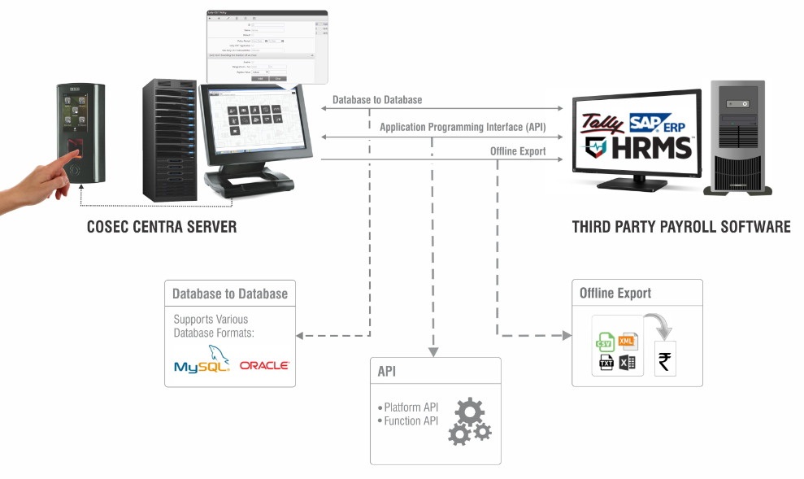
  Third Party Payroll Integration
Seamless Payroll Integration for Faster Salary Payments

Slide 20
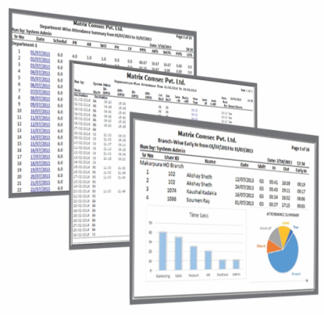
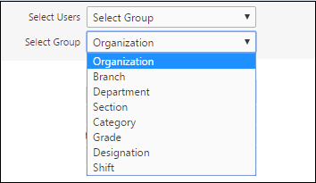




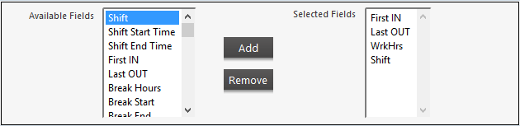

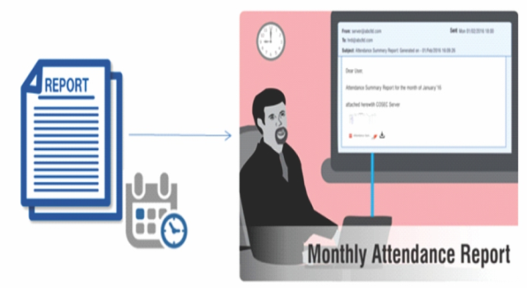

  Reports & Charts for Quick Decision Making
200+ Reports and Charts
Apply Various Filters to Generate Specific Reports
File Formats
Customized Report Template
Reports on Email at Scheduled Time

Slide 21


Security of Manpower and Assets
Restrict Unauthorized Entry in Sensitive Areas

Slide 22


  Time-Zone-User based Access
User Access only During Particular Time Period
User Access to Limited Areas
User Access for Particular Zone

Slide 23


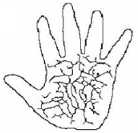

  Biometric Access Control
Palm Vein
Fingerprint
RFID Card
PIN
Multiple Credential Support

Slide 24
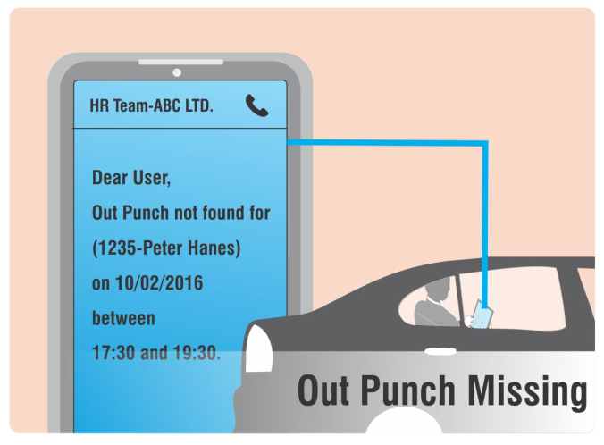
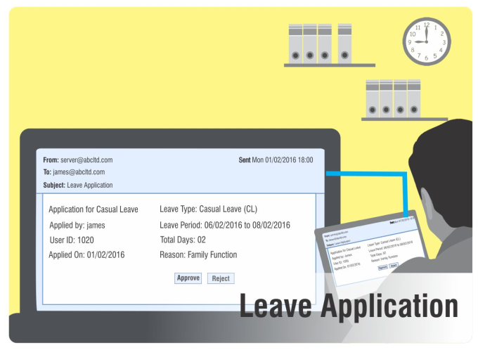
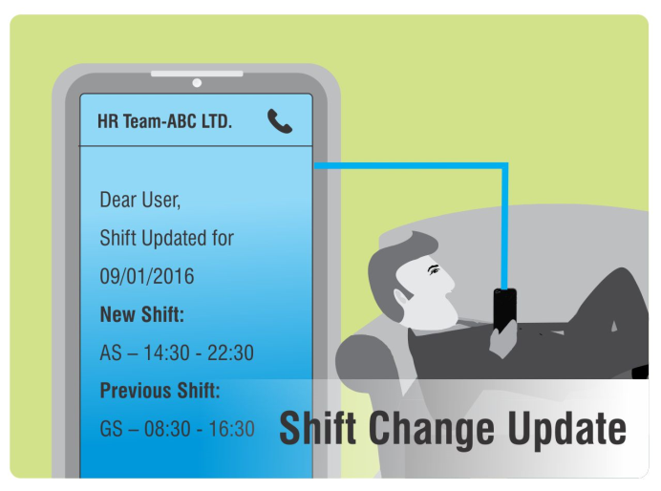
  Real-time SMS & Email Notifications
Notify Employee/Reporting Officer on Exceptions
Alerts on Missed Punches, Attendance-Leave Status, Access Control Mishaps

Slide 25

Security of Manpower and Assets
Avoid Proxy Punching by Staff Members

Slide 26
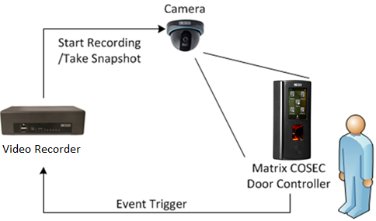
  Integration with Video Surveillance Solution
Capture User’s Snap on Punch

Slide 27
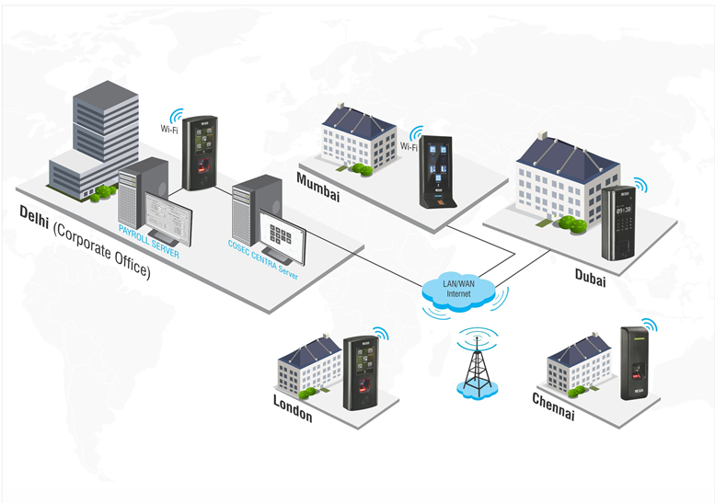
  Centralized Monitoring
Fully Web based Software with only one Public IP
Monitor Status of each Door connected in Network

Slide 28

Security of Manpower and Assets
Easy Escape from Premises in Case of Fire

Slide 29
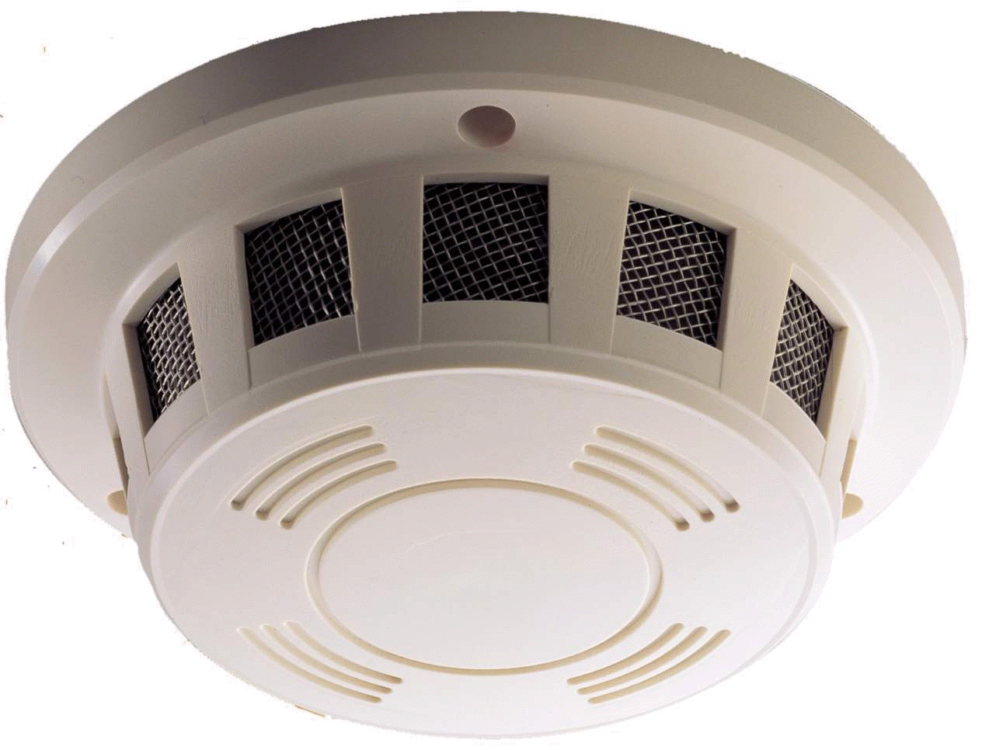
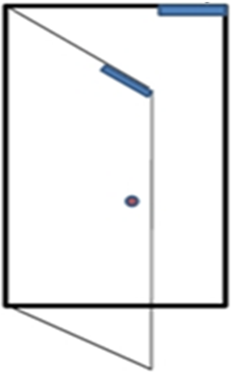

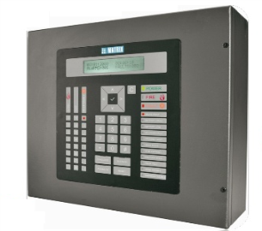

  Easy Access from Premises in case of Fire
Detector
Door Lock Open
Fire Event
Fire Alarm Panel
Matrix COSEC Door Controller
Fire Event Trigger
On catching Fire, the Door of Premises will Open Automatically for Easy Escape.

Slide 30

Increase Customer Satisfaction
Timely Customer Attention

Slide 31






  Comprehensive Attendance Policies
Late IN/OUT
Early IN/OUT
Overtime
!
Absenteeism Policies
C-OFF Policies
Break Policies

Slide 32
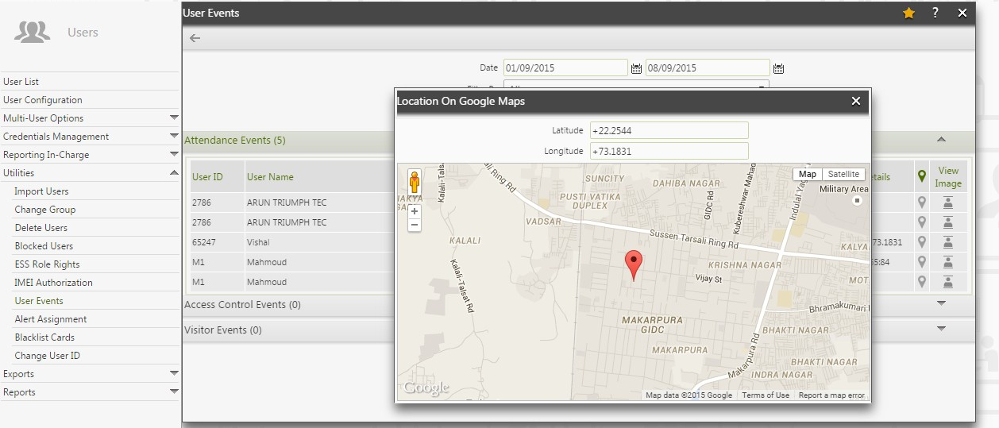
  GPS based Attendance Tracking
GPS based Manual Attendance Marking by Field Employees

Slide 33
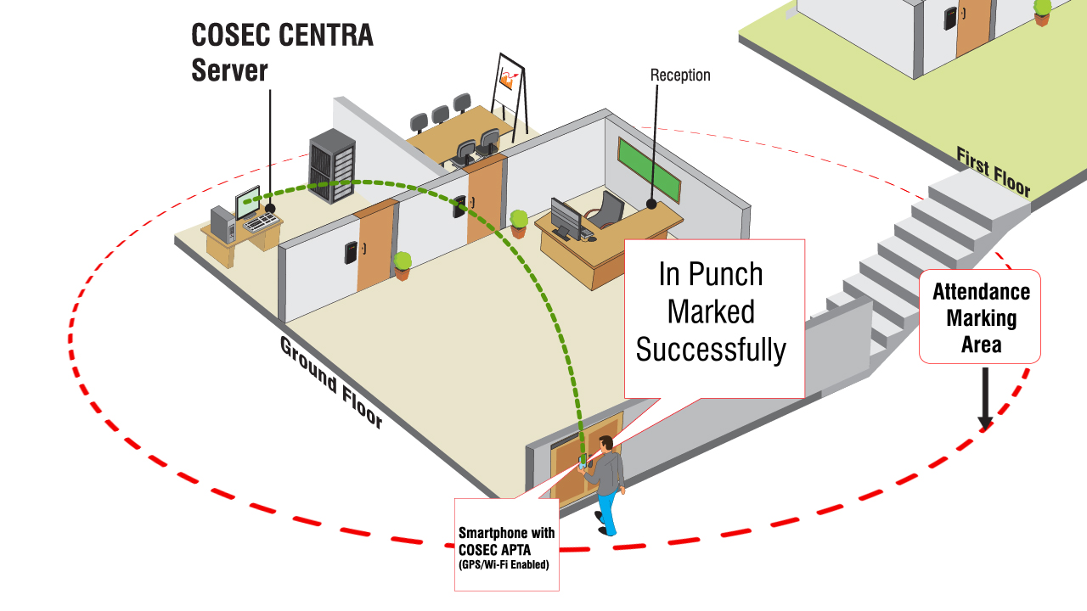
  Automatic Attendance Marking
On Entering/Exiting any Location Predefined in System, Attendance gets Marked Automatically through Wi-Fi / GPS

Slide 34
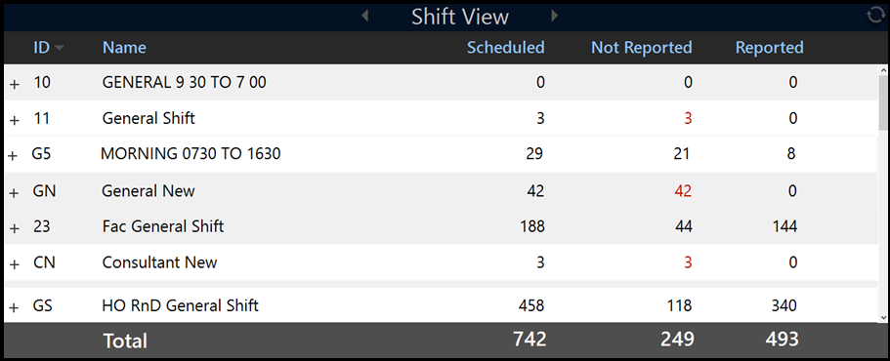
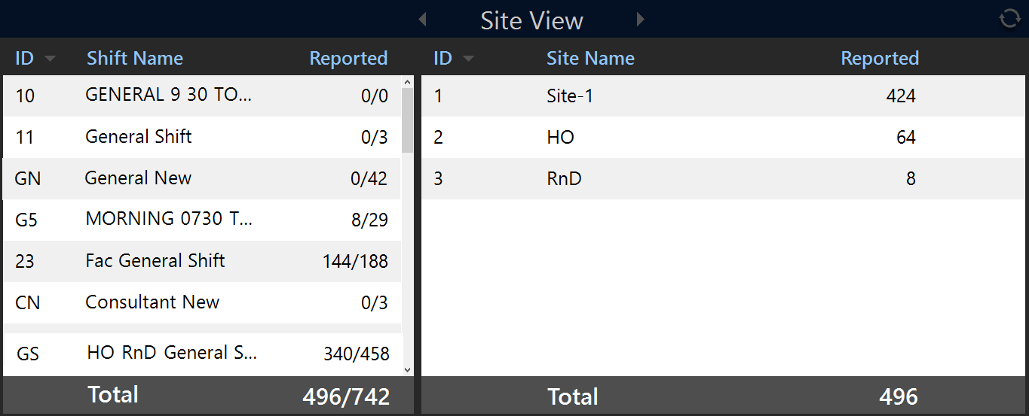
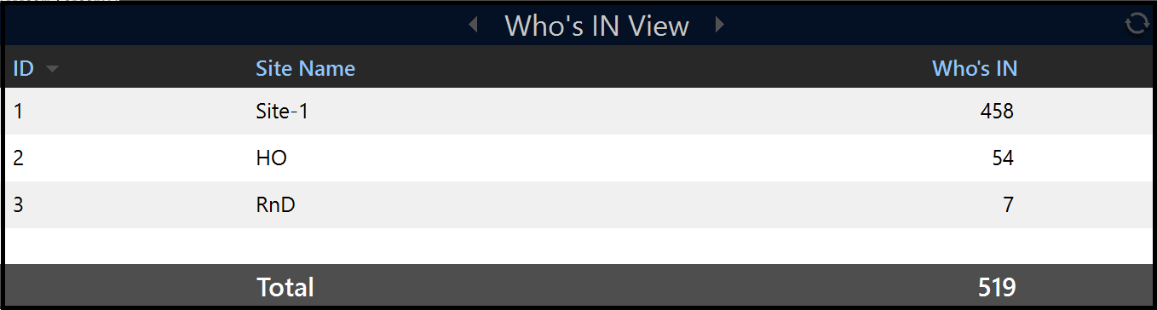
  Live Tracker
Shift View
Site View
Who’s IN View
Shows Live Head Count of Users according to Shift, Site or Who’s IN

Slide 35
Increase Customer Satisfaction
Leave Management of Employees

Slide 36





  Leave Policies
Leave Types
Tour Policies
Accrual Policies
Leave Application and Approval
Leave Encashment

Slide 37
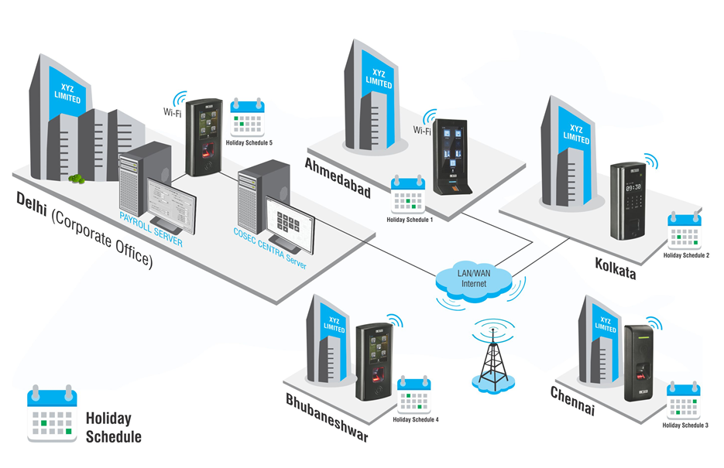
  Region-wise Holiday Management
Configure up to 30 Holiday Schedules with 32 Holidays in each

Slide 38


  Attendance and Leave Management Portal
Employee Self Service Portal (ESS)
Employees
Reporting Managers
View Attendance/Leave/Shift Details
Mark Attendance
Apply for Leave/Tour
Apply for Attendance Correction
Edit Personal Information
Approve Leave/Tour Request
Approve Attendance Correction
Authorize Attendance
View Team Attendance

Slide 39



  ESS is available on

Slide 40
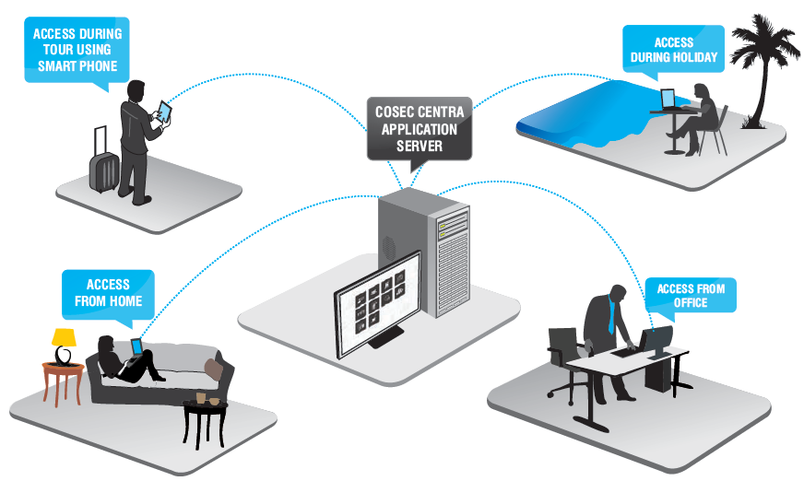
  Access ESS Portal from Anywhere

Slide 41
Increase Customer Satisfaction
Proper Shift-Scheduling of Employees

Slide 42
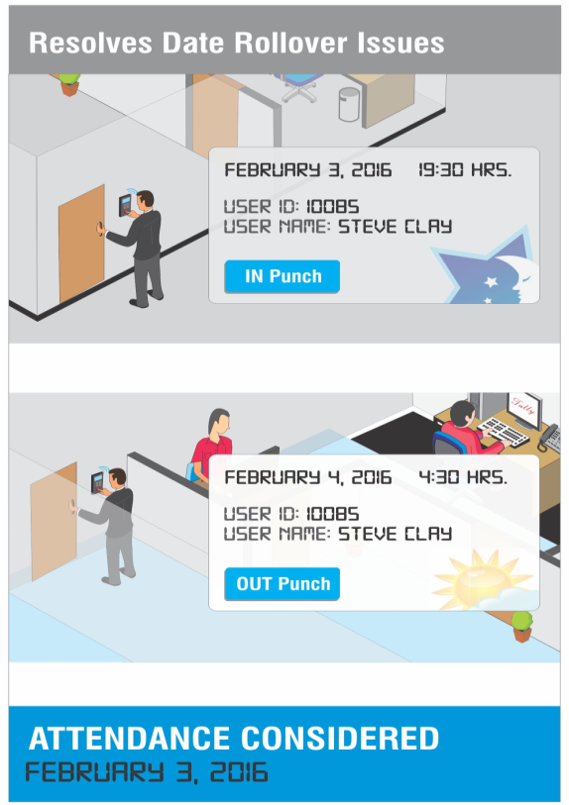
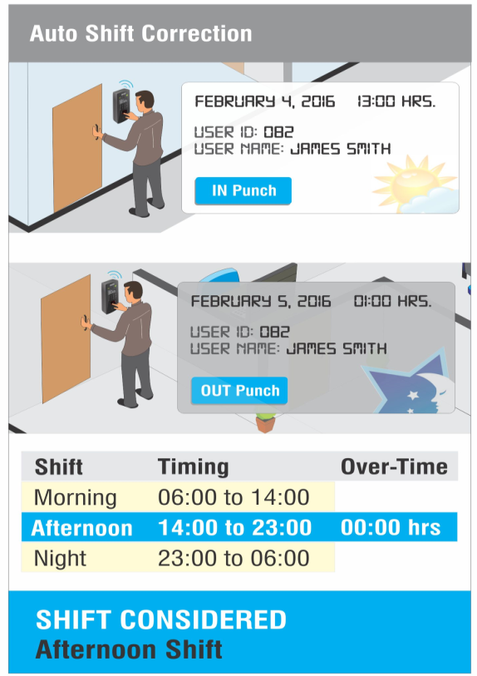
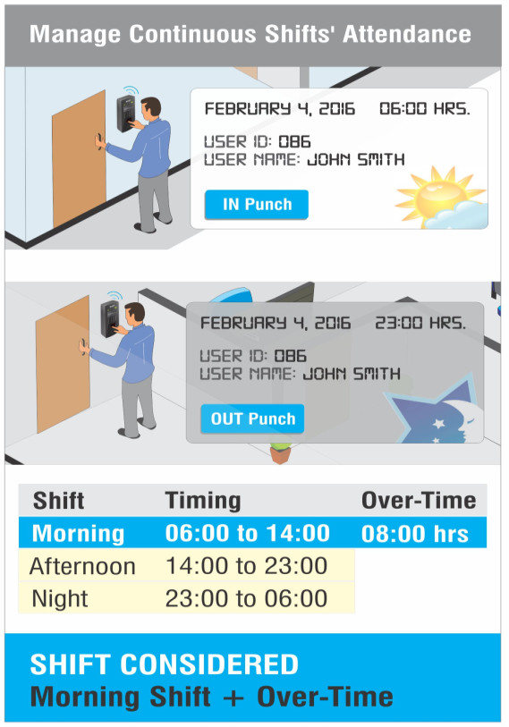
  Shifts and Schedules
Create up to 999 Shift Schedules with Unlimited Shifts

Slide 43





  Benefits with Matrix
Improves Productivity
Automates Attendance
Process
Increases Security
ERRORS
Reduces Payroll
Errors
Reduces Cost
Leverages Peace of Mind

Slide 44









  Clientele List
 | India |  | India
 | India |  | India
 | India |  | Dubai, UAE
 | India |  | Oman
 | India |  | India
Departmental Store Chain
Textile Retailer
Departmental Store Chain
Shopping Mall
Apparel Store Chain
Apparels
Hamburger fast food restaurant chain
Multibrands ‘Wholesale
Auto Dealer - Toyota Cars
Shopping Mall

Slide 45
  Case Reference

Slide 46
  Matrix Time-Attendance at Burger King, Mumbai
Applications:
Managing Time-Attendance of 1000+ Employees in Outlets at Mumbai
Solution Offered:
Web based time-attendance solution for 30+ locations with biometric fingerprint based terminals
Flexible attendance marking option for calculating accurate working hours in a day and payroll tracking
Monthly attendance reports with overtime
Direct integration with HRM software
Technology:
Fingerprint Reader (with Optical sensor)
Matrix Offering:
Users: 1000+
Devices: 30+
Locations: 30+ Outlets (in Mumbai)
Benefits:
Improved productivity with accurate attendance calculation
Automated payroll tracking and calculations save time of HR personnel

Slide 47
  Matrix Hardware

Slide 48
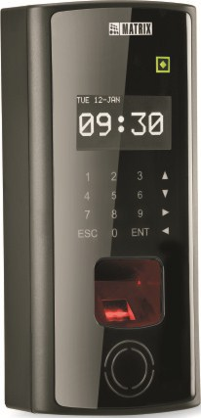
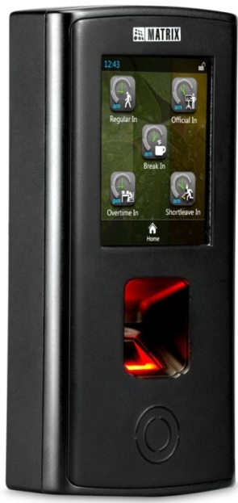
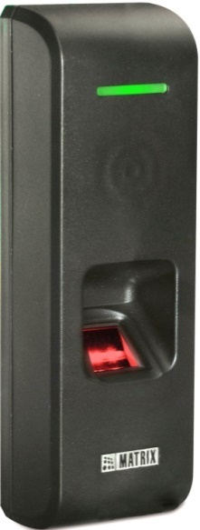
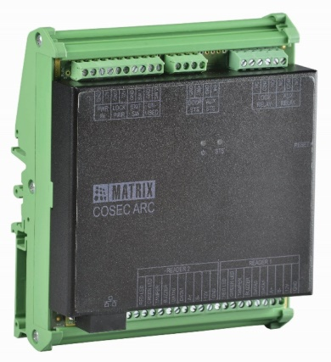
  Matrix COSEC Product Range
VEGA Series
DOOR Series
PATH Series
ARC Series

Slide 49
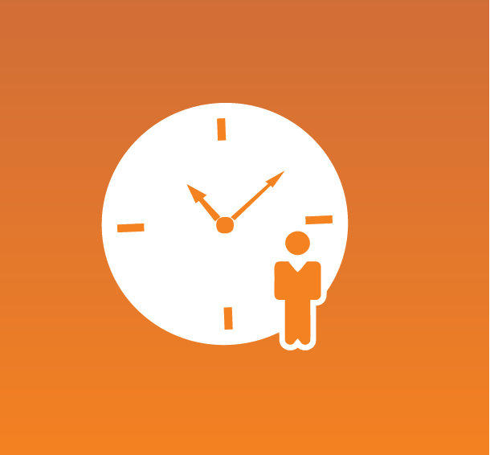
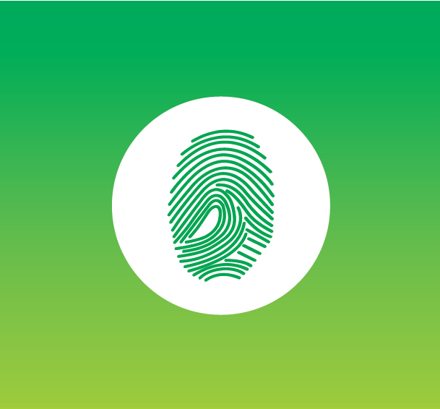
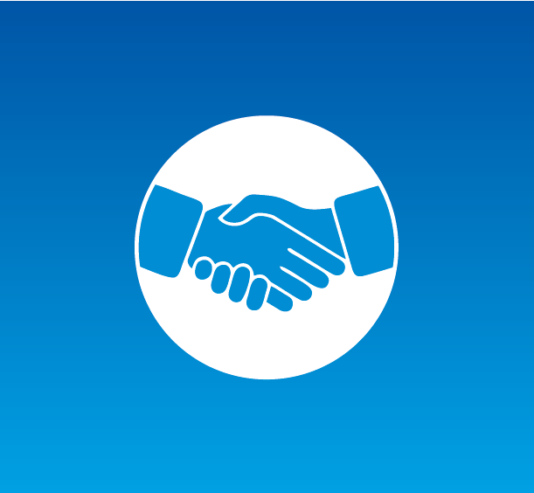

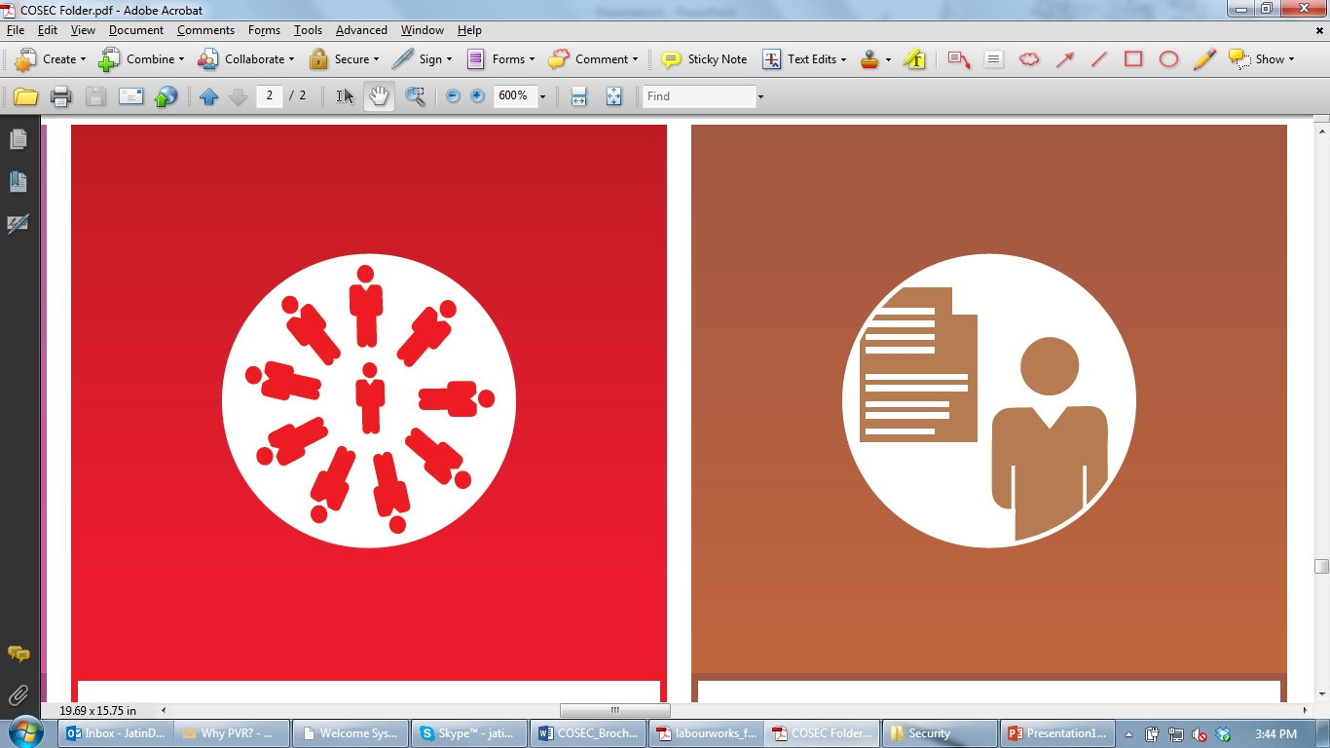




  Matrix COSEC Solutions
Time-Attendance
Access Control
Visitor Management
Cafeteria
Management
Contract Workers Management
Roster Management
Job Processing and Costing
Employee Self-Service
Vehicle Access Management
Field Visit Management

Slide 50
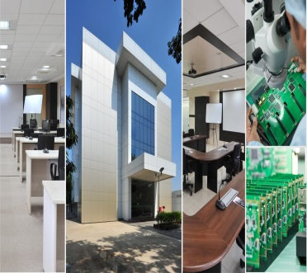

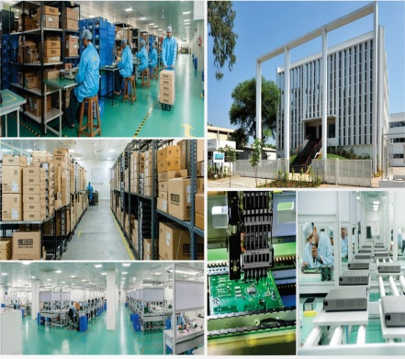
  About Matrix
1991
60+
40+
500+
400+
25+
We Established
Products
Telecom & Security
Countries we Present
No. of
Channel Partners
No. of
Employees
Awards and Achievements
R&D Center
Corporate Office
Manufacturing Unit
www.MatrixSecuSol.com

Slide 51
  For Further Information -
Email | More@MatrixComSec.com
Contact No | +91 265 2630555
Website | www.MatrixSecuSol.com
Address | 394-GIDC Makarpura, Vadodara-390010, Gujarat, India

Slide 52


