Slide 1

Matrix People Mobility Solution for Manufacturing Unit
Right People in Right Place at Right Time

Slide 2
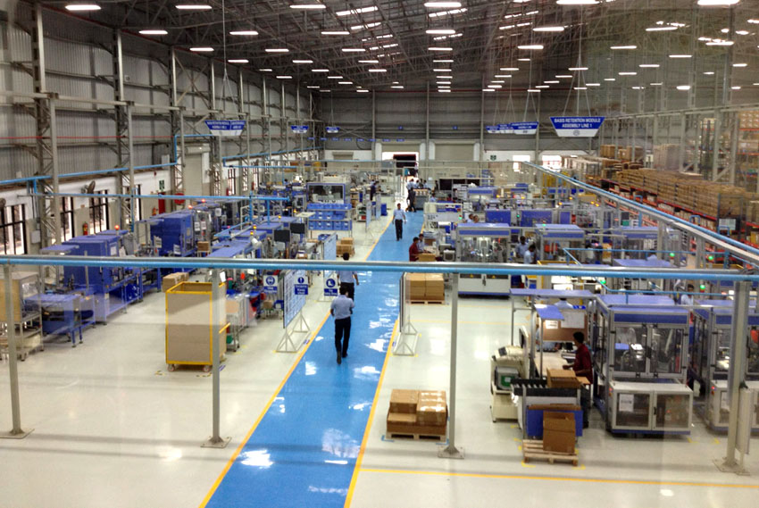
MATRIX PEOPLE MOBILITY SOLUTION FOR MANUFACTURING UNIT

Slide 3

Pain Areas

Slide 4



Pain Areas
Safety of Manpower
Security of Manpower and Assets
Productivity of a Manufacturing Unit

Slide 5



Pain Areas
Operations Under Threat
Safety of Manpower
Integration with Third Party Devices
Prompt Response on Casualties

Slide 6



Pain Areas
Restrict Unauthorized Access
Security of Manpower and Assets
Protect Physical Assets and Manpower
Visitor, Contractor and Vehicle Security

Slide 7




Pain Areas
Worker Irregularities
Productivity of Manufacturing Unit
Timely and Accurate Salary Payments
Time Spent on Each Job

Slide 8
Safety of Manpower
Operations Under Threat

Slide 9




Dead Man Zone: Ensure Safety of Employees at Defined Time
User Shows Credential at Pre-defined Time to Ensure his Presence

Slide 10

Duress Detection
Dials with Access Code Followed by a Secret Code
System Opens the Door and at the Same Time Notifies Concerned Person without Giving any Local Alarm

Slide 11
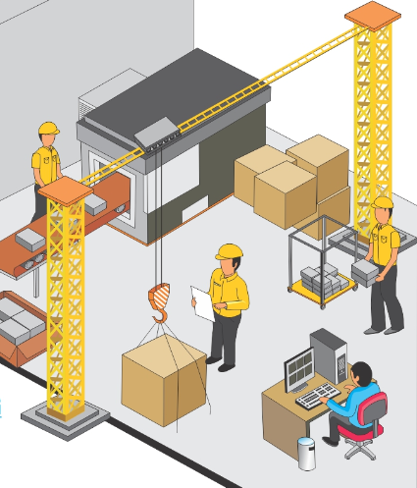


Access Control - User
Manufacturing Assembly Line
Manufacturing Assembly Line
Assembly Line Engineer
Labour
User Access to Limited Areas

Slide 12


Access Control - Time
8:00 AM – 1:00 PM
8:00 AM – 1:00 PM
Assembly Line Engineer
Assembly Line Engineer
In Punch: 9:00 AM
In Punch: 2:00 PM
User Access only During Particular Time Period

Slide 13
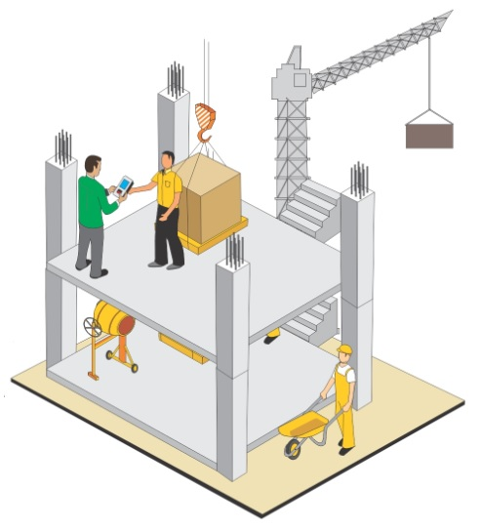
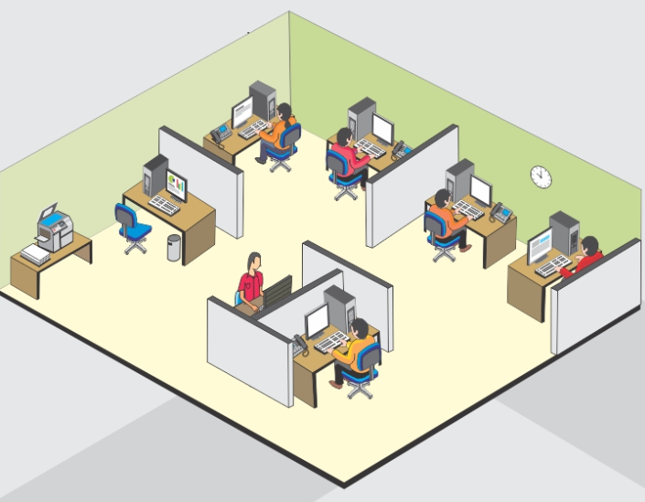



Access Control
Zone 1: Assembly Line
Zone 2: Material Management Line
Zone 3: Administration
Admin
Define Zone for Users

Slide 14
Safety of Manpower
Integration with Third Party Devices

Slide 15
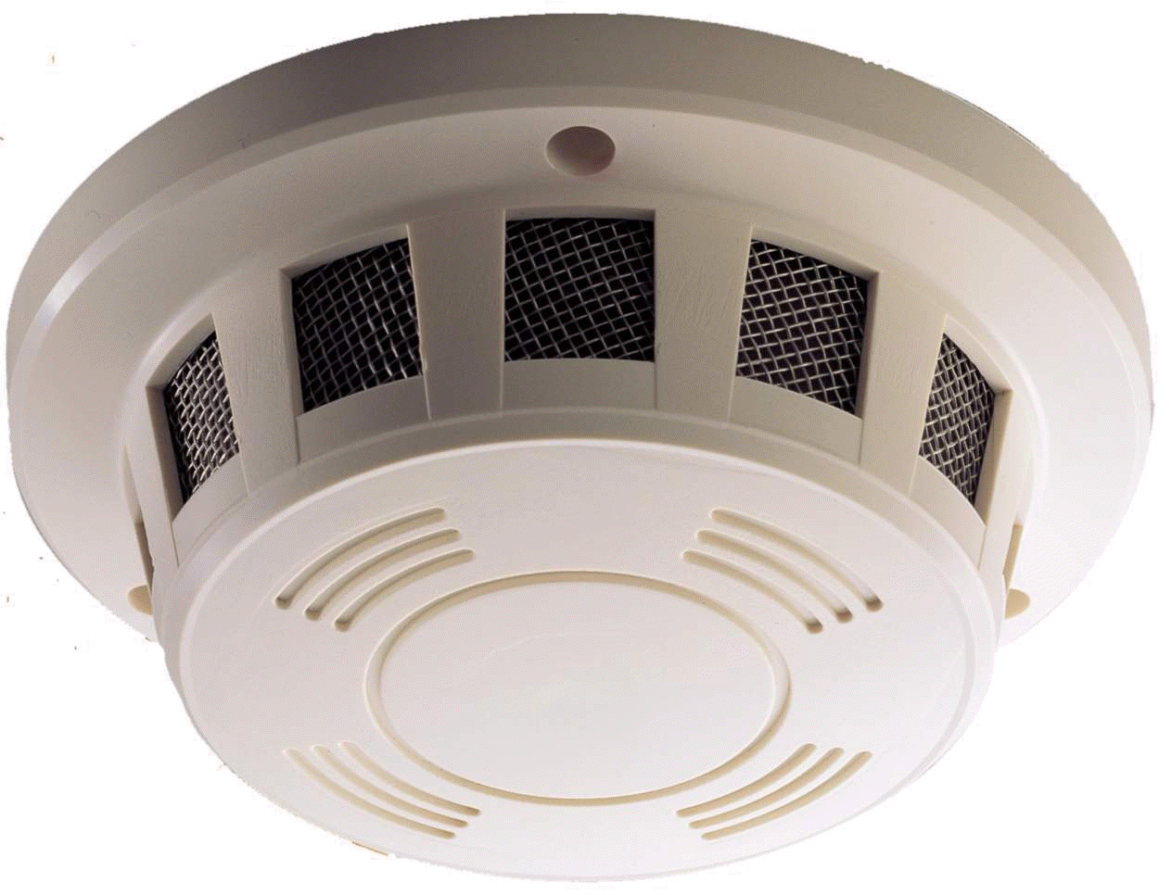
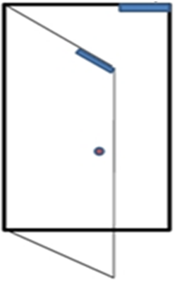

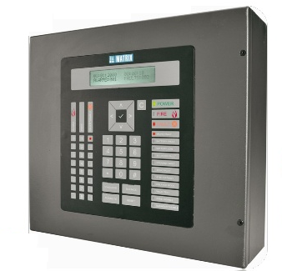
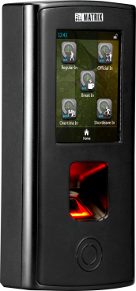
Integration with Fire Alarm
Detector
Door Lock Open
Fire Event
Fire Alarm Panel
Matrix COSEC Door Controller
Fire Event Trigger

Slide 16
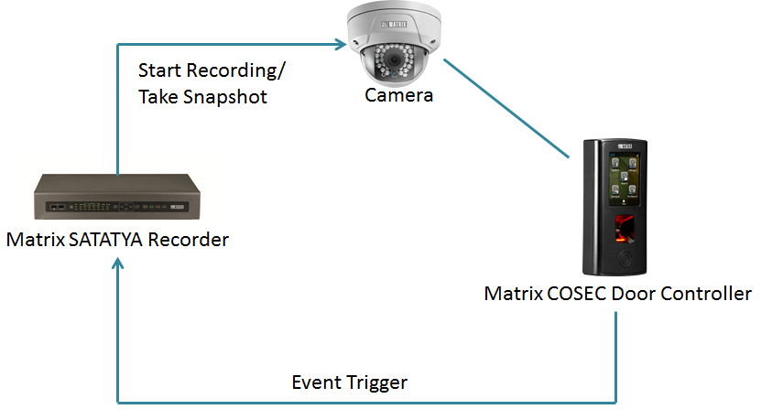
Integration with Video Surveillance

Slide 17




Integration with Hardware
Boom Barrier
Turnstile
Tripod
Electronic Door Lock

Slide 18



I/O Linking: Take Action based on Event Occurrence
Motion Sensor
Siren
Sprinkler
Integrate in Server Rooms, Warehouses to Keep a Safety Check
Integrate with Matrix Door Controller to Notify Employees as Lunch break, Emergency, Casualties, etc.
Integrate with Fire Alarm to Extinguish Fire and Prevent Hazardous Situations

Slide 19
Safety of Manpower
Prompt Response on Casualties

Slide 20




SMS and Email Notifications
Door Kept Open For More than Normal Time
Door Forcefully Opened
Threats and Casualties
Dead Man Zone Violation
SMS and Email Alerts to Respond Quickly on situations

Slide 21
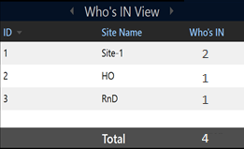



Get Count of Members Present during Hazardous Situations
Manufacturing Unit
Site-1
There’s a Fire. We need to save 4 Members who are inside the premises
HO
RnD
Presents Live Head Count of Users according to Shift, Site or Who’s IN

Slide 22
Security of manpower and Assets
Restrict Unauthorized Access

Slide 23


Access Control
25+ Advanced Access Control Features
Restrict Unauthorized Access

Slide 24
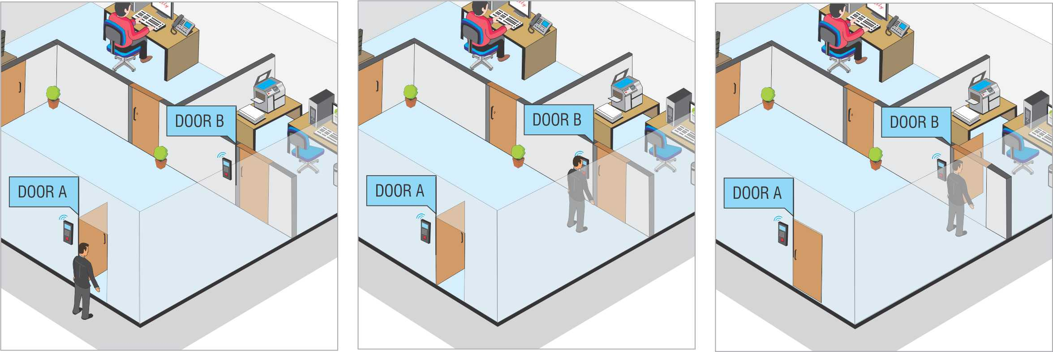
Man Trap: Open one Door at a Time
Control Traffic, Intruders and Air

Slide 25
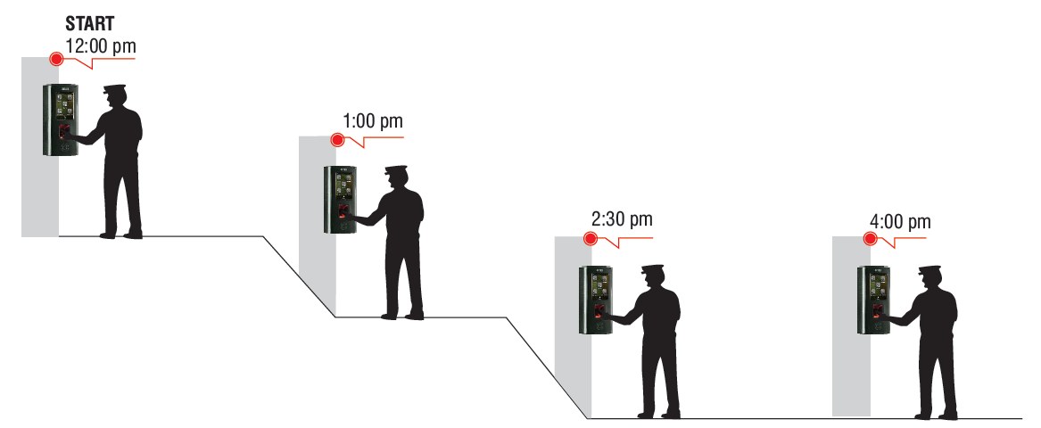
Guard Tour
Enforce Vigil Patrol of Security Guards or Such Pre-fixed Movement of Other People

Slide 26
Security of Manpower and Assets
Protect Physical Assets and Manpower

Slide 27



2 Person Rule: Dual Authentication
Access Allowed only When Two Authorized Users Punch within a Specified Time to Ensure High Security

Slide 28
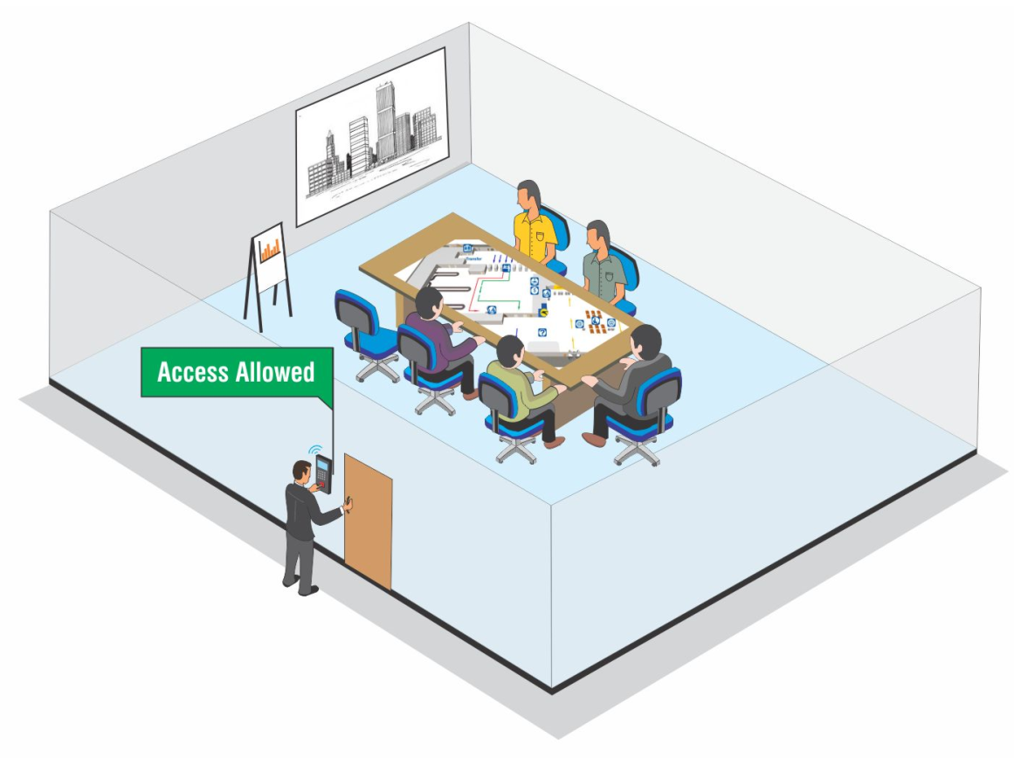
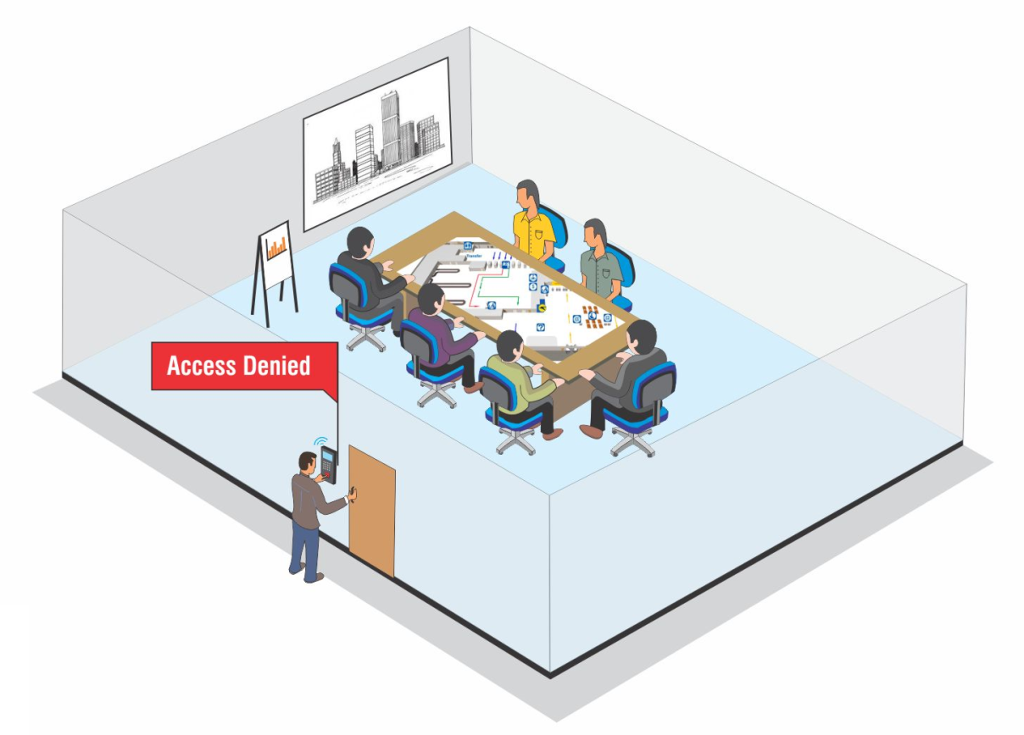
Occupancy Control
Occupancy: 6
Controls Number of Users in a Particular Area

Slide 29






Relative Occupancy Control
SECURITY
SECURITY
Employee Can Enter the Office, Only if Security Guard is Present in the Cabin

Slide 30
Security of Manpower and Assets
Visitor, Vehicle and Contractor Security

Slide 31
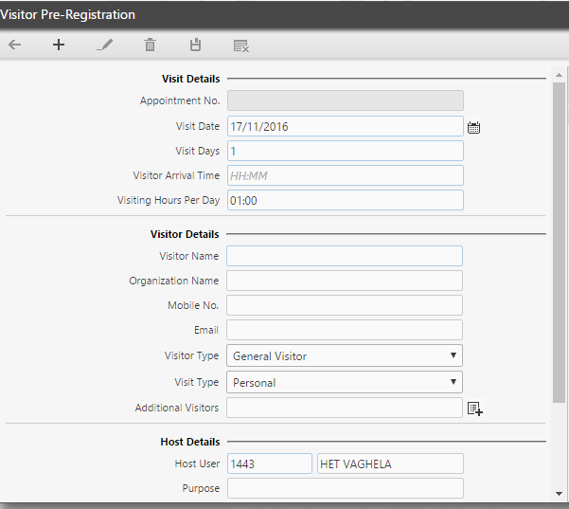
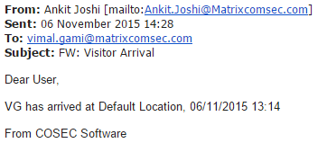



Visitor Management
Pre-register/Spot Register a Visitor
SMS/Email Notification on Visitor Arrival

Slide 32

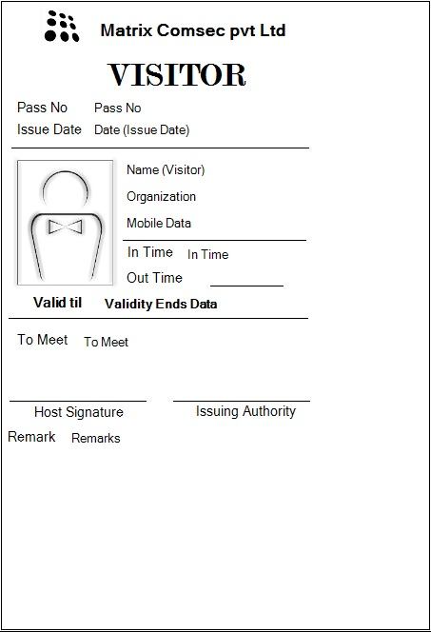





Visitor Management
Reports on:
Visitor Punch Details
Visitor Access Denied
Pre-registered Visitors
Visitor Pass Validity
Visitor enrolment Status
Visitor Pass Creation and Integrations
Visitor Pass Surrender
Reports

Slide 33
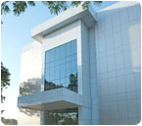

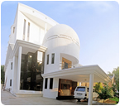

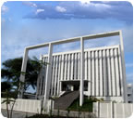

Vehicle Access Management
R&D
R&D
Corporate
Factory
Corporate
Factory
COSEC VAM
COSEC VAM
Exit from R&D Noted
Entry to Factory Noted

Slide 34
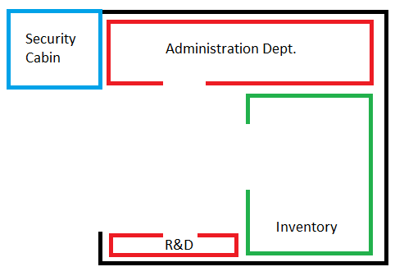

Vehicle Access Management
Material Carrying Vehicle
Pre-define Access Route to Vehicles

Slide 35
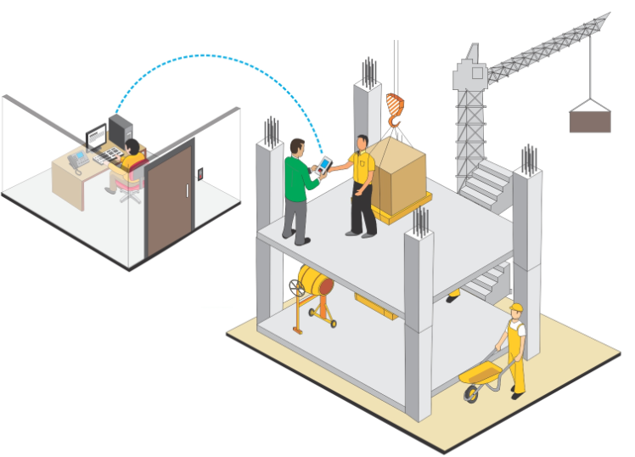
Contract Workers Management
In Punch
Admin
Worker
Contractor
Manage Contractor and Worker Profile Effectively

Slide 36

Contract Workers Management
Work Order Creation
Assign to Contactor
Create Workers
Worker Attendance
Worker Hours Data
Allow Managers and Contractors to Improve Labour Productivity

Slide 37
Productivity of Manufacturing Unit
Worker Irregularities

Slide 38




Flexible Attendance Policies
Late IN/OUT
Early IN/OUT
Overtime
C-OFF Policies

Slide 39





Leave Management
Leave Policies
Tour Policies
Accrual Policies
Leave Application and Approval
Leave Encashment

Slide 40
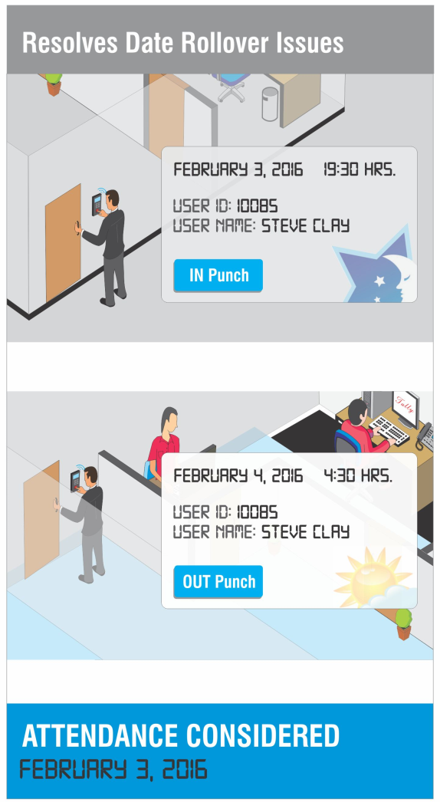
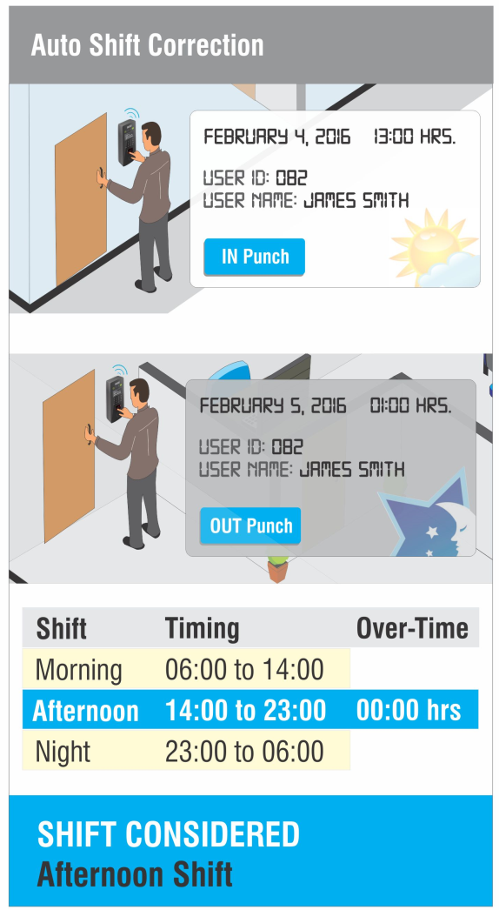
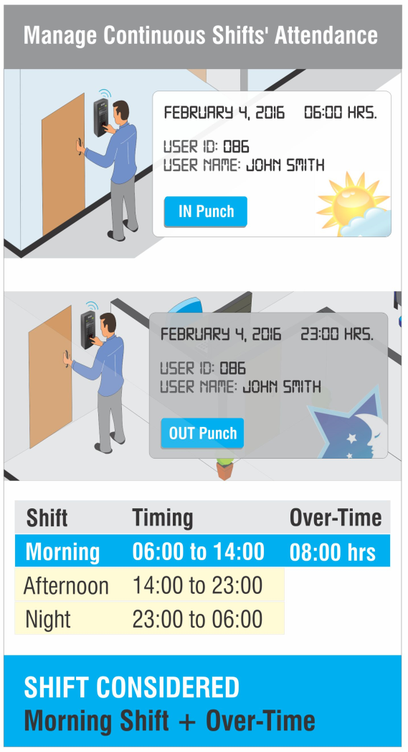
Shift and Schedules
Up to 999 Shift Schedules with Unlimited Shifts

Slide 41
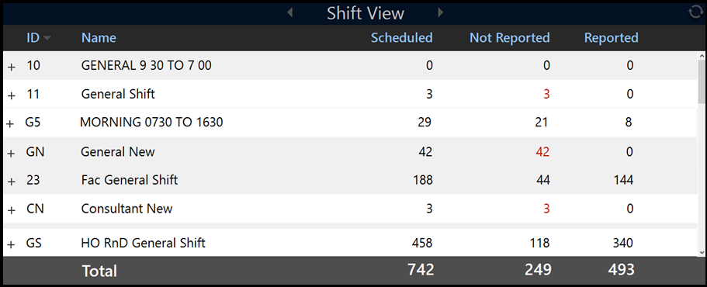
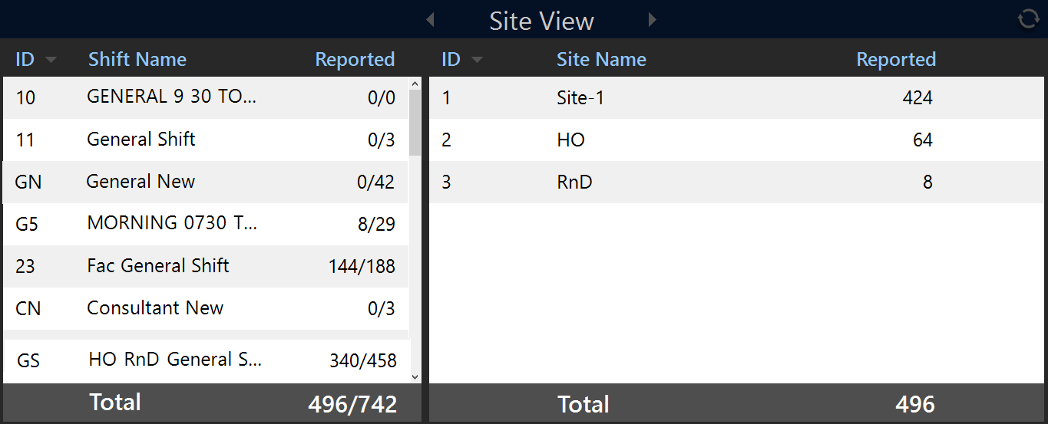
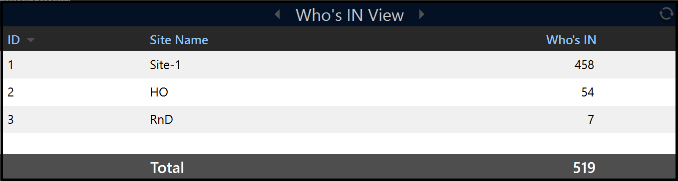
COSEC Tracker: Live Count of Person Inside the Premises
Shift View
Site View
Presents Live Head Count of Users according to Shift, Site or Who’s IN
Who’s IN View

Slide 42
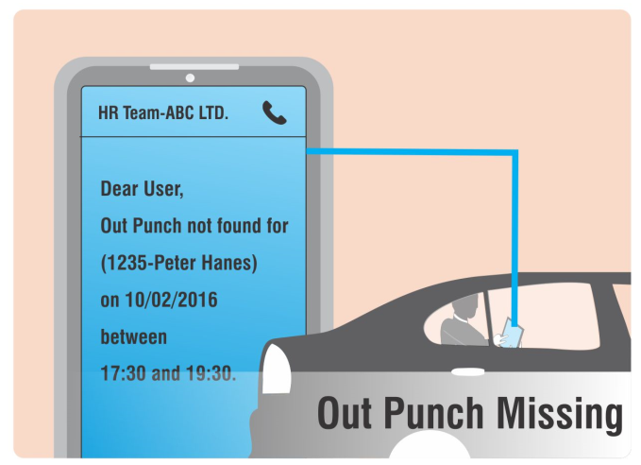
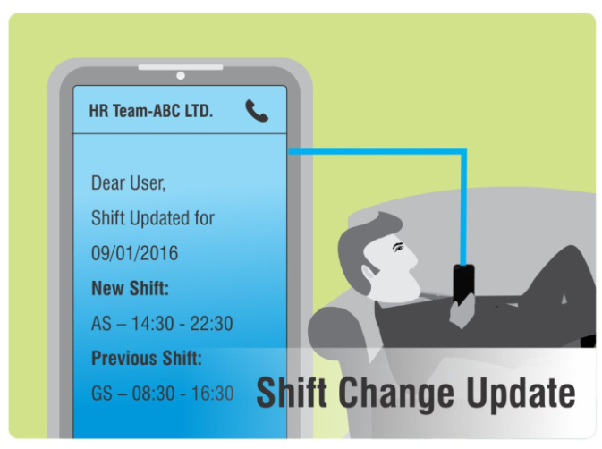
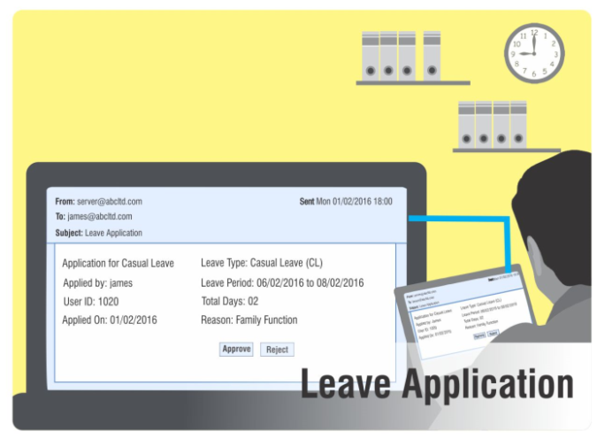
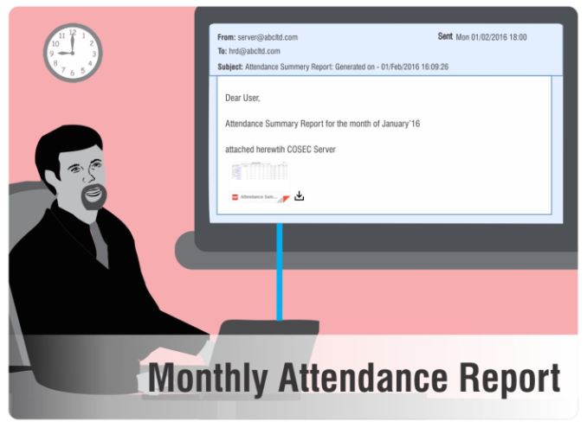
SMS and Email Notifications
SMS and Email Alerts to Respond Quickly on situations

Slide 43

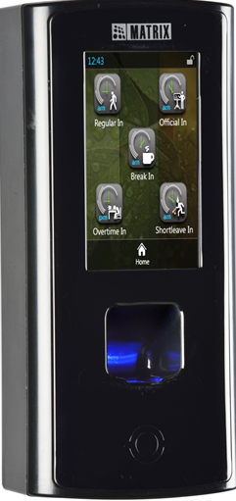
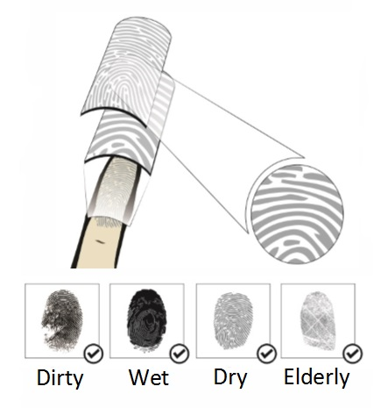



COSEC DOOR FMX
COSEC DOOR FMX
Reads Surface as Well as Subsurface of Finger
Reads Live Finger Only

Slide 44
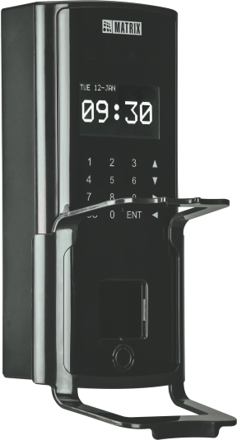
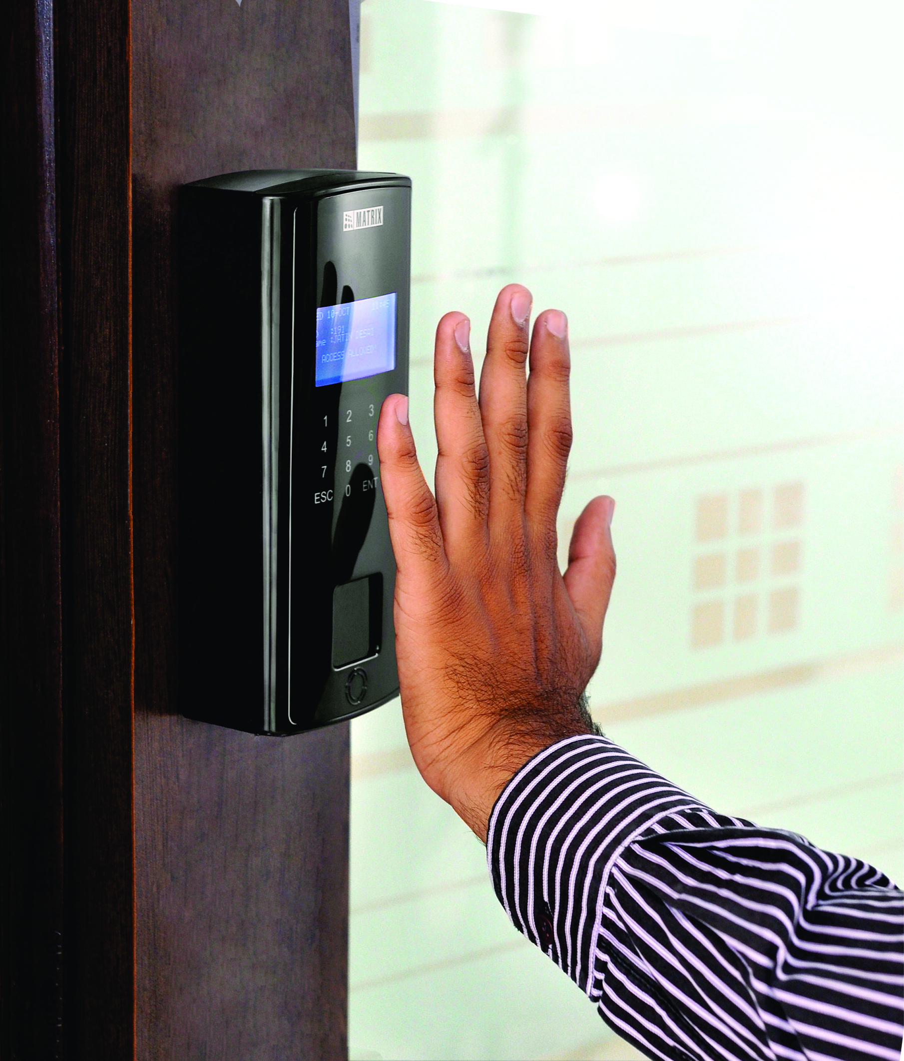




COSEC DOOR PVR
Chemicals
Pharmaceuticals
R&D Labs
Refinery
COSEC DOOR PVR with Detachable Hand Guide
Contactless Technology
Target Audience

Slide 45
Productivity of Manufacturing Unit
Timely and Accurate Salary Payments

Slide 46
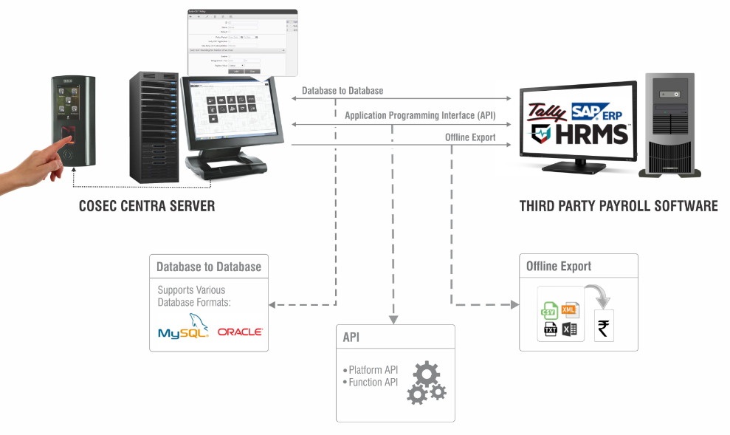
Third Party Payroll Integration
Seamless Payroll Integration for Faster HR Process

Slide 47
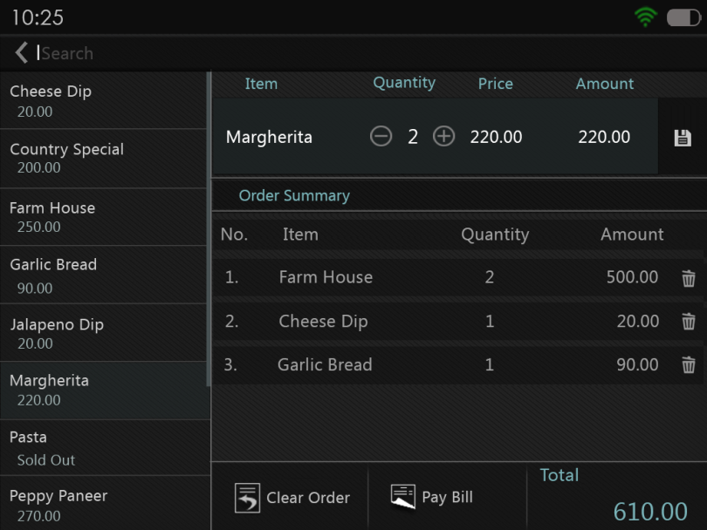
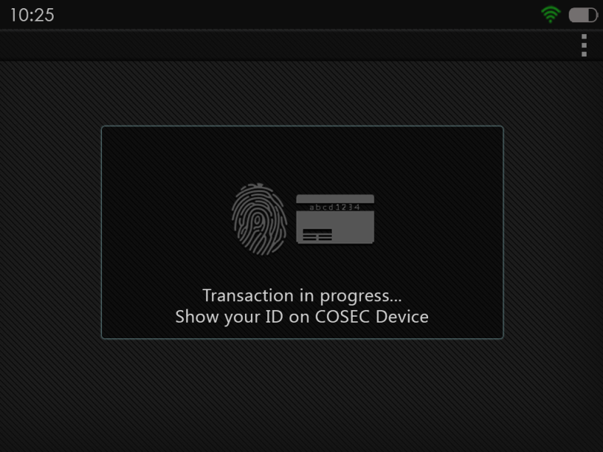
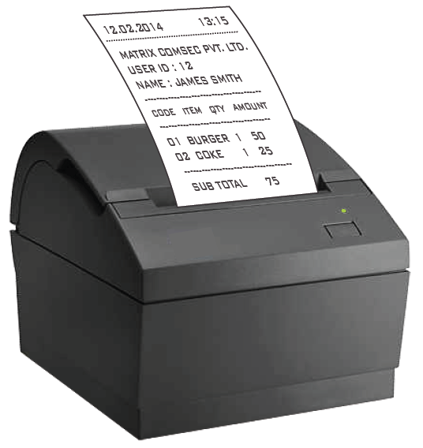
Cafeteria Management
Select Item quantity from COSEC Device
Show Credentials on COSEC Device
Directly Print Receipt for Ordered Food

Slide 48


Cafeteria Management: Cashless Transactions
Pre-paid Transactions:
Smart Card to Store Balance
Recharge As and When Needed
Post-paid Transactions:
Through Fingerprint, RFID
Define Maximum Credit Permitted per User per Month

Slide 49
Productivity of Manufacturing Unit
Time Spent on Each Job

Slide 50










Job Processing and Costing
Project and Phases
Job Group and Job
Job Count
Time based Job Allocation
Site Mapping
Daily Job View
Job Status
Forecasting
Time-sheet Correction
Reports

Slide 51
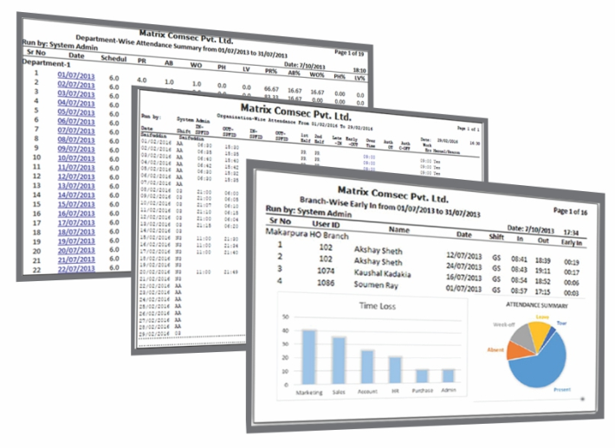
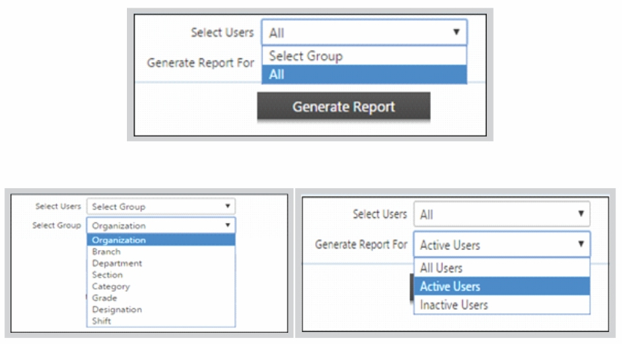




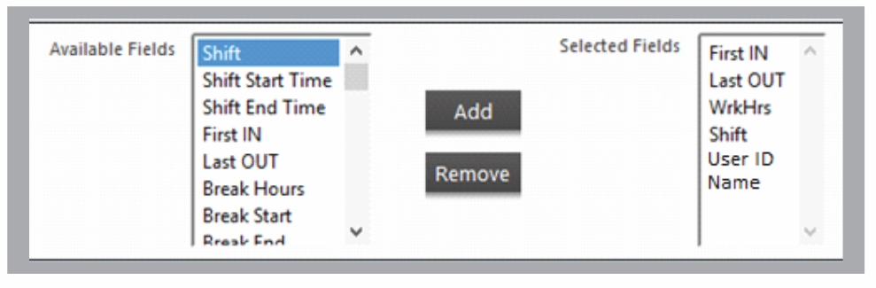



Customized Reports
Generate 200+ Reports and Charts
Apply Various Filters to Generate Specific Reports
Generate Customized Report Template
Send Reports on Email at Scheduled Time
File Formats

Slide 52





Benefits with Matrix
Increase Productivity
Automate Attendance
Process
Increase Security
ERRORS
Reduce Payroll
Errors
Reduce Cost
Higher Employee
Satisfaction

Slide 53

Adani
Applications:
Managing Access Control and Contract Workers across multiple locations
Solutions Offered:
Centralized Attendance Management
Tracking Work Orders’ Progress
Integration with SAP using Database to Database Linking
Real-time Notifications on Exceptions
Integration with Boom Barrier and Turnstile
Advanced Access Control Features
Alarm on Access Rule Violation
Dead Man Alarm for Security Cabin’s Access Rule Violation
Technology:
Biometric Fingerprint
Smart RFID Card
Wireless Connectivity
Matrix Offering:
Devices: 17000 +
Users: 85000 +
Location: 25 + Business Units
Benefits:
Increase Security of Business by 15%
Enhance Security by Integration
Error Free Man-hours Computation for Quick and Effective Wages’ Calculation
Smooth Monitoring of Workers and Contractors
Easy Tracking of Work Orders

Slide 54










Clientele
Company Logo | Company Name | Location | Company Logo | Company Name | Location
 | Adani | India |  | Hero Moto Corp | India
 | Coca Cola | India |  | L&T | India
 | Ellams | Africa |  | Albanna Engineering | UAE
 | Khimji Ramdas | Oman |  | Schneider Electric | India
 | Al-Khodari | Saudi Arabia |  | TATA STEEL | India

Slide 55










Clientele
Company Logo | Company Name | Location | Company Logo | Company Name | Location
 | ABB | India |  | Alkem | India
 | Ford Motors | Thailand |  | Intas | India
 | AIA Engineering | India |  | Kuwait Oil Company | Kuwait
 | Gujarat Ambuja Exports Ltd. | India |  | Maccain Foods | India
 | Shakti Pumps | India |  | Almajdouie | Saudi Arabia

Slide 56
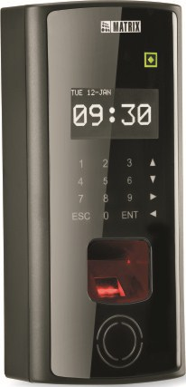
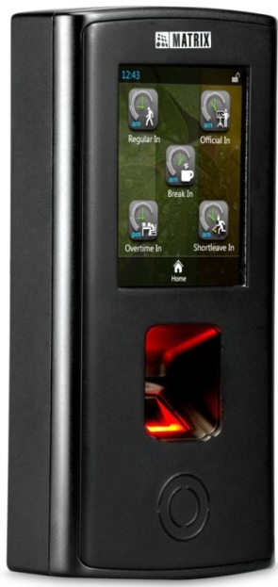
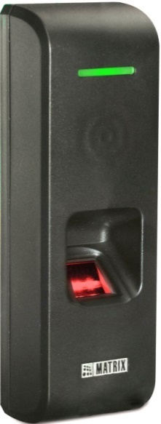
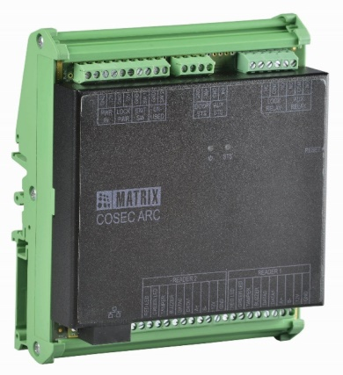
Matrix COSEC Product Range
VEGA Series
DOOR Series
PATH Series
ARC Series

Slide 57
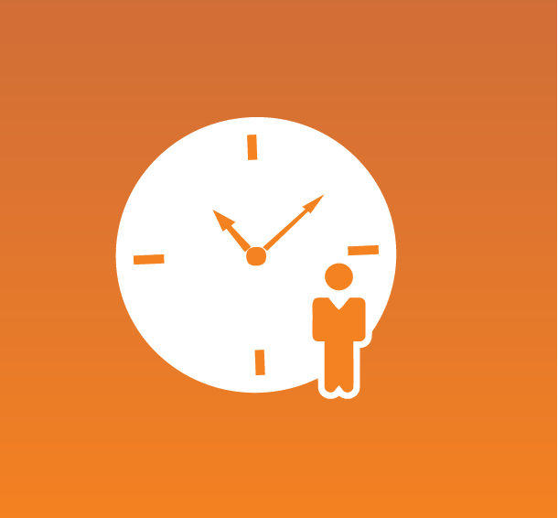



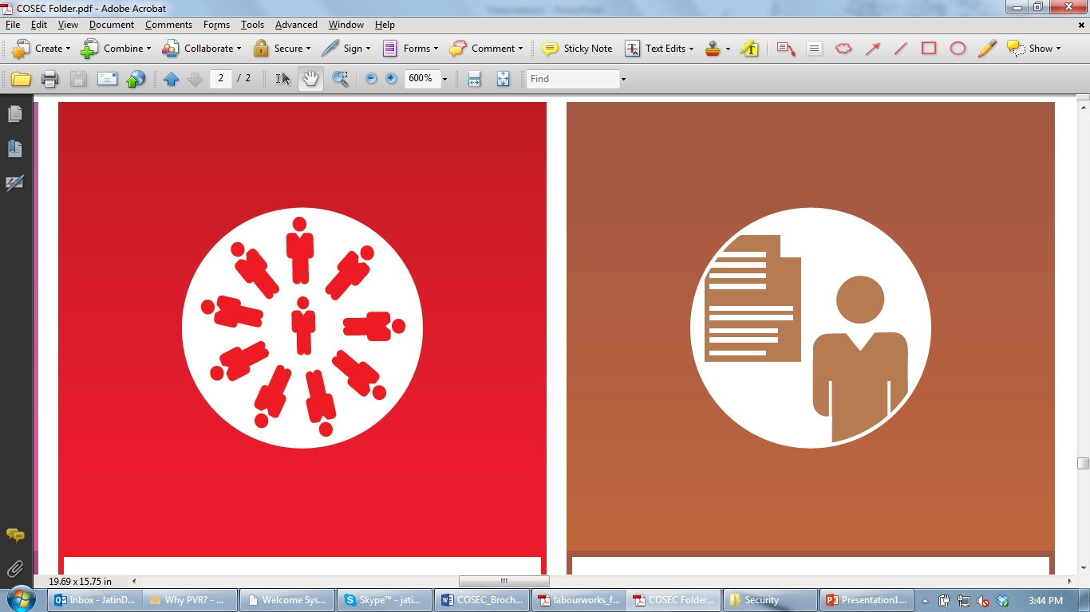




Matrix COSEC Solutions
Time-Attendance
Access Control
Visitor Management
Cafeteria
Management
Contract Workers Management
Roster Management
Job Processing and Costing
Employee Self-Service
Vehicle Access Management
Field Visit Management

Slide 58
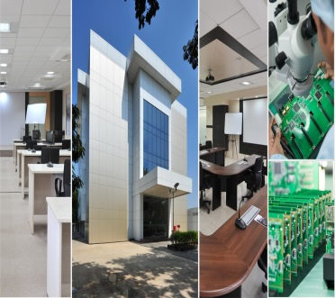


About Matrix
1991
60+
40+
500+
400+
25+
We Established
Products
Telecom & Security
Countries we Present
Channel Partners
No. of Employees
Awards and Achievements
R&D Center
Corporate Office
Manufacturing Unit
www.MatrixSecuSol.com

Slide 59


