Slide 1
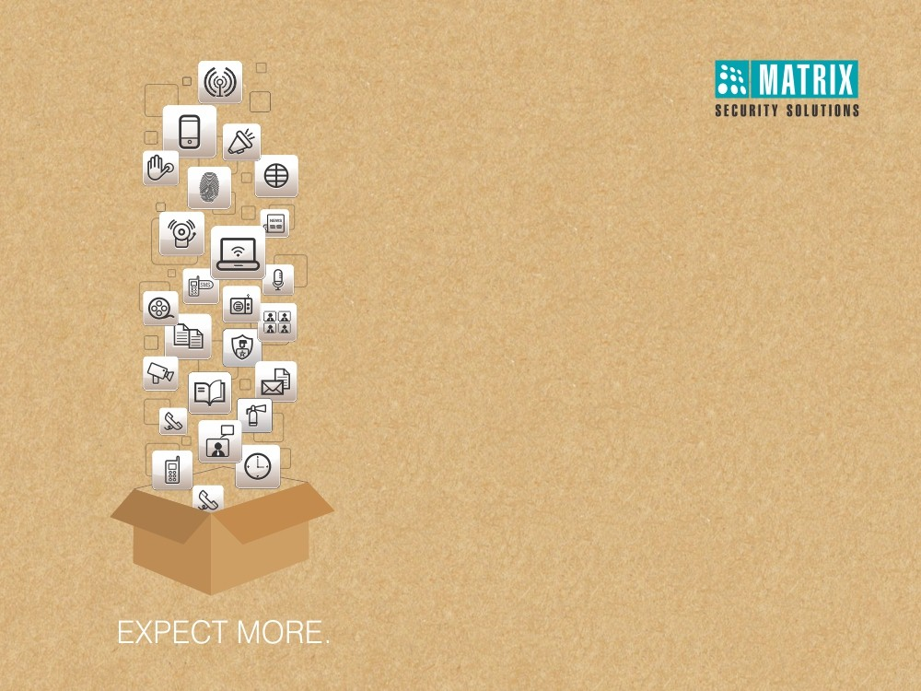
Matrix People Mobility Solution for IT/CALL-CENTER
Right People in Right Place at Right Time

Slide 2

MATRIX PEOPLE MOBILITY SOLUTION FOR IT/CALL-CENTER

Slide 3

Pain Areas

Slide 4


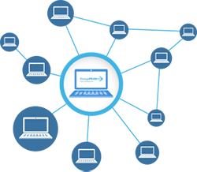

Pain Areas
Security of Assets and Employees
Increase Productivity
Centralized Management of Multiple Branches/Users

Slide 5



Pain Areas
Restrict Unauthorized Entry in Secured Areas
Security of Assets and Manpower
Monitor each Movement in Secured Areas
Integration of Third Party Hardware

Slide 6



Pain Areas
Timely Employee Management
Increase Productivity
Leave Management of Employees
Visitor Management

Slide 7



Pain Areas
Continuous Addition of New Branches/Users in Different Locations
Centralized Management of Multiple Branches/Users
Timely and Accurate Employee Salary
Restrict Branch-wise Roles and Rights

Slide 8
Security of Assets and Manpower
Restrict Unauthorized Entry in Secured Areas

Slide 9
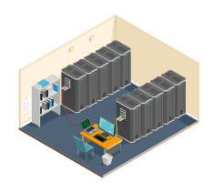



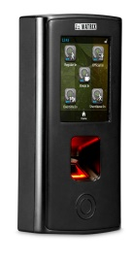
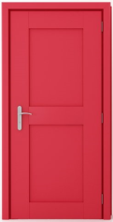
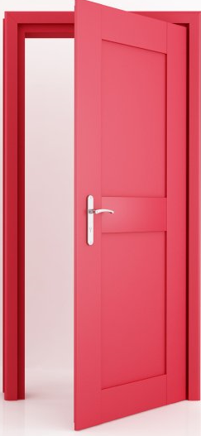
Restrict Access by Dual Authentication
Restrict Access in Un-Authorized zones like Admin Office, Server Room

Slide 10



User, Zone and Time based Access
sauna
User Access only During Particular Time Period
User Access to Limited Areas
Define Zone for Users
To Ensure there is No Intrusion

Slide 11
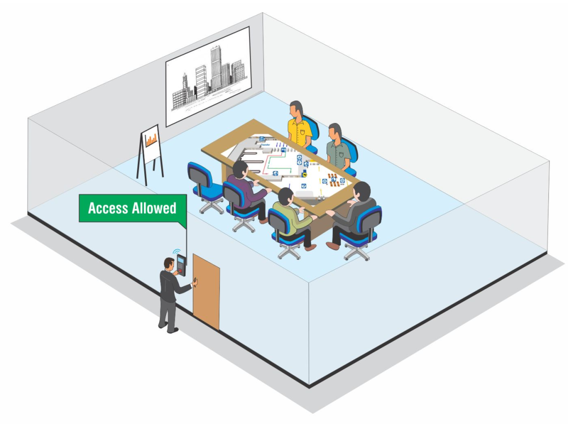
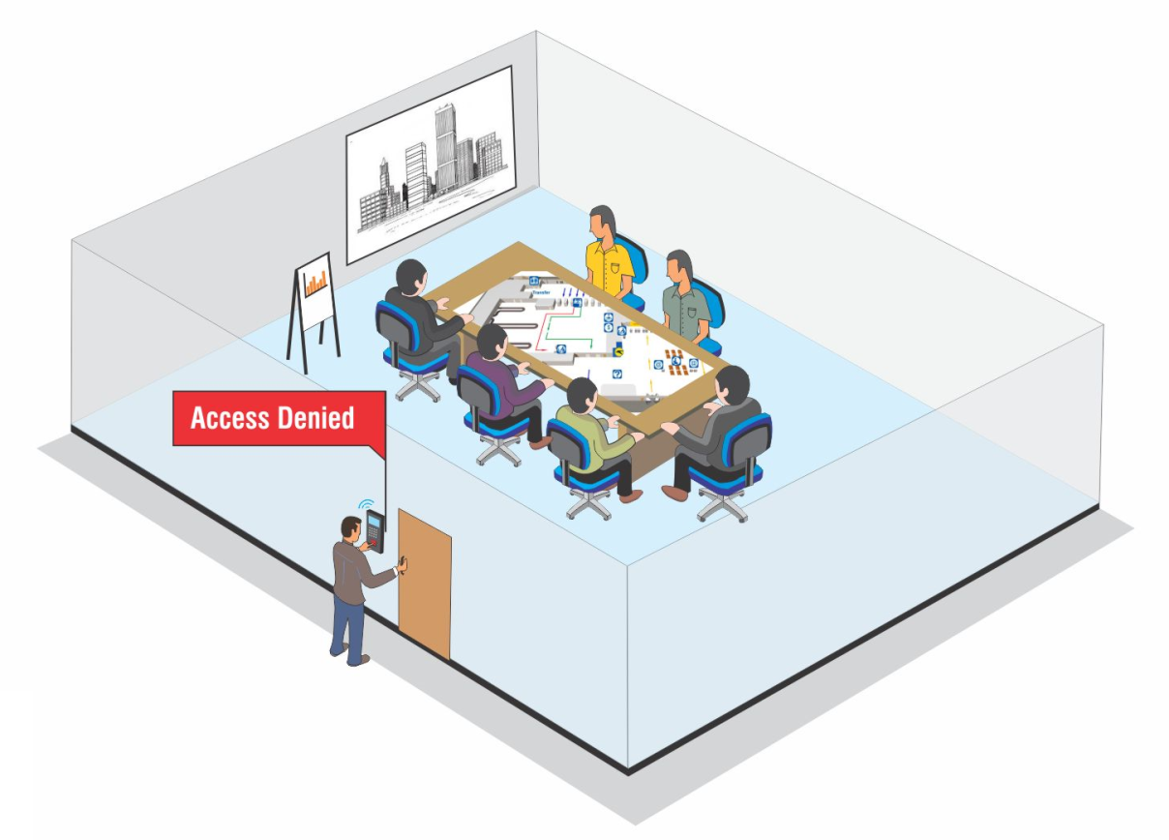
Occupancy Control
Occupancy: 6
Controls Number of Users in a Particular Area

Slide 12


Duress Detection
Dials with Access Code Followed by a Secret Code
System Opens the Door and at the Same Time Notifies Concerned Person without Giving any Local Alarm

Slide 13
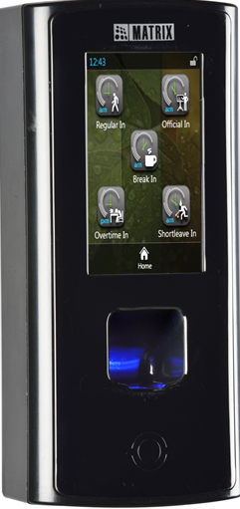
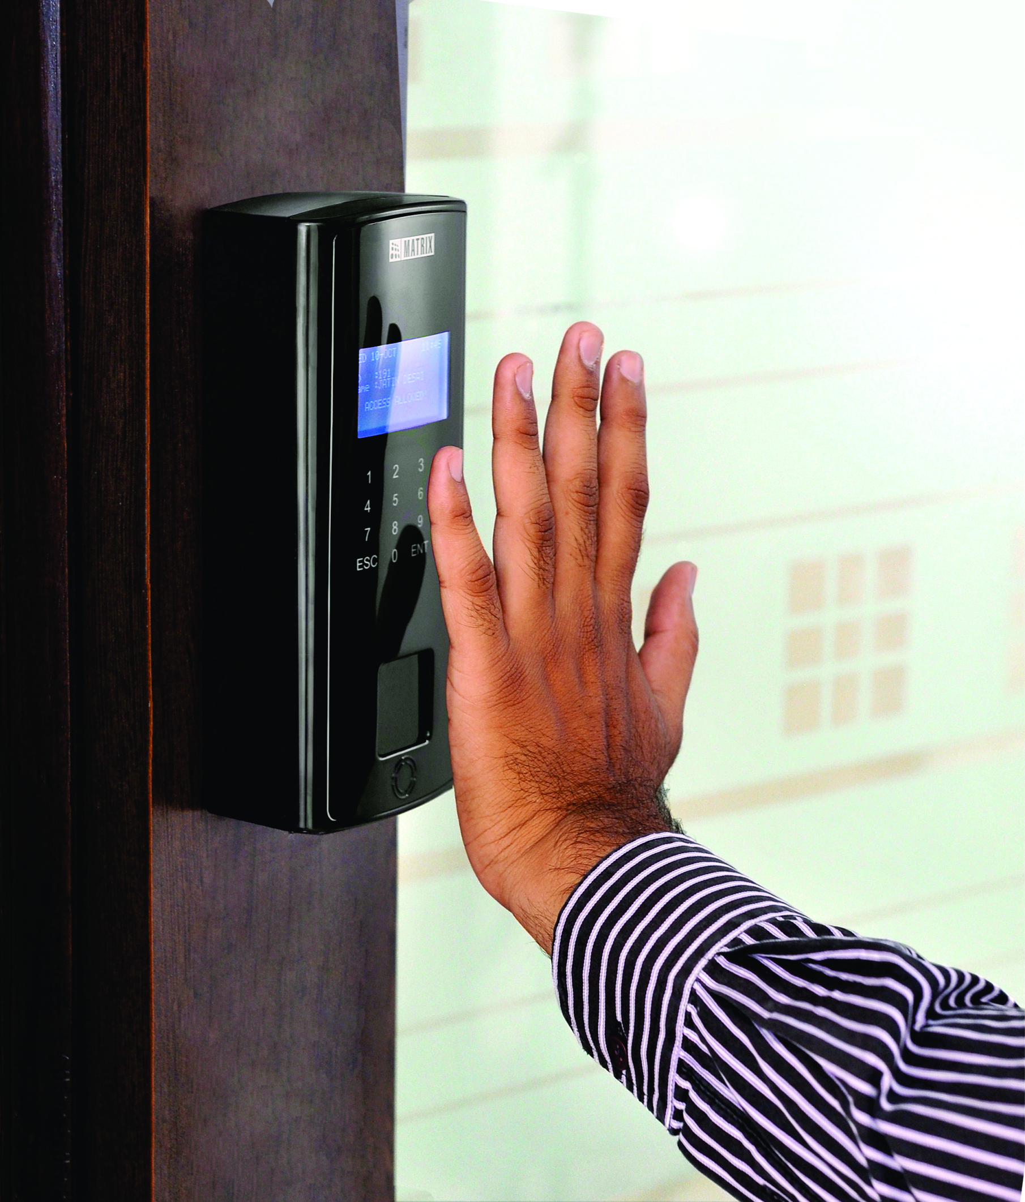
Biometric Access Control
Use Biometric Credentials like Fingerprint and Palm-Vein Print

Slide 14
Security of Assets and Manpower
Monitor each Movement in Secured Areas

Slide 15
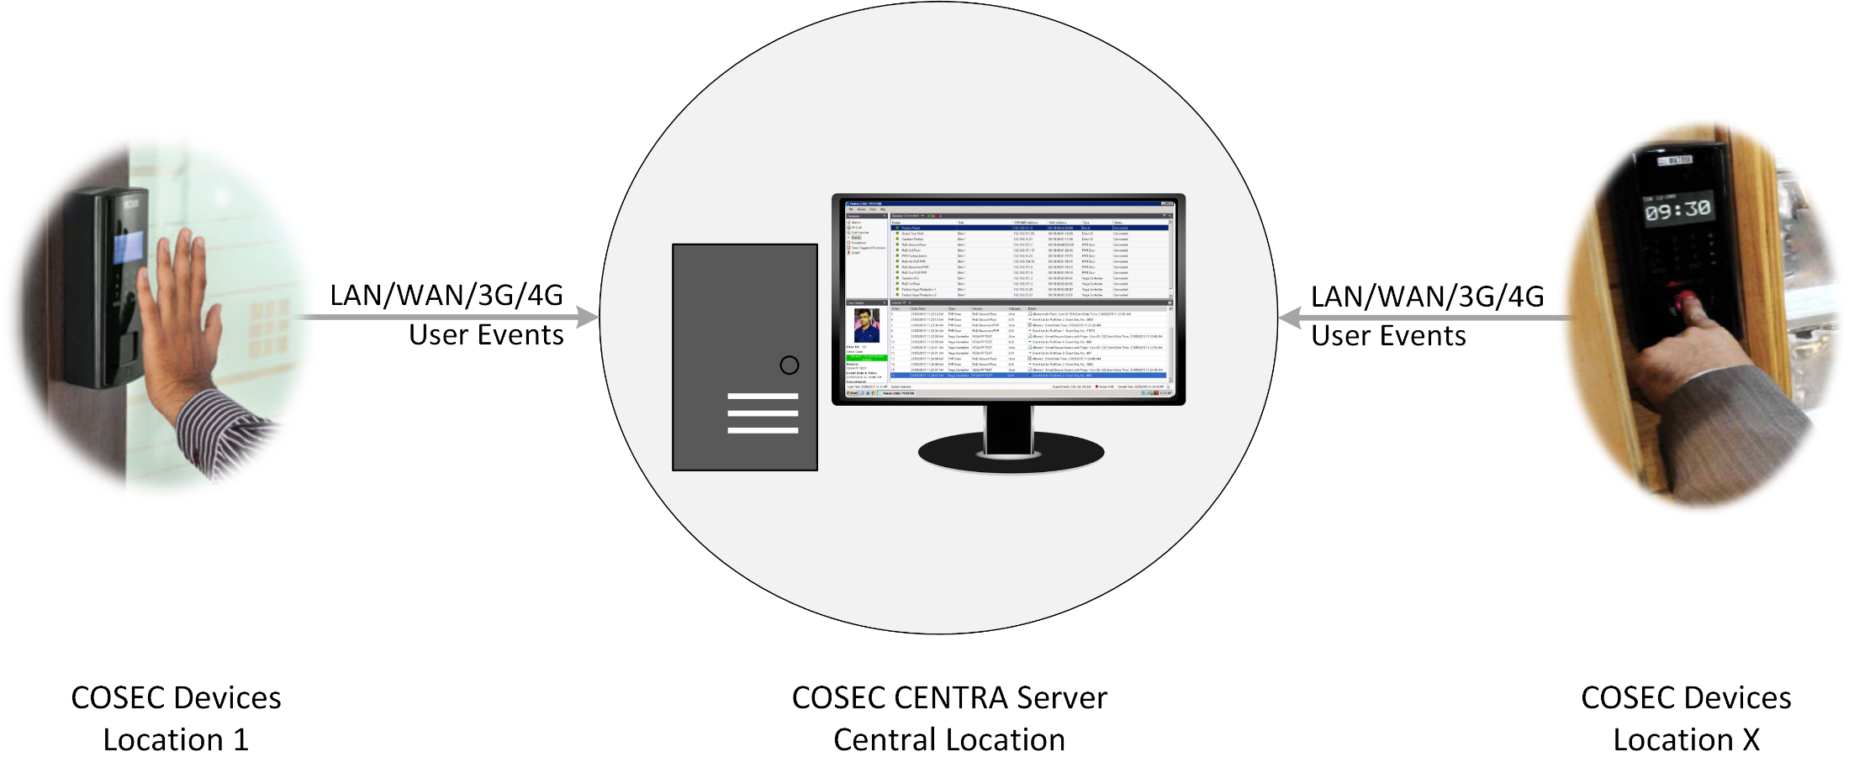
Time Stamping
User events noted and sent to server through auto push technology

Slide 16
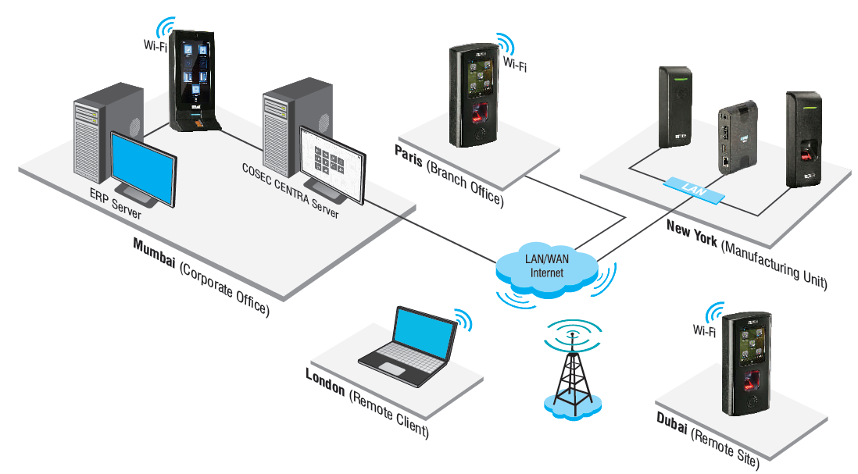
Centralized Monitoring
Keep a Track of Every Event Occurring Across Every Branch From One Place

Slide 17

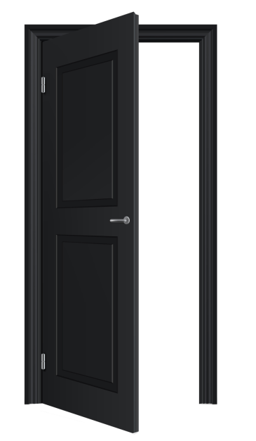


Real-Time SMS and Email Notifications
Door Kept Open For More than Normal Time
Door Forcefully Opened
Threats and Casualties
Dead Man Zone Violation
SMS and Email Alerts to Respond Quickly on situations

Slide 18
Security of Assets and Manpower
Integration of Third Party Hardware

Slide 19
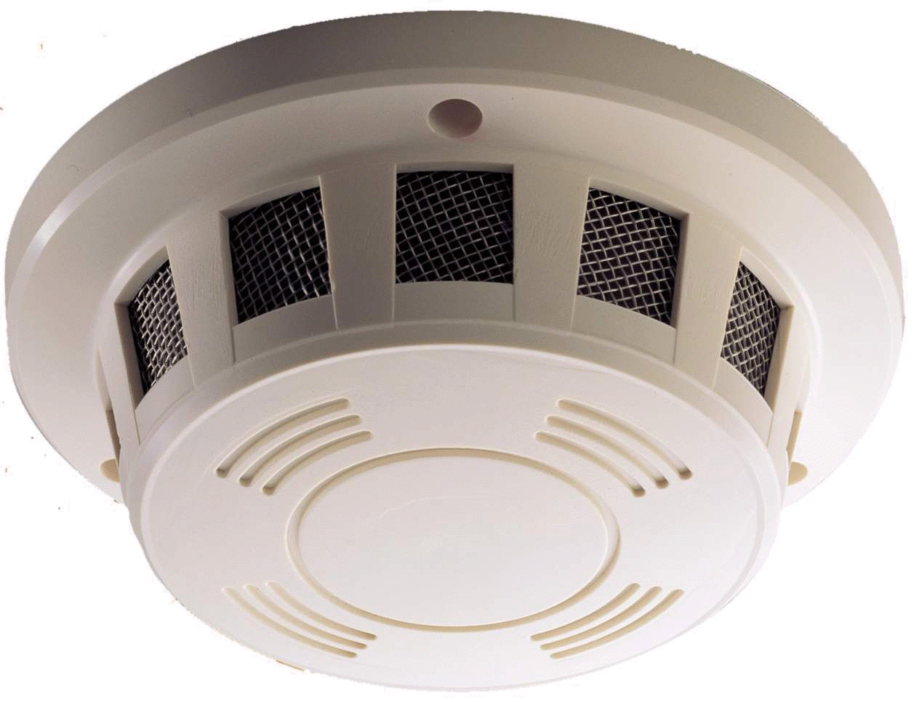
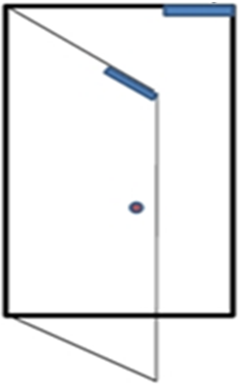

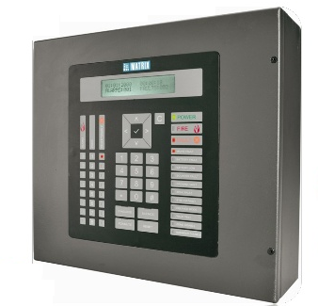
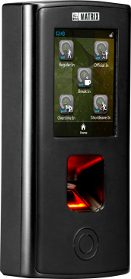
Integration with Fire Alarm
Detector
Door Lock Open
Fire Event
Fire Alarm Panel
Matrix COSEC Door Controller
Fire Event Trigger

Slide 20
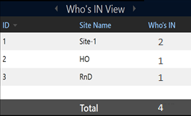



Get Count of Members Present during Hazardous Situations
Manufacturing Unit
Site-1
There’s a Fire. We need to save 4 Members who are inside the premises
HO
R&D
Presents Live Head Count of Users According to Shift, Site or Who’s IN

Slide 21
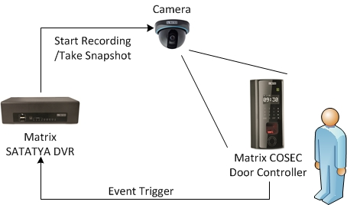
Integration with Video Surveillance System

Slide 22
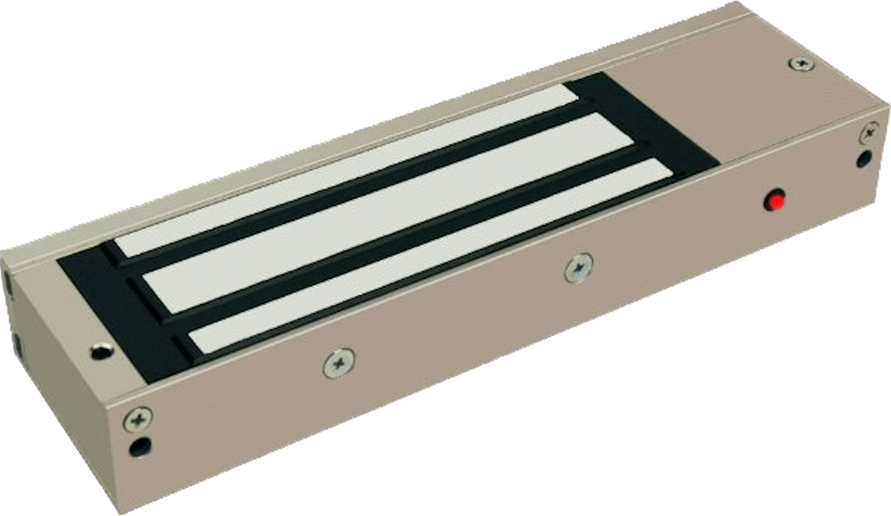
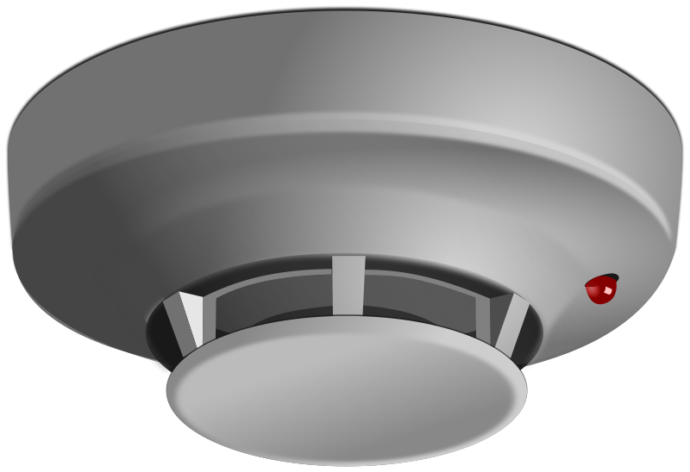
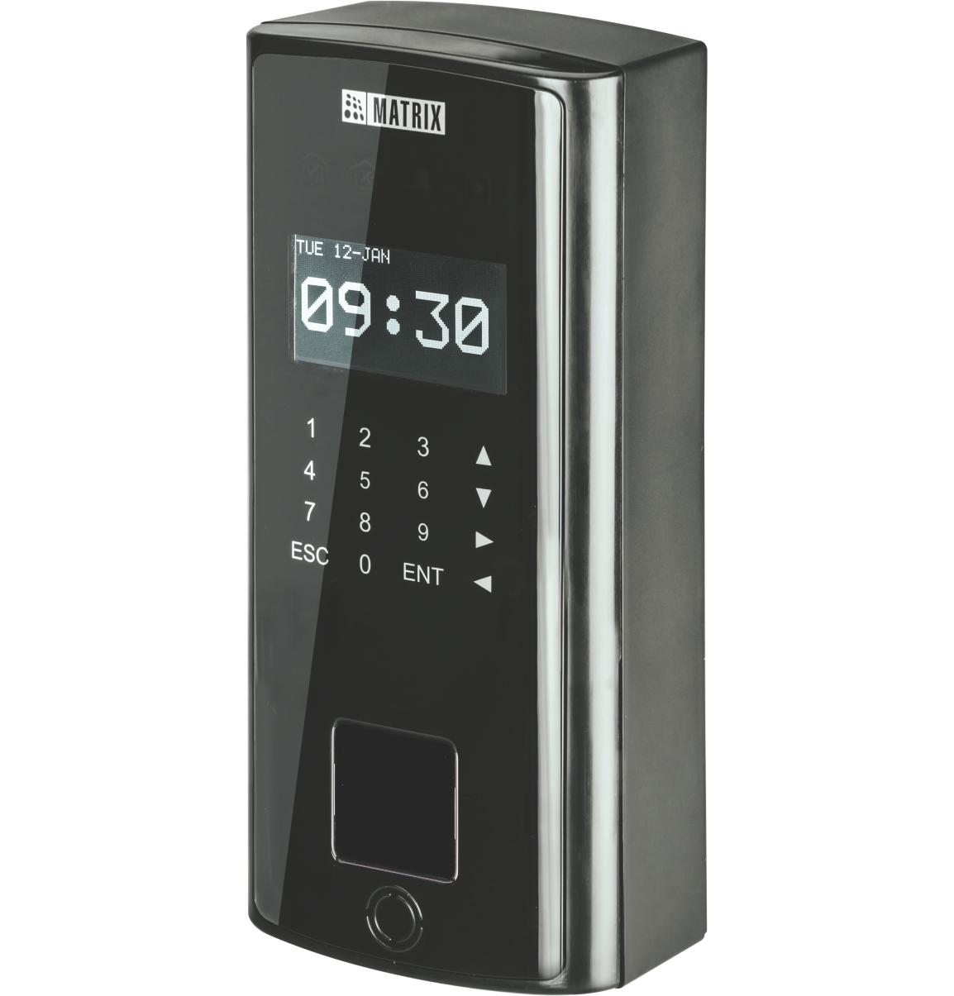

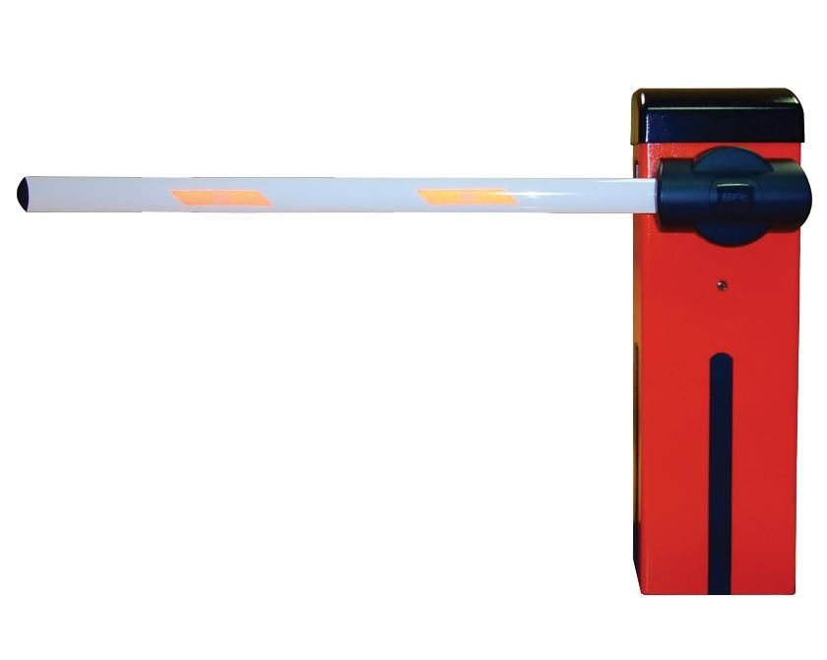
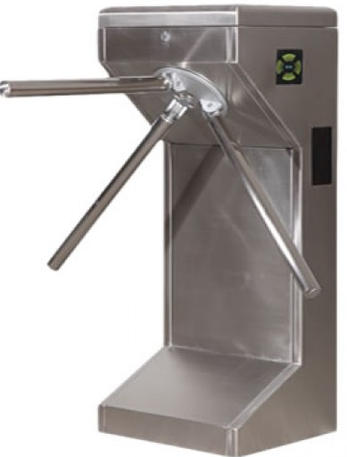
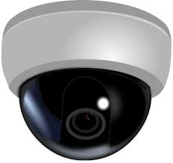
Integration with Other Hardware
Electronic Door Lock
Smoke Detector
Boom Barriers
Alarm
Tripod
Video Surveillance

Slide 23
Increased Productivity
Timely Employee Management

Slide 24



Flexible Attendance Policies
Late IN/OUT
Early IN/OUT
Overtime
C-OFF Policies
Consistent and Transparent Attendance Policies without Manual Intervention

Slide 25
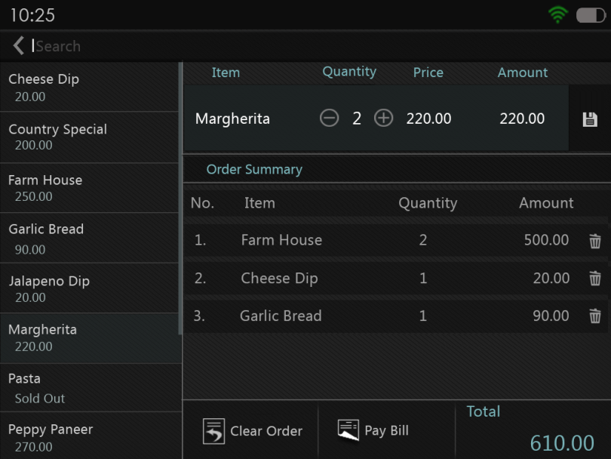
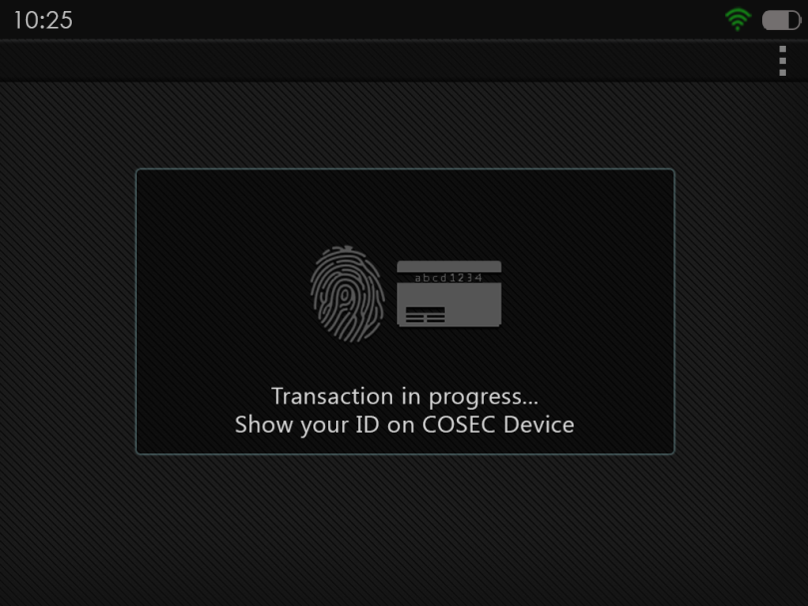
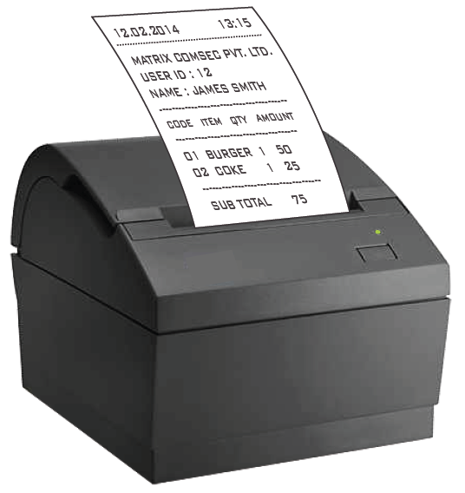
Cafeteria Management
Select Item quantity from COSEC Device
Show Credentials on COSEC Device
Directly Print Receipt for Ordered Food

Slide 26


Cafeteria Management: Cashless Transactions
Pre-paid Transactions:
Smart Card to Store Balance
Recharge As and When Needed
Post-paid Transactions:
Through Fingerprint, RFID
Define Maximum Credit Permitted per User per Month

Slide 27
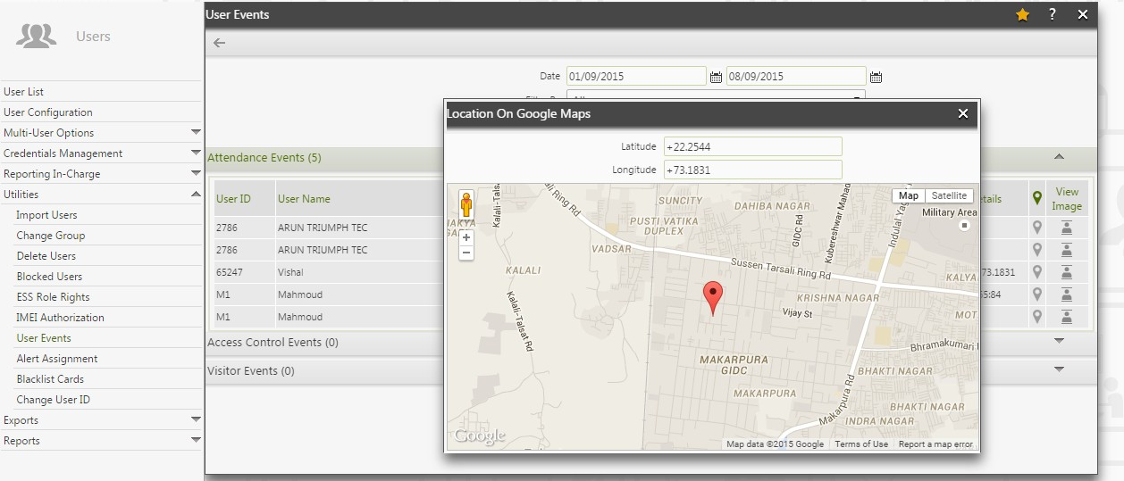
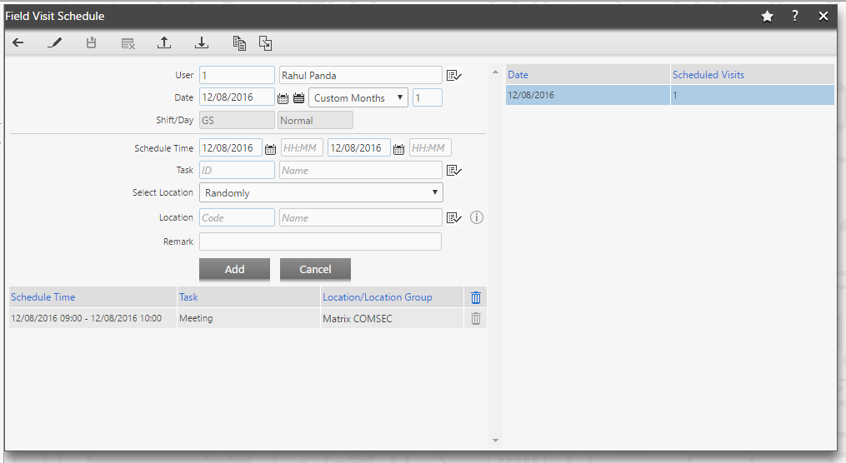
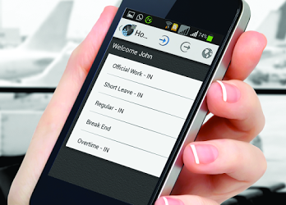
Field Staff Management
Schedule a Field Visit and Keep a Track of the GPS Location

Slide 28
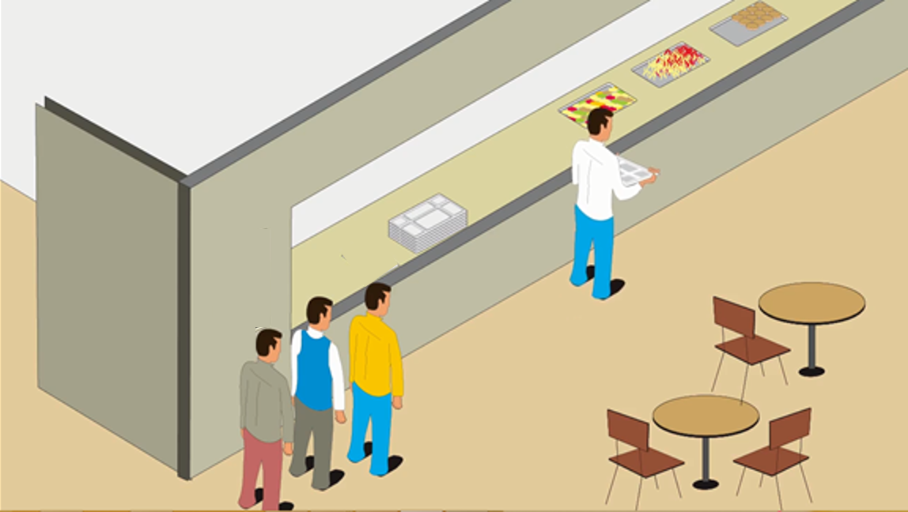
Break Management
Through N-punch Feature, Decide Break Time for Employees

Slide 29
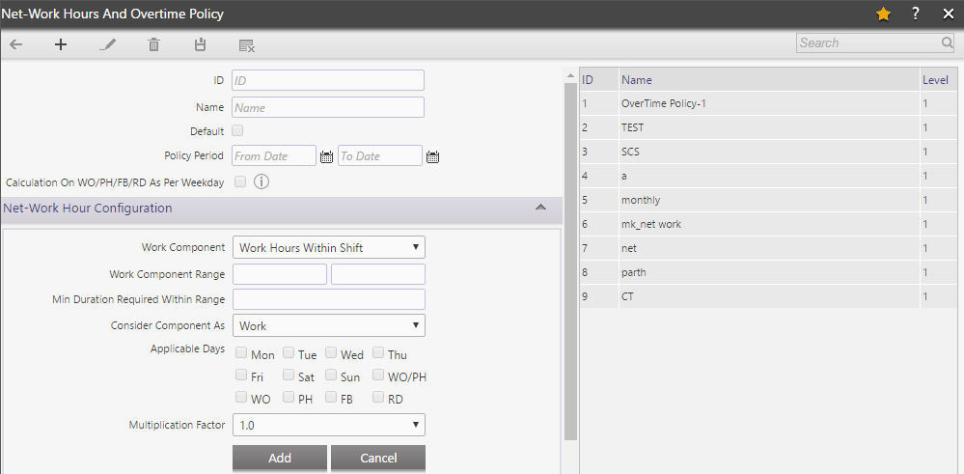
Actual Work Hours Calculation
Configure and Calculate Exact Work Hours to Maintain Transparency

Slide 30
Increased Productivity
Leave Management of Employees

Slide 31
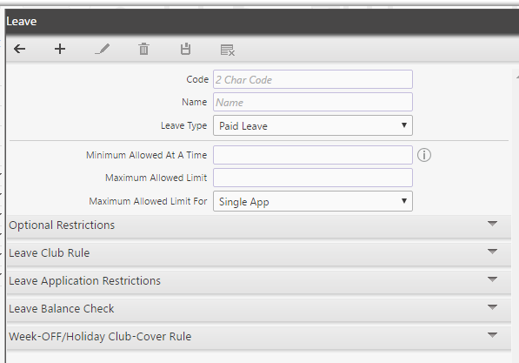
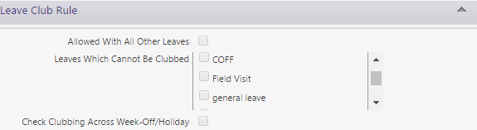
Multiple Leave Policies and Clubbing

Slide 32
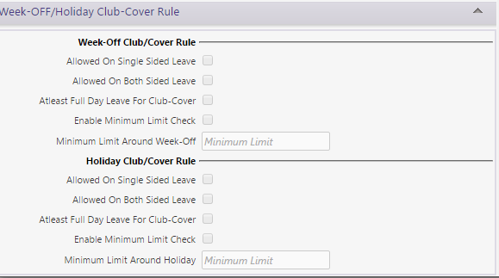
Region-wise Holiday Management
Make Holiday Plans Region-wise for the Employees

Slide 33
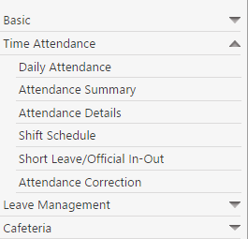
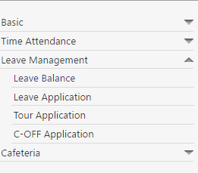
Employee Portal for Attendance and Leave Management
Time-Attendance
Leave Management
Employees at Their End Can Check Their Daily Attendance and Leave Balance

Slide 34
Increased Productivity
Visitor Management

Slide 35

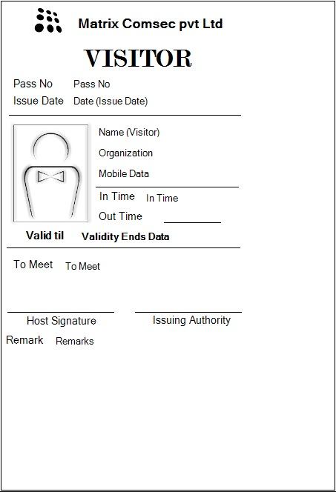







Visitor Pre-registration and Pass Generation
Reports on:
Visitor Punch Details
Visitor Access Denied
Pre-registered Visitors
Visitor Pass Validity
Visitor enrolment Status
Visitor Pass Creation and Integrations
Visitor Pass Surrender
Reports

Slide 36
Centralized Management of Multiple Branches/Users
Continuous Addition of New Branches/Users in Different Locations

Slide 37
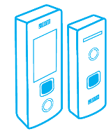
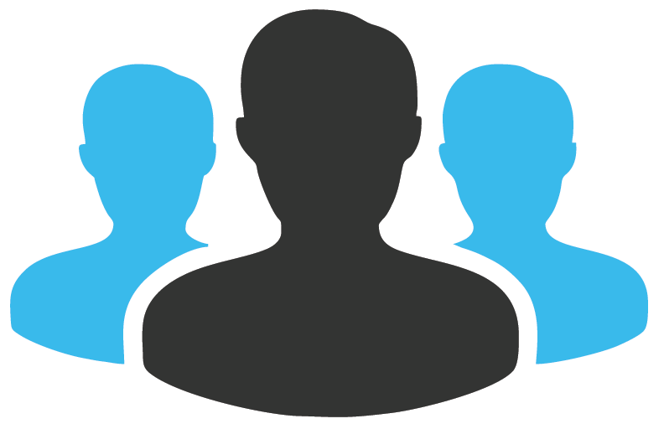


Scalable and Flexible Architecture
65,000 Devices
1 Million Users
Add Software Modules based on Requirements any Time
Web based- Access from Anywhere

Slide 38
Web-based Management
A Complete Web-based Management with Real-Time Data Transfer

Slide 39

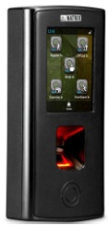
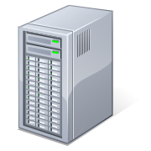



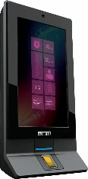

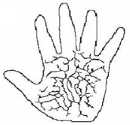


Automatic Template Distribution
LAN/WAN/3G
Enrollment from Location 1
COSEC CENTRA Server
Location 2
Location X
Location 3
Palm Vein, Fingerprint, RFID Card Template
Distribution from COSEC Server
No Need to Enroll Again on Other Locations

Slide 40
Centralized Management of Multiple Branches/Users
Timely and Accurate Employee Salary

Slide 41
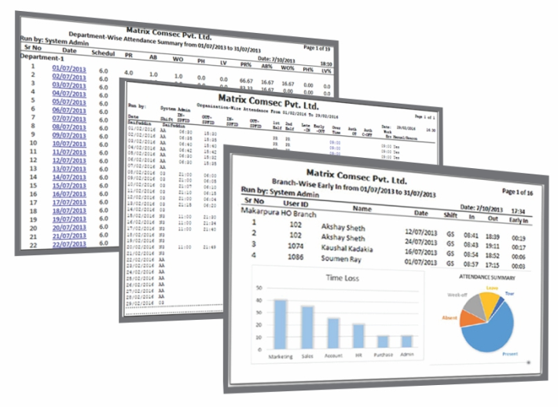
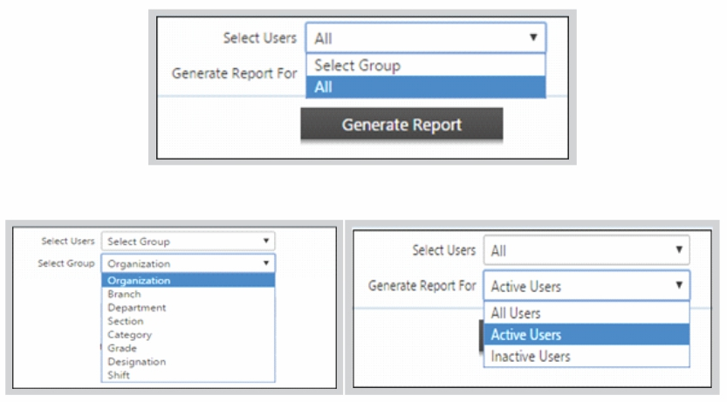
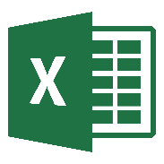



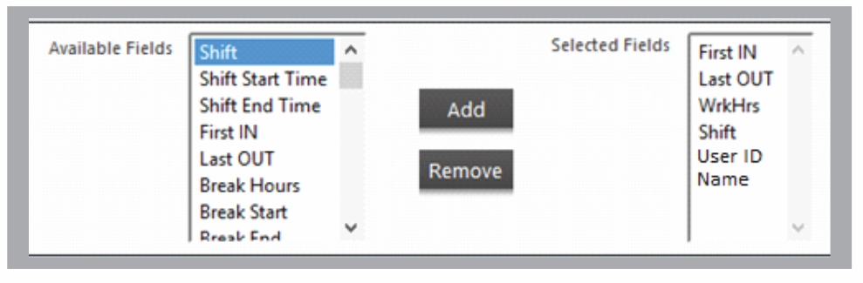
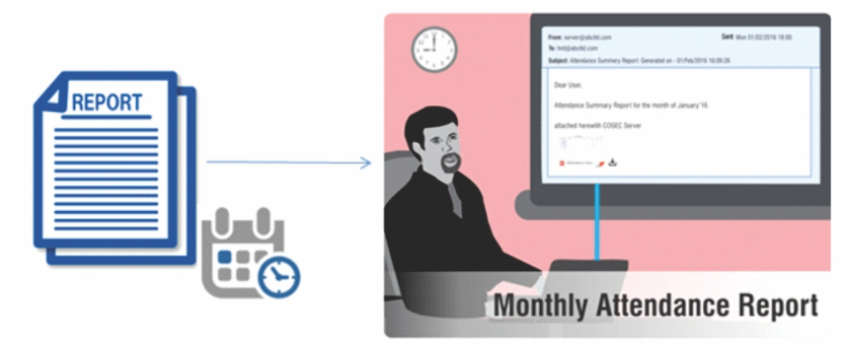


200+ Attendance Reports and Charts
Generate 200+ Reports and Charts
Apply Various Filters to Generate Specific Reports
Generate Customized Report Template
Send Reports on Email at Scheduled Time
File Formats

Slide 42

Centralized Time-Attendance Management and Payroll Integration

Slide 43
Centralized Management of Multiple Branches/Users
Restrict Branch-wise Roles and Rights

Slide 44


Create Enterprise Structure

Slide 45

Manage Login Roles and Rights
Location-1
Location-2
Location-3
Location-4
Define Roles and Rights of Employees at Different Branches

Slide 46





Benefits with Matrix
Increase Productivity
Automate Attendance
Process
Increase Safety and Security
ERRORS
Reduce Payroll
Errors
Cashless Management
Higher Employee
Satisfaction

Slide 47
Matrix Time-Attendance Solution for IT/Call-Center
Applications:
Solutions Offered:
Matrix COSEC Door Controllers and Exit Readers
Time-Attendance Module
Access Control Module
Cafeteria Management Module
Employee Self Service Portal
Leave Management Module
Visitor Management Module
Time-Attendance and Access Control Solution
Technology:
Fingerprint
Smart card
Matrix Offering:
Devices: Up to 65000
Users : Up to 1 Million
Multi-location
Benefits:
Managing shifts and attendance and thus tracking regularities of employees.
Capturing biometric attendance of all employees has smoothened HR’s task.

Slide 48








Clientele
 | Tata Consultancy Services (India) |  | YOU Telecom and Broadband Ltd (India)
 | Now Floats (Telangana) |  | Intec Capital Ltd. (India)
 | Wipro Ltd.(India) |  | Aamra Smart Solutions
 | Indus Integrated Information Management Limited (West Bengal) |  | NetSYS Consultants (Dubai)

Slide 49




Matrix COSEC Product Range
VEGA Series
DOOR Series
PATH Series
ARC Series

Slide 50









Matrix COSEC Solutions
Visitor Management
Cafeteria Management
Contract Workers Management
Time-Attendance
Access Control
Roster Management
Job Processing and Costing
Employee Self Service
Vehicle Access Management
Field Visit Management

Slide 51



About Matrix
1991
60+
40+
500+
400+
25+
We Established
Products
Telecom & Security
Countries we Present
Channel Partners
No. of Employees
Awards and Achievements
R&D Center
Corporate Office
Manufacturing Unit
www.MatrixSecuSol.com

Slide 52


