Slide 1
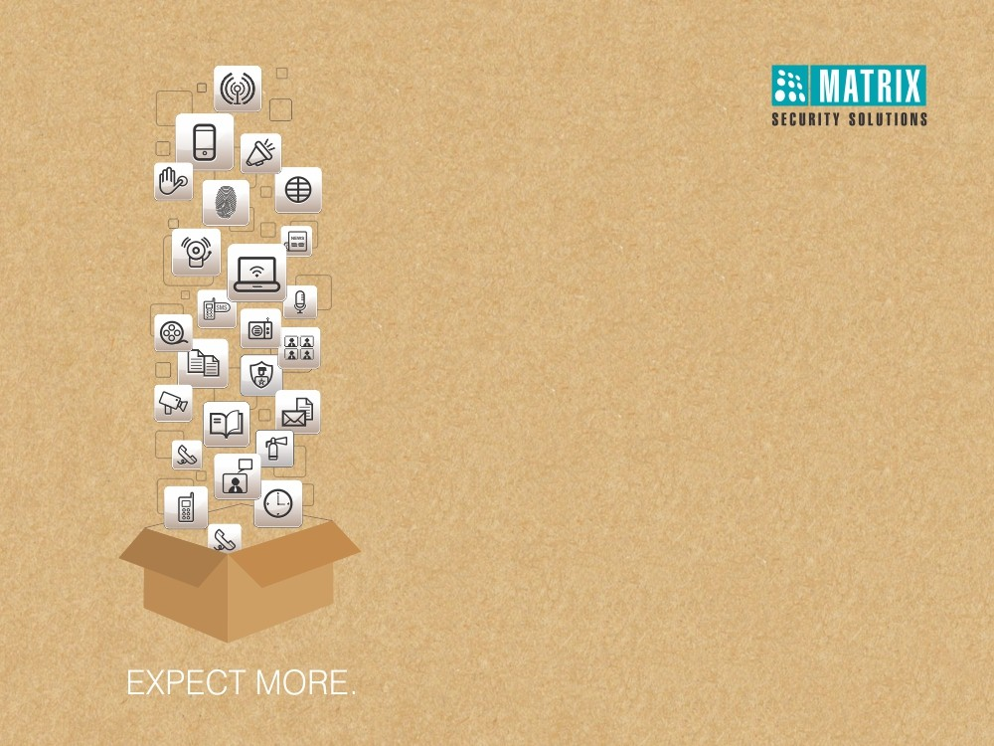
Matrix People Mobility Solution for HEALTHCARE
Right People in Right Place at Right Time

Slide 2
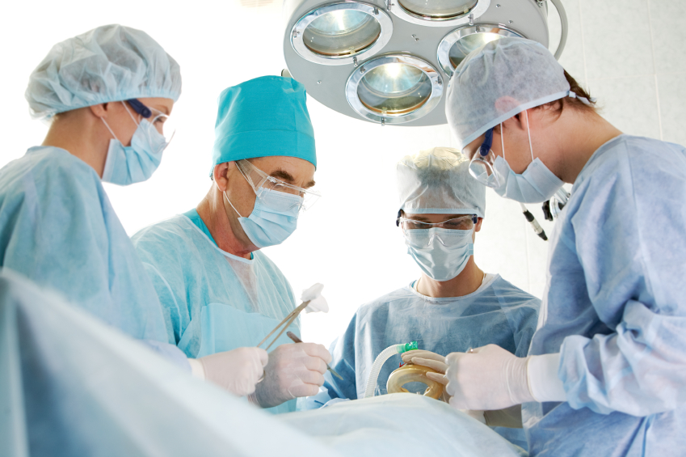
MATRIX PEOPLE MOBILITY SOLUTION FOR HEALTHCARE

Slide 3

Pain Areas

Slide 4
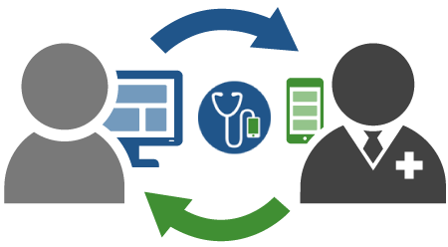


Pain Areas
Effective Patient Management
Security of Assets and Patients

Slide 5



Pain Areas
Timely Patient Attention
Effective Patient Management
Integrated Solutions
Hygiene of Patient

Slide 6



Pain Areas
Un-Authorized Access
Security
of Assets and Patient
Keep a check on visitors
Safety measures

Slide 7
Effective Patient Management
Timely Patient Attention

Slide 8




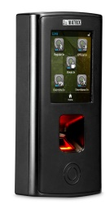


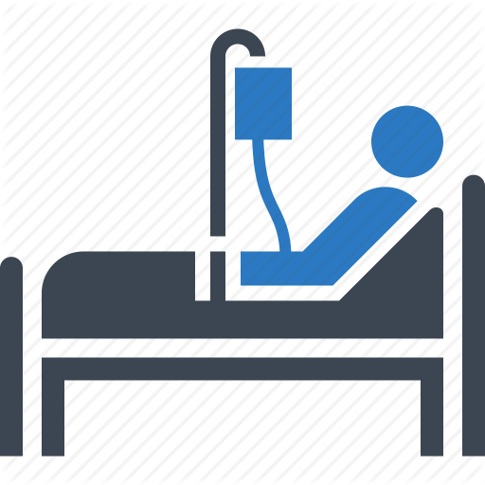

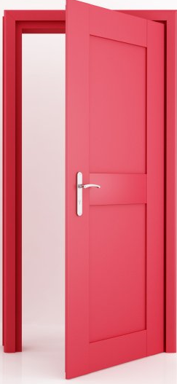
Continuous Attention by Nurse
A nurse would only be able to leave if another is available to replace her

Slide 9
Nurse/Doctor Touring
Ward Room4
Ward Room3
Ward Room2
Ward Room1
Pre-scheduled visits to every ward by assigned doctors or nurses

Slide 10




Flexible Attendance Policies
Late IN/OUT
Early IN/OUT
Overtime
C-OFF Policies

Slide 11
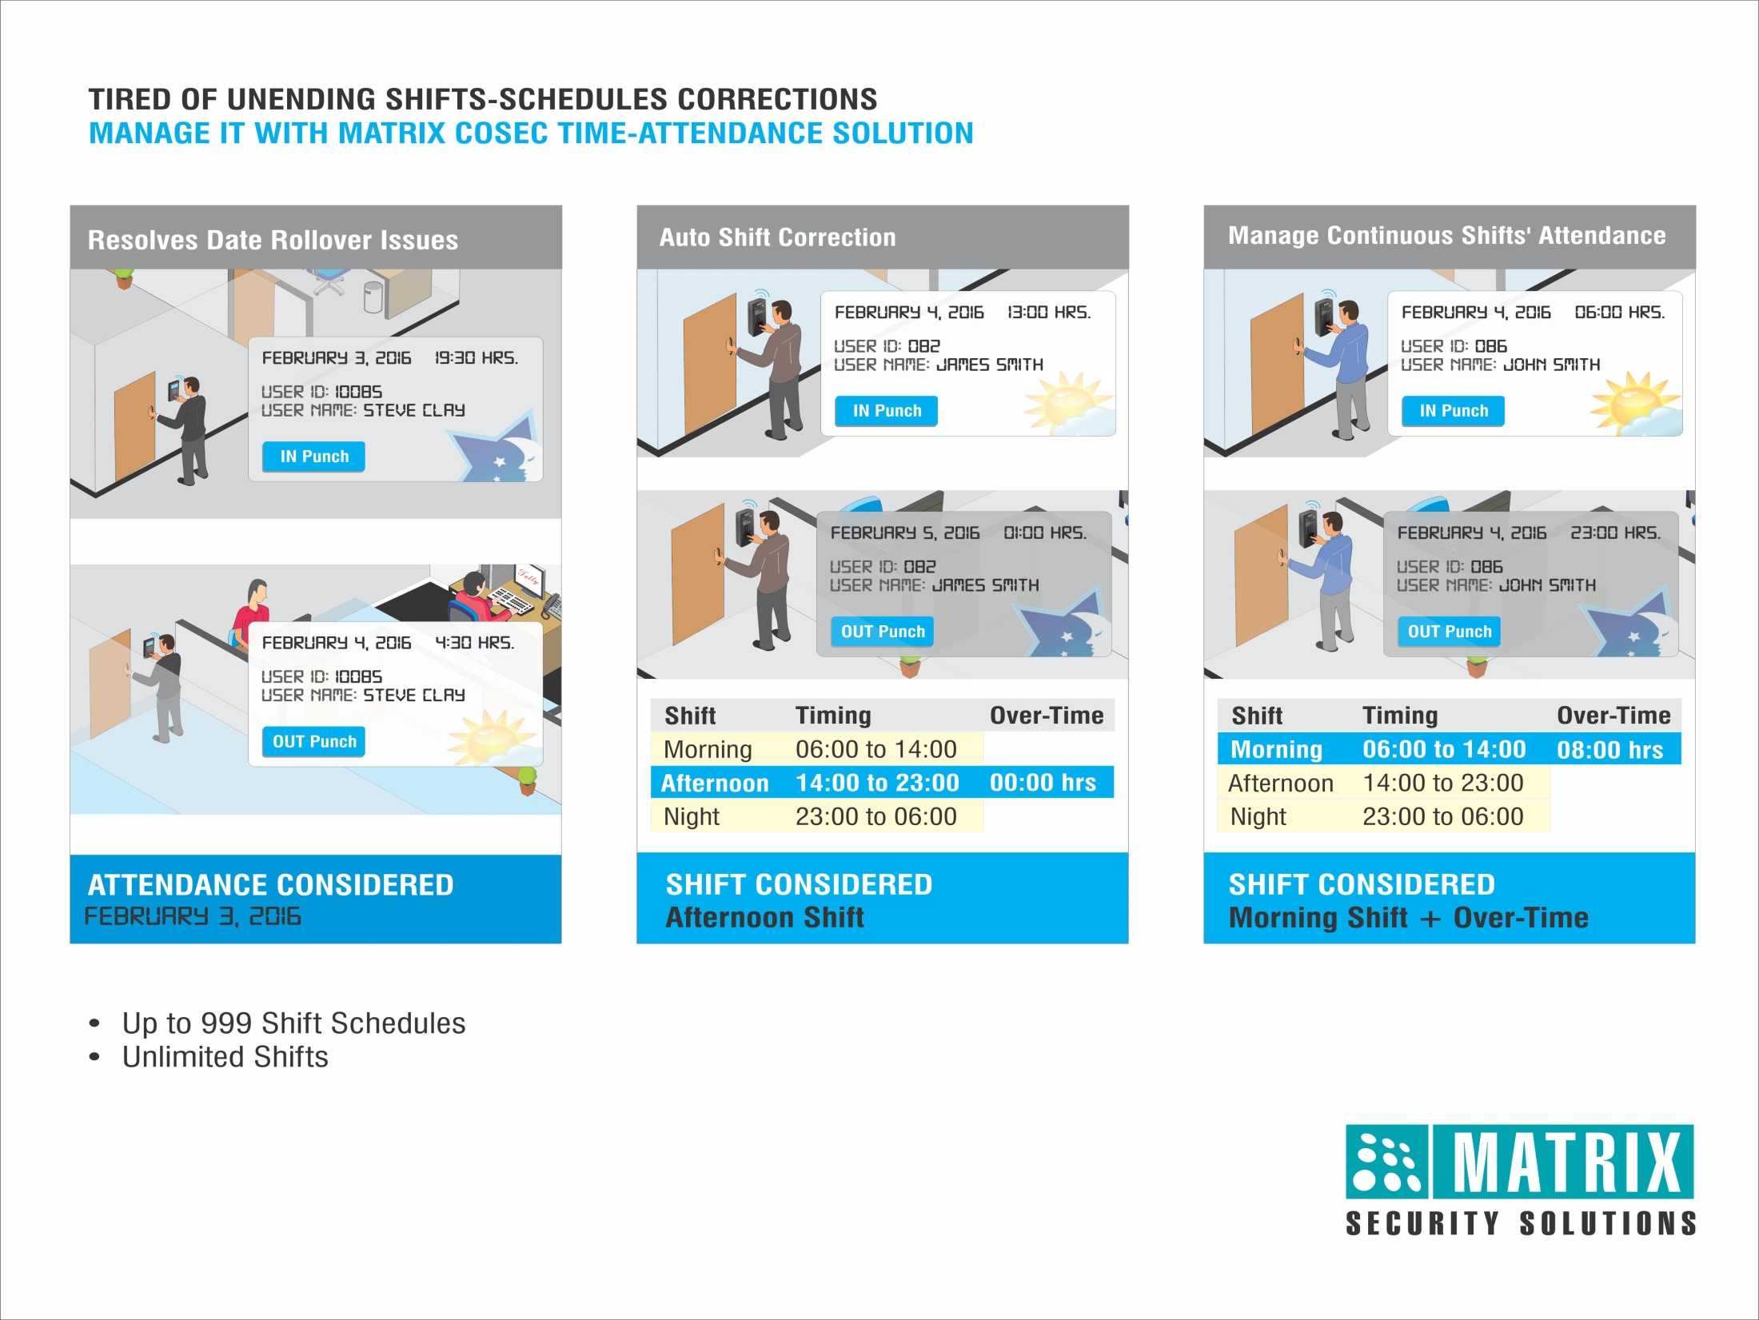
Shift Management

Slide 12
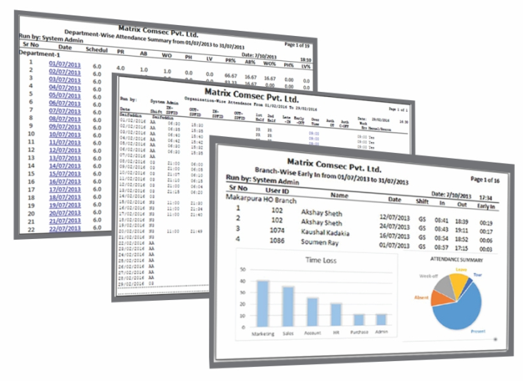
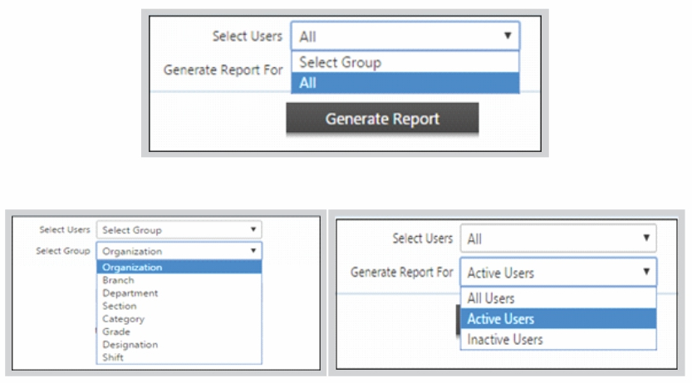




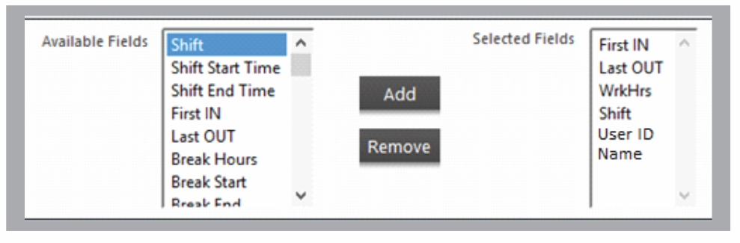
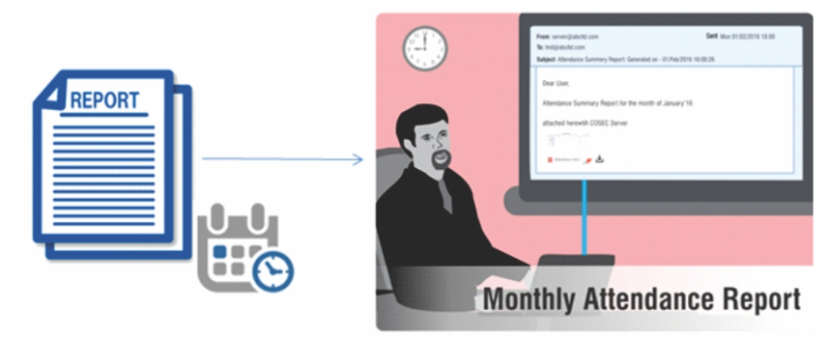


Customized Reports
Generate 200+ Reports and Charts
Apply Various Filters to Generate Specific Reports
Generate Customized Report Template
Send Reports on Email at Scheduled Time
File Formats

Slide 13
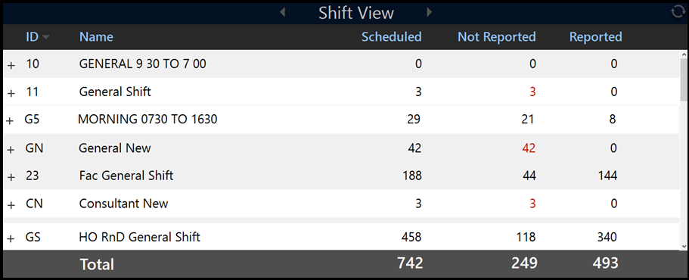
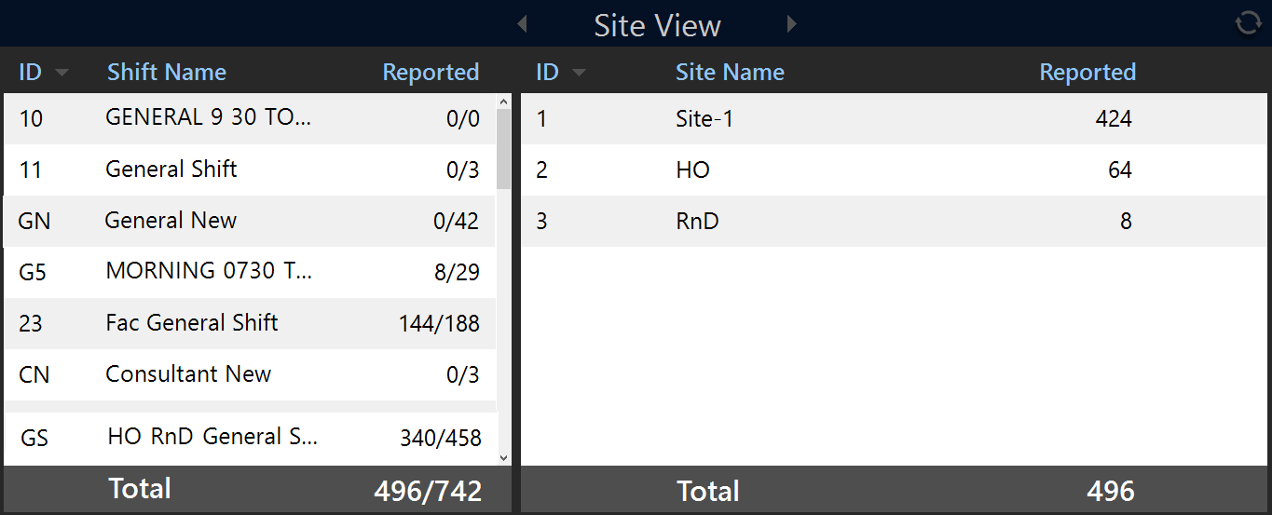
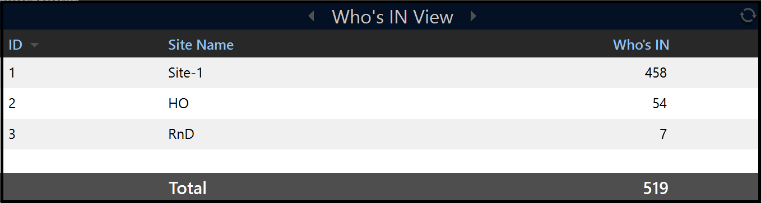
COSEC Tracker: Live Count of Person Inside the Premises
Shift View
Site View
Presents Live Head Count of Users according to Shift, Site or Who’s IN
Who’s IN View

Slide 14
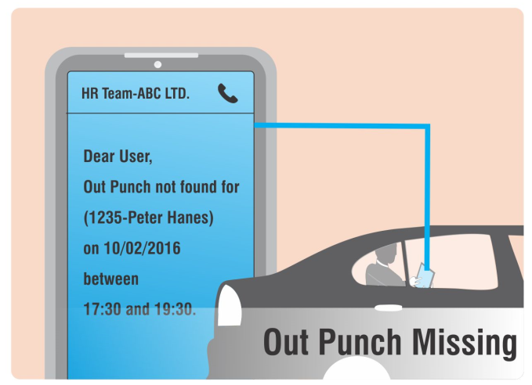
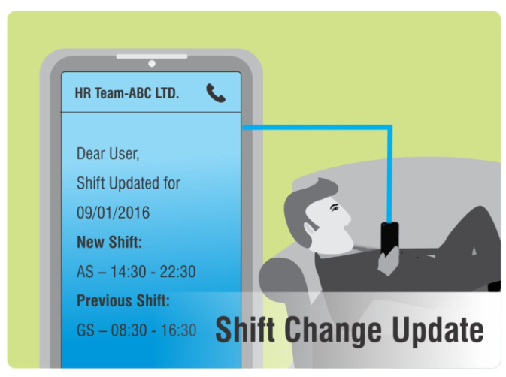
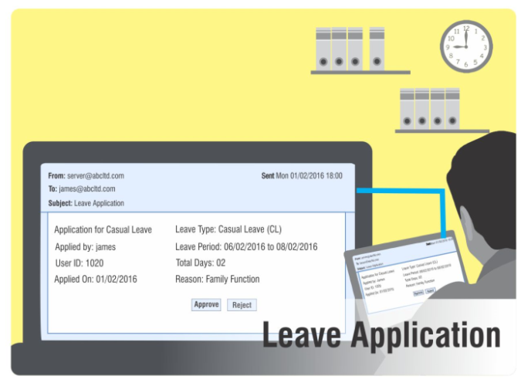
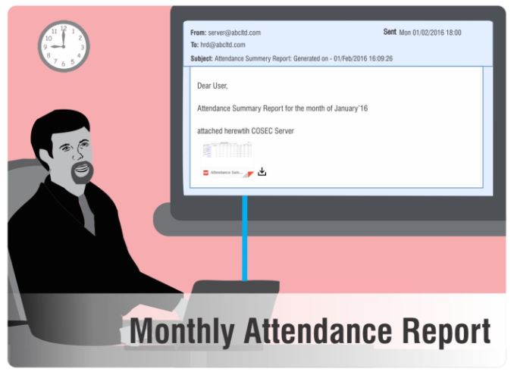

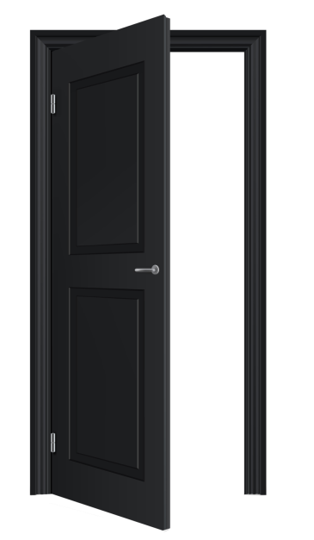



SMS and Email Notifications
Door Kept Open For More than Normal Time
Door Forcefully Opened
Threats and Casualties
Dead Man Zone Violation
SMS and Email Alerts to Respond Quickly on situations

Slide 15
Effective Patient Management
Integrated Solutions

Slide 16
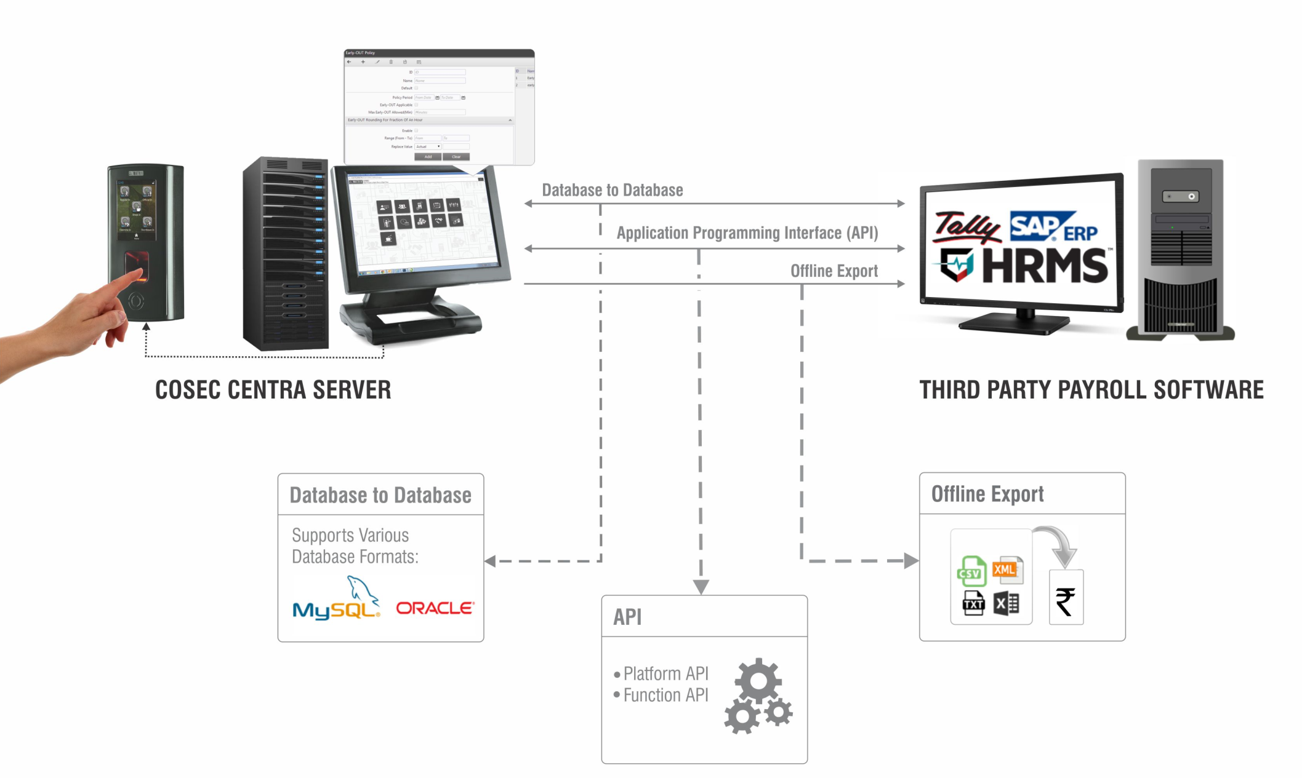
Integration with Patient Management Software
Patient management software
Third Party Patient Management Software

Slide 17
Centralized Time-Attendance Management and Payroll Integration

Slide 18


Integration For Cashless Cafeteria Expenses
Pre-paid Transactions:
Smart Card to Store Balance
Recharge As and When Needed
Post-paid Transactions:
Through Fingerprint, RFID
Define Maximum Credit Permitted per User per Month
No need of carrying change everywhere

Slide 19
Effective Patient Management
Hygiene

Slide 20
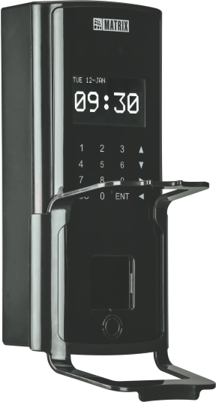
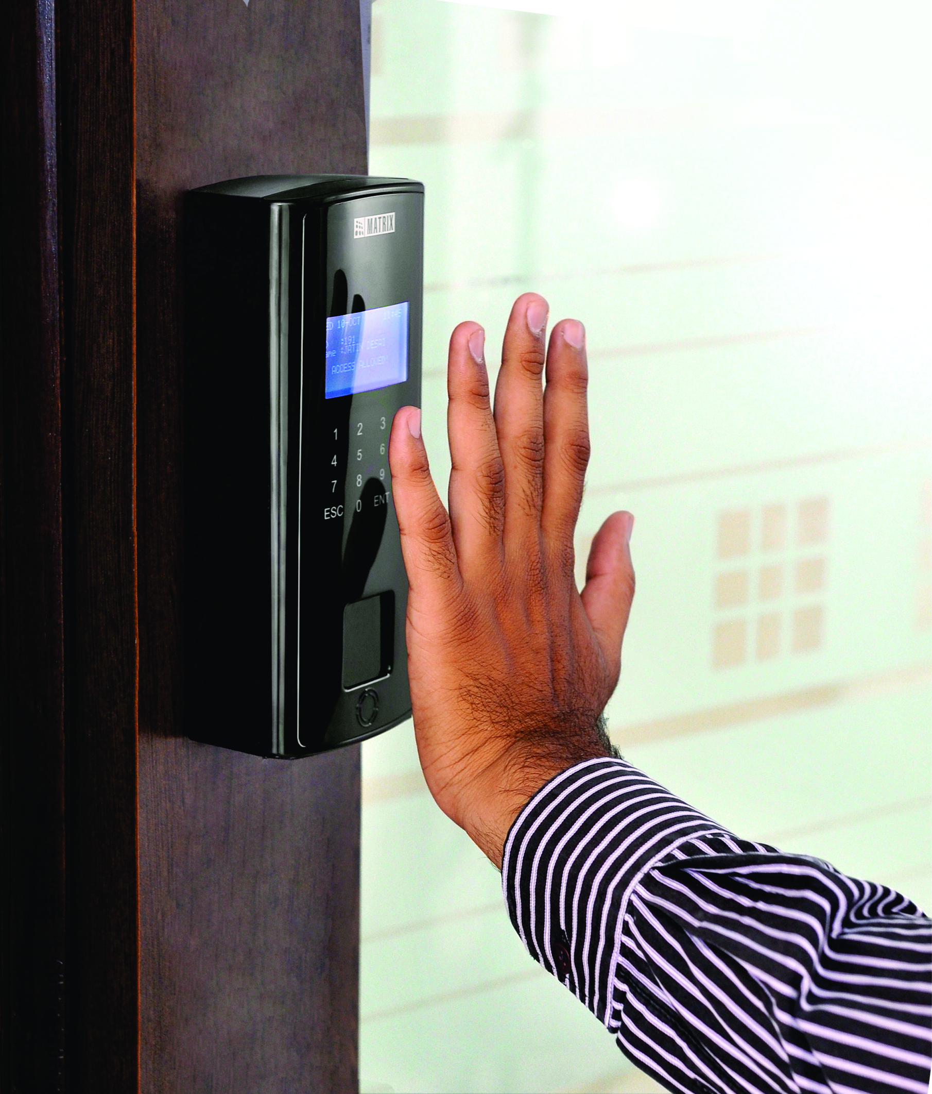
Contact less Biometric Reader
COSEC DOOR PVR with Detachable Hand Guide
Contactless Technology
When hygiene is your prime necessity

Slide 21

Track Cleaning Staff
Room4
Room3
Room2
Room1
Make sure the cleaning staff is regularly cleaning

Slide 22
Security
of Assets and Patient
Un-Authorized Access

Slide 23



User, Zone and Time based Access
sauna
User Access only During Particular Time Period
User Access to Limited Areas
Define Zone for Users
To ensure there is no intrusion

Slide 24

2-Person Rule: Dual Authentication
High Security Areas
High Security Areas
Restrict Access in un-authorized zones like ICU, ICCU, Recovery Room

Slide 25
Security
of Assets and Patient
Keep a check on visitors

Slide 26

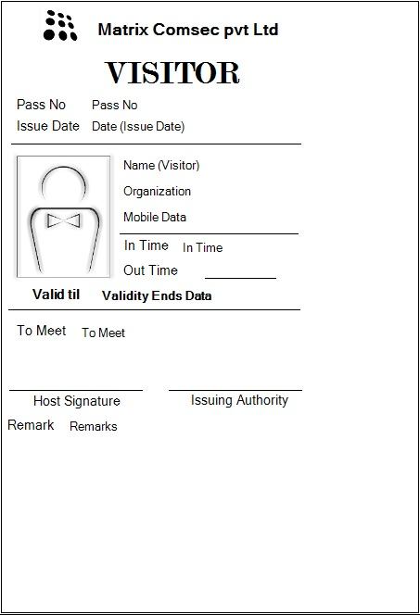







Visitor Pass and Validity
Reports on:
Visitor Punch Details
Visitor Access Denied
Pre-registered Visitors
Visitor Pass Validity
Visitor enrolment Status
Visitor Pass Creation and Integrations
Visitor Pass Surrender
Reports

Slide 27
Limited Access Permission for Visitors
Sensitive Rooms
Ward Rooms
Decide where the visitors will be allowed access

Slide 28
Security
of Assets and Patient
Safety measures

Slide 29
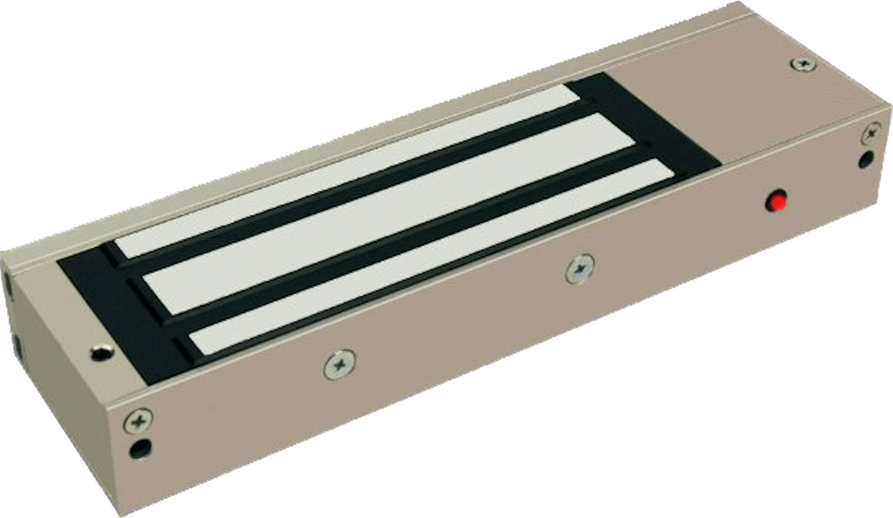
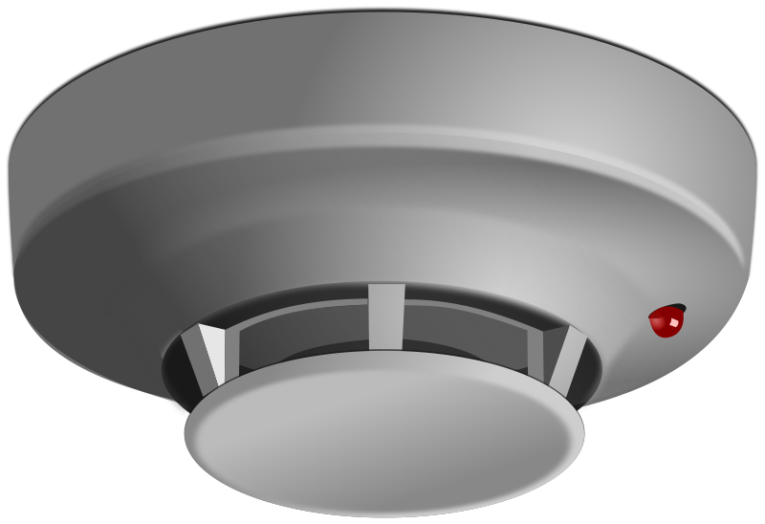
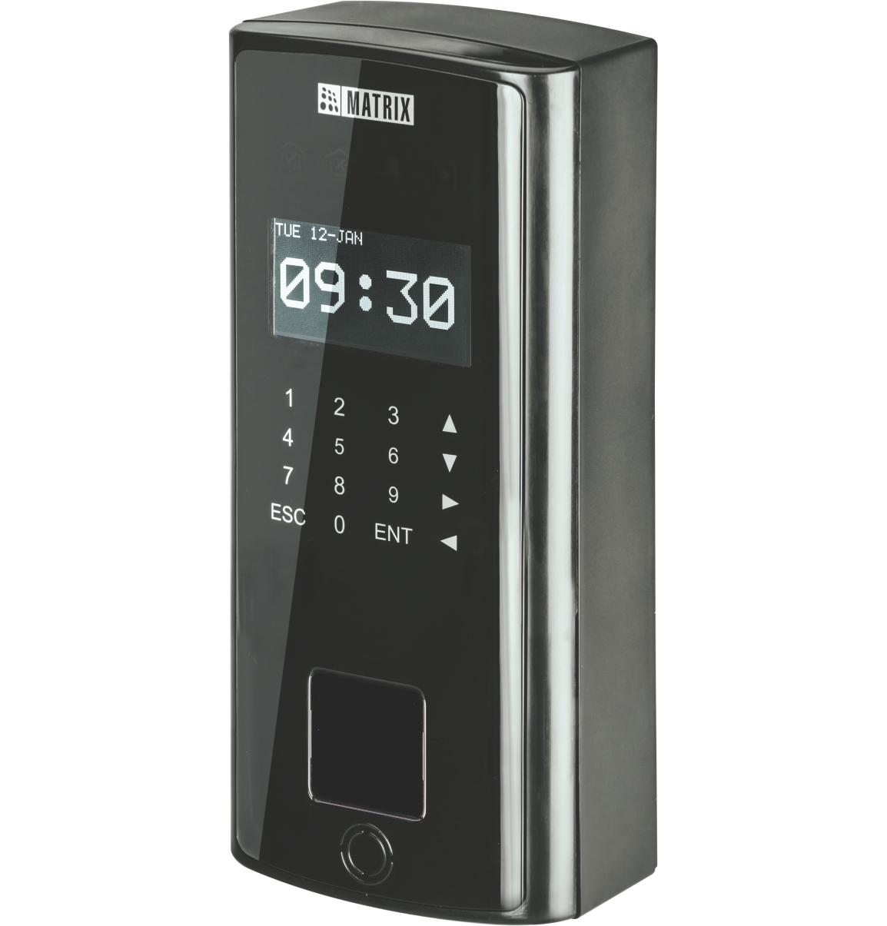

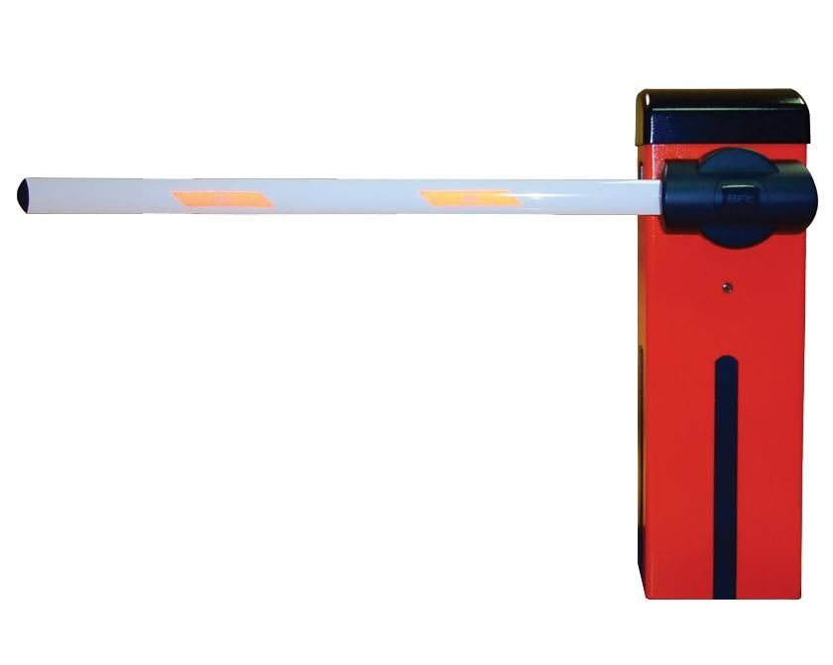
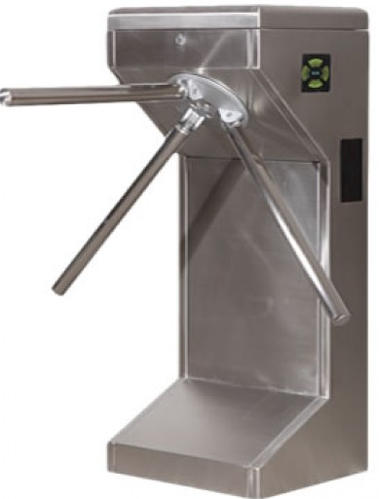
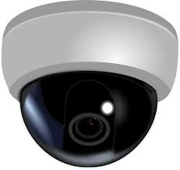
Integration with Other Hardware
Electronic Door Lock
Smoke Detector
Boom Barriers
Alarm
Tripod
Video Surveillance

Slide 30
Prompt Response on Casualties
Door Kept Open For More than Normal Time
Door Forcefully Opened
Threats and Casualties
Dead Man Zone Violation
SMS and Email Alerts to Respond Quickly on situations

Slide 31

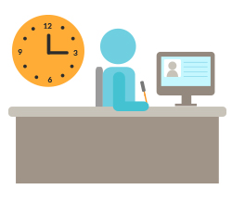



Benefits with Matrix
Increase Productivity
Automate Attendance
Process
Increase Safety and Security
ERRORS
Reduce Payroll
Errors
Cashless Management
Higher Patient
Satisfaction

Slide 32
Matrix Time-Attendance Solution for Sir Ganga Ram Hospital
Applications:
Solutions Offered:
Palm Vein Reader with Time-Attendance Modules for 6000 employees in the Hospital.
Time-Attendance Solution
Technology:
Fingerprint
Smart card
Matrix Offering:
Devices: 11
Users : 6000
Benefits:
Managing shifts and attendance and thus tracking regularities of employees.
Capturing biometric attendance of all employees has smoothened HR’s task.

Slide 33






Clientele
 | Apollo Health & Lifestyle Ltd (Delhi) |  | Omega Healthcare (Bangalore)
 | Narayana Multispecialty Hospital (WB) |  | MIOT International (Chennai)
 | SKS Hospitals (Tamil Nadu) |  | Solace Hospitals (Vadodara)

Slide 34
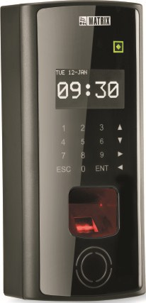

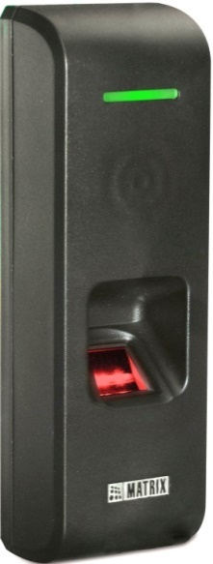
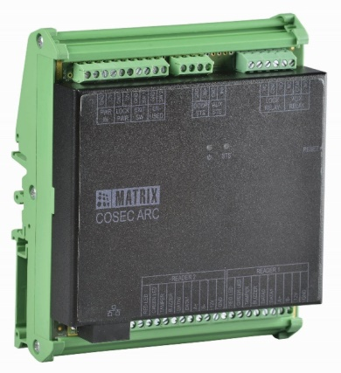
Matrix COSEC Product Range
VEGA Series
DOOR Series
PATH Series
ARC Series

Slide 35
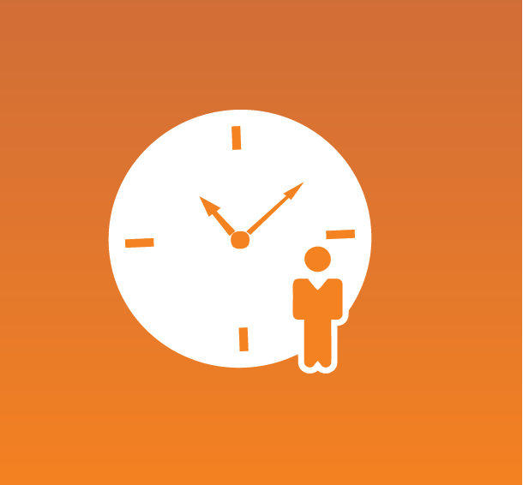
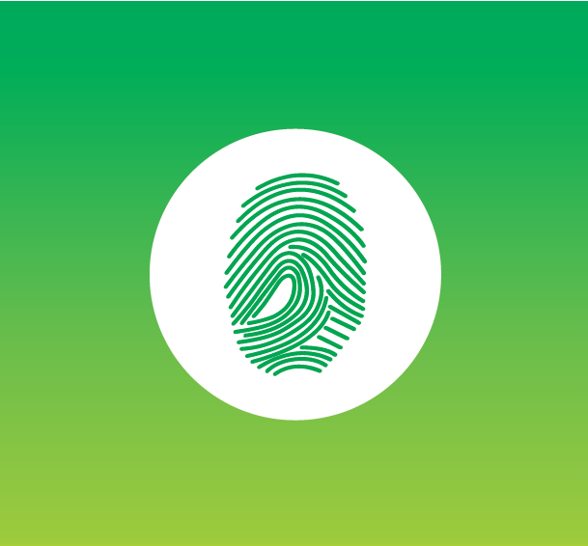
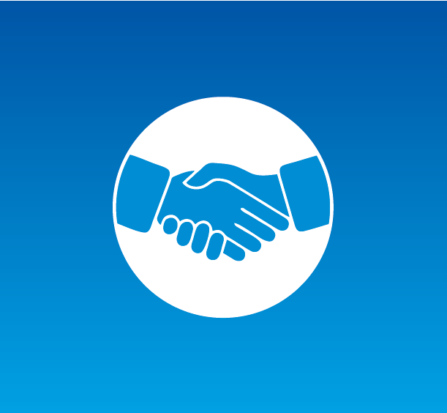

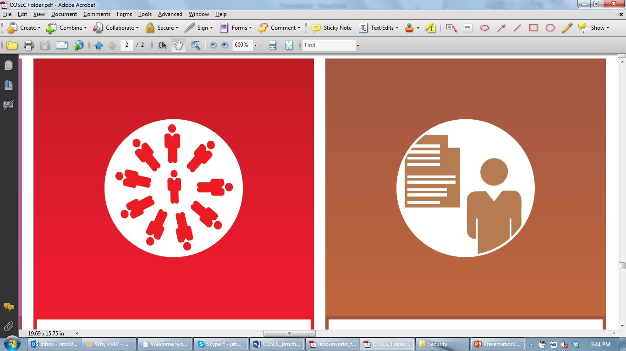

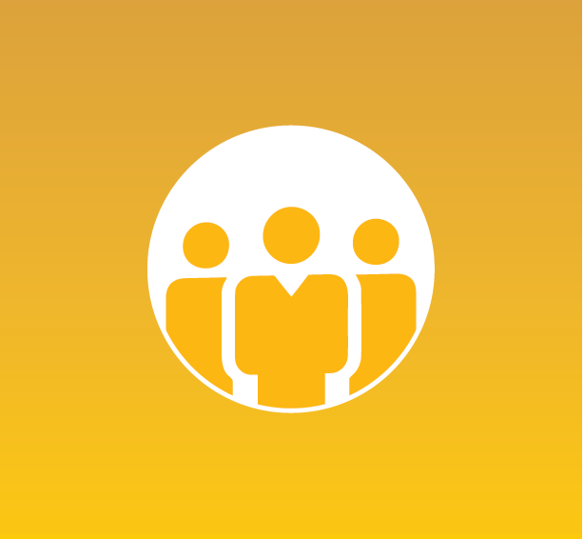


Matrix COSEC Solutions
Visitor Management
Cafeteria Management
Contract Workers Management
Time-Attendance
Access Control
Roster Management
Job Processing and Costing
Employee Self Service
Vehicle Access Management
Field Visit Management

Slide 36
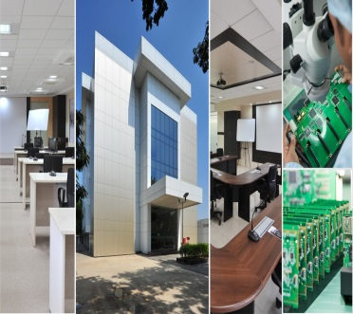
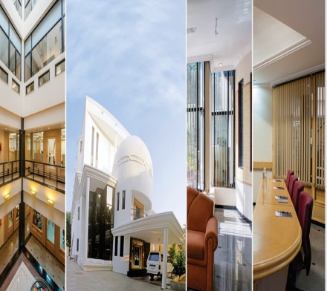
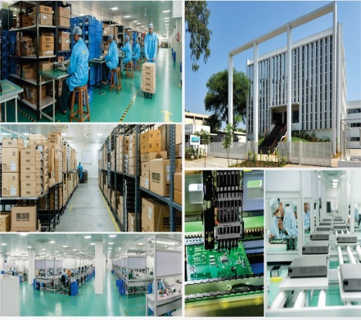
About Matrix
1991
60+
40+
500+
400+
25+
We Established
Products
Telecom & Security
Countries we Present
Channel Partners
No. of Employees
Awards and Achievements
R&D Center
Corporate Office
Manufacturing Unit
www.MatrixSecuSol.com

Slide 37


